Slide 1
Chapter 14 - Protocols and Layering
Page Number Title
1 Introduction
2 Why network software?
3 Why protocols?
4 One or many protocols?
5 Protocol suites
6 Layered protocol design
7 The ISO 7-layer reference model
8 The layers in the ISO model
9 Layered software implementation

Slide 2
10 Layered software and stacks
11 Layering principle
12 Messages and protocol stacks
13 Commercial stacks
14 Protocol headers
15 Control packets
16 Techniques for reliable network communication
17 Out-of-order delivery
18 Duplicate delivery
19 Lost packets
20 Retransmission
21 Replay
22 Flow control
23 Stop-and-go flow control

Slide 3
24 Sliding window
25 Example of sliding window
26 Comparison of stop-and-go and sliding window
27 Transmission times
28 Network congestion
29 Aoviding and recovering from network congestion
30 Art, engineering and protocol design
31 Summary

Slide 4
Introduction
LAN/WAN hardware can't solve all computer communication problems
Software for LAN and WAN systems is large and complicated
Layering is a structuring technique to organize networking software design and implementation

Slide 5
Why network software?
Sending data through raw hardware is awkward and inconvenient - doesn't match programming paradigms well
Equivalent to accessing files by making calls to disk controller to position read/write head and accessing individual sectors
May not be able to send data to every destination of interest without other assistance
Network software provides high-level interface to applications

Slide 6
Why protocols?
Name is derived from the Greek protokollen, the index to a scroll
Diplomats use rules, called protocols, as guides to formal interactions
A network protocol or computer communication protocol is a set of rules that specify the format and meaning of messages exchanged between computers across a network
  Format is sometimes called syntax
  Meaning is sometimes called semantics
Protocols are implemented by protocol software

Slide 7
One or many protocols?
Computer communication across a network is a very hard problem
Complexity requires multiple protocols, each of which manages a part of the problem
May be simple or complex; must all work together

Slide 8
Protocol suites
A set of related protocols that are designed for compatibility is called a protocol suite
Protocol suite designers:
  Analyze communication problem
  Divide problems into subproblems
  Design a protocol for each subproblem
A well-designed protocol suite
  Is efficient and effective - solves the problem without redundancy and makes best use of network capacity
  Allows replacement of individual protocols without changes to other protocols

Slide 9
Layered protocol design
Layering model is a solution to the problem of complexity in network protocols
Model suggests dividing the network protocol into layers, each of which solves part of the network communication problem
These layers have several constraints, which ease the design problem
Network protocol designed to have a protocol or protocols for each layer

Slide 10
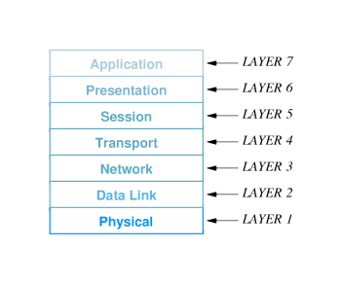
The ISO 7-layer reference model
International Organization for Standards (ISO) defined a 7-layer reference model as a guide to the design of a network protocol suite

Slide 11
Layers are named and numbered; reference to ``layer n'' often means the n^{th} layer of the ISO 7-layer reference model

Slide 12
The layers in the ISO model
Caveat - many modern protocols do not exactly fit the ISO model, and the ISO protocol suite is mostly of historic interest
Concepts are still largely useful and terminology persists
Layer 7: Application
  Application-specific protocols such as FTP and SMTP (electronic mail)
Layer 6: Presentation
  Common formats for representation of data

Slide 13
Layer 5: Session
  Management of sessions such as login to a remote computer
Layer 4: Transport
  Reliable delivery of data between computers
Layer 3: Network
  Address assignment and data delivery across a physical network
Layer 2: Data Link
  Format of data in frames and delivery of frames through network interface
Layer 1: Physical
  Basic network hardware - such as RS-232 or Ethernet

Slide 14
Layered software implementation
Software implemented from layered design has layered organization
Software modules can be viewed as:

Slide 15
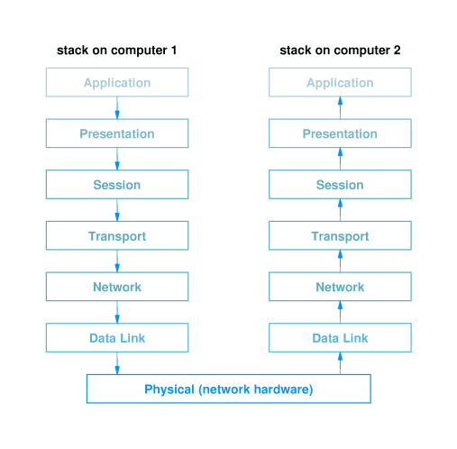

Slide 16
Layered software and stacks
Related modules from previous figure are called a protocol stack or simply a stack
Two constraints:
  The software for each layer depends only on the services of the software provided by lower layers
  The software at layer n at the destination receives exactly the same protocol message sent by layer n at the sender
These constraints mean that protocols can be tested independently and can be replaced within a protocol stack

Slide 17
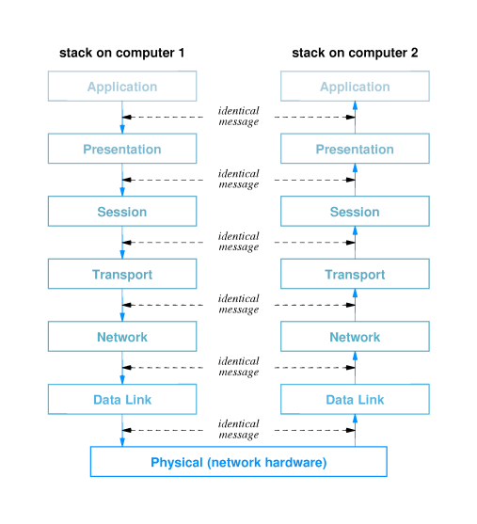
Layering principle

Slide 18
Messages and protocol stacks
On the sender, each layer:
  Accepts an outgoing message from the layer above
  Adds a header and other processing
  Passes resulting message to next lower layer
On the receiver, each layer:
  Receives an incoming message from the layer below
  Removes the header for that layer and performs other processing
  Passes the resulting message to the next higher layer

Slide 19
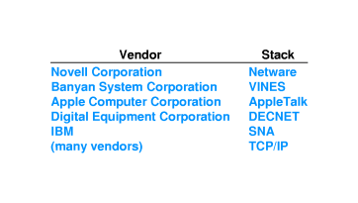
Commercial stacks

Slide 20
Protocol headers
The software at each layer communicates with the corresponding layer through information stored in headers
Each layer adds its header to the front of the message from the next higher layer
Headers are nested at the front of the message as the message traverses the network

Slide 21
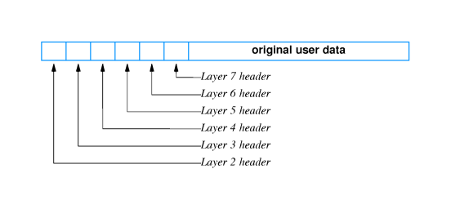

Slide 22
Control packets
Protocol layers often need to communicate directly without exchanging data
  Acknowledge incoming data
  Request next data packet
Layers use control packets
  Generated by layer n on sender
  Interpreted by layer n on receiver
  Transmitted like any other packet by layers n-1 and below

Slide 23
Techniques for reliable network communication
Model - reliable delivery of a block of data from one computer to another
  Data values unchanged
  Data in order
  No missing data
  No duplicated data
Example - parity bit, checksum and CRC used to ensure data is unchanged

Slide 24
Out-of-order delivery
Packets may be delivered out of order - especially in systems that include multiple networks
Out of order delivery can be detected and corrected through sequencing
  Sender attaches sequence number to each outgoing packet
  Received uses sequence numbers to put packets in order and detect missing packets

Slide 25
Duplicate delivery
Packets may be duplicated during transmission
Sequencing can be used to...
  Detect duplicate packets with duplicated sequence numbers
  Discard those duplicate packets

Slide 26
Lost packets
Perhaps the most widespread problem is lost packets
Any error - bit error, incorrect length - causes receiver to discard packet
Tough problem to solve - how does the receiver decide when a packet has been lost?

Slide 27
Retransmission
Protocols use positive acknowledgment with retransmission to detect and correct lost packets
  Receiver sends short message acknowledging receipt of packets
  Sender infers lost packets from missing acknowledgments
  Sender retransmits lost packets
Sender sets timer for each outgoing packet
  Saves copy of packet
  If timer expires before acknowledgment is received, sender can retransmit saved copy
Protocols define upper bound on retransmission to detect unrecoverable network failure

Slide 28
Replay
Sufficiently delayed packets may be inserted into later sessions
Suppose two computers exchange data with packets numbered 1 to 5
Packet 4 encounters an extraordinary delay; computers use retransmission to deliver valid copy of packet 4
Two computers exchange data later on with packets numbered 1 to 10
Initial `packet 4' can arrive during second session, so that the data from that old packet (rather than the current `packet 4' is inserted into the data
Protocols attach session number to each packet in a protocol session to differentiate packets from different sessions

Slide 29
Flow control
Data overrun can occur when sender transmits data faster than receiver can process incoming data
Protocols use flow control mechanisms through which receiver can control rate of data transmission
  Stop-and-go
  Sliding window

Slide 30
Stop-and-go flow control
Receiver sends small control packet when it is ready for next packet
Sender waits for control packet before sending next packet
Can be very inefficient of network bandwidth if delivery time is large

Slide 31
Sliding window
Allows sender to transmit multiple packets before receiving an acknowledgment
Number of packets that can be sent is defined by the protocol and called the window
As acknowledgments arrive from the receiver, the window is moved along the data packets; hence ``sliding window''

Slide 32
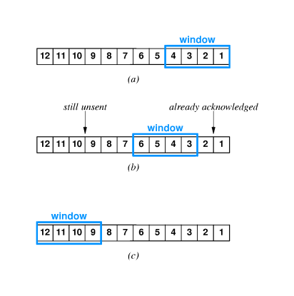
Example of sliding window

Slide 33
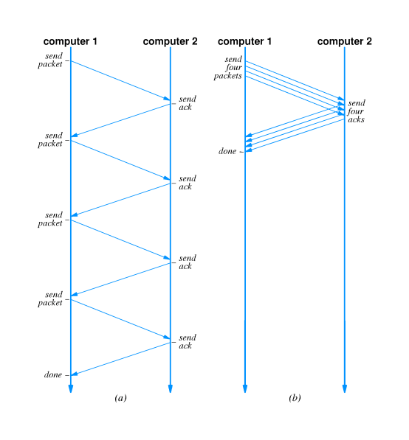
Comparison of stop-and-go and sliding window

Slide 34
Transmission times
For stop-and-go, each packet takes 2L time to deliver (where L is the latency, or network delivery time)
Sliding window can improve by number of packets in window:
T_{w} = T_{g} * W
(T_{w} is sliding window throughput, T_{g} is stop-and-go throughput
Transmission time also limited by network transmission rate:
T_{w} = min(B, T_{g} * W)
(B is maximum network bandwidth)

Slide 35
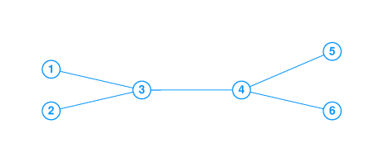
Network congestion
Network congestion arises in network systems that include multiple links
If input to some link exceeds maximum bandwidth, packets will queue up at connection to that link

Slide 36
Eventually, packets will be discarded and packets will be retransmitted
Ultimately, network will experience congestion collapse
Problem related to, but not identical to, data overrun

Slide 37
Aoviding and recovering from network congestion
Protocols attempt to avoid congestion and recover from network collapse by monitoring the state of the network and taking appropriate action
Can use two techniques:
  Notification from packet switches
  Infer congestion from packet loss
Packet loss can be used to detect congestion because modern networks are reliable and rarely lose packets through hardware failure
Sender can infer congestion from packet loss through missing acknowledgments
Rate or percentage of lost packets can be used to guage degree of congestion

Slide 38
Art, engineering and protocol design
Protocol design mixes engineering and art
  There are well-known techniques for solving specific problems
  Those techniques interact in subtle ways
  Resulting protocol suite must account for interaction
Efficiency, effectiveness, economy must all be balanced

Slide 39
Summary
Layering is a technique for guiding protocol design and implementation
Protocols are grouped together into related protocol suites
A collection of layered protocols is called a protocol stack
Protocols use a variety of techniques for reliable delivery of data

