Slide 1
Internetworking
PART II Internetworking Page Number
Chapter 15 Internetworking: Concepts, Architecture, and Protocols223
Chapter 16 IP: Internet Protocol Addresses 235
Chapter 17 Binding Protocol Addresses (ARP) 251
Chapter 18 IP Datagrams And Datagram Forwarding 267
Chapter 19 IP Encapsulation, Fragmentation, And Reassembly 277
Chapter 20 The Future IP (IPv6) 287
Chapter 21 An Error Reporting Mechanism (ICMP) 299
Chapter 22 TCP: Reliable Transport Service 309

Slide 2
Chapter 15 - Internetworking
Page Number Title
1 Motivation
2 Universal service
3 Internetworking
4 Routers
5 Internet architecture
6 Routers in an organization
7 A virtual network
8 A protocol suite for internetworking
9 Internetworking protocols
10 TCP/IP layering
11 Hosts, routers and protocol layers
12 Summary

Slide 3
Motivation
There are many different LAN and WAN technologies
In real world, computers are connected by many different technologies
Any system that spans a large organization must accommodate multiple technologies

Slide 4
Universal service
Telephones are useful because any telephone can reach any other telephone
Universal service among computers greatly increases the usefulness of each computer
Providing universal service requires interconnecting networks employing different technologies

Slide 5
Internetworking
Internetworking is a scheme for interconnecting multiple networks of dissimilar technologies
Uses both hardware and software
Extra hardware positioned between networks
Software on each attached computer
System of interconnected networks is called an internetwork or an internet

Slide 6
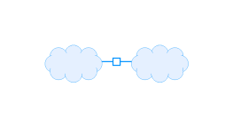
Routers
A router is a hardware component used to interconnect networks
A router has interfaces on multiple networks
Networks can use different technologies
Router forwards packets between networks
Transforms packets as necessary to meet standards for each network

Slide 7
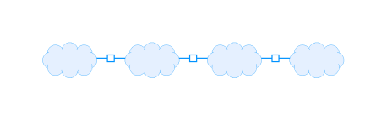
Internet architecture
An internetwork is composed of arbitrarily many networks interconnected by routers

Slide 8
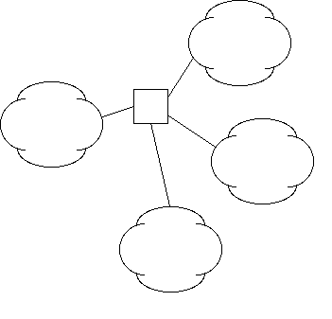
Routers can have more than two interfaces

Slide 9
Routers in an organization
Would be possible to interconnect all networks in an organization with a single router
Most organizations use multiple routers
  Each router has finite capacity; single router would have to handle all traffic across entire organization
  Because internetworking technology can automatically route around failed components, using multiple routers increases reliability

Slide 10
A virtual network
Internetworking software builds a single, seamless virtual network out of multiple physical networks
  Universal addressing scheme
  Universal service
All details of physical networks hidden from users and application programs

Slide 11
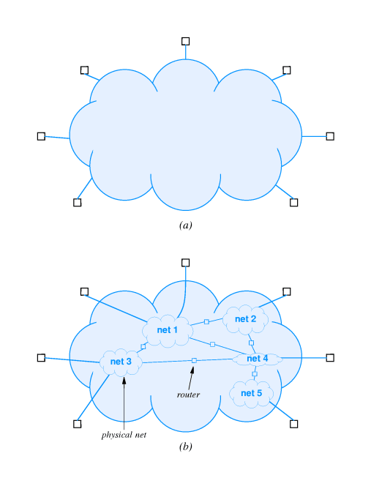

Slide 12
A protocol suite for internetworking
The TCP/IP Internet Protocols or, simply, TCP/IP is the mostly widely used internetworking protocol suite
First internetworking protocol suite
Internet concept (originally called catenet developed in conjunction with TCP/IP
Initially funded through ARPA
Picked up by NSF
Described in Where Wizards Stay Up Late

Slide 13
Internetworking protocols
Others include IPX, VINES, AppleTalk
TCP/IP is by far the most widely used
Vendor and platform independent
Used in the Internet - 20 million computers in 82 countries

Slide 14
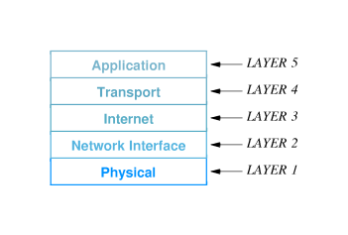
TCP/IP layering
OSI 7-layer model does not include internetworking
TCP/IP layering model includes five layers

Slide 15
Layer 5: Application
  Corresponds to ISO model layers 6 and 7; used for communication among applications
Layer 4: Transport
  Corresponds to layer 4 in the ISO model; provides reliable delivery of data
Layer 3: Internet
  Defines uniform format of packets forwarded across networks of different technologies and rules for forwarding packets in routers
Layer 2: Network
  Corresponds to layer 2 in the ISO model; defines formats for carrying packets in hardware frames
Layer 1: Hardware
  Corresponds to layer 1 in the ISO model; defines basic networking hardware

Slide 16
Hosts, routers and protocol layers
A host computer or host is any system attached to an internet that runs applications
Hosts may be supercomputers or toasters
TCP/IP allows any pair of hosts on an internet communicate directly
Both hosts and routers have TCP/IP stacks
  Hosts typically have one interface and don't forward packets
  Routers don't need layers 4 and 5 for packet forwarding

Slide 17
Summary
An internet is a collection of physical networks interconnected into a single virtual network
Routers provide the physical interconnection and forward packets between networks
Hosts communicate across multiple network through packets forwarded by routers
TCP/IP is the most widely used internetworking protocol suite

