Slide 1
Chapter 16 - IP Protocol Addresses
Page Number Title
1 Motivation
2 TCP/IP addresses
3 IP address hierarchy
4 Network and host numbers
5 Porperties of IP addresses
6 Designing the format of IP addresses
7 Classes of addresses
8 Using IP address classes
9 Dotted decimal notation
10 Bucknell's IP addresses

Slide 2
11 Address classes at a glance
12 Networks and hosts in each class
13 Internet address allocation
14 Example
15 Special IP addresses
16 Berkeley broadcast address
17 Routers and IP addressing
18 Multi-homed hosts
19 Summary

Slide 3
Motivation
One key aspect of virtual network is single, uniform address format
Can't use hardware addresses because different technologies have different address formats
Address format must be independent of any particular hardware address format
Sending host puts destination internet address in packet
Destination address can be interpreted by any intermediate router
Routers examine address and forward packet on to the destination

Slide 4
TCP/IP addresses
Addressing in TCP/IP is specified by the Internet Protocol (IP)
Each host is assigned a 32-bit number
Called the IP address or Internet address
Unique across entire Internet

Slide 5
IP address hierarchy
Each IP address is divided into a prefix and a suffix
  Prefix identifies network to which computer is attached
  Suffix identifies computer within that network
Address format makes routing efficient

Slide 6
Network and host numbers
Every network in a TCP/IP internet is assigned a unique network number
Each host on a specific network is assigned a host number or host address that is unique within that network
Host's IP address is the combination of the network number (prefix) and host address (suffix)

Slide 7
Porperties of IP addresses
Network numbers are unique
Host addresses may be reused on different networks; combination of network number prefix and host address suffix will be unique
Assignment of network numbers must be coordinated globally; assignment of host addresses can be managed locally

Slide 8
Designing the format of IP addresses
IP designers chose 32-bit addresses
Allocate some bits for prefix, some for suffix
  Large prefix, small suffix - many networks, few hosts per network
  Small prefix, large suffix - few networks, many hosts per network
Because of variety of technologies, need to allow for both large and small networks

Slide 9
Classes of addresses
Designers chose a compromise - multiple address formats that allow both large and small prefixes
Each format is called an address class
Class of an address is identified by first four bits

Slide 10
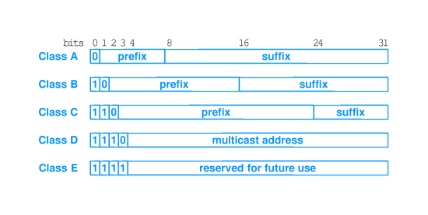

Slide 11
Using IP address classes
Class A, B and C are primary classes
Used for ordinary host addressing
Class D is used for multicast, a limited form of broadcast
  Internet hosts join a multicast group
  Packets are delivered to all members of group
  Routers manage delivery of single packet from source to all members of multicast group
  Used for mbone (multicast backbone)
Class E is reserved

Slide 12
Dotted decimal notation
Class A, B and C all break between prefix and suffix on byte boundary
Dotted decimal notation is a convention for representing 32-bit internet addresses in decimal
Convert each byte of address into decimal; display separated by periods (``dots'')

Slide 13
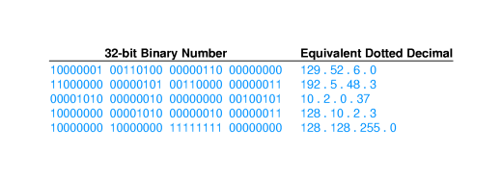

Slide 14
Bucknell's IP addresses
Bucknell has a single Class B network: 134.82.0.0
All hosts at Bucknell have 134.82 prefix:
  134.82.7.4 - coral
  134.82.56.118 - regulus
  134.82.250.4 - droms-dsl.bucknell.edu
Suffix bytes are used to determine local network and host through subnetting

Slide 15
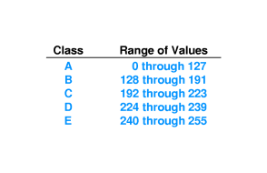
Address classes at a glance
While dotted decimal makes separating network address from host address easier, determining class is not so obvious
Look at first dotted decimal number, and use this table:

Slide 16
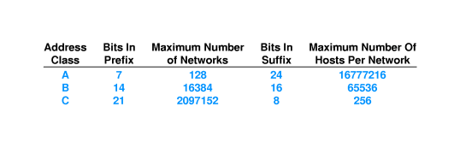
Networks and hosts in each class
Classing scheme does not yield equal number of networks in each class
Class A:
  First bit must be 0
  7 remaining bits identify Class A net
  2⁷ (= 128) possible class A nets

Slide 17
Internet address allocation
Addresses in the Internet are not used efficiently
Bucknell is typical, using 2,000-3,000 out of possible 2^16
Large organizations may not be able to get as many addresses in the Internet as they need
Example - UPS needs addresses for millions of computers
Solution - set up private internet and allocate addresses from entire 32-bit address space

Slide 18
Example
Select address class for each network depending on expected number of hosts
Assign network numbers from appropriate classes
Assign host suffixes to form internet addresses for all hosts

Slide 19
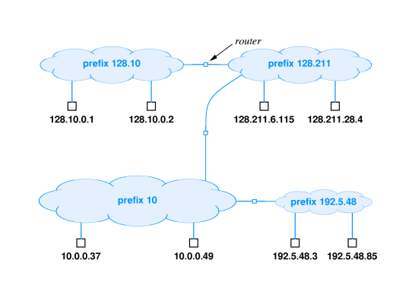

Slide 20
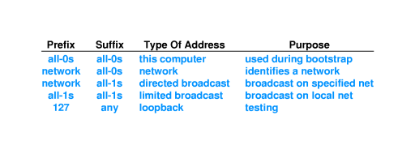
Special IP addresses

Slide 21
Berkeley broadcast address
First BSD implementation (Berkeley Software Distribution) of UNIX used all 0s for broadcast instead of all 1s
This non-standard implementation spread with BSD UNIX
Still in common use today
``There are two major developments that have come out of Berkeley: BSD UNIX and LSD. This is not a coincidence.''
- Anon.

Slide 22
Routers and IP addressing
IP address depends on network address
What about routers - connected to two networks?
IP address specifies an interface, or network attachment point, not a computer
Router has multiple IP addresses - one for each interface

Slide 23
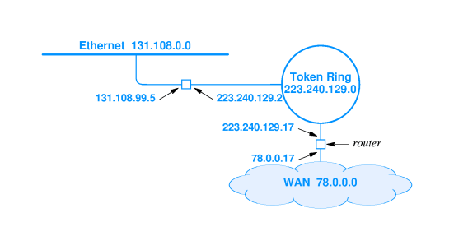

Slide 24
Multi-homed hosts
Hosts (that do not forward packets) can also be connected to multiple networks
Can increase reliability and performance
Multi-homed hosts also have one address for each interface

Slide 25
Summary
Virtual network needs uniform addressing scheme, independent of hardware
IP address is a 32-bit address; each interface gets a unique IP address
IP address is composed of a network address and a host address
Network addresses are divided into three primary classes: A, B and C
Dotted decimal notation is a standard format for Internet addresses: 134.82.11.70
Routers have multiple addresses - one for each interface

