Slide 1
Chapter 17 - Binding Protocol Addresses
Page Number Title
1 Introduction
2 Address translation
3 Address resolution
4 Address resolution (continued)
5 Address resolution techniques
6 Table lookup
7 Table lookup (continued)
8 Closed-form computation
9 Dynamic resolution
10 Dynamic resolution techniques

Slide 2
11 ARP
12 ARP message exchange
13 ARP example
14 ARP message contents
15 ARP message format
16 Sending an ARP message
17 Caching ARP responses
18 Identifying ARP frames
19 Processing ARP messages
20 Layering and address resolution
21 Summary

Slide 3
Introduction
Upper levels of protocol stack use protocol addresses
Network hardware must use hardware address for eventual delivery
Protocol address must be translated into hardware address for delivery; will discuss three methods

Slide 4
Address translation
Upper levels use only protocol addresses
  "Virtual network" addressing scheme
  Hides hardware details
Translation occurs at data link layer
  Upper layer hands down protocol address of destination
  Data link layer translates into hardware address for use by hardware layer

Slide 5
Address resolution
Finding hardware address for protocol address:
  address resolution
  Data link layer resolves protocol address to hardware address
Resolution is local to a network
Network component only resolves address for other components on same network

Slide 6
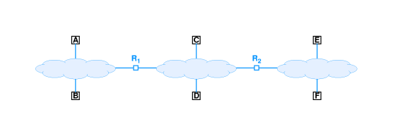
Address resolution (continued)

Slide 7
A resolves protocol address for B for protocol messages from an application on A sent to an application on B
A does not resolve a protocol address for F
  Through the internet layer, A delivers to F by routing through R₁ and R₂
  A resolves R₁ hardware address
Network layer on A passes packet containing destination protocol address F for delivery to R₁

Slide 8
Address resolution techniques
Association between a protocol address and a hardware address is called a binding
Three techniques:
  Table lookup
    Bindings stored in memory with protocol address as key
    Data link layer looks up protocol address to find hardware address
  Closed-form computation
    Protocol address based on hardware address
    Data link layer derives hardware address from protocol address
  Dynamic
    Network messages used for "just-in-time" resolution
    Data link layer sends message requesting hardware address; destination responds with its hardware address

Slide 9
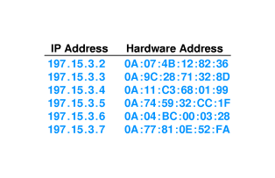
Table lookup
Use a simple list containing IP address and hardware address for each host on net
Search on IP address and extract corresponding hardware address
Note that all IP addresses have same prefix; can save space by dropping prefix

Slide 10
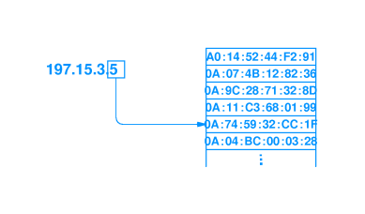
Table lookup (continued)
Sequential search may be prohibitively expensive (O(n²))
Can use indexing or hashing for O(n) lookup
  Indexing - use hostid part of IP address as list (array) index

Slide 11
  Hashing - use hashing function on hostid to generate list index

Slide 12
Closed-form computation
If hardware technology uses small, configurable hardware address, network administrator can choose hardware address based on IP address
Example - hardware uses one octet address that can be configured
Simply choose hardware address to be hostid
Now, any host can determine hardware address as:
hardware_address = ip_address & 0xff

Slide 13
Dynamic resolution
Use network to resolve IP addresses
Message exchange with other computer(s) returns hardware address to source
Two designs:
  Server-based - computer sends message to server to resolve address
    List of servers
    Broadcast to locate servers
  Distributed - all computers participate; destination provides hardware address to host

Slide 14
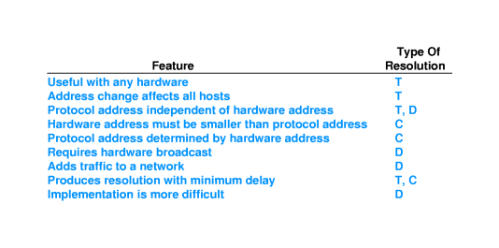
Dynamic resolution techniques
Server-based - centralized, easier to manage, used on non-broadcast media (e.g., ATM)
Distributed - requires no dedicated computers, no administration

Slide 15
ARP
IP uses distributed resolution technique
Address Resolution Protocol (ARP) - part of TCP/IP protocol suite
Two-part protocol
  Request from source asking for hardware address
  Reply from destination carrying hardware address

Slide 16
ARP message exchange
ARP request message dropped into hardware frame and broadcast
Uses separate protocol type in hardware frame (ethernet = 806)
Sender inserts IP address into message and broadcast
Every other computer examines request
Computer whose IP address is in request responds
  Puts hardware address in response
  Unicasts to sender
Original requester can then extract hardware address and send IP packet to destination

Slide 17
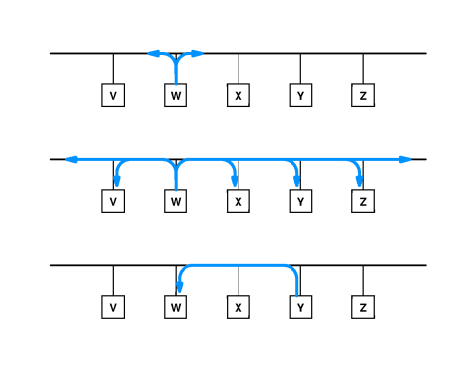
ARP example

Slide 18
ARP message contents
Maps protocol address to hardware address
Both protocol address and hardware address sizes are variable
  Ethernet = 6 octets
  IP = 4 octets
Can be used for other protocols and hardware types

Slide 19
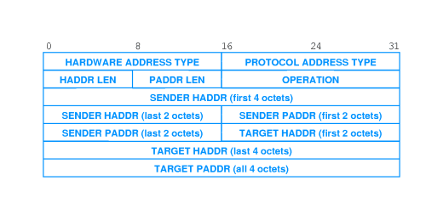
ARP message format

Slide 20
HARDWARE ADDRESS TYPE = 1 for Ethernet
PROTOCOL ADDRESS TYPE = 0x0800 for IP
OPERATION = 1 for request, 2 for response
Contains both target and sender mappings from protocol address to hardware address
  Request sets hardware address of target to 0
  Target can extract hardware address of sender (saving an ARP request)
  Target exchanges sender/target in response

Slide 21
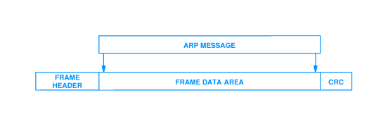
Sending an ARP message
Sender constructs ARP message
ARP message carried as data in hardware frame - encapsulation

Slide 22
Caching ARP responses
Using ARP for each IP packet adds two packets of overhead for each IP packet
Computer caches ARP responses
  Flushes cache at system startup
  Entries discarded periodically
Cache searched prior to sending ARP request

Slide 23
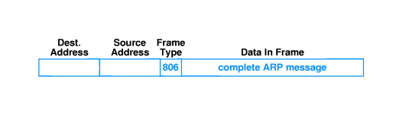
Identifying ARP frames
Uses separate frame type
Ethernet uses type 0x0806

Slide 24
Processing ARP messages
Receiver extracts sender's hardware address and updates local ARP table
Receiver checks operation - request of response
Response:
  Adds sender's address to local cache
  Sends pending IP packet(s)
Request:
  If receiver is target, forms response
  Unicasts to sender
  Adds sender's address to local cache
Note:
  Target likely to respond "soon"
  Computers have finite storage for ARP cache
  Only target adds sender to cache; others only update if target already in cache

Slide 25
Layering and address resolution
Address resolution (ARP) is a network interface layer function
Protocol addresses used in all higher layers
Hides ugly details and allows generality in upper layers

Slide 26
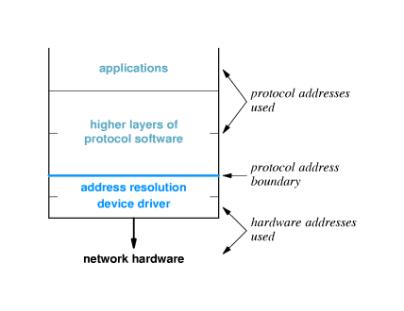

Slide 27
Summary
Address resolution - translates protocol address to hardware address
  Static - table lookup
  Computation - extract hardware address from protocol address
  Dynamic - use network messages to resolve protocol address
ARP - TCP/IP protocol for address resolution

