Slide 1
Chapter 18 - IP Datagrams and Datagram Forwarding
Page Number Title
1 Introduction
2 Connectionless service
3 Virtual packets
4 IP datagram format
5 Forwarding datagrams
6 Routing example
7 Routing table
8 Default routes
9 Routing tables and address masks
10 Address masks

Slide 2
11 Forwarding, destination address and next-hop
12 Best-effort delivery
13 IP datagram header format
14 IP datagram header fields
15 IP datagram options
16 Summary

Slide 3
Introduction
Fundamental Internet communication service
Format of packets
Processing of packets by routers
  Forwarding
  Delivery

Slide 4
Connectionless service
End-to-end delivery service is connectionless
Extension of LAN abstraction
  Universal addressing
  Data delivered in packets (frames), each with a header
Combines collection of physical networks into single, virtual network
Transport protocols use this connectionless service to provide connectionless data delivery (UDP) and connection-oriented data delivery (TCP)

Slide 5
Virtual packets
Packets server same purpose in internet as frames on LAN
Each has a header
Routers (formerly gateways) forward between physical networks
Packets have a uniform, hardware-independent format
  Includes header and data
  Can't use format from any particular hardware
Encapsulated in hardware frames for delivery across each physical network

Slide 6
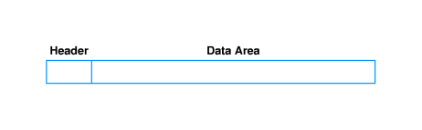
IP datagram format
Formally, the unit of IP data delivery is called a datagram
Includes header area and data area
Datagrams can have different sizes
  Header area usually fixed (20 octets) but can have options
  Data area can contain between 1 octet and 65,535 octets (2¹⁶ - 1)
  Usually, data area much larger than header

Slide 7
Forwarding datagrams
Header contains all information needed to deliver datagram to destination computer
  Destination address
  Source address
  Identifier
  Other delivery information
Router examines header of each datagram and forwards datagram along path to destination

Slide 8
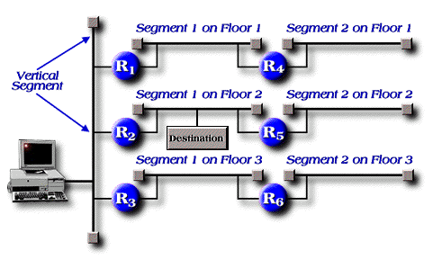
Routing example

Slide 9
Routing table
For efficiency, information about forwarding is stored in a routing table
  Initialized at system initialization
  Must be updated as network topology changes
Contains list of destination networks and next hop for each destination

Slide 10
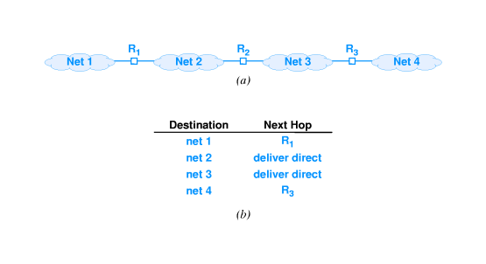

Slide 11
Default routes
Routing table kept small by listing destination networks rather than hosts
Can be further reduced through default route
  Entry used if destination network not explicitly listed in routing table
  E.g., Bucknell uses default routes for all off-campus networks

Slide 12
Routing tables and address masks
In practice, additional information is kept in routing table
Destination stored as network address
Next hop stored as IP address of router
Address mask defines how many bits of address are in prefix
  Prefix defines how much of address used to identify network
  E.g., class A mask is 255.0.0.0
  Used for subnetting

Slide 13
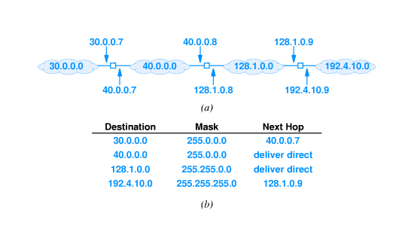

Slide 14
Address masks
To identify destination network, apply address mask to destination address and compare to network address in routing table
Can use Boolean and
if ((Mask[i] & D) == Dest[i]) forward to NextHop[i]
Consider 128.1.15.26:

Slide 16
Forwarding, destination address and next-hop
Destination address in IP datagram is always ultimate destination
Router looks up next-hop address and forwards datagram
Network interface layer takes two parameters:
  IP datagram
  Next-hop address
Next-hop address never appears in IP datagram

Slide 17
Best-effort delivery
IP provides service equivalent to LAN
Does not guarantee to prevent
  Duplicate datagrams
  Delayed or out-of-order delivery
  Corruption of data
  Datagram loss
Reliable delivery provided by transport layer
Network layer - IP - can detect and report errors without actually fixing them
  Network layer focuses on datagram delivery
  Application layer not interested in differentiating among delivery problems at intermediate routers

Slide 18
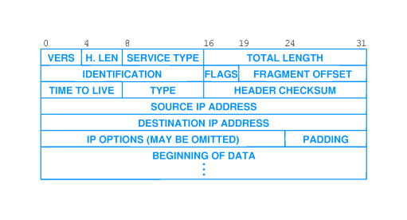
IP datagram header format

Slide 19
IP datagram header fields
VERS - version of IP (currently 4)
H. LEN - header length (in units of 32 bits)
SERVICE TYPE - sender's preference for low latency, high reliability (rarely used)
TOTAL LENGTH - total octets in datagram
IDENT, FLAGS, FRAGMENT OFFSET - used with fragmentation
TTL - time to live; decremented in each router; datagram discarded when TTL = 0
TYPE - type of protocol carried in datagram; e.g., TCP, UDP
HEADER CHECKSUM - 1s complement of 1s complement sum
SOURCE, DEST IP ADDRESS - IP addresses of original source and ultimate destination

Slide 20
IP datagram options
Several options can be added to IP header:
  Record route
  Source route
  Timestamp
Header with no options has H. LEN field value 5; data begins immediately after DESTINATION IP ADDRESS
Options added between DESTINATION IP ADDRESS and data in multiples of 32 bits
Header with 96 bits of options has H. LEN field value 8

Slide 21
Summary
Basic unit of delivery in TCP/IP is IP datagram
Routers use destination address in IP datagram header to determine next-hop
Forwarding information stored in routing table
IP datagram header has 40 octets of fixed field information and (possibly) options

