Slide 1
Chapter 19 - IP Encapsulation, Fragmentation and Reassembly
Page Number Title
1 Datagram transmission and frames
2 Encapsulation
3 Encapsulation across multiple hops
4 Internet encapsulation (example)
5 MTU
6 MTU and datagram transmission
7 MTU and heterogeneous networks
8 Fragmentation
9 Fragmentation (details)
10 Datagram reassembly
11 Fragment identification
12 Fragment loss
13 Fragmenting a fragment
14 Summary

Slide 2
10 Datagram reassembly
11 Fragment identification
12 Fragment loss
13 Fragmenting a fragment
14 Summary

Slide 3
Datagram transmission and frames
IP internet layer
  Constructs datagram
  Determines next hop
  Hands to network interface layer
Network interface layer
  Binds next hop address to hardware address
  Prepares datagram for transmission
But ... hardware frame doesn't understand IP; how is datagram transmitted?

Slide 4
Encapsulation
Network interface layer encapsulates IP datagram as data area in hardware frame
  Hardware ignores IP datagram format
  Standards for encapsulation describe details
Standard defines data type for IP datagram, as well as others (e.g., ARP)
Receiving protocol stack interprets data area based on frame type

Slide 5
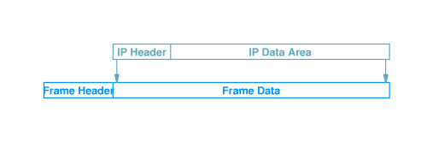

Slide 6
Encapsulation across multiple hops
Each router in the path from the source to the destination:
  Unencapsulates incoming datagram from frame
  Processes datagram - determines next hop
  Encapsulates datagram in outgoing frame
  (Figure)
Datagram may be encapsulated in different hardware format at each hop
Datagram itself is (almost!) unchanged

Slide 7
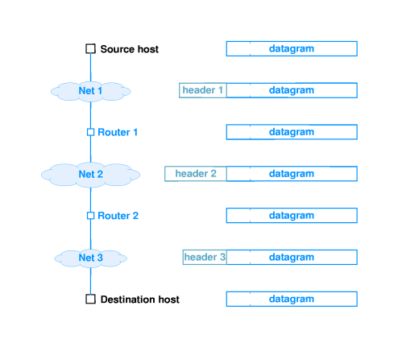

Slide 8
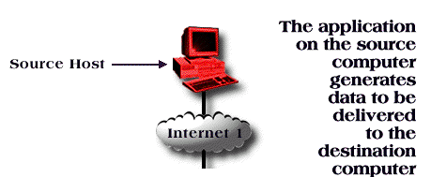
Internet encapsulation (example)

Slide 9
MTU
Every hardware technology specification includes the definition of the maximum size of the frame data area
Called the maximum transmission unit (MTU)
Any datagram encapsulated in a hardware frame must be smaller than the MTU for that hardware

Slide 10
MTU and datagram transmission
IP datagrams can be larger than most hardware MTUs
  IP: 2¹⁶ ⁻ ¹
  Ethernet: 1500
  Token ring: 2048 or 4096
Source can simply limit IP datagram size to be smaller than local MTU
  Must pass local MTU up to TCP for TCP segments
  What about UDP?

Slide 11
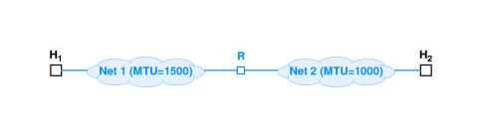
MTU and heterogeneous networks
An internet may have networks with different MTUs
Suppose downstream network has smaller MTU than local network?

Slide 12
Fragmentation
One technique - limit datagram size to smallest MTU of any network
IP uses fragmentation - datagrams can be split into pieces to fit in network with small MTU
Router detects datagram larger than network MTU
  Splits into pieces
  Each piece smaller than outbound network MTU

Slide 13
Fragmentation (details)
Each fragment is an independent datagram
  Includes all header fields
  Bit in header indicates datagram is a fragment
  Other fields have information for reconstructing original datagram
  FRAGMENT OFFSET gives original location of fragment
Router uses local MTU to compute size of each fragment
Puts part of data from original datagram in each fragment
Puts other information into header

Slide 14
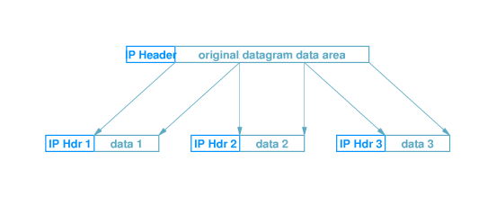

Slide 15
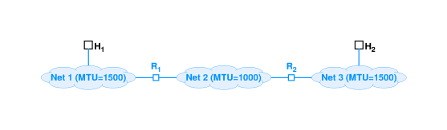
Datagram reassembly
Reconstruction of original datagram is call reassembly
Ultimate destination performs reassembly

Slide 16
Fragments may arrive out of order; header bit identifies fragment containing end of data from original datagram
Fragment 3 identified as last fragment

Slide 17
Fragment identification
How are fragments associated with original datagram?
IDENT field in each fragment matches IDENT field in original datagram
Fragments from different datagrams can arrive out of order and still be sorted out

Slide 18
Fragment loss
IP may drop fragment
What happens to original datagram?
  Destination drops entire original datagram
How does destination identify lost fragment?
  Sets timer with each fragment
  If timer expires before all fragments arrive, fragment assumed lost
  Datagram dropped
Source (application layer protocol) assumed to retransmit

Slide 19
Fragmenting a fragment
Fragment may encounter subsequent network with even smaller MTU
Router fragments the fragment to fit
Resulting (sub)fragments look just like original fragments (except for size)
No need to reassemble hierarchically; (sub)fragments include position in original datagram

Slide 20
Summary
IP uses encapsulation to transmit datagrams in hardware frames
Network technologies have an MTU
IP uses fragmentation to carry datagrams larger than network MTU

