Slide 1
Chapter 20 - IPv6

Slide 2
Page Numer Title
1 Introduction - the future of IP
2 Success of IP
3 Motivation for change
4 Name and versions number
5 New features
6 IPv6 datagram format
7 IPv6 base header format
8 IPv6 NEXT HEADER
9 Parsing IPv6 headers
10 Fragmentation
11 IPv6 address notation
15 Summary

Slide 3
Introduction - the future of IP
Current version of IP - version 4 - is 20 years old
IPv4 has shown remarkable ability to move to new technologies
IETF has proposed entirely new version to address some specific problems

Slide 4
Success of IP
IP has accommodated dramatic changes since original design
  Basic principles still appropriate today
  Many new types of hardware
  Scale
Scaling
  Size - from a few tens to a few tens of millions of computers
  Speed - from 56Kbps to 1Gbps
Increased frame size in hardware

Slide 5
Motivation for change
Address space
  32 bit address space allows for over a million networks
  But...most are Class C and too small for many organizations
  2¹⁴ Class B network addresses already almost exhausted (and exhaustion was first predicted to occur a couple of years ago)
Type of service
  Different applications have different requirements for delivery reliability and speed
  Current IP has type of service that's not often implemented
Multicast

Slide 6
Types of Name and versions number messages
Preliminary versions called IP - Next Generation (IPng)
Several proposals all called IPng
One was selected and uses next available version number (6)
Result is IP version 6 (IPv6)

Slide 7
New features
Address size - IPv6 addresses are 128bits
Header format - entirely different
Extension headers - Additional information stored in optional extension headers, followed by data
Support for audio and video - flow labels and quality of service allow audio and video applications to establish appropriate connections
Extensible - new features can be added more easily

Slide 8
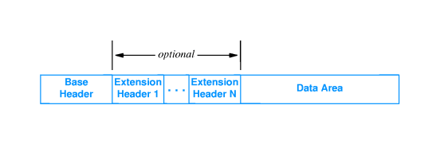
IPv6 datagram format

Slide 9
IPv6 base header format
Contains less information than IPv4 header
NEXT HEADER points to first extension header
FLOW LABEL used to associate datagrams belonging to a flow or communication between two applications
  Traffic class
  Specific path
  Routers use FLOW LABEL to forward datagrams along prearranged path

Slide 10
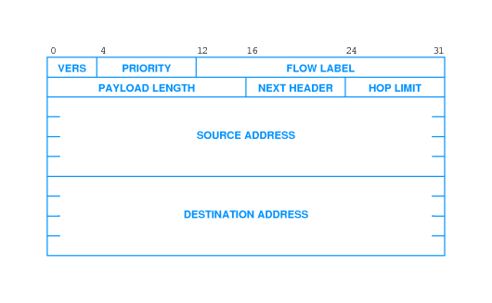

Slide 11
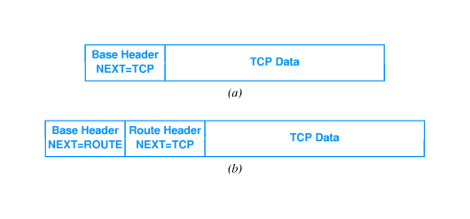
IPv6 NEXT HEADER

Slide 12
Parsing IPv6 headers
Base header is fixed size - 40 octets
  NEXT HEADER field in base header defines type of header
  Appears at end of fixed-size base header
Some extensions headers are variable sized
  NEXT HEADER field in extension header defines type
  HEADER LEN field gives size of extension header

Slide 13
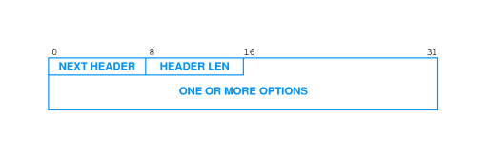

Slide 14
Fragmentation
Fragmentation information kept in separate extension header
Each fragment has base header and (inserted) fragmentation header
Entire datagram, including original header may be fragmented

Slide 15
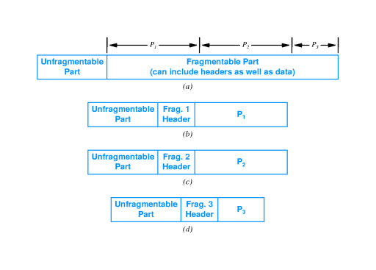

Slide 16
Fragmentation and path MTU
IPv6 source (not intermediate routers) responsible for fragmentation
  Routers simply drop datagrams larger than network MTU
  Source must fragment datagram to reach destination
Source determines path MTU
  Smallest MTU on any network between source and destination
  Fragments datagram to fit within that MTU
Uses path MTU discovery
  Source sends probe message of various sizes until destination reached
  Must be dynamic - path may change during transmission of datagrams

Slide 17
Use of multiple headers
Efficiency - header only as large as necessary
Flexibility - can add new headers for new features
Incremental development - can add processing for new features to testbed; other routers will skip those headers

Slide 18
IPv6 addressing
128-bit addresses
Includes network prefix and host suffix
No address classes - prefix/suffix boundary can fall anywhere
Special types of addresses:
  unicast - single destination computer
  multicast - multiple destinations; possibly not at same site
  cluster - collection of computers with same prefix; datagram is delivered to one out of cluster
IPv4 broadcast flavors are subsets of multicast
Cluster addressing allows for duplication of services

Slide 19
IPv6 address notation
128-bit addresses unwieldy in dotted decimal; requires 16 numbers
105.220.136.100.255.255.255.255.0.0.18.128.140.10.255.255
Groups of 16-bit numbers in hex separated by colons - colon hexadecimal (or colon hex)
69DC:8864:FFFF:FFFF:0:1280:8C0A:FFFF
Zero-compression - series of zeroes indicated by two colons
FF0C:0:0:0:0:0:0:B1 FF0C::B1
IPv6 address with 96 leading zeros is interpreted to hold an IPv4 address

Slide 20
Summary
IPv4 basic abstractions have been very successful
IPv6 carries forward many of those abstraction... but, all the details are changed
  128-bit addresses
  Base and extension headers
  Source does fragmentation
  New types of addresses
  Address notation

