Slide 1
Chapter 21 - ICMP

Slide 2
Page Number Title
1 Introduction
2 Error detection
3 Error reporting
4 Types of messages
5 ICMP message transport
6 ICMP and reachability
7 ICMP and internet routes
8 ICMP and path MTU discovery
9 ICMP and router discovery
10 ICMP redirect
11 Summary

Slide 3
Introduction
IP provides best-effort delivery
Delivery problems can be ignored; datagrams can be "dropped on the floor"
Internet Control Message Protocol (ICMP) provides error-reporting mechanism

Slide 4
Error detection
Internet layer can detect a variety of errors:
  Checksum (header only!)
  TTL expires
  No route to destination network
  Can't deliver to destination host (e.g., no ARP reply)
Internet layer discards datagrams with problems
Some - e.g., checksum error - can't trigger error messages

Slide 5
Error reporting
Some errors can be reported
  Router sends message back to source in datagram
  Message contains information about problem
Encapsulated in IP datagram

Slide 6
Types of messages
Internet Control Message Protocol (ICMP) defines error and informational messages
Error messages:
  Source quench
  Time exceeded
  Destination unreachable
  Redirect
  Fragmentation required
Informational messages:
  Echo request/reply
  Address mask request/reply
  Router discovery

Slide 7
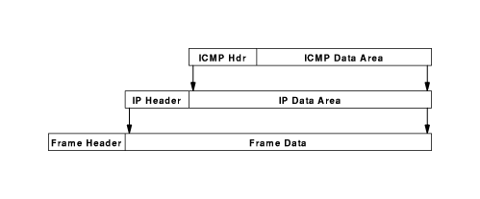
ICMP message transport
ICMP encapsulated in IP

Slide 8
But ... how can that work?
ICMP messages sent in response to incoming datagrams with problems
ICMP message not sent for ICMP message

Slide 9
ICMP and reachability
An internet host, A, is reachable from another host, B, if datagrams can be delivered from A to B
ping program tests reachability - sends datagram from B to A that A echoes back to B
Uses ICMP echo request and echo reply messages
Internet layer includes code to reply to incoming ICMP echo request messages

Slide 10
ICMP and internet routes
List of all routers on path from A to B is called the route from A to B
traceroute uses UDP to non-existent port and TTL field to find route via expanding ring search
Sends ICMP echo messages with increasing TTL
  Router that decrements TTL to 0 sends ICMP time exceeded message, with router's address as source address
  First, with TTL 1, gets to first router, which discards and sends time exceeded message
  Next, with TTL 1, gets through first router to second router
  Continue until message from destination received
traceroute must accommodate varying network delays
Must also accommodate dynamically changing routes

Slide 11
ICMP and path MTU discovery
Fragmentation should be avoided
How can source configure outgoing datagrams to avoid fragmentation?
Source determines path MTU - smallest network MTU on path from source to destination
Source probes path using IP datagrams with don't fragment flag
Router responds with ICMP fragmentation required message
Source sends smaller probes until destination reached

Slide 12
ICMP and router discovery
Router can fail, causing "black-hole" or isolating host from internet
ICMP router discovery used to find new router
Host can broadcast request for router announcements to auto-configure default route
Host can broadcast request if router fails
Router can broadcast advertisement of existence when first connected

Slide 13
ICMP redirect
Default route may cause extra hop
Router that forwards datagram on same interface sends ICMP redirect
Host installs new route with correct router as next hop

Slide 14
Summary
Internet layer provides best-effort delivery service
May choose to report errors for some problems
ICMP provides error message service

