Slide 1
Chapter 22 - Transport Protocols

Slide 2
Page Number Title
1 Introduction
2 User Datagram Protocol
3 UDP and TCP/IP layering
4 UDP headers
5 Selecting UDP port numbers
6 Well-known port numbers
7 TCP
8 Features of TCP
9 Using IP for data delivery
10 Delvering TCP
11 TCP and reliable delivery
12 Lost packets
13 TCP segments and sequence numbers
14 Acknowledgments
15 Setting the timeout
16 RTOs for different network delays
17 Picking a timeout value
Computing RTT and RTO

Slide 3
19 Measuring RTT
20 Karn's algorithm
21 TCP sliding window
22 Sliding window with acknowledgments
23 Sliding window example
24 Sliding window with lost segment
25 Flow control with sliding window
26 Silly window syndrome
27 TCP segment format
28 Three-way handshake
29 Closing a connection
30 Opening a connection
31 Closing a connection
32 Congestion control
33 Summary

Slide 4
Introduction
Internet Protocol (IP) provides ``unreliable datagram service'' between hosts
Transport protocols provide end-to-end delivery between endpoints of a connection; e.g., processes or programs
User Datagram Protocol (UDP) provides datagram service
Transmission Control Protocol (TCP) provides reliable data delivery

Slide 5
User Datagram Protocol
UDP delivers independent messages, called datagrams between applications or processes on host computers
  ``Best effort'' delivery - datagrams may be lost, delivered out of order, etc.
  Checksum (optionally) guarantees integrity of data
For generality, endpoints of UDP are called protocol ports or ports
Each UDP data transmission identifies the internet address and port number of the destination and the source of the message
Destination port and source port may be different

Slide 6
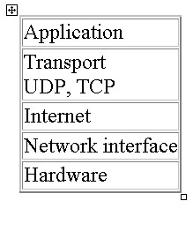
UDP and TCP/IP layering
Transport protocols use IP to provide data delivery for application protocols.

Slide 7

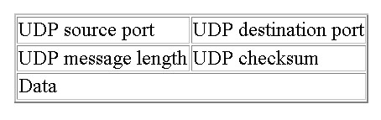
UDP headers
UDP datagrams have a header that follows the hardware and IP headers:
UDP header is very simple:
  Port numbers
  Message length
  Checksum

Slide 8
Selecting UDP port numbers
Communicating computers must agree on a port number
  ``Server'' opens selected port and waits for incoming messages
  ``Client'' selects local port and sends message to selected port
Services provided by many computers use reserved, well-known port numbers:
  ECHO
  DISCARD
  NTP
Other services use dynamically assigned port numbers

Slide 9
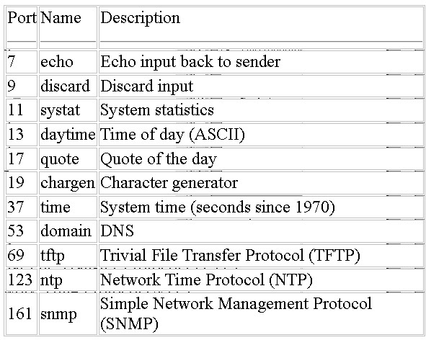
Well-known port numbers

Slide 10
TCP
Transmission Control Protocol (TCP) is most widely used transport protocol
Provides reliable data delivery by using IP unreliable datagram delivery
Compensates for loss, delay, duplication and similar problems in Internet components
Reliable delivery is high-level, familiar model for construction of applications

Slide 11
Features of TCP
Connection oriented: Application requests connection to destination and then uses connection to deliver data to transfer data
Point-to-point: A TCP connection has two endpoints
Reliability: TCP guarantees data will be delivered without loss, duplication or transmission errors
Full duplex: The endpoints of a TCP connection can exchange data in both directions simultaneously
Stream interface: Application delivers data to TCP as a continuous stream, with no record boundaries; TCP makes no guarantees that data will be received in same blocks as transmitted

Slide 12
Reliable connection startup: Three-way handshake guarantees reliable, synchronized startup between endpoints
Graceful connection shutdown: TCP guarantees delivery of all data after endpoint shutdown by application

Slide 13
Using IP for data delivery
TCP uses IP for data delivery (like UDP)
Endpoints are identified by ports (like UDP)
  Allows multiple connections on each host
  Ports may be associated with an application or a process
IP treats TCP like data and does not interpret any contents of the TCP message

Slide 14
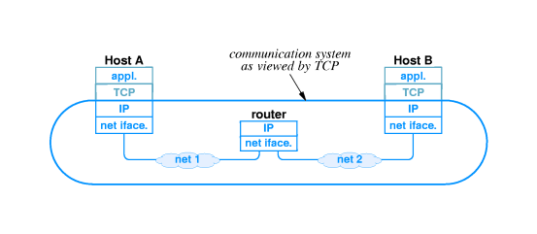
Delivering TCP
TCP travels in IP datagrams
Internet routers only look at IP header to forward datagrams
TCP at destination interprets TCP messages

Slide 15
TCP and reliable delivery
TCP uses many techniques described earlier to provide reliable delivery
Recovers from
  Lost packets
  Duplicate packets
  Delayed packets
  Corrupted data
  Transmission speed mismatches
  Congestion
  System reboots

Slide 16
Lost packets
TCP uses positive acknowledgment with retransmission to achieve reliable data delivery
Recipient sends acknowledgment control messages (ACK) to sender to verify successful receipt of data
Sender sets timer when data transmitted; if timer expires before acknowledgment arrives, sender retransmits (with new timer)

Slide 17
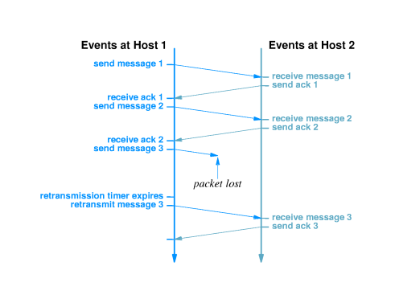

Slide 18
TCP segments and sequence numbers
Application delivers arbitrarily large chunks of data to TCP as a``stream''
TCP breaks this data into segments, each of which fits into an IP datagram
Original stream is numbered by bytes
Segment contains sequence number of data bytes

Slide 19
Acknowledgments
Receiver sends segment with sequence number of acknowledged data (not segments)
One ACK can acknowledge many segments

Slide 20
Setting the timeout
Inappropriate timeout can cause poor performance:
  Too long - sender waits longer than necessary before retransmitting
  Too short - sender generates unnecessary traffic
Timeout must be different for each connection and set dynamically
  Host on same LAN should have shorter timeout than host 20 hops away.
  Delivery time across internet may change over time; timeout must accommodate changes

Slide 21
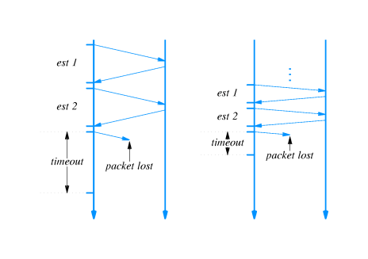
RTOs for different network delays

Slide 22
Picking a timeout value
Timeout should be based on round trip time (RTT)
Sender can't know RTT of any packet before transmission
Sender picks retransmission timeout (RTO) based on previous RTTs
Specific method is call adaptive retransmission algorithm

Slide 23
Computing RTT and RTO
Weighted average for RTT:
RTT_{new} = (alpha*RTT_{old}) + ((1 - alpha)*RTT_{sample}))
Computation of RTO:
RTO = beta*RTT_{new}

Slide 24
Measuring RTT
RTT measured by observing difference between time of transmission and arrival of acknowledgment
However - acknowledgments carry no information about which packet is acknowledged
Sender cannot determine whether acknowledgment is from original transmission or retransmission
  Choosing original transmission overestimates RTT
Choosing retransmission underestimates RTT

Slide 25
Karn's algorithm
How to choose between original and retransmission? Answer: choose neither!
Karn's algorithm specifies that sender ignores RTTs for retransmitted segments
How will RTT get updated if internet round trip time increases?
Karn's algorithm specifies that RTO is separated from RTT when retransmission occurs
RTO doubles for each new message until ACK arrives with no retransmission

Slide 26
TCP sliding window
TCP uses sliding window for flow control
Receiver specifies window
  Called window advertisement
  Specifies which bytes in the data stream can be sent
  Carried in segment along with ACK
Sender can transmit any bytes, in any size segment, between last acknowledged byte and within window size

Slide 27
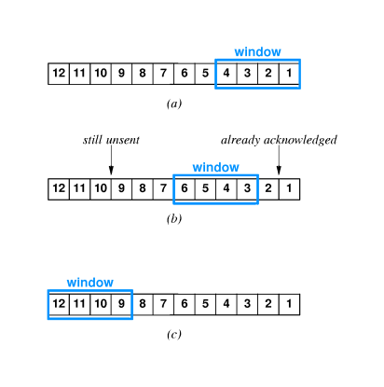

Slide 28
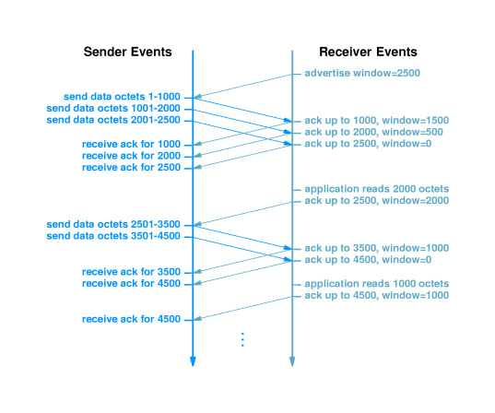
Sliding window with acknowledgments

Slide 29
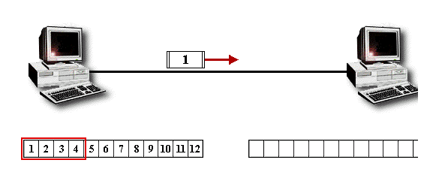
Sliding window example

Slide 30
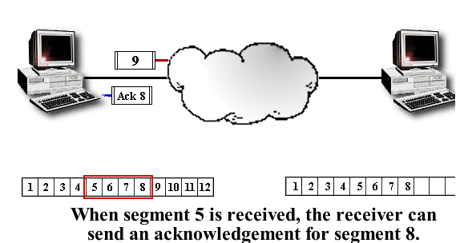
Sliding window with lost segment

Slide 31
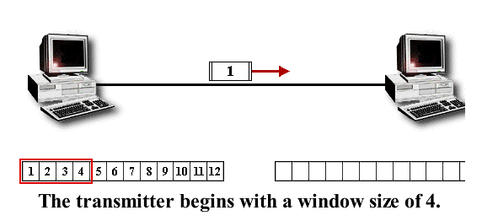
Flow control with sliding window

Slide 32
Silly window syndrome
Under some circumstances, sliding window can result in transmission of many small segments
If receiver window full, and receiving application consumes a few data bytes, receiver will advertise small window
Sender will immediately send small segment to fill window
Inefficient in processing time and network bandwidth
Solutions:
  Receiver delays advertising new window
  Sender delays sending data when window is small

Slide 33
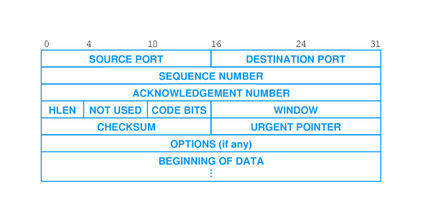
TCP segment format
Same header format used in both directions
Segment can carry both data and acknowledgment

Slide 34
Three-way handshake
TCP uses three-way handshake for reliable connection establishment and termination
  Host 1 sends segment with SYN bit set and random sequence number
  Host 2 responds with segment with SYN bit set, acknowledgment to Host 1 and random sequence number
  Host 1 responds with acknowledgment
TCP will retransmit lost segments
Random sequence numbers ensure synchronization between endpoints

Slide 35
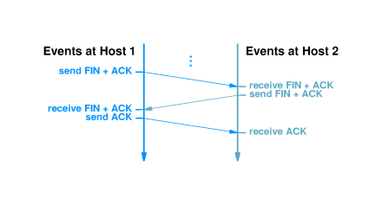
Closing a connection

Slide 36
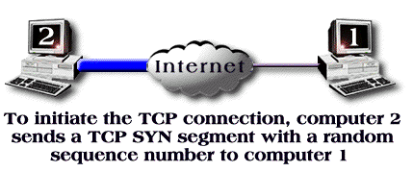
Opening a connection

Slide 37
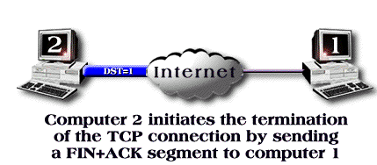
Closing a connection

Slide 38
Congestion control
Excessive traffic can cause packet loss
  Transport protocols respond with retransmission
  Excessive retransmission can cause congestion collapse
TCP interprets packet loss as an indicator of congestion
Sender uses TCP congestion control and slows transmission of packets
  Sends single packet
  If acknowledgment returns without loss, sends two packets
  When TCP sends one-half window size, rate of increase slows

Slide 39
Summary
UDP provides end-to-end best-effort message delivery
  IP used for delivery to destination host
  Protocol ports demultiplex to destination application
TCP provides end-to-end reliable bytestream delivery
  IP used for delivery to destination host
  Protocol ports demultiplex to destination application
  Additional techniques develop reliable delivery from IP messages
Positive acknowledgment with retransmission

Slide 40
Sequence numbers detect missing, duplicate and out-of-order data
Sliding window flow control
Three-way handshake
Congestion control

