Slide 1
Chapter 22 a– Internet Routing
Page Number Title
1 Introduction
2 Static Vs. Dynamic Routing
3 Static Routing in Hosts and A Default Route
4 Dynamic Routing and Routers
5 Routing in The Global Internet
6 Autonomous Systems Concept
7 The Two Types of Internet Routing Protocols
8 Routes and Data Traffic
9 The Border Gateway Protocol (BGP)
10 The Routing Information Protocol (RIP)

Slide 2
11 RIP Packet Format
12 The Open Shortest Path First Protocol (OSPF)
13 An Example OSPF Graph
14 OSPF Areas
15 Multicast Routing
16 Summary

Slide 3
Introduction
Previous chapters describe fundamental concept of datagram forwarding, and explains how IP uses a routing table to forward datagrams.
This chapter explores internetworking technology:
  The propagation of routing information that is used to create and update routing tables.
How routing tables built initially, and explains how routing software the tables as needed.
This chapter focused on the propagation of routing information in global Internet.
Routing information exchange, and then describes several routing update protocols.

Slide 4
Static Vs. Dynamic Routing
IP routing can be partitioned into two broad categories: static and dynamic routing.
Routes are called static if they do not change; loaded when system starts and routes does not change unless an error is detected.
Dynamic routing refers to a system that can change routing information over time; begins exact like static routing.
The system also start route propagation software, which called routing software when it boots.
The routing software interact with routing software on other computers to learn about optimal routing routes and updates the local routing tables to follow optimal routes.

Slide 5
Static Routing in Hosts and A Default Route
Static routing is straight forward, easy to specify, and does not require extra routing software.
It does not consume bandwidth,
And no CPU cycles required to propagate the routing information.
However, static routing is relatively inflexible; it cannot accommodate failures or changes in topology.
Generally, this networks is used to connect a single router to rest of internets, (simple sub-networks).
Figure 25.1 illustrates a typical example.
The routing table in a host is quite simple.

Slide 6
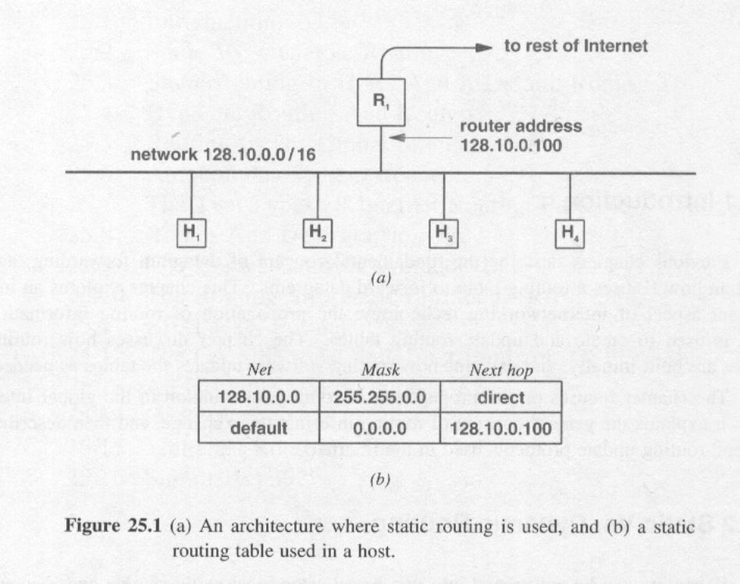
Figure 25.1

Slide 7
When an application generates a datagram for a computer on the local net, the first entry is used in the routing table direct IP to deliver the datagram directly to its destination.
When a datagram is destined for any other network, the second entry in the table directs IP to send the datagram to the router.
Most PCs use static routing table.
When configuring IP software on a PC, a user enters a network prefix, a subnet mask and a address of default IP router.
When PC boots, the operating system reads three values.
Most hosts use satanic routing. The host routing table contained two entries one for the network to which the hosts attached and a default entry that directs all other traffic to a specific router.

Slide 8
Dynamic Routing and Routers
Can the global Internet use static routing?
Yes?, How large is the routing table?
The answer is complex and most routers are dynamic.
An ISP (Internet Service provider) All traffics the customer’s site through router R1 must travel to ISP across the DSL connection in figure 25.1.
Consider three networks as figure 25.2 illustrates.
Net 1 inter connects the networks, R1 does not know about Net 3 because there is no direct connection (and route r2 does not know Net 2).

Slide 9
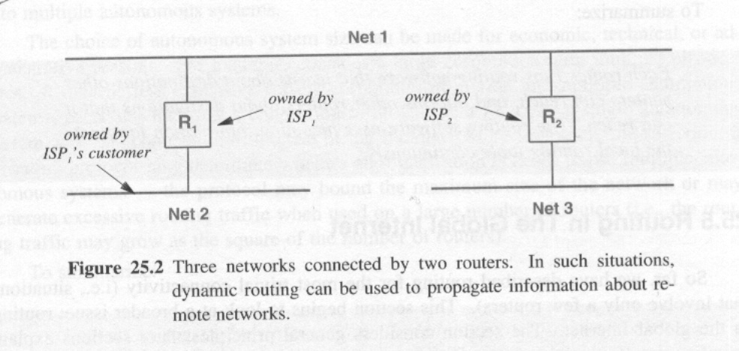
Figure 25.2

Slide 10
Here ISPs have hundreds or thousands of customers (this can not be managed manually). Because this may produce delay fails, accidental unplugging, congestion and slows down the network.
To ensure that all routers maintain information about how to reach each possible destinations.
Each router must run software that ensures this.
The routing software updates the local routing tables. (routers changes information periodically).
If one router crashes other router detects and makes unreachable and removes the route from the table. When it comes back updates the table.
Each router runs routing software that learns about the destinations other routers can reach, and informs other routers about the destination that it can reach. The routing software uses incoming information to update to local routing continuously.

Slide 11
Routing in The Global Internet
This section begins to look at broader issue: routing in the global Internet; general principles, later sections explain specific route propagation protocols.
Propagation protocols allows the user exchange routing information with another.
Routers and networks in the Internet are divided into groups.
All routers in a group exchanges routing information.
Then, at least one router in each group summarizes the information before passing it to other groups.

Slide 12
How large is a group? Did not indicate exact size (variable maximum and minimum size for a group) nor did they specify an exact data representation or protocol..
What protocol do routers use within a group
How is routing information represented?
What protocol do router use between groups?
Each organization choose routing protocols independently ( to handle wide range of organization and flexibility).

Slide 13
Autonomous Systems Concept
Groups are Autonomous Systems (AS).
Router all under control of one administrative authority (sufficiently flexible to accommodate many possibilities).
Each ISP is single AS. But it is possible for large ISP to divide itself into multiple autonomous systems.
Routers in the global Internet are divided into groups, where each group is known as an autonomous system. The routers within an autonomous system exchanges routing information, which is then summarized before being passed to another group.

Slide 14
The Two Types of Internet Routing Protocols
Internet routing can be defined more precisely.
All routing protocols fall into one of two categories.

Slide 15
Interior Gateway Protocols (IGPs)
The routers within an autonomous system use an Interior Gateway Protocol (IGP) to exchange routing information.
There are several IGPs.
An IGP is easy to install and operate, but an IGP may limit the size or routing complexity of an autonomous system.

Slide 16
Exterior Gateway Protocol (EGPs)
A router uses an Exterior Gateway Protocol (EGP) to exchange routing information with a router in another autonomous system.
Complex to install but offer more flexible and lower overhead (less traffic).
EGP summarizes routing information before passing it EGP implement policy constrains that allow a system manager to determine exactly what information is released outside the organization.

Slide 17
When EGPs and IGPs are used
AS1 chooses IGP1.
And AS2 chooses IGP2.
All router in AS1 communicate using IGP1.
All router in AS2 communicate using IGP2.
R1 must summaries information and send the summary to r4.
R1 also accepts summary from R4.

Slide 18
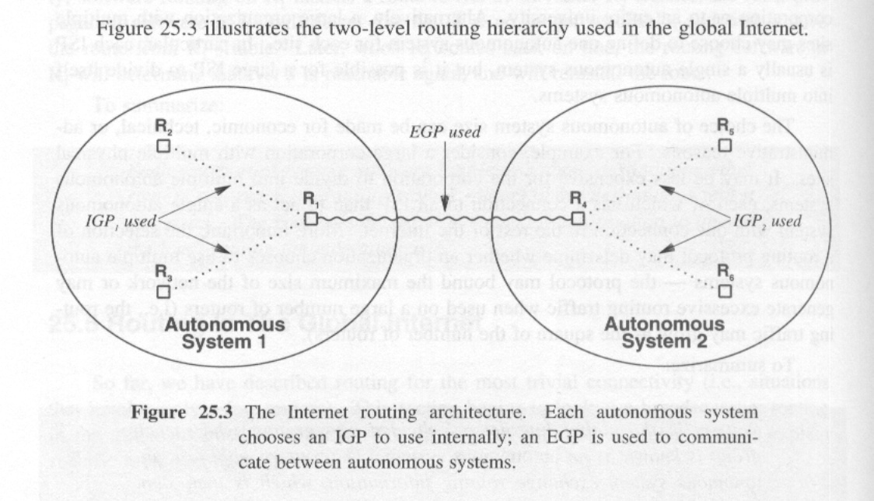
Figure 25.3

Slide 19
Optimal Router, Routing metrics and IGPs
Routing software should find all possible paths and then choose one that is optimal.
For an interactive login application, a path with least delay is optimal.
For a browser, maximum throughput is optimal.
For an audio webcast application, least jitter is optimal.
The term routing metric refers to a measure of the path that routing software uses when choosing a route.
It is possible to use throughput, jitter, and delay.
Combination of metrics also can be used: administrative cost and hop count (routers).
IPG and EPG differs in an important way with respect to routing metrics. IPGs use routing metrics but EPGs do not.

Slide 20
EPGs summarized the information and does not to attempt to chose an optimal path.
Within an autonomous system, IPG software uses a routing metric to choose an optimal path to each destination. EPG software finds a path to each destination, but cannot find an optimal path because it cannot compare routing metrics from multiple autonomous systems.

Slide 21
Routes and Data Traffic
An aphorism (söz, deyiş)in networking suggest that the response to a routing advisement is data.
The data traffics for a given destination flows in exactly the opposite direction of routing traffic.
ISP1 contains network N. Before traffic can arrive destination N for N ISP1 must adverse a route to N.
This is illustrated in figure 25.4.

Slide 22
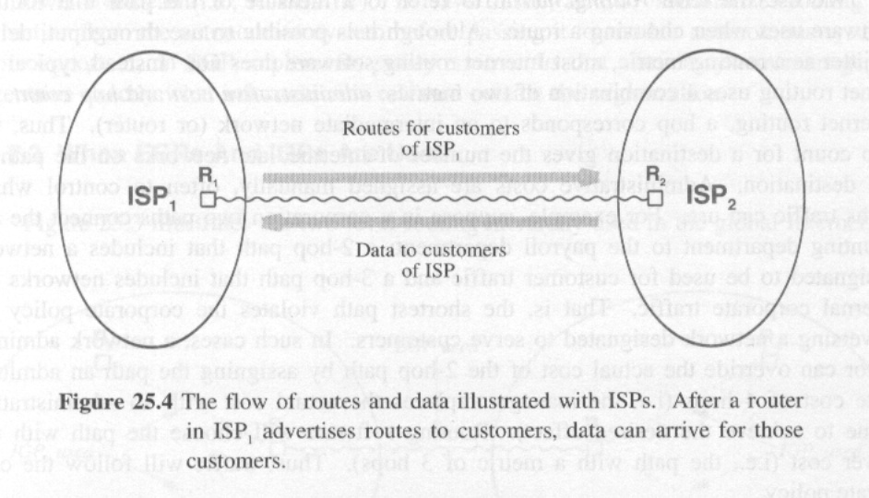
Figure 25.4

Slide 23
The Border Gateway Protocol (BGP)
One protocol has emerged as the most popular EGP in internet.
Known as the Border Gate Protocol (BGP), BGP4 is often used.
BGP has following characteristics;
  Routing Among Autonomous Systems;BGP provided routing information at the autonomous system level.
  Provision For Policies; BGP allows the sender and receivers to enforce policies; Restricts advertencies to outside.
  Facilities For Transit Routing; BGP allow a corporation.

Slide 24
  Reliable Transport; BGP uses TCP for all communication.
Central database of routing information is maintained to ensure that routing remain consistent.
This is known as routing arbiter system.
Version 4 of Border gateway protocol (BGP-4) is the exterior gate protocol used to exchange routing information among autonomous systems in the global Internet.
ISPs use BGP-4 to obtain routing information from each other an from an authoritative route server. Because all ISPs participates, a datagram from an arbitrary computer to an arbitrary destination will be forwarded correctly.

Slide 25
The Routing Information Protocol (RIP)
Although BGP-4 provides routing exchange among autonomous systems, additional Interior Gateway Protocol is needed to allow routers to pass such information within an autonomous systems. Two protocols are exist; Routing Information Protocol (RIP) (Unix originated) and OSPF.
RIP has these characteristics;
  Routing within an autonomous systems.
  Hop count metrics. RIOP measures distance in network hops.
  Unreliable Transport; RIP uses UDP.
  Broadcast Or multicast Delivery.

Slide 26
  Support for default route propagation.
  Distance vector algorithm.
  Passive version for hosts; pass,ve RIP listen and updates.
RIP is simple.
RIP requires little configuration RIP also handles the propagation of a default router.
(Read the section)

Slide 27
RIP Packet Format
RIP packet format is shown in figure 25.5.
The format will help to illustrate how distance vector protocol operates.
RIP is an Interior Gateway Protocol that uses a distance vector algorithm to propagate routing information. A route running RIP advertises the destinations it can reach along with a distance to each destination adjacent routers receive the information and update their routing tables.

Slide 28
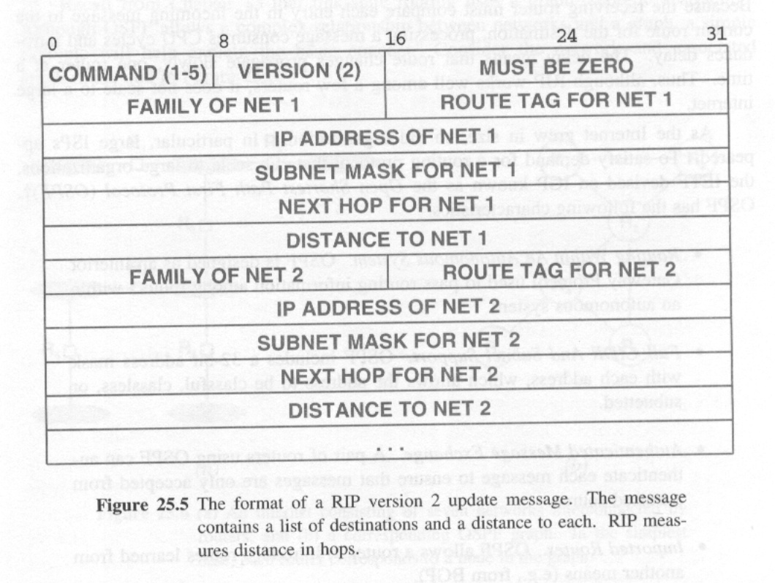
Figure 25.5

Slide 29
The Open Shortest Path First Protocol (OSPF)
Each message contains a complete list of destination and distances, and messages are large.
RIP works well among a few routers but delays are possible for large scale organizations.
For large scale organizations, an IGP known as OSPF is used and has following characteristics.
  Routing within an autonomous system. IGP passes routing information within AS (Autonomous system).
  Full CIDR and subnet support. OSPF includes a 32 bit address mask with each address, which allows the address to be classfull, classless, or subnetted in (CIDR standard).

Slide 30
  Authenticated Message Exchange; accept messages from thrusted source.
  Imported routes; OSFP allow to learn routes from another BGP.
  Link-state algorithm.
  Support for multi access Networks;
  OSPF is an Interior Gateway Protocol that uses a link-state algorithms to propagate routing information. Each routers participating in OSPF must periodically probe adjacent routers and then broadcast a link-state message; routers that receive the message use Dijkstra’s SPF algorithm to compute shortest path.

Slide 31
An Example OSPF Graph
The link-state routing uses a graph-theoretic abstraction. OSPF allows a complex relationship between networks and a graph.
Consider the network in the following figure 25.6.
Each node corresponds a router. Each connected router probes one another periodically.
And broadcast link-status messages to other routers.
All routers receive the broadcast message; each uses the message to update its local copy of the graph and recomputed shortest paths when the status changes.

Slide 32
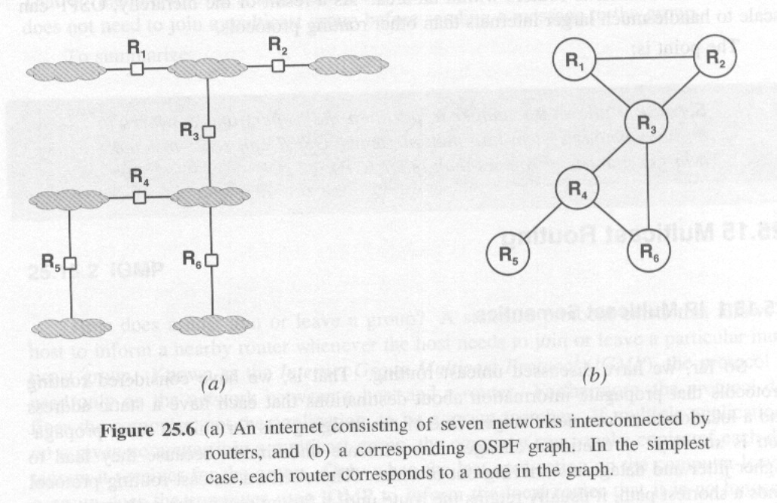
Figure 25.6

Slide 33
OSPF Areas
To achieve a hierarchy, OSPF allows an AS to be partitioned for routing purpose.
Because it allows a manager to partition the routers and networks in an AS into multiple areas, OSPF can scale to handle a large number of routers than other IGPs.

Slide 34
Multicast Routing
IP Multicast Semantics.
IGMP.
IP Multicast Semantics.
Forwarding and discovery techniques.
Multicast Protocols

Slide 35
IP Multicast Semantics
Propagation multicast routing information differs dramatically from uni-cast route propagation.
The IP multicast abstraction allows an application running on an arbitrary computer to:
  Join a multicast group at any time and begin receiving a copy of all packets sent to group .
  Leave a multicast group at any time.
Membership in an IP multicast group is dynamic: a computer can join or leave a group at any time. Group membership defines a set of receivers; an arbitrary application can send a datagram to the group even if the application is not a group member.

Slide 36
IGMP
A standard protocol exist that allows a host to inform a nearby router whenever the host needs to join or leave a particular multicast group.
Internet Group Multicast Protocol (IGMP).

Slide 37
Forwarding and discovery techniques
To accommodate dynamic membership, multicast protocol must be able to change routing quickly and continually.
In practice multicast protocols have followed three different approaches for datagram forwarding:
  Flood-and prune; is suitable for small groups, this technique floods the datagrams but reverse path broadcasting technique uses to prevent cycles.
  Configuration- and tunneling; is suitable for geographically disperse groups, when multi cast datagrams arrives, the router at a site transmit the datagram on all directly attached LANs via hardware multicasts. The router uses IP in IP tunneling to transfer a copy of multicast datagrams to other sites.

Slide 38
Multicast Protocols
Distance vector multicast routing protocol (DVMRP).
Core based trees (CBT); a multicast routing schema.
Protocol Independent multicast- sparse mode (PIM-SM; form multicast tree for multicast routing.
Protocol independent multicast- Dense Mode (PIM-DM); designed to use in an organization ,broadcast multicast packets to all directions.
Multicast extension to the Open Shortest Path First protocol (MOSPF); designed to use in an organization, Uses OSPS structure.
The dynamic characteristics of Internet multicast make the problem of multicast route propagation difficult. Although many protocols have been proposed, the Internet does not currently have an Internet-wide multicast routing facilities.

Slide 39
Summary
Both hosts and routers contain an IP routing table.
Most host uses static routing tables; initialized at system startup.
Router and some host uses dynamic routing.
Routing tables are initialized and updated constantly.
EPGs and IPGs exchanges routing information.
BGP and RIP are popular protocols.
Dynamic group membership is allowed for multicast.
Many multicast Internet protocols are available but Internet-wide multicast technology does not exist.

