Slide 1
Chapter 25 - Client/Server Example

Slide 2
Page Number Title
1 Introduction
2 Connection-oriented communication
3 An example service
4 Example programs
5 Program architecture
6 Server
7 Client
8 Client calls to recv
9 Sockets and blocking
10 Using client with another server
11 Using another client with server
12 Summary

Slide 3
Introduction
Will examine details of client and server programs
Examples use socket API
Will illustrate details of socket use
Will also illustrate program architecture

Slide 4
Connection-oriented communication
Client/server developer must choose between connectionless and connection-oriented service
  Connectionless can be used at any time; does not provide reliability
  Connection-oriented requires explicit connection; provides reliable data delivery
This example will use connection-oriented transport
  Server contacts local protocol software to accept incoming connections
  Client establishes connection to server through client's local protocol software
Client and server exchange data once connection is established

Slide 5
An example service
Server
  Keeps track of how many times it has been contacted
  Returns that count in an ASCII string
Client
  Establishes connection
  Waits for message from server (ASCII string)
  Prints data from message
Application-level protocol:
  Syntax:
    No headers
    Client sends null message body
    Server message contains ASCII string
  Semantics - Client establishes connection; server returns ASCII string

Slide 6
Example programs
Example server in server.c
  Runs as background program
  Takes single (optional) command line argument: port number to listen on (default is 5193)
Example client in client.c
  Runs as user program
  Takes two (optional) command line arguments: name of host to contact (default is localhost) and port number to contact (default is 5193)

Slide 7
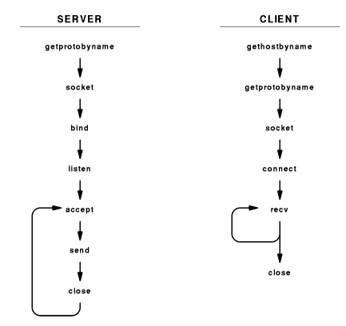
Program architecture
Sequence of socket calls in server and client

Slide 8
Server
Initialization:
  getprotobyname - looks up protocol number for TCP
  socket - creates socket
  listen - associates socket with incoming requests
Loop:
  accept - accepts incoming connection
  send - send message to client
  close - closes connection socket

Slide 9
Client
Initialization:
  gethostbyname - looks up server
  getprotobyname - looks up protocol port number for TCP
  socket - creates socket
  connect - connects to server port
Loop:
  recv - receives message from server
Termination:
  close - closes socket

Slide 10
Client calls to recv
The call to recv is in a loop in the client
But, the server send only a single message - why would multiple calls be required?
Protocol software does not guarantee to deliver data to receiver in the same blocks as generated by the server
  May travel in different segments
  recv need not return as much data as was requested
Client must make repeated calls to recv until 0 returned

Slide 11
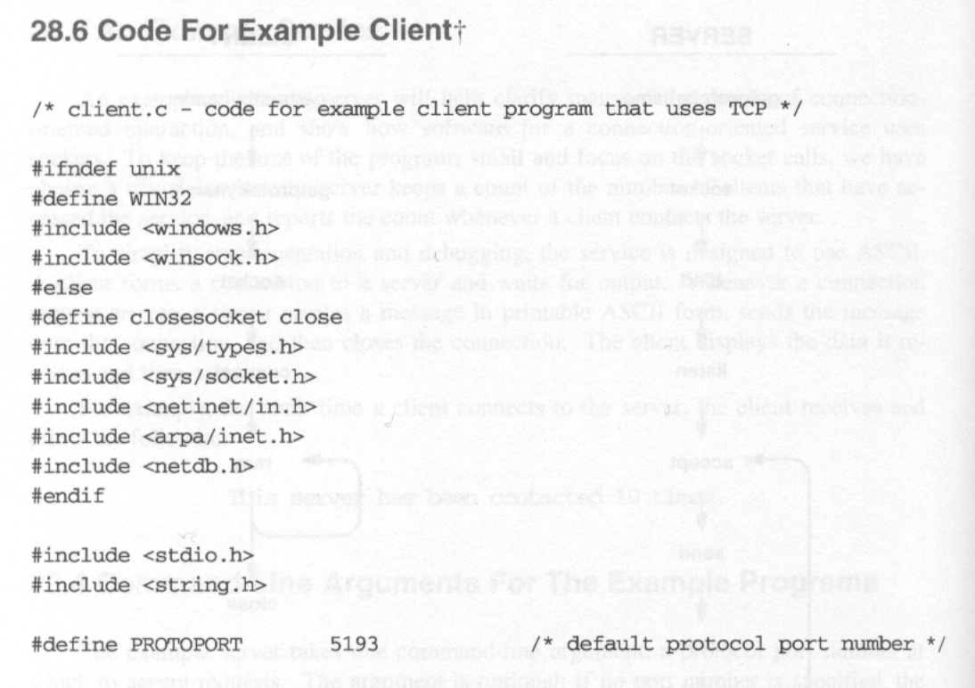
Code for Example Client

Slide 12
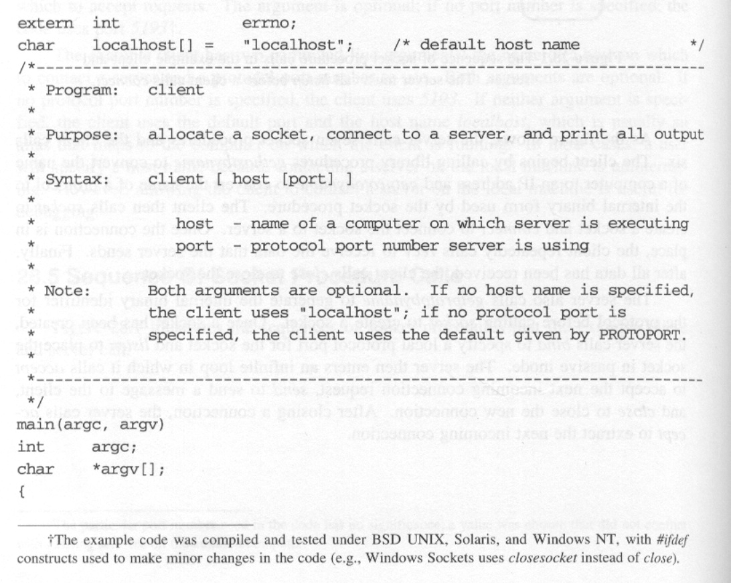

Slide 13
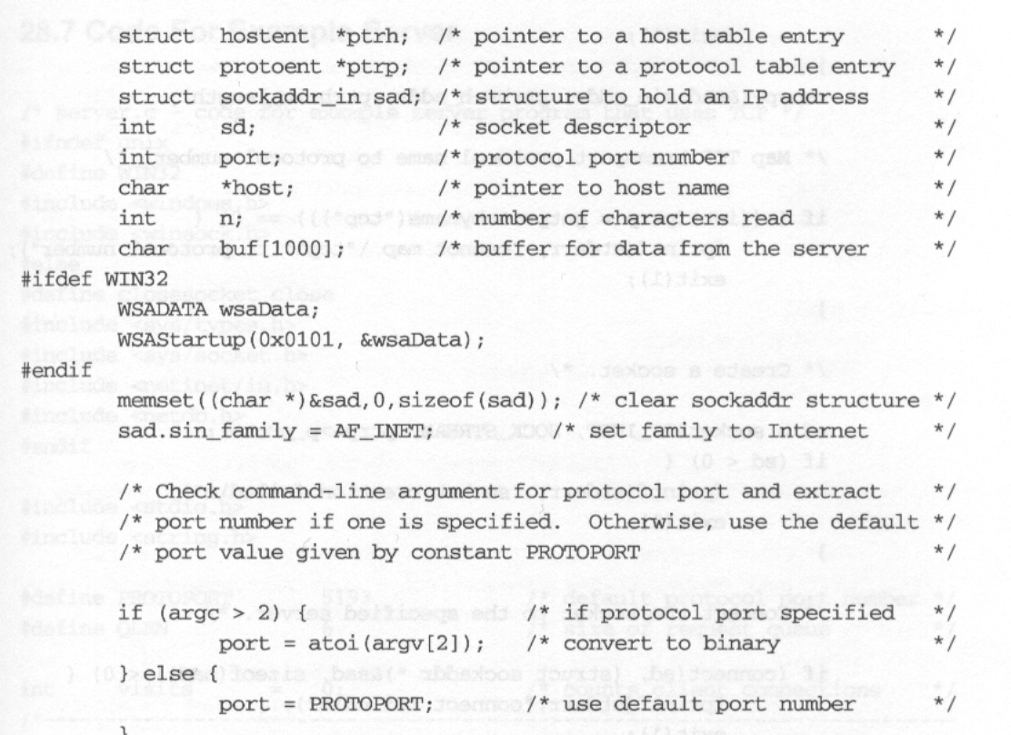

Slide 14
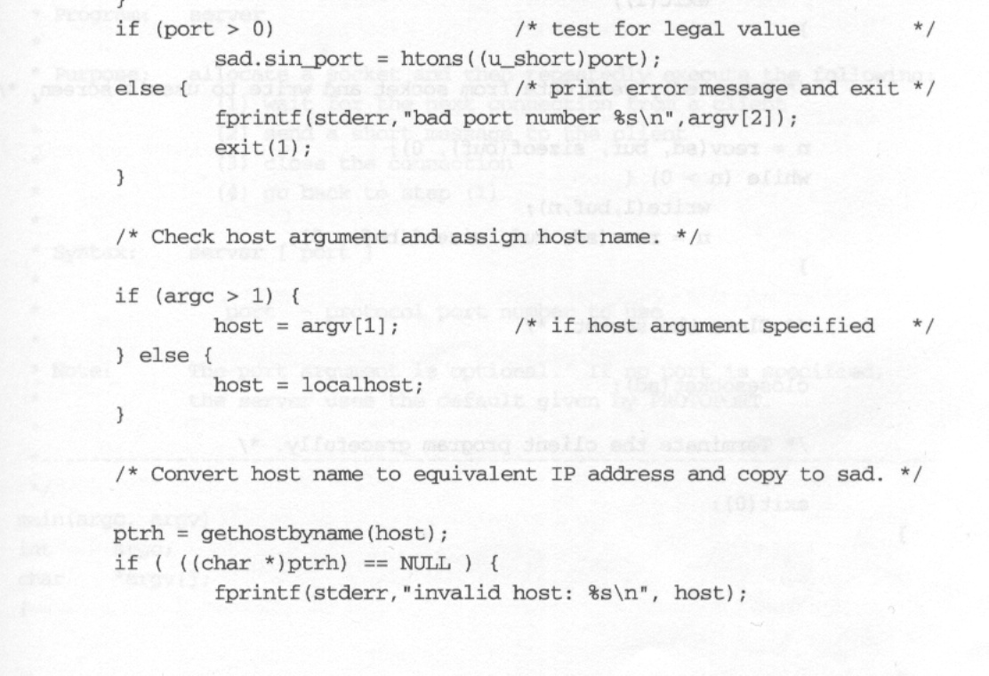

Slide 15
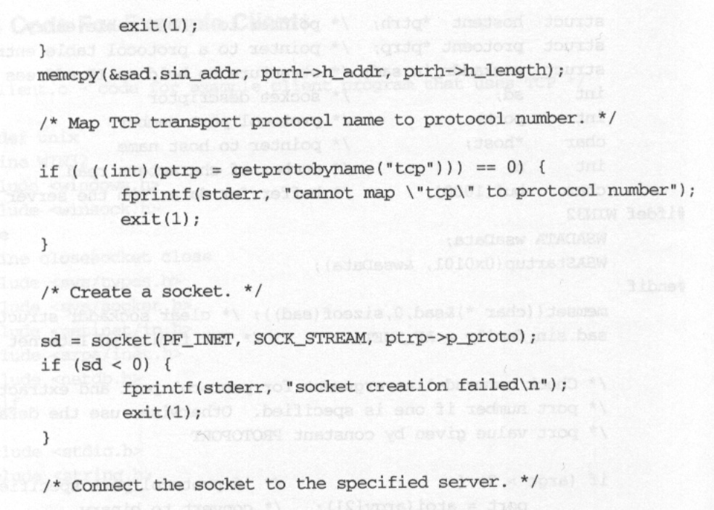

Slide 16
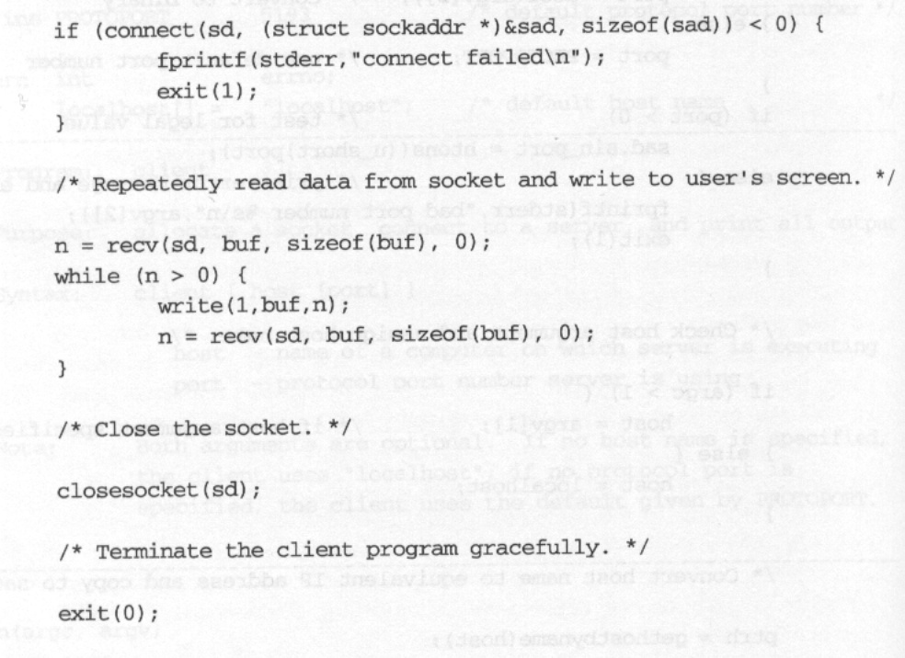
}

Slide 17
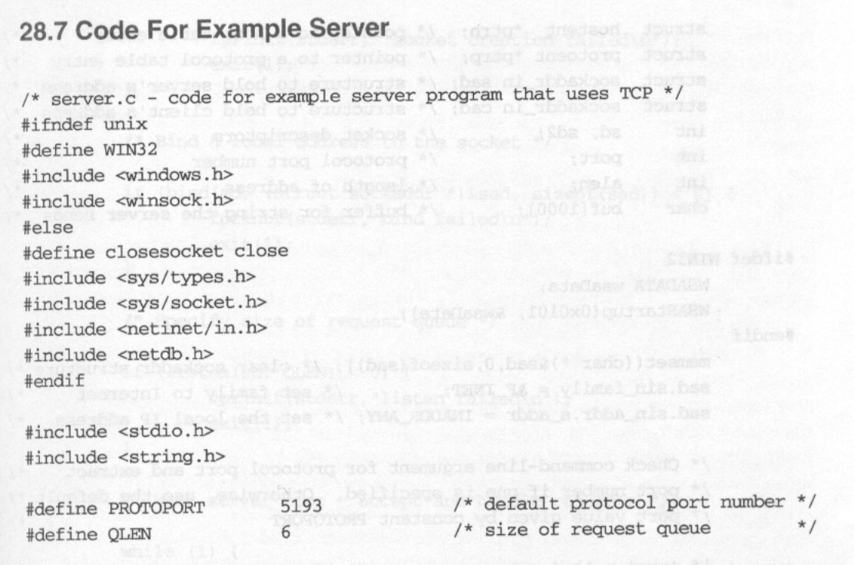
Code for Example Server

Slide 18
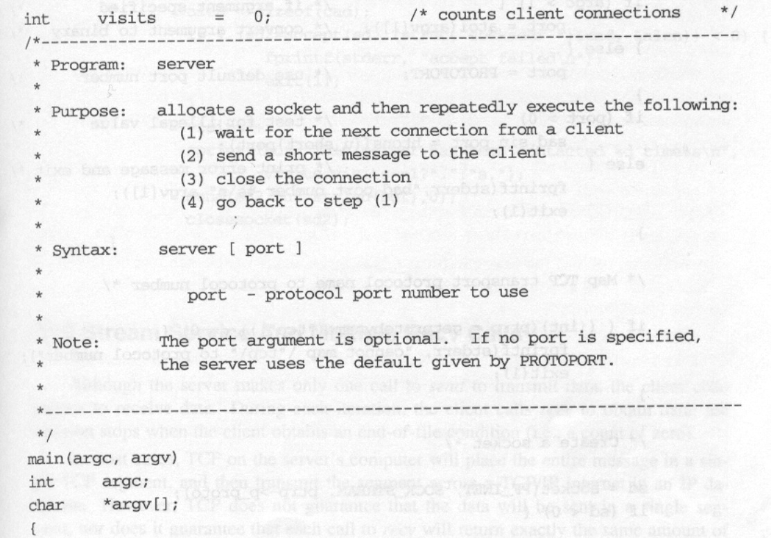

Slide 19
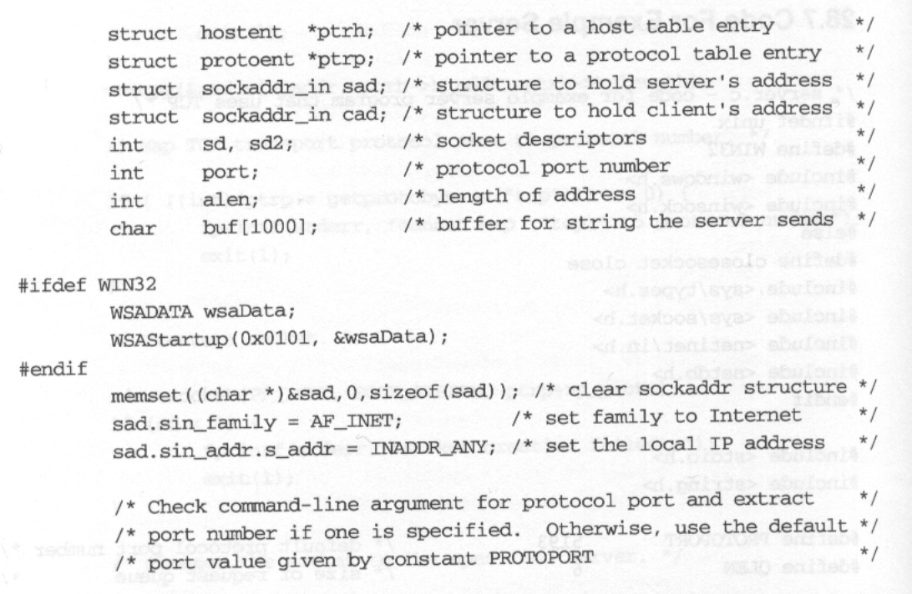

Slide 20
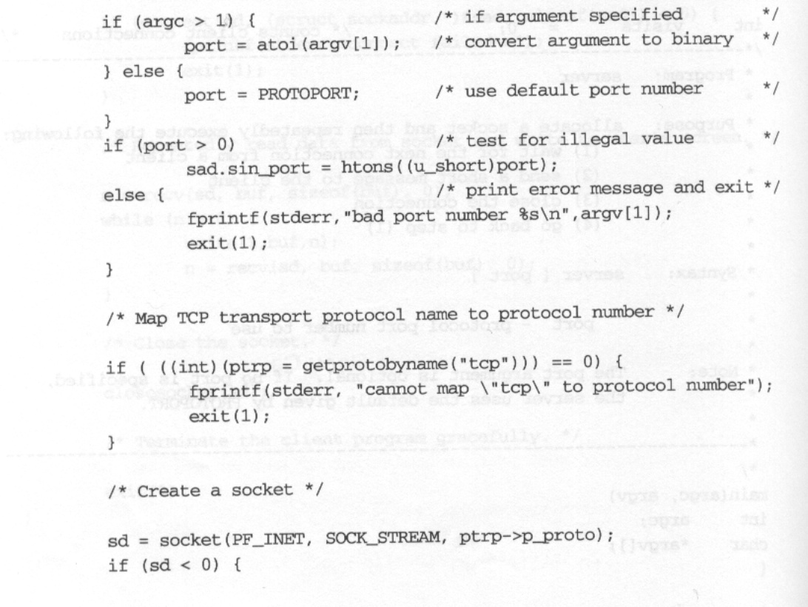

Slide 21
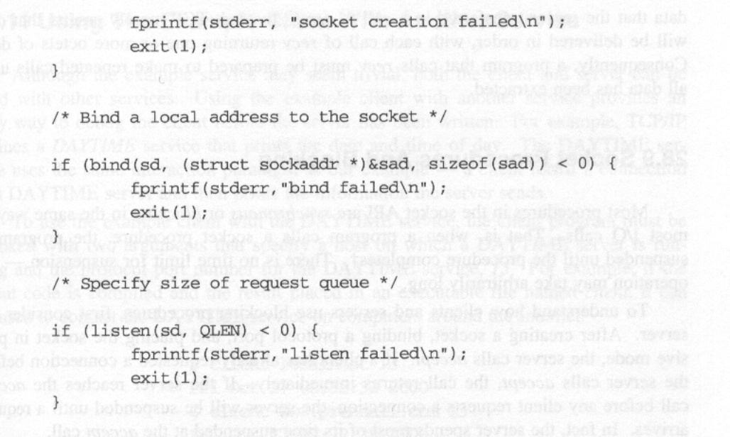

Slide 22
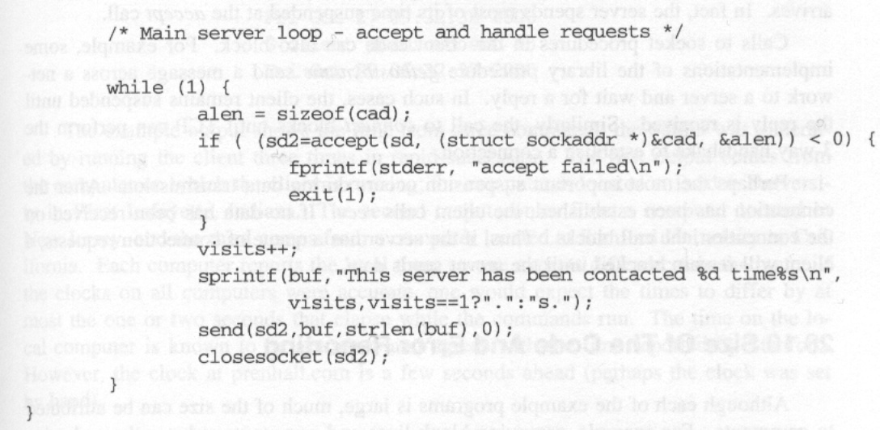

Slide 23
Sockets and blocking
Most socket calls are blocking
Calling process is blocked (taken off ready queue) until socket operation completes
Server blocks:
  accept until new connection arrives
  send until data delivered to protocol software
Client blocks:
  gethostbyname until DNS resolves server name
  recv until message delivered from server

Slide 24
Using client with another server
Other services use similar application protocol:
  DAYTIME
  CHARGEN
  MOTD
Specifying port connects to alternate services
Example:
$ client www.netbook.cs.purdue.edu
13Thu Feb 27 15:19:06 1997
$ client leo.eg.bucknell.edu
13Thu Feb 27 15:19:18 1997
$ client merlin.cs.purdue.edu
13Thu Feb 27 15:19:26 1997
$ client cs.ucla.edu 13Thu Feb 27 12:20:28 1997
$ client uran.informatik.uni-bonn.de
13Thu Feb 27 21:22:37 1997
$ client yotaga.psu.ac.th 13
Fri Feb 28 03:24:20 1997

Slide 25
Using another client with server
Other client that uses same application protocol can test server
Example: telnet
$ telnet www.netbook.cs.purdue.edu
5193Trying 134.82.11.70 ...
Connected to regulus.eg.bucknell.edu.
Escape character is '^]'.
This server has been contacted 5 times.
Connection closed by foreign host.

Slide 26
Summary
Example client and server
  Connection-oriented transport
  Very simple application protocol
Demonstrates use of socket calls
Can be used with other clients and servers

