Slide 1
Chapter 26 - the Domain Name System

Slide 2
Page Number Title
1 Introduction
2 Structure of DNS names
3 DNS naming structure
4 Geographic structure
5 Domain names within an organization
6 Example DNS hierarchy
7 DNS names and physical location
8 Client-server computing
9 DNS and client-server computing
10 DNS server hierarchy
11 Choosing DNS server architecture
12 Name resolution
13 DNS messages
14 DNS servers
15 Using DNS servers
16 DNS caching
17 Types of DNS entries
18 Abbreviations
19 Summary

Slide 3
Introduction
IP assigns 32-bit addresses to hosts (interfaces)
  Binary addresses easy for computers to manage
  All applications use IP addresses through the TCP/IP protocol software
  Difficult for humans to remember:
% telnet 134.82.11.70
The Domain Name System (DNS) provides translation between symbolic names and IP addresses

Slide 4
Structure of DNS names
Each name consists of a sequence of alphanumeric components separated by periods
Examples:
www.eg.bucknell.edu
www.netbook.cs.purdue.edu
charcoal.eg.bucknell.edu
Names are hierarchical, with most-significant component on the right
Left-most component is computer name

Slide 5
DNS naming structure
Top level domains (right-most components; also known as TLDs) defined by global authority
com Commercial organization
edu Educational institution
gov Government organization
mil Military organization
Organizations apply for names in a top-level domain:
bucknell.edu
macdonalds.com
Organizations determine own internal structure
eg.bucknell.edu
cs.purdue.edu

Slide 6
Geographic structure
Top-level domains are US-centric
Geographic TLDs used for organizations in other countries:
TLD Country
.uk United Kingdom
.fr France
.ch Switzerland
.in India
Countries define their own internal hierarchy: ac.uk and .edu.au are used for academic organizations in the United Kingdom and Australia

Slide 7
Domain names within an organization
Organizations can create any internal DNS hierarchy
Uniqueness of TLD and organization name guarantee uniqueness of any internal name (much like file names in your directories)
All but the left-most component of a domain name is called the domain for that name:

Slide 8
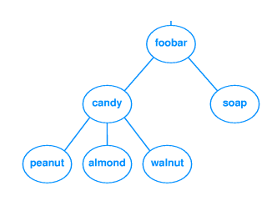
Name Domain
www.netbook.cs.purdue.edu netbook.cs.purdue.edu
regulus.eg.bucknell.edu eg.bucknell.edu
coral.bucknell.edu bucknell.edu
Authority for creating new subdomains is delegated to each domain
Administrator of bucknell.edu has authority to create eg.bucknell.edu and need not contact any central naming authority
Example DNS hierarchy

Slide 9
DNS names and physical location
DNS domains are logical concepts and need not correspond to physical location of organizations
DNS domain for an organization can span multiple networks
  bucknell.edu covers all networks at Bucknell
  www.netbook.cs.purdue.edu is in 318 Dana
  laptop.eg.bucknell.edu could be connected to a network in California

Slide 10
Client-server computing
Clients and servers communicate in distributed computing
  Client initiates contact to request some remote computation
  Server waits for clients and answers requests as received
Clients are usually invoked by users as part of an end-user application
Servers are usually run on central, shared computers

Slide 11
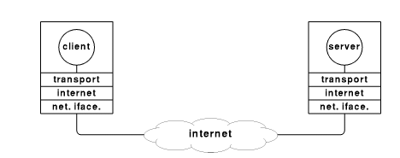
DNS and client-server computing
DNS names are managed by a hierarchy of DNS servers
Hierarchy is related to DNS domain hierarchy

Slide 12
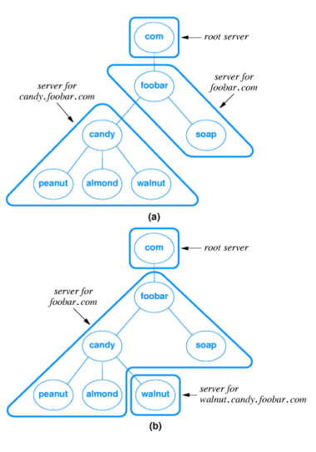
Root server at top of tree knows about next level servers
Next level servers, in turn, know about lower level servers

Slide 13
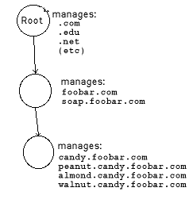
DNS server hierarchy

Slide 14
Choosing DNS server architecture
Small organizations can use a single server
  Easy to administer
  Inexpensive
  Large organizations often use multiple servers
  Reliability through redundancy
  Improved response time through load-sharing
  Delegation of naming authority
Locality of reference applies - users will most often look up names of computers within same organization

Slide 15
Name resolution
Resolver software typically available as library procedures
  Implement DNS application protocol
  Configured for local servers
  Example - UNIX gethostbyname
Calling program is client
  Constructs DNS protocol message - a DNS request
  Sends message to local DNS server
DNS server resolves name
  Constructs DNS protocol message - a DNS reply
  Sends message to client program and waits for next request

Slide 16
DNS messages
DNS request contains name to be resolved
DNS reply contains IP address for the name in the request

Slide 17
DNS servers
Each DNS server is the authoritative server for the names it manages
If request contains name managed by receiving server, that server replies directly
Otherwise, request must be forwarded to the appropriate authoritative server

Slide 18
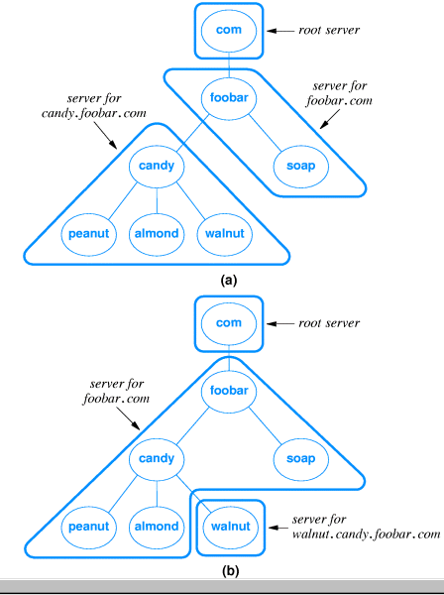

Slide 19
Using DNS servers
DNS request is forwarded to root server, which points at next server to use
Eventually, authoritative server is located and IP address is returned
DNS server hierarchy traversal is called iterative resolution
Applications use recursive iteration and ask DNS server to handle traversal

Slide 20
DNS caching
DNS resolution can be very inefficient
  Every host referenced by name triggers a DNS request
  Every DNS request for the address of a host in a different organization goes through the root server
Servers and hosts use caching to reduce the number of DNS requests
  Cache is a list of recently resolved names and IP addresses
  Authoritative server include time-to-live with each reply

Slide 21
Types of DNS entries
DNS can hold several types of records
Each record includes
  Domain name
  Record type
  Data value
A records map from domain name to IP address
  Domain name - regulus
  Record type - A
  Data value - 134.82.56.118
Other types:
  MX (Mail eXchanger) - maps domain name used as e-mail destination to IP address
  CNAME - alias from one domain name to another
Result - name that works with one application may not work with another!

Slide 22
Abbreviations
May be convenient to use abbreviations for local computers; e.g. coral for coral.bucknell.edu
Abbreviations are handled in the resolver; DNS servers only know full-qualified domain names (FQDNs)
Local resolver is configured with list of suffixes to append
Suffixes are tried sequentially until match found

Slide 23
Summary
Domain Name System maps from computer names and IP addresses
Important to hide 32-bit IP addresses from humans
DNS names are hierarchical and allocated locally
Replication and caching are important performance enhancements
DNS provides several types of records

