Slide 1
Chapter 27 - Electronic Mail

Slide 2
Page Number Title
1 Introduction
2 Electronic mail paradigm
3 Electronic mailboxes
4 E-mail addresses
5 Networked e-mail addresses
6 Internet mail addressing
7 E-mail message format
8 E-mail headers
9 E-mail example
10 E-mail headers
11 Data in e-mail
12 MIME

Slide 3
13 MIME (continued)
14 Programs as mail recipients
15 Mail transfer
16 SMTP
17 SMTP protocol exchange
18 Multiple recipients on one computer
19 Mailing lists and forwarders
20 Mail gateways
21 Mail gateways and forwarding
22 Mail gateways and e-mail addresses
23 Mailbox access
24 Mail access protocols
25 POP and dialup access
26 Summary

Slide 4
Introduction
Many user applications use client-server architecture
Electronic mail client accepts mail from user and delivers to server on destination computer
Many variations and styles of delivery

Slide 5
Electronic mail paradigm (Örnek, Numune)
Electronic version of paper-based office memo
  Quick, low-overhead written communication
  Dates back to time-sharing systems in 1960s
Because e-mail is encoded in an electronic medium, new forms of interaction are possible
  Fast
  Automatic processing - sorting, reply
  Can carry other content

Slide 6
Electronic mailboxes
E-mail users have an electronic mailbox into which incoming mail is deposited
User then accesses mail with a mail reader program
Usually associated with computer account; one user may have a different electronic mailboxes

Slide 7
E-mail addresses
Electronic mailbox is identified by an e-mail address
Typically user's account ID, although not always
On non-networked multi-user computer, e-mail address is just account ID (no need to identify computer)

Slide 8
Networked e-mail addresses
Mail delivery among networked computers is more complicated
Must identify computer as well as mailbox
Syntactically, e-mail address is composed of computer name and mailbox name
Common example - user@host
Other:
  host1!host2!host!user
  host%user

Slide 9
Internet mail addressing
User portion is site-specific
  droms
  Ralph_E._Droms
  578.4309
Host portion is domain name
Source mail client
  Resolves destination name using DNS (MX, if available)
  Contacts mail delivery server at destination
  Copies mail to server
Destination mail server
  Interprets user name according to local mailbox addresses
  Places mail in appropriate mailbox

Slide 10
E-mail message format
Simple two-part format:
  Header includes delivery information
  Body carries text of message
Header and body separated by blank line

Slide 11
E-mail headers
Lines of text in format keyword: information
keyword identifies information; information can appear in any order
Essential information:
  To: list of recipients
  From: sender
  Cc: list of copy recipients
Useful information:
  Reply-to: different address than From:
  Received-by: for debugging
Frivolous information:
  Favorite-drink: lemonade
  Phase-of-the-moon: gibbous

Slide 12
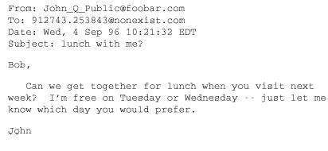
E-mail example

Slide 13
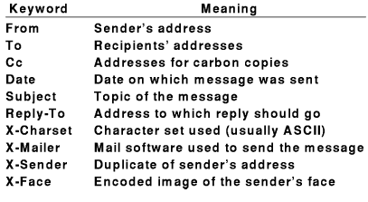
E-mail headers
Mail software passes unknown headers unchanged
Some software may interpret vendor-specific information

Slide 14
Data in e-mail
Original Internet mail carried only 7-bit ASCII data
Couldn't contain arbitrary binary values; e.g., executable program
Techniques for encoding binary data allowed transport of binary data
uuencode: 3 8-bit binary values as 4 ASCII characters (6 bits each)
  Also carries file name and protection information
  Incurs 33% overhead
  Requires manual intervention

Slide 15
MIME
Extends and automates encoding mechanisms - Multipart Internet Mail Extensions
Allows inclusion of separate components - programs, pictures, audio clips - in a single mail message
Sending program identifies the components so receiving program can automatically extract and inform mail recipient
  Header includes:
MIME-Version: 1.0Content-Type: Multipart/Mixed; Boundary=Mime_separator

Slide 16
  Separator line gives information about specific encoding
  Plain text includes:
Content-type: text/plain

Slide 17
MIME (continued)
MIME is extensible - sender and receiver agree on encoding scheme
MIME is compatible with existing mail systems
  Everything encoded as ASCII
  Headers and separators ignored by non-MIME mail systems
MIME encapsulates binary data in ASCII mail envelope

Slide 18
Programs as mail recipients
Can arrange for e-mailbox to be associated with a program rather than a user's mail reader
Incoming mail automatically processed as input to program.
Example - mailing list subscription administration
Can be used to implement client-server processing
  Client request in incoming mail message
  Server response in returned mail reply

Slide 19
Mail transfer
E-mail communication is really a two-part process:
  User composes mail with an e-mail interface program
  Mail transfer program delivers mail to destination
    Waits for mail to be placed in outgoing message queues
    Picks up message and determines recipient(s)
    Becomes client and contacts server on recipient's computer
    Passes message to server for delivery

Slide 20
SMTP
Simple Mail Transfer Protocol (SMTP) is standard application protocol for delivery of mail from source to destination
Provides reliable delivery of messages
Uses TCP and message exchange between client and server
Other functions:
  E-mail address lookup
  E-mail address verification

Slide 21
SMTP protocol exchange
220 coral.bucknell.edu Sendmail 5.65v3.0 (1.1.8.2/29Aug94-0956AM) Sat, 5 Apr 1997 06:47:12 –0500
HELO regulus.eg.bucknell.edu
250 coral.bucknell.edu Hello regulus.eg.bucknell.edu,
pleased to meet you
MAIL FROM: droms250 droms...
Sender okRCPT TO: droms250 droms...
Recipient okDATA354 Enter mail, end with "." on a line by itselfThis is a test mail message..
250 Ok
QUIT
221 coral.bucknell.edu closing connection

Slide 22
Multiple recipients on one computer
Suppose droms@bucknell.edu, zaccone@bucknell.edu and hyde@bucknell.edu are all recipients of a mail message
SMTP allows client to specify all three and deliver single copy of message
Server makes three copies for delivery

Slide 23
Mailing lists and forwarders
E-mail addresses can be attached to programs as well as electronic mailboxes
Mail exploder or mail forwarder resends copies of message to e-mail addresses in mailing list
    UNIX mail program sendmail provides simple mail aliases
    Mailing list processor, e.g., listserv, can also interpret subscription management commands

Slide 24
Mail gateways
Mailing list processing may take significant resources in large organization
May be segregated to a dedicated server computer: mail gateway
  Provides single mail destination point for all incoming mail
  e.g., bucknell.edu
  Can use MX records in DNS to cause all mail to be delivered to gateway

Slide 25
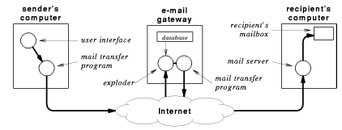

Slide 26
Mail gateways and forwarding
Users within an organization may want to read mail on local or departmental computer
Can arrange to have mail forwarded from mail gateway
Message now makes multiple hops for delivery
Hops may be recorded in header
Forwarded mail may use proprietary (non-SMTP) mail system

Slide 27
Mail gateways and e-mail addresses
Organization may want to use uniform naming for external mail
Internally, may be delivered to many different systems with different naming conventions
Mail gateways can translate e-mail addresses
Ralph_Droms droms@regulus.eg.bucknell.edu
Dan_Little dlittle@mail.bucknell.edu
Ruth_Miller miller@charcoal.eg.bucknell.edu

Slide 28
Mailbox access
Where should mailbox be located?
Users want to access mail from most commonly used computer
Can't always use desktop computer as mail server
  Not always running
  Requires multitasking operating system
  Requires local disk storage
Can TELNET to remote comptuer with mail server

Slide 29
Mail access protocols
Instead of TELNET, use prtocl that accesses mail on remote computer directly
TCP/IP protocol suite includes Post Office Protocol (POP) for remote mailbox access
  Computer with mailboxes runs POP server
  User runs POP client on local computer
  POP client can access and retrieve messages from mailbox
  Requires authentication (password)
  Local computer uses SMTP for outgoing mail

Slide 30
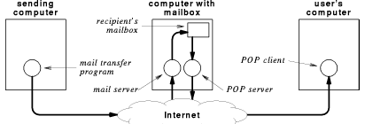

Slide 31
POP and dialup access
POP useful for dialup connection
  Users computer not always connected
  Can download all mail at once and read off-line
  Can compose mail off-line and mail in one connection

Slide 32
Summary
Electronic mail based on office memo paradigm
Allows quick, asynchronous communication across entire Internet
Can attach e-mail addresses to programs for processing
  Mailing lists
  Other client-server applications
Simple Mail Transfer Protocol (SMTP) is Internet standard for mail delivery
Mail gateways
  Provide uniform user addressing outside organizations
  Translate from Internet mail (e.g., SMTP) to proprietary systems
Post Office Protocol (POP) allows remote access to electronic mailboxes

