Slide 1
Chapter 28 - File Transfer and Remote File Access

Slide 2
Page Number Title
1 Introduction
2 Two problems
3 Generalized file transfer
4 Interactive and batch transfer
5 File transfer Protocol
6 Model and interface
7 ftp client commands
8 Two-way file transfer
9 File name translation

Slide 3
10 File types and transfer modes
11 FTP messages
12 FTP client-server model
13 Using separate data connections
14 TFTP
15 NFS
16 NFS function
17 NFS implementation
18 Summary

Slide 4
Introduction
Many programs written to use disk file paradigm for I/O
Moving a file from one computer to another required removable medium and sneakernet
Network allows direct communication
  File transfer - equivalent of tape, floppy transfer
  Remote file system - access to files on networked computer through same interface as local files

Slide 5
Two problems
Coordinating scheduling of distributed computations
Saving intermediate results
File transfer paradigm - programs write intermediate results to disk file
  Components of distributed application need not be run concurrently
  Intermediate results can be used to restart failed computation

Slide 6
Generalized file transfer
Allow transfer of arbitrary files
Accommodate different file types
Convert between heterogeneous systems
  Data types
  Word lengths
  Rules for file names
User login

Slide 7
Interactive and batch transfer
Batch transfer
  User creates list of files to be transferred through interface program
  Request dropped in queue
  Transfer program reads requests and performs transfers
  Transfer program retries until successful
  Good for slow or unreliable transfers
Interactive transfer
  User starts transfer program
  Actions include listing contents of directories, transferring files
  User can find and transfer files immediately
  Quick feedback in case of, e.g., spelling errors

Slide 8
File transfer Protocol
TCP/IP standard is File Transfer Protocol (FTP)
General purpose protocol
  Operating system and hardware independent
  Transfers arbitrary files
  Accommodates file ownership and access restrictions
Predates TCP/IP; adapted to TCP/IP later

Slide 9
Model and interface
Underlying protocol can run either interactive or batch mode
  ftp client gives interactive interface
  MIME, HTTP can use directly
Protocol actions include:
  List contents of directory
  Change to a different working directory
  Retrieve a file
  Put a file

Slide 10
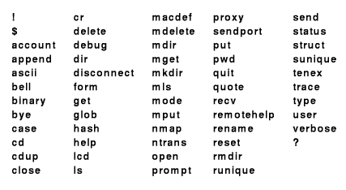
ftp client commands

Slide 11
ftp client interface from BSD UNIX is de facto standard
  Many commands archaic and no longer used: tenex, carriage control
  Most often used: cd, dir, ls, get, put
  Other useful: cr, pwd, lcd
Two-step process:
  Launch ftp
  Connect to remote host
    Connect involves using user account on remote host
    Some FTP servers provide anonymous FTP

Slide 12
Two-way file transfer
get: from FTP server to local host
put: to FTP server from local host
Default uses same name on both hosts; ftp client allows specification of different names
mget, mput transfer multiple files
  UNIX-like wildcard expansion
  prompt disables prompt for batch transfer

Slide 13
File name translation
File name syntaxes may be incompatible
UNIX - 128 character, mixed case; DOS - 8+3 character, upper case
Some names may not be legal in all systems
BSD ftp allows rules for filename translation

Slide 14
File types and transfer modes
Many different styles of file typing
  UNIX - untyped; may hold anything
  MacOS - strongly typed
ftp does two types of transfer:
  Text - with appropriate translations to maintain integrity
  Binary - no translation whatsoever

Slide 15
FTP messages
Each message from server includes a three-digit decimal number
  226 Transfer complete
  221 Goodbye
Convenient for computer and human recognition
Verbose mode shows messages; quiet mode suppresses messages

Slide 16
FTP client-server model
Remote server accepts control connection from local client
  Client sends commands to server
  Persists through entire session
Server creates data connection for data transfer
  One data connection for each transferred file
  Data transferred (either way)

Slide 17
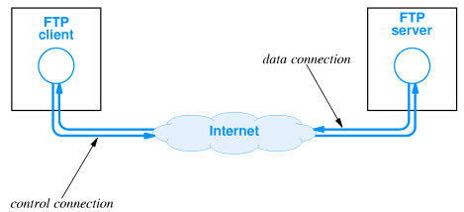

Slide 18
Using separate data connections
Separates commands from data
Client can send commands during data transfer
Closed connection indicates end of file

Slide 19
TFTP
Trivial File Transfer Protocol (TFTP) - much simpler than FTP
  Based on UDP
  File transfer only; no directory listing
  No authorization
Can be used in UDP-only system
Requires less code than FTP
Often used for bootstrap; e.g., ROM-based diskless system

Slide 20
NFS
Network File System gives random access to files across a network
Many distributed file systems exist; NFS is TCP/IP standard
  AppleShare
  Microsoft/NETBIOS
Based on client-server model
Originally developed by Sun; implementations now available on most UNIX and many PC systems

Slide 21
NFS function
Provides functions equivalent to OS access to local files
  Open
  Read
  Write
  Close
Local file access operations mapped to network messages
  Each message contains file system operation
  Read/write carry one disk block in each message
File naming integrated into local directory system
  Remote file systems mounted onto local directory
Access through mount point mapped to server

Slide 22
NFS implementation
NFS operations are UNIX-like, but not exactly equivalent
  Local OS performs some operations - open, close
  NFS provides block read/write; local OS does buffering
Other OS file functions can also be mapped into NFS operations
File naming, authorization/account identification, access rights all problematic

Slide 23
Summary
FTP - whole file transfer using TCP between Internet hosts
  Directory listing
  Data translation
TFTP - whole file transfer using UDP between Internet hosts
  File transfer only
  No authorization
NFS - file-level access using UDP

