Slide 1
Chapter 30 - CGI and Dynamic Web Documents

Slide 2
Page Number Title
1 Introduction
2 Document types
3 Dynamic documents and servers
4 CGI standard
5 Output from CGI program
6 CGI example
7 Inputs to CGI programs
8 State information
9 CGI program with long-term state
10 CGI program with short-term state
11 Forms and interactions
12 Summary

Slide 3
Introduction
Documents in previous section are static
  Defined in text file by page author
  Remains unchanged until edited by author
Dynamic documents are generated on demand by HTTP server
Active execute code on the WWW browser host computer

Slide 4
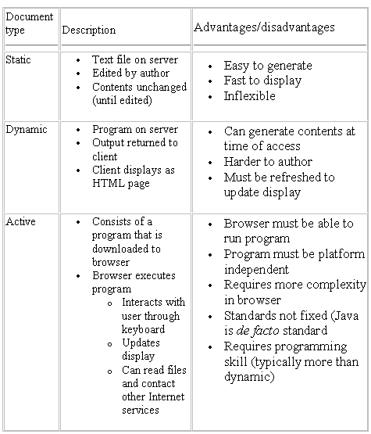
Document types

Slide 5
Dynamic documents and servers
Support for dynamic documents requires some changes on HTTP server
Typically implemented as extensions to existing server
Server must be able to execute program that generates dynamic document
  Can be implemented in
  Shell/csh script
  C program (executable)
  Others?
  Output returned to browser (looks like contents of static page)
Each dynamic document needs separate program
Server must differentiate between static and active document references

Slide 6
CGI standard
Common Gateway Interface (CGI) standard defines server-application interaction
Program sometimes called CGI program
Guidelines for interaction
  Language
  Parameter passing

Slide 7
Output from CGI program
Output from CGI program routed to WWW browser
Can be in several formats, e.g., plain text or HTML
Program must identify content to server for relay to browser
Header - consists of lines of text followed by blank line
Content-type: text/html
Content-type: text/plain
Location: http://other.server.com/new.txt

Slide 8
CGI example
Here's an example
A simple CGI program
Try it again...
Uses shell script language
  echo prints its command line arguments
  date returns date
  `foo` returns output from command foo as command line argument

Slide 9
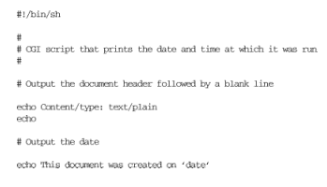
Linked to with:
<a href="http://www.netbook.cs.purdue.edu/cgi-bin/netbook-28-1">
A simple CGI program</a>

Slide 10
Inputs to CGI programs
Server passes inputs to CGI programs through parameters
Browser may supply parameters (through server)
  Browser extends URL with additional parameters
  Separated by "?"
Parameters passed as environment variables
  Essentially keyword-value pairs
  Based on original UNIX servers
Very easy to access in shell script

Slide 11
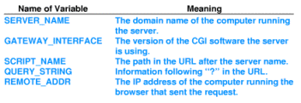

Slide 12
State information
CGI program invoked identically at each reference
Server maintains no history of previous invocations or any other state
Long-term - store in file on server
Short-term - return to browser in URL

Slide 13
CGI program with long-term state
Keeps record of IP addresses
Responds with initial message at first reference; subsequent message otherwise
Try me!
Try it again...
Implementation details
  List of known addresses kept in file ipaddrs
  grep -s returns TRUE if argument string not found in file
  Environment variables $REMOTE_ADDR contains string with IP address of browser host

Slide 14
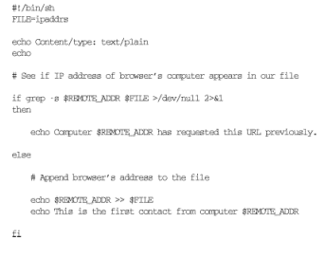

Slide 15
CGI program with short-term state
Trick is to encode state in URL, return URL in link
When user selects link, state returned as parameter suffix in new URL
Script can parse $QUERY_STRING to retrieve state
Try me!
Try it again...
Implementation details
  N is internal variable
  case statement allows for null string
  ;; is end of case

Slide 16
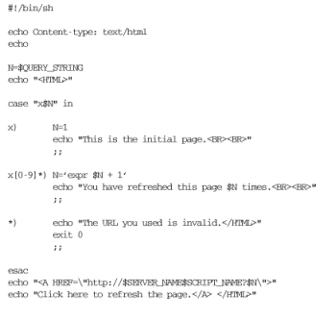

Slide 17
Forms and interactions
CGI includes support for forms
Server sends document to browser identified as a form
Form includes items for information entry
  Each form item has a name
  Contents of that item encoded in query string:
?ITEM1=4,ITEM2=Bucknell,ITEM3=CS363

Slide 18
Summary
Three types of WWW documents
  Static
  Dynamic
  Active
Dynamic document
  Generated by program on server at each reference
  May display different contents over time
  Must be refreshed to update display
May include long-term and short-term state

