Slide 1
Chapter 31 - Java Technology For Active Web Documents

Slide 2
Page Number Title
1 Introduction
2 Continuous update through server push
3 Active documents
4 Representing and executing active documents
5 Java
6 Java language
7 Java run-time environment
8 Portability
9 Java library
10 AWT graphics
11 Java and browsers
12 Compiling a Java program
13 An example applet
14 A Java example
15 Running the example
16 Interacting with the browser
17 Running the example
18 Alternatives
19 JavaScript example
20 Summary

Slide 3
Introduction
Active documents consist of code executed on computer running browser
Java language allows development of active document programs
  Programs called applets
  Platform independent
  Secure

Slide 4
Continuous update through server push
Some servers will send new versions of document
Technique called server push
Each server push document requires dedicated server resources
May scale with number of clients
Also requires network bandwidth for each update

Slide 5
Active documents
Delegates responsibility for updates to browser client
Work scales with number of active documents on client
Active document can, in fact, incur less server overhead than dynamic document

Slide 6
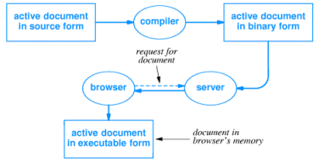
Representing and executing active documents
Requires programming language; what should that language look like?
How should the language be represented for execution
Multiple implementations possible; standards necessary for coordination

Slide 8
Java
Technique for writing, compiling, downloading and executing active documents
Includes:
  Programming language
  Runtime environment
  Class library

Slide 9
Java language
Resembles C++
  Object-oriented
  Some C++ cruft excised or restricted
Characteristics:
  High level, general purpose, object oriented
  Dynamic
  Strongly typed, static type checking
  Concurrent

Slide 10
Java run-time environment
Interpretive execution - Java language compiled into bytecodes
Automatic garbage collection
Multithreaded execution
Internet access
Graphics

Slide 11
Portability
Java must be platform-independent
Run-time environment clearly defined and has no implementation dependencies
Bytecode representation is platform independent

Slide 12
Java library
Library provides collection of common functions for Java applets
Class definitions and methods
Classes:
  Graphics
  Low-level network I/O (socket-level)
  Web server interaction
  Run-time system calls
  File I/O
  Data structures
  Event capture - user interaction
  Exception handling

Slide 13
AWT graphics
Java graphics library called Abstract Window Toolkit (AWT)
Includes high-level and low-level facilities
  Windows with components - scrollbars, buttons
  Blank rectangular area with object drawing
Implements abstract functions; run-time environment implementation maps to window system-specific functions

Slide 14
Java and browsers
Browser must include Java interpreter
Java interpreter works through browser
  Graphics
  HTML
Interpreter also works through native operating system
  File I/O
  Network operations

Slide 15
Compiling a Java program
javac translates Java source code into bytecodes
  Checks for correct syntax
  Imports classes from library
  Writes bytecode program to filename.class
Other development environments exist
  May include source code management
  "Visual" systems provide "pluggable" modules

Slide 16

An example applet
NerdClock

Slide 17
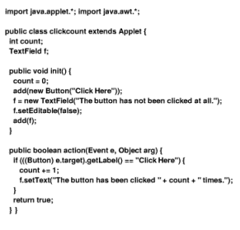
A Java example
Example code...

Slide 18

Running the example
<applet code="clickcount.class" height=50 width=400>
</applet>

Slide 19
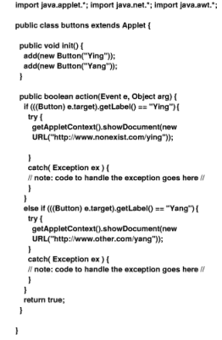
Interacting with the browser

Slide 20

Running the example

Slide 21
Alternatives
JavaScript
  Interpreted scripting language
  Like csh for browser
Other languages compiled into Java bytecodes
Other programming technologies - Inferno

Slide 22
JavaScript example
<SCRIPT LANGUAGE="JavaScript">
<!--
var loc = location.href.toString()
var ep = loc.lastIndexOf("/")
var dirloc = "“
if (ep > 0)
{ dirloc = loc.substring(0, ep) }
function doform(form)
{// Find next file
var URL
URL = dirloc + "/page20b.htm“
// Some problems getting background to look nice... parent.frames[2].document.open() parent.frames[2].document.clear()

Slide 23
parent.frames[2].document.writeln('<HTML><HEAD></HEAD><BODY BGCOLOR="#FFFFFF">') parent.frames[2].document.writeln("<DL>")
//search stuff goes here
URL = URL + "?" + form.keyword.value
parent.frames[0].location.href = URL}
// some hackery to force the bottom frame to be empty every
// time the page is reloaded
var URL
var loc = location.href.toString()
var ep = loc.lastIndexOf("/")
URL = dirloc + "/page20y.htm“
// force frame 0 to empty frame so re-execution is a no-op parent.frames[0].location.href = URL
// -->
</SCRIPT>

Slide 24
Summary
Active documents execute code in browser on user's computer
Java is most widely used active document technology
Java consists of:
  Programming language
  Run-time environment
  Class library
  Tags in browser for Java program invocation

