Slide 1
Chapter 32 - RPC and Middleware

Slide 2
Page Number Title
1 Introduction
2 Tools for networked applications
3 Programming with procedures
4 Procedure call graph
5 Remote Procedure Call
6 RPC paradigm
7 RPC call graph
8 What does RPC mechanism have to do?
9 Where is this work done?
10 External data representation
11 Middleware and Object-oriented Middleware
12 ONC RPC
13 DCE RPC
14 CORBA
15 Summary

Slide 3
Introduction
Client-server model most often used for networked applications
  Fits well with program execution model
  Modular
May not be easy to program
  Model not intuitive to coding experience
  Lots of details to manage

Slide 4
Tools for networked applications
Lots of details to manage
  Connections between components of networked application
  Synchronization
  Robust data exchange
  Data conversions
  Error conditions
Many details similar or identical in different networked applications
Idea: use tools to handle routine parts of interface

Slide 5
Programming with procedures
Modularizes code
  Reusable components
  Procedures operate on parameters
Procedures may call other procedures

Slide 6
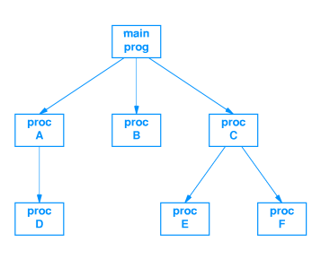
Procedure call graph

Slide 7
Remote Procedure Call
Remote Procedure Call (RPC) model provides structure for development of networked applications
  Based on procedure call model in familiar languages
  Related to client-server model
Hides details of communication and synchronization beneath procedure call interface

Slide 8
RPC paradigm
Network communication hidden by procedure calls
  Procedure may be executed on different computer
  RPC mechanism hides details
Programmer decides which procedures are executed where

Slide 9
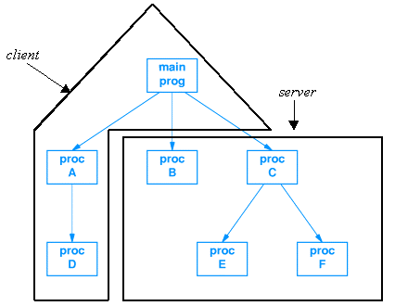
RPC call graph

Slide 10
What does RPC mechanism have to do?
Caller:
  Marshal arguments
  Transmit procedure identifier and arguments to remote procedure
  Wait for response
Called procedure:
  Unpack arguments
  Execute procedure
  Reply with any returned value

Slide 11
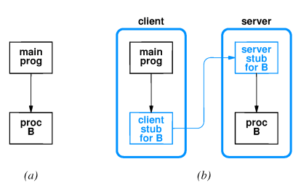
Where is this work done?
  Client stub with name of remote procedure on client
  Server stub "spoofs" caller on server

Slide 12
External data representation
Machine-dependent data representations
  Integer byte ordering
  Floating point
  Character strings (ASCII - EBCDIC; null-terminated - length encoded)
External data representation: common format for data exchange

Slide 13
Middleware and Object-oriented Middleware
Middleware: tools for generating RPC-based applications
Interface Definition Language (IDL)
  Defines specifications for procedure interfaces
  Used by client and server programmers
Object-oriented middleware: remote invocation of object methods

Slide 14
ONC RPC
Open Network Computing Remote Procedure Call (ONC RPC)
  Designed by Sun Microsystems
  Early example of middleware
Used in many Sun applications; e.g. NFS
Includes eXternal Data Representation (XDR) standard

Slide 15
DCE RPC
Open Software Foundation (OSF) defined Distributed Computing Environment (DCE)
Includes DCE RPC as middleware component
Defines its own IDL
Microsoft derived Microsoft Remote Procedure Call (MSRPC) from DCE RPC

Slide 16
CORBA
Common Object Request Broker Architecture (CORBA)
  Developed by Object Management Group (OMG)
  Vendor-independent, interoperable spec for middleware
Remote invocation instantiated by local object proxies
  Proxies instantiated at runtime
  Methods passed to "real" remote object

Slide 17
Summary
Client-server programming may be difficult sue to details and synchronization
Procedure call model is "natural" paradigm for programmers
Remote Procedure Call (RPC) uses procedure call paradigm for client-server communication
  Client sends parameters for procedure call to server
  Server executes procedure and replies with returned value
Middleware is category of development tools for RPC

