Slide 1
Chapter 33 - Network Management: SNMP

Slide 2
Page Number Title
1 Introduction
2 Internet Management
3 Types of problems
4 Problem with hidden failures
5 Network management software
6 Network management model
7 SNMP
8 SNMP data representation
9 Fetch-store paradigm
10 SNMP operations
11 Identifying objects with SNMP
12 Storing ASN.1 numeric values
13 Storing ASN.1 lengths
14 Types of MIBs
15 Arrays in MIBs
16 Array example
17 Summary

Slide 3
Introduction
Network management is a hard problem
Will discuss network management paradigm base on network communication and client-server model
SNMP is TCP/IP standard

Slide 4
Internet Management
Network manager or network administrator is responsible for monitoring and controlling network hardware and software
  Designs and implements efficient and robust network infrastructure
  Identifies and corrects problems as they arise
  Must know both hardware and software
Why is network management hard?
  Most internets heterogeneous
  Most internets large

Slide 5
Types of problems
Catastrophic
  Fiber broken by backhoe
  LAN switch loses power
  Invalid route in router
  Easiest to diagnose
Intermittent or partial
  NIC sends frames too close together
  Router has one invalid entry
  Hardest to diagnose

Slide 6
Problem with hidden failures
Some intermittent of partial failures may not be evident to user
  Hardware may drop frames with data errors
  Network protocols may recover from lost packet
However, network performance decreases

Slide 7
Network management software
Monitor operation and performance of network devices:
  Hosts
  Routers
  Bridges, switches
Control operations through rebooting, changing routing table entries

Slide 8
Network management model
Network management does not have an internet or transport layer protocol
Defines application layer protocol using TCP/IP transport layer protocol
Based on client-server model; names changes
  Manager == client; run by network manager
  Agent == server; runs on managed device
Manager composes requests for agent; agent composes response and returns to manager

Slide 9
SNMP
TCP/IP standard is Simple Network Management Protocol (SNMP)
Defines all communication between manager and agent
  Message formats
  Interpretation of messages
  Data representation

Slide 10
SNMP data representation
SNMP uses Abstract Syntax Notation.1 (ASN.1)
  Platform-independent data representation standard
  Strongly-typed
  Can accommodate arbitrary data types
Example - integer representation
  Length octet - number of octets containing data
  Data octets - value in big-endian binary

Slide 11
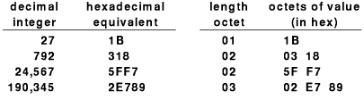

Slide 12
Fetch-store paradigm
Manager-agent interaction based on fetch-store paradigm
  Fetch retrieves a value from the agent
  Store changes a value on the agent
  Any other information is extracted from the fetched data and displayed by the manager
Fetch used to monitor internal data values and data structures
Store used to modify and control data values and data structures; also used to control behavior by setting "reboot" object

Slide 13
SNMP operations
Get (fetch) retrieves value of object
Set (store) stores new values into object
Get-next retrieves next object (for scanning)

Slide 14
Identifying objects with SNMP
SNMP is not tied to any particular set of data structures
Operates on a collection of related objects identified in a Management Information Base (MIB)
Objects in a MIB are identified by ASN.1 naming scheme
  Hierarchical naming structure
  Authority for new names delegated as in DNS
Example - count of incoming IP datagrams:
iso.org.dod.internet.mgmt.mib.ip.ipInReceives
For efficiency, each name has a numeric equivalent; e.g.:
1.3.6.1.2.1.4.3

Slide 15
Storing ASN.1 numeric values
Value stored in sequence of octets
Leftmost bit is 0 in last octet
Example

Slide 16
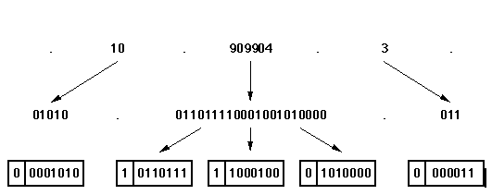

Slide 17
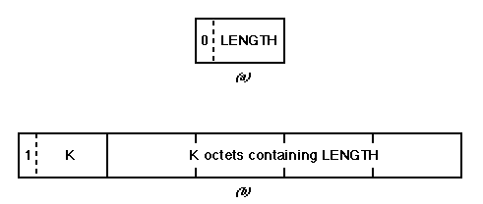
Storing ASN.1 lengths
Leftmost bit 0 means length in same octet
Leftmost bit 1 means length in k octets

Slide 18
Types of MIBs
Very flexible structure
MIBs defined for protocols, devices, network interfaces
MIB I is original TCP/IP standard for protocol suite; MIB II extends that original version

Slide 19
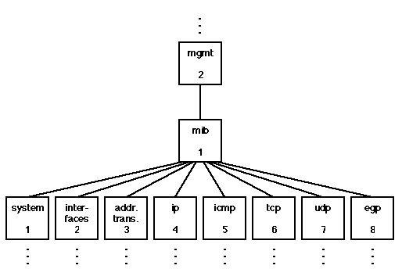

Slide 20
Arrays in MIBs
Some types of data - such as a routing table - is most naturally stored as an array
ASN.1 supports variable length, associative arrays
  Number of elements can increase and decrease over time
  Each element can be a structured object
Indexing is implicit
  Manager must know object is an array
  Manager must include indexing information as suffix

Slide 21
Array example
Routing table is an array:
ip.ipRoutingTable
List of routing table entries is indexed by IP address
To identify one value:
ip.ipRoutingTable.ipRouteEntry.ipRouteNextHop.IPdestaddr
  ipRouteEntry indicates indexing
  ipRouteNextHop is a field in a routing table entry
  IPdestaddr is 32-bit IP address

Slide 22
Summary
TCP/IP includes SNMP as network management protocol
SNMP is an application protocol that uses UDP for transport
Based on fetch-store paradigm
  Controls operation as side-effect of store operations
  Get-next used top scan objects
Management Information Base (MIB) defines structure of objects
Abstract Syntax Notation.1 (ASN.1) used for data representation and object identification

