Slide 1
Chapter 34 - Network security

Slide 2
Page Number Title
1 Introduction
2 Secure networks and security policies
3 Components of security policy
4 Aspects of security
5 Responsibility and control
6 Integrity mechanisms
7 Encryption and privacy
8 Public key encryption
9 Digital signatures
10 Digital signatures and privacy
11 Packet filtering
12 Internet firewall
13 Summary

Slide 3
Introduction
Routers forward packets - from any source
Bad guys can send in packets from outside
How to avoid security breaches?

Slide 4
Secure networks and security policies
Can't describe a network as secure in the abstract
University may have different notion of security than military installation
Must define a security policy
Many possibilities to consider:
  Data stored on servers
  Messages traversing LANs
  Internal or external access
  Read/write versus read-only access

Slide 5
Components of security policy
Describes items to be protected and rules for protection
Must cover computer systems, LANs, interconnection devices, ...
Development must include assessment of cost of protected information versus cost of protection

Slide 6
Aspects of security
Data accessibility - contents accessible
Data integrity - contents remain unchanged
Data confidentiality - contents not revealed

Slide 7
Responsibility and control
Must be able to delegate and control responsibility
Accountability - who is responsible for tracking access to data
Authorization - who is responsible for who access data

Slide 8
Integrity mechanisms
Checksum, CRC - protects integrity
Message digest - more robust integrity check

Slide 9
Encryption and privacy
Encryption - rewrite contents so that they cannot be read without key
  Encrypting function - produces encrypted message
  Decrypting function - extracts original message
  Encryption key - parameter that controls encryption/decryption; sender and receiver share secret key
Sender produces: E = encrypt(K, M)
Sender transmits E on network
Receiver extracts: M = decrypt(K, E)

Slide 10
Public key encryption
Previous scheme requires shared secret K
If K is discovered, security is compromised
Public key encryption uses two keys:
  Private key - kept secret by user
  Public key - published by user
To send to user, encrypt using public key, decrypt using private key

Slide 11
Digital signatures
Goal - guarantee that message must have originated with certain entity
Idea - encrypt with private key, decrypt with public key
Only owner of private key could have generated original message

Slide 12
Digital signatures and privacy
Can combine techniques - signed by A, private 10 B
A forms: X = encrypt(PUBB, encrypt(PRVA, M))
B extracts: M = decrypt(PUBA, decrypt(PRVB))

Slide 13
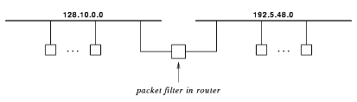
Packet filtering
Can configure packet forwarding devices - esp. routers - to drop certain packets
Consider example:

Slide 14
Suppose 192.5.48.0 is test network and 128.10.0.0 has controlling workstations
  Install filter to allow packets only from 192.5.48.0 to 128.10.0.0
  Keeps potentially bad packets away from remainder of Internet

Slide 15
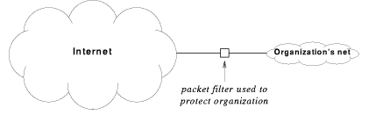
Internet firewall
Packet filter at edge of intranet can disallow unauthorized packets
Restricts external packets to just a few internal hosts

Slide 16
Proxies forward packets through firewall after authorization
DMZ net adds extra layer of access
Net 10 and network address translation (NAT) boxes also add security

Slide 17
Summary
Security is a problem because Internet is not owned by one entity
Organizations can use firewalls to prevent unauthorized access
Encryption and digital signatures can provide confidentiality and secure identification

