Slide 1
Chapter 35 - Initialization

Slide 2
Page Number Title
1 Introduction
2 Bootstrapping
3 Protocol parameters
4 Examples
5 Modes of protocol configuration
6 Why automate?
7 Methods of automated protocol configuration
8 The chicken-and-egg problem
9 RARP
10 ICMP
11 BOOTP
12 BOOTP forwarding
13 Automatic address assignment
14 DHCP
15 Address leases
16 DHCP message format
17 DHCP and DNS
18 Summary

Slide 3
Introduction
How does protocol software begin operation
From where is the software loaded
How are configuration parameters determined

Slide 4
Bootstrapping
Generally. initialization process is called bootstrapping
Key idea is to perform initialization in stages, each of which enables more functions
Protocol software may be:
  Run out of on-board PROM
  Loaded with bootstrap program from disk
  Loaded with operating system from disk

Slide 5
Protocol parameters
Protocol software needs specific information for operation
Software employs parameters for operation on a specific hardware and network
Process of supplying parameters to protocol software is called configuration

Slide 6
Examples
IP address - depends on network, must be unique on network
Default router address - where to send packets aimed at remote network
Subnet mask - to specify if subnet addressing is used and what the subnet is
DNS server address - for DNS queries
Server addresses

Slide 7
Modes of protocol configuration
Manual
Local disk file
Automated through network

Slide 8
Why automate?
Centralized configuration for groups of computers
Automatic address assignment

Slide 9
Methods of automated protocol configuration
Decentralized - host discovers parameters independently
Server-based - host contacts server

Slide 10
The chicken-and-egg problem
How can host use network to get network address?
Use broadcast-based link-layer protocol
  RARP
  AppleTalk

Slide 11
RARP
Reverse Address Resolution Protocol (RARP)
Maps MAC address to IP address
Host broadcasts RARP request with its MAC address
Server replies:
  Must be on same subnet
  Looks up MAC address in table
  Replies with IP address

Slide 12
ICMP
ICMP address mask request - find subnet mask
ICMP gateway discovery - find default router
Sequence:
1. Broadcast RARP request
2. Extract IP address from RARP response
3. Broadcast ICMP address mask request
4. Extract subnet mask from ICMP address mask reply
5. Broadcast ICMP gateway discovery request
6. Extract default router from ICMP gateway discovery reply

Slide 13
BOOTP
Bootstrap Protocol (BOOTP) provides multiple parameters
BOOTP request broadcast on subnet
Server returns reply with IP address, subnet mask, servers, etc.
Format:

Slide 14
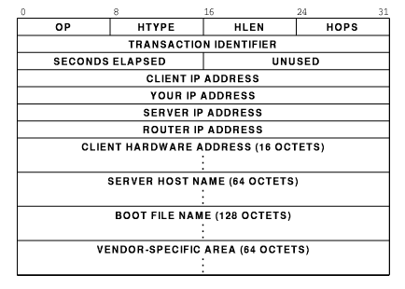

Slide 15
BOOTP forwarding
Maintaining BOOTP server on each subnet can be expensive
BOOTP relay agent listens for BOOTP requests
  Forwards to BOOTP server
  Returns responses from server back to BOOTP client

Slide 16
Automatic address assignment
BOOTP requires that client be present in server database before BOOTP arrives
Can addresses be allocated automatically?
  AppleTalk
  IPX

Slide 17
DHCP
Dynamic Host Configuration Protocol (DHCP) can be used to allocate addresses to hosts without pre-configuration
Plug-and-play networking
  Host sends DHCP request message
  Server finds unused address
  Adds to local list of addresses
  Returns address to host

Slide 18
Address leases
Suppose host leaves subnet?
Address no longer in use; server should reassign
How does server know when to reassign?
Address is assigned with a lease
  Client cannot use address after lease expires
  Client can ask for extension prior to expiration

Slide 19
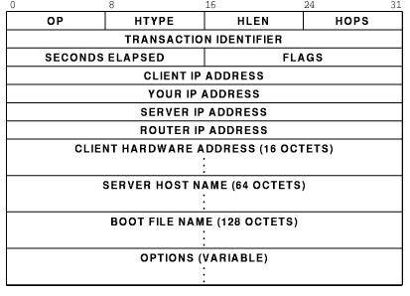
DHCP message format
Extension of BOOTP; includes new options

Slide 20
DHCP and DNS
New addresses should be entered in DNS
DNS just recently added capability to automate entry updates
"Soon", DHCP client or server will be able to add new entries to DNS

Slide 21
Summary
Protocol software requires configuration parameters
Small, heterogeneous networks can use decentralized configuration
IP uses server-based configuration
  BOOTP
  DHCP

