Slide 1
Chapter 8 - Hardware Addressing and Frame Type Identification
Page Number Title
1 Introduction
2 Specifying a destination
3 Hardware addressing
4 LAN hardware and packet filtering
5 LAN hardware and packet filtering
6 Format of hardware addresses
7 Assigning hardware addresses
8 Broadcasting
9 Identifying packet contents
10 Headers and frame formats

Slide 2
11 Example frame format
12 Ethernet fields
13 Frames without type fields
14 Encoding the data type
15 IEEE 802.2 LLC
16 Unknown types
17 Network analyzers
18 Operation of a network analyzer
19 Filtering incoming frames
29 Summary

Slide 3
Introduction
Previous chapter on LAN technology described techniques for providing connectivity between computers
Need to devise technique for delivering message through LAN medium to single, specific destination computer
Sending computer uses a hardware address to identify the intended destination of a frame
Sending computer also identifies type of data carried in the frame

Slide 4
Specifying a destination
Data sent across a shared network reaches all attached stations - for all LAN topologies
Interface hardware detects delivery of frame and extracts frame from medium
But ... most applications want data to be delivered to one specific application on another computer - not all computers

Slide 5
Hardware addressing
Most network technologies have a hardware addressing scheme that identifies stations on the network
Each station is assigned a numeric hardware address or physical address
Sender includes hardware address in each transmitted frame
Only station identified in frame receives copy of frame
Most LAN technologies include sender's hardware address in frame, too

Slide 6
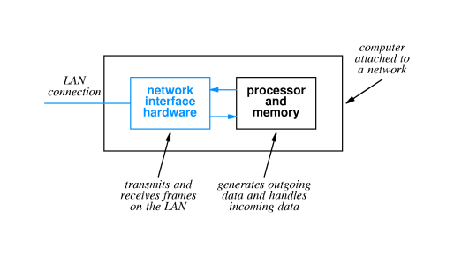
LAN hardware and packet filtering
A little detail about organization of LAN hardware and computer:

Slide 7
LAN hardware and packet filtering
LAN interface handles all details of frame transmission and reception
  Adds hardware addresses, error detection codes, etc. to outgoing frames
  May use DMA to copy frame data directly from main memory
  Obeys access rules (e.g., CSMA/CD) when transmitting
  Checks error detection codes on incoming frames
  May use DMA to copy data directly into main memory
  Checks destination address on incoming frames

Slide 8
If destination address on incoming frame matches the local station's address, a copy of the frame is passed to the attached computer
Frames not addressed to the local computer are ignored and don't affect the local computer in any way

Slide 9
Format of hardware addresses
Numeric value
Size selected for specific network technology
Length is one to six bytes

Slide 10
Assigning hardware addresses
Hardware addresses must be unique on a LAN
How can those address be assigned and who is responsible for uniqueness?

Slide 11
Static:
  Hardware manufacturer assigns permanent address to each interface
  Manufacturer must ensure every interface has a unique address
Dynamic:
  Address can be set by end user, either through switches or jumpers on the interface or through software
  System administrators must coordinate to avoid conflict
Automatic:
  Interface automatically assigns hardware address each time it is powered up
  Automatic scheme must be reliable to prevent conflicts

Slide 12
Broadcasting
Some applications want to broadcast messages to all stations on the LAN
Shared communication channel can make broadcast efficient - message is delivered to all stations
Special broadcast address used to identify broadcast messages, which are captured by all stations

Slide 13
Identifying packet contents
Destination must get some clue about how to interpret frame data
Can use:
  Explicit frame type - identifying value included with frame describes type of included data
  Implicit frame type - receiver must infer type from frame data

Slide 14
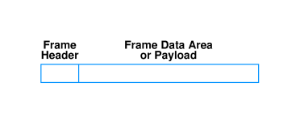
Headers and frame formats
LAN technology standards define frame format for each technology
All contemporary standards use the following general format:

Slide 15
Frame header has address and other identifying information
Information typically in fields with fixed size and location
Data area may vary in size

Slide 16
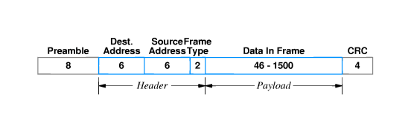
Example frame format
Ethernet frame format:

Slide 17
Details:
Field
Purpose
Preamble
Receiver synchronization
Dest. addr.
Identifies intended receiver
Source addr.
Hardware address of sender
Frame type
Type of data carried in frame
Data
Frame payload
CRC
32-bit CRC code

Slide 18
Ethernet fields
Preamble and CRC often not shown
Destination address of all 1s is the broadcast address
Special values are reserved for frame type field:

Slide 19
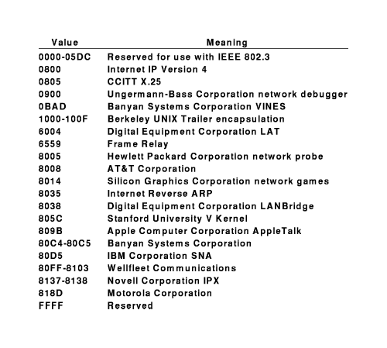

Slide 20
Frames without type fields
Some LAN technologies do not include a type field
Sender and receiver can agree on interpretation:
  Agree on a single data format and use only that format
    Limits LAN to one type of data
    All computers on LAN must use one format
  Agree to encode the data format in the first few bytes of the data field

Slide 21
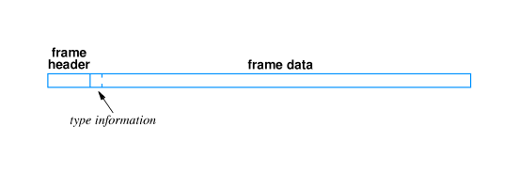
Encoding the data type
Illustration of using data area to encode data type:
To ensure interoperability, format of encoding area must be universally agreed upon
Format typically set by standards body

Slide 22
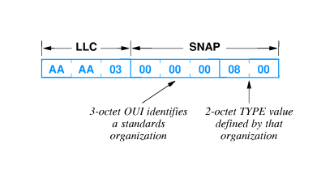
IEEE 802.2 LLC
IEEE 802.2 standard includes Logical Link Control (LLC) SubNetwork Attachment Point (SNAP) header
SNAP/LLC format widely used; e.g., by Ethernet

Slide 23
LLC portion indicates SNAP field to follow
OUI (Organizationally Unique Identifier) identifies Ethernet specification organization
TYPE field interpreted as in Ethernet (in this case, IP)

Slide 24
Unknown types
For either encoding format, some computers may not be prepared to accept frames of some types
  Protocol type not installed
  Newly defined type
Receiving computer examines type field and discards any frames with unknown type

Slide 25
Network analyzers
A network analyzer or network monitor or ``network sniffer'' is used to examine the performance of or debug a network
Can report statistics such as capacity utilization, distribution of frame size, collision rate or token circulation time
Can record and display specific frames, to understand and debug packet transmissions and exchanges

Slide 26
Operation of a network analyzer
Basic idea is a computer with a network interface that receives all frames
Sometimes called promiscuous mode
Many desktop computers have interface that can be configured for promiscuous mode
  Combined with software, computer can examine any frame on LAN
  Communication across a LAN is not guaranteed to be private!
Computer receives and displays (but does not respond to) frames on the LAN

Slide 27
Filtering incoming frames
Analyzer can be configured to filter and process frames
  Count frames of a specific type or size
  Display only frames from or to specific computers
  In general, can be configured to match value of any field and capture only those frames meeting the filter specification
Analyzer can display real-time performance by computing running totals over specific time periods

Slide 28
Summary
LAN technologies use hardware addresses to identify destination for frames sent across shared communication channel
Each LAN technology defines its own hardware format
Addresses may be statically assigned, configurable or automatically assigned
Each station must have a unique address on the LAN segment
Frames include a header with fields for destination, source and other information such as frame type
Frame type defines how to interpret frame data
Network analyzer can receive all frames and display statistics or aid in debugging problems

