Slide 1
Chapter 10 - Extending LANs: Fiber Modems, Repeaters, Bridges and Switches
Page Number Title
1 Introduction
2 LAN design for distance
3 LAN extensions
4 Fiber optic extensions
5 Repeaters
6 Ethernet repeaters
7 Limits on repeaters
8 Repeater architecture
9 Characteristics of repeaters

Slide 2
10 Bridges
11 Bridged LAN segments
12 Characteristics of bridges
13 Filtering bridges
14 Frame filtering
15 How does bridge set up table?
16 Filtering example
17 Startup behavior of filtering bridges
18 Designing with filtering bridges
19 Bridging between buildings
20 Bridging across longer distances
21 Bridges and cycles

Slide 3
22 Cycles of bridges
23 Eliminating broadcast cycles
24 Switching
25 Switches and hubs
26 Summary

Slide 4
Introduction
LAN technologies are designed with constraints of speed, distance and costs
Typical LAN technology can span, at most, a few hundred meters
How can a network be extended to cover longer distances; e.g., the Bucknell campus?

Slide 5
LAN design for distance
Many LANs use shared medium - Ethernet, token ring
Length of medium affects fair, shared access to medium
  CSMA/CD - delay between frames, minimum frame length
  Token passing - circulation time for token
Length of medium affects strength of electrical signals and noise immunity

Slide 6
LAN extensions
Several techniques extend diameter of LAN medium
Most techniques use additional hardware
LAN signals relayed between LAN segments
Resulting mixed technology stays within original engineering constraints while spanning greater distance

Slide 7
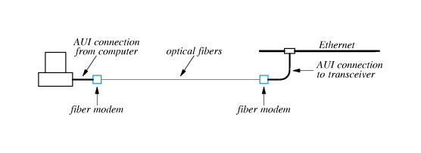
Fiber optic extensions
Can extend connection to a computer using fiber optic cable
Insert fiber modems and fiber optic cable into AUI cable

Slide 8
Fiber modems:
  Convert AUI signals to digital signal
  Transmit digital signals via fiber optic cable to other modem
Most often used to connect two LANs - typically through a bridge - different buildings

Slide 9
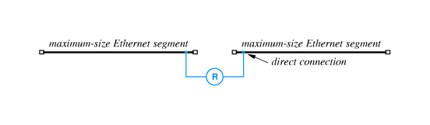
Repeaters
May want to extend LAN medium
  Ethernet - timing constraints allow longer medium
  Signal strength constraints limit length
Repeater - bidirectional, analog amplifier that retransmits analog signals
One repeater can effectively double the length of an LAN segment

Slide 10
Ethernet repeaters
Simply copy signals between segments
  Do not understand frame formats
  Do not have hardware addresses
Any Ethernet segment is limited to 500 meters
Repeater can double to 1,000 meters

Slide 11
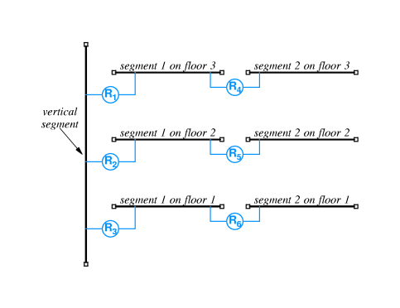

Slide 12
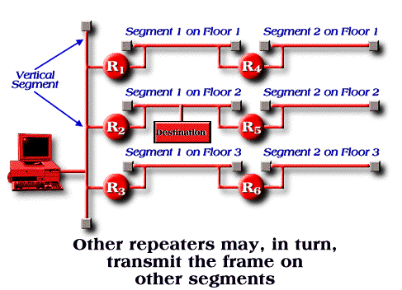
Repeater architecture
With four repeaters, can extend Ethernet through a building

Slide 13
FOIRL - Fiber Optic Intra-Repeater Link - can be used to connect bridges

Slide 14
Characteristics of repeaters
Very easy to use - just plug in
Repeaters simply re-transmit analog signals
  Collisions affect entire network
  Transient problems - noise - propagates throughout network

Slide 15
Bridges
Also connect two LAN segments
Retransmits frames from one segment on other segment(s)
Handles complete frame
  Uses NIC like any other station
  Performs some processing on frame
Invisible to other attached computers

Slide 16
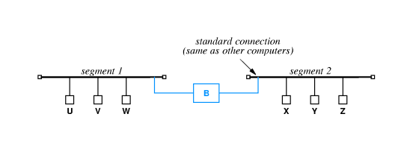
Bridged LAN segments

Slide 17
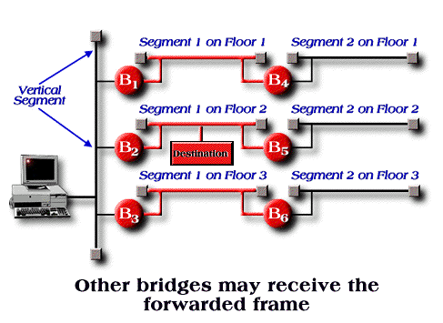
Characteristics of bridges
Relatively easy to use - just plug in
Isolate collisions, noise

Slide 18
Filtering bridges
Bridges can do additional processing
  Don't forward collisions, noise
  Only forward frames where necessary
Bridge performs frame filtering and forwards frames along LAN segments to destination
  Learns location of stations by watching frames
  Forwards all broadcast and multicast packets

Slide 19
Frame filtering
Bridge checks destination of each incoming frame
Looks up destination in list of known stations
  Forwards frame to next interface on path to destination
  Doesn't forward frame if destination on LAN segment from which frame was received

Slide 20
How does bridge set up table?
Bridge examines source address in each frame
Adds entry to list for LAN segment from which frame was received
Must forward any frame whose destination is not in the list on every interface

Slide 21
Filtering example

Slide 22
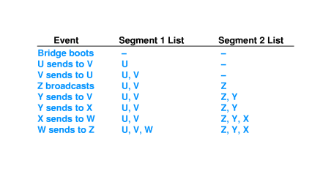

Slide 23
Startup behavior of filtering bridges
Initially, the forwarding tables in all bridges are empty
First frame from each station on LAN is forwarded to all LAN segments
After all stations have been identified, frames are only forwarded as needed
May result in burst of traffic after, e.g., power failure

Slide 24
Designing with filtering bridges
Filtering bridge allows concurrent use of different LAN segments if traffic is local
U and V can exchange frames at the same time X and Y exchange frames

Slide 25
Designers identify patterns of local communication and isolate groups of communicating computers with bridges

Slide 26
Bridging between buildings
Similar to extending AUI with fiber modems
Can put bridge in one building with long connection to LAN segment in different building
Avoids extended AUI connection for each computer in remote building

Slide 27
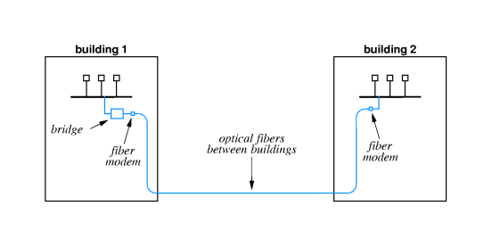

Slide 28
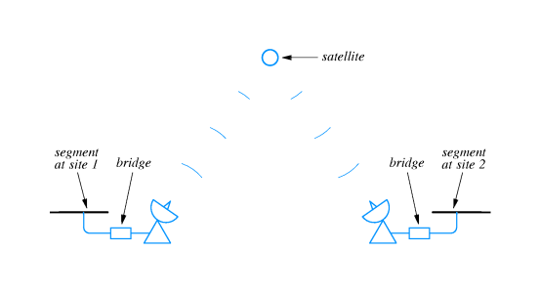
Bridging across longer distances
Can use leased line, microwave, laser or satellite to connect two bridges and LAN segments

Slide 29
Using two bridges instead of one:
  Filters at both ends, reducing traffic across slow link
  Provides buffering at both ends, matching dissimilar transmission speeds

Slide 30
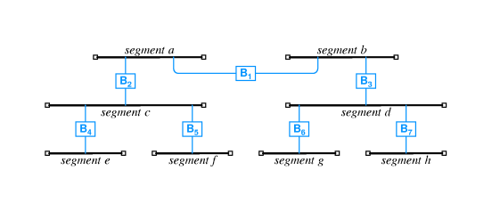
Bridges and cycles
Can use multiple bridges to interconnect many LAN segments

Slide 31
Station of segment c sends frames to station on segment g through B₂, B₁, B₃ and B₆
Broadcasts are forwarded through all bridges
Suppose another bridge connects g and f?

Slide 32
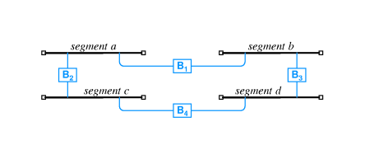
Cycles of bridges
A circular path through bridged networks is called a cycle
Adding B₄ creates a cycle

Slide 33
Eliminating broadcast cycles
Bridges must cooperate to broadcast frames exactly once on each segment
Solution from graph theory - spanning tree - used to determine which bridges will forward broadcasts
As each bridge joins the network, it communicates with other bridges on special hardware (typically multicast) address
  Learns network topology
  Performs spanning tree computation
  Determines if bridge will form a cycle

Slide 34
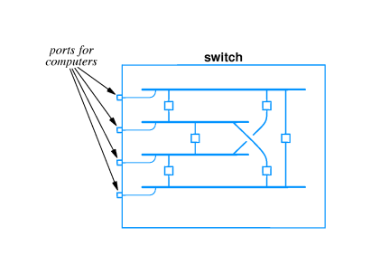
Switching
Effectively a separate LAN segment for each port
Similar to hub - hub shares single segment among all ports

Slide 35
With switching, multiple stations can transmit simultaneously
Provides much higher aggregate bandwidth

Slide 36
Switches and hubs
Switches are more expensive per port
May make more sense economically to use hubs for some stations and switches for others

Slide 37
Summary
Optical fiber and modems can be used to extend AUI for single station
Repeater acts as amplifier and retransmits analog signals
Bridge accepts entire incoming frame and retransmits
  Doesn't forward collisions
  Avoids collisions on destination segments
Filtering bridge forwards frames only as needed
  Allows simultaneous use of LAN segments for local transmission
  Forwards all broadcast and multicast packets
Switches provide full LAN speed to each port by simulating separate LAN segments

