Slide 1



SkillsNET Plans
and Activities
®
OOA, Human Resources
Oxford, England
October 11, 2007
Michael L. Brown, Founder & CEO
SkillsNET Enterprises, Ltd.
Michael.brown@skillsnet.com

Slide 2



SkillsNET Overview
Founded in 1996
Headquarters: Waxahachie, Texas
500% 3 year revenue growth
78.60 % three year CAGR
Core Business:
Web Assisted JTA
SkillObject® Technology
Standards and Framework Formation
2006 Awardees Fasting Growing
Companies in America #270
Cox business school
2006 Top 100
Dallas Entrepreneur Awards
Largest Known
Occupational Database
NSOL
Innovation:
Web-Based JTA
11 Patents Pending
Task, KSA’s, Resources
For 3,000 jobs
Accredited Standards and Frameworks

Slide 3
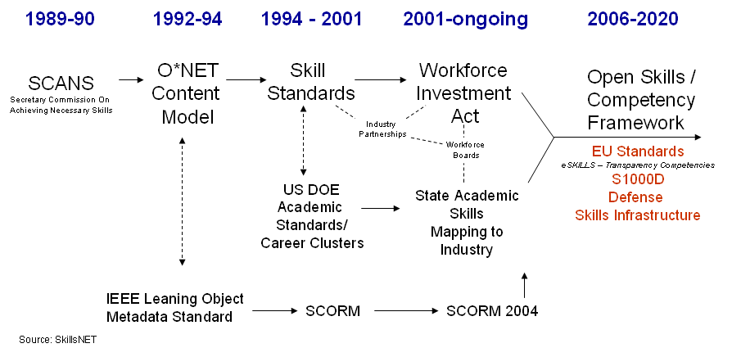
Public Infrastructure Plans – The Journey
IEEE

Slide 4
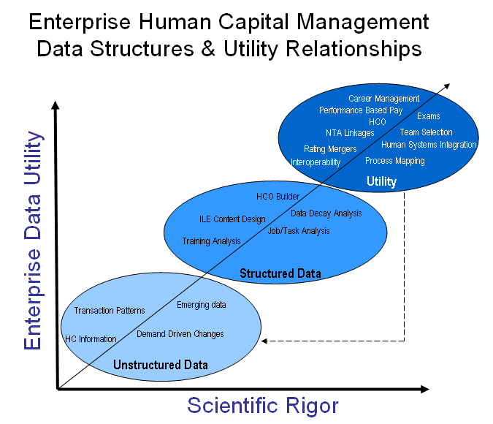
Public Infrastructure Plans – User Education
Why Standards are important!
Build once, use many, change often
Substantial ROI
Value Add
Skill and Competency
Common Framework
D-SCOR Framework

Slide 5
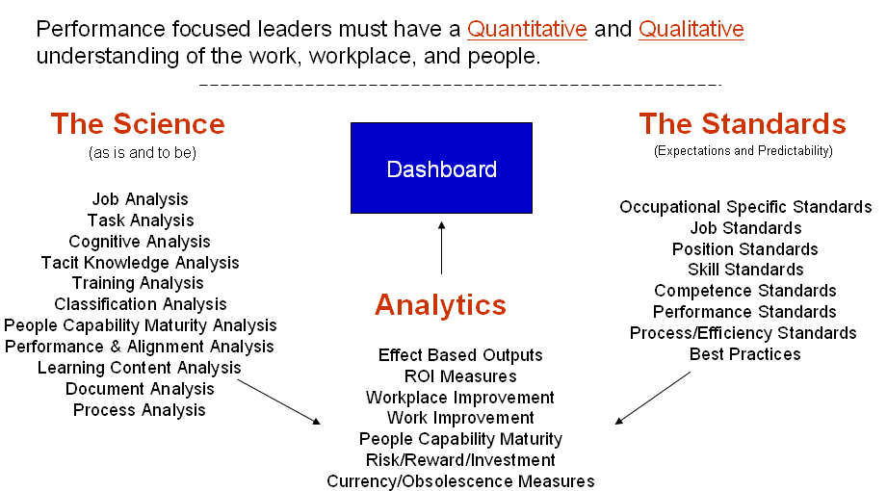
Public Infrastructure Plans – User Education

Slide 6
Public Infrastructure Plans
Occupational Skills Ontology
IEEE Skills and Competency Study Groups
Defense Skill and Competency Open Resource (D-SCOR) Framework
Germany and Austria Skills Formation and Learning Demand Signal System.
Universal Skills and Competency Lexicon and category classification
Global Living public and private laboratories
Open Source Standard and Framework Integration and Solution Models

Slide 7
Activities: OS Ontology
The right level of granularity: Manageable and significant ROI
Essential Skill Element to support people, position and place
Increase skill portability across job families, industry clusters, education
Enabling KSA’s (KSC) building blocks for core and cross-functional utility

Slide 8
Activities: IEEE LTSC
Accredited Standards & Alignment
IEEE LTSC P1484.20
Specifically the three new parts would be:
  P1484.12.20.3 Performance Objective Statements
  P1484.12.20.4 Competency Operational Definitions
  P1484.12.20.5 Competency Logical Data Model

Slide 9
D-SCOR Framework
Activities: D-SCOR Framework
Defense Skills and Competency Open Resource (D-SCOR) Framework
A system of tools and authoritative data resources to collect/validate skills and competency work, worker, workplace content using a common language and defensible taxonomy.
D-SCOR Framework

Slide 10
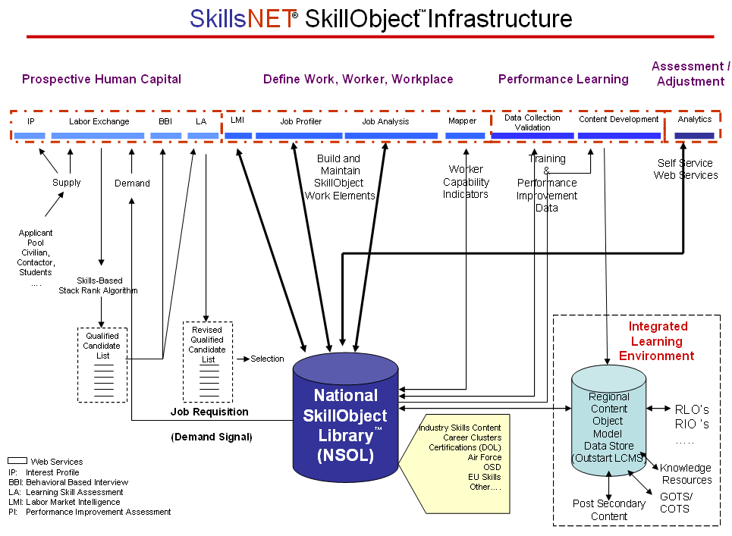
Activities: D-SCOR Framework

Slide 11
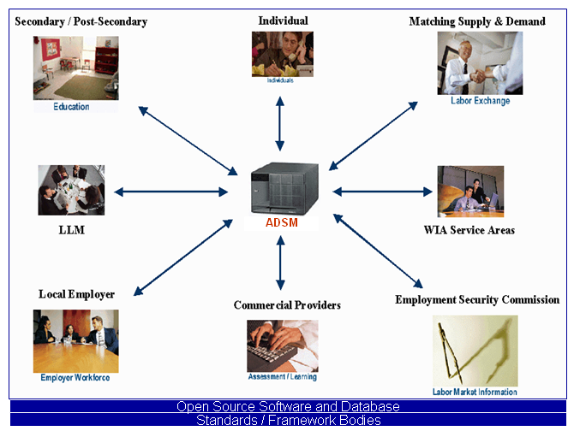
Activities: The Skills and Competency Economy

Slide 12
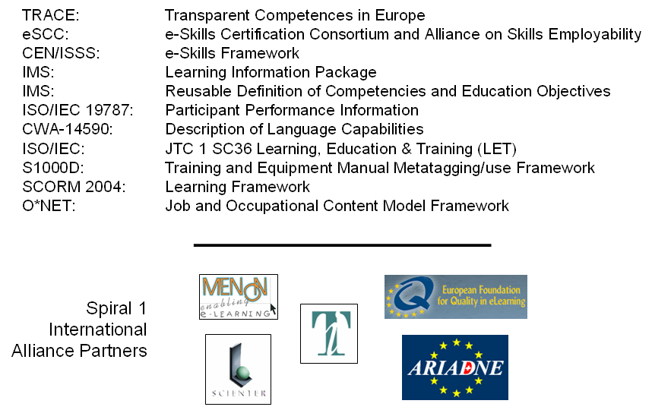
Activity: Skill and Competency Framework Integration
Integration Points

Slide 13


Activity: Germany and Austria Public Services
Frameworks (EQF, eCompetence, E*NET, etc.) integration
Socialization of Science and user utility
Industry cluster formation
Individual skill and competency data registry
Local, regional and state labor market information (supply & demand)
Germany Lead:
Austria Lead:
Dierk Ladendorff
Dr. Jörg Markowitsch

Slide 14

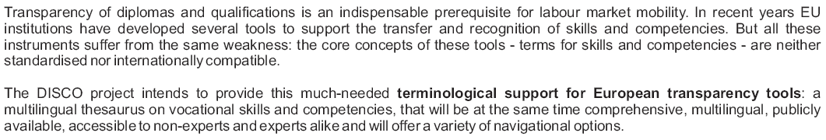
Activities: Universal Skills & Competency Lexicon

Slide 15
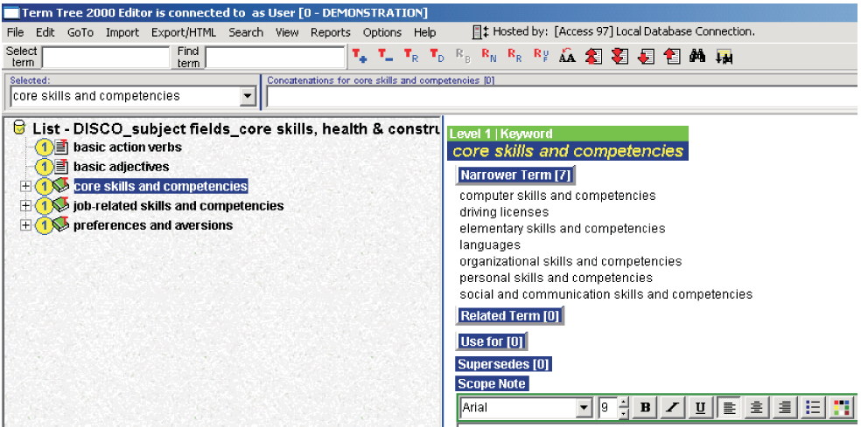
Activities: Universal Skills & Competency Lexicon

Slide 16

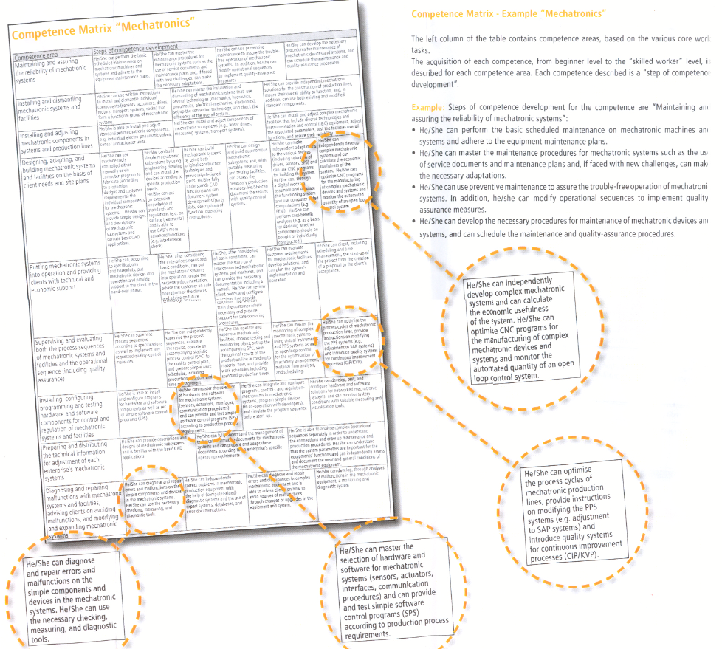
Activities: VQnet Competency Levels

Slide 17
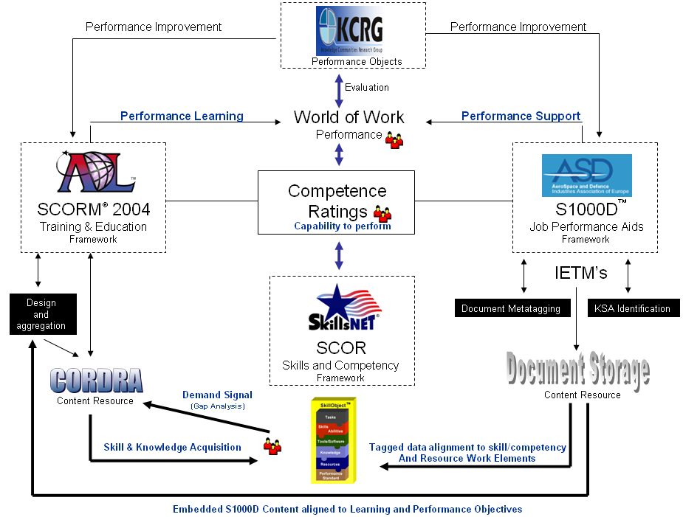
Activity: Framework Integration

Slide 18
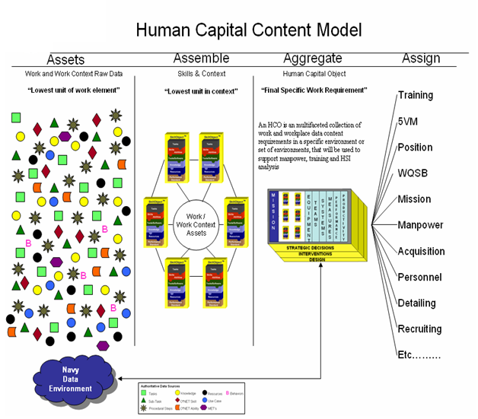
Activity: Content Aggregation Model
Position Configuration Management
Mass Customization
Data Integration with Legacy systems
Process Control

Slide 19
Questions?

