Slide 1

Competences Assessment based on Semantic Networks: the eCCO tool
Clementina Marinoni - Oxford, October 11, 2006

Slide 2
Drivers
Different ICT competences and ICT job profiles models from training and labour institutions
Difficulties speaking a shared ICT language among companies, both vendors and users, as well as the other institutions
Different points of views on ICT job profiles between companies and training or labour agencies (any company adopts its own sets of ICT job profiles that usually are fewer and richer than those ones suggested by official institutions….)
Different training and learning objectives

Slide 3
Objectives, method, findings
Goals
The study
Guiding
principles
Key features
found
Developing an ICT competence management system, able to analyse, represent, compare and integrate the different Italian and European approaches and to assess ICT competences
- Participating in the work teams within the European and Italian eSkillsForum
Models/ Metamodels
From Italy: ISFOL (Istituto per lo Sviluppo Professionale dei Lavoratori, close to the Italian Ministries of Welfare and Education, University and Research), IFTS (Istruzione e Formazione Tecnica Superiore), SIL (Italian job market place), ANASIN and other ICT company associations
- From Europe: SFIA (Skills Framework for the Information Age)- eSkills UK, APO/AITTS (German project mainly by Bitkom+IGMetal), Career Space, Eucip (by CEPIS)
Prevailing approaches;
Most flexible approaches
* Definition of competence ≡ knowledge (and skills) put into action in a specific context towards measurable objectives;
* Identification of competences by Top Down (from business processes and job profiles)/ Bottom Up (from people’s best practices) approaches;
* Representation of competences through modular / holistic approaches;
* Competence models aimed towards performances or learning

Slide 4
The model
Knowledge ≡ know-how, know-what and know-why
Knowledge Object (KO) ≡ a “small enough”, self consistent set of knowledge (with respect to specific areas of analysis, targets, objectives, etc.)
Skill ≡ KO put into action, KO + Action Verb (AV)
Competence ≡ KO put into action in specific contexts of activity (Cx), KO + AV + Cx, that is, to be able to do something in a given context
Performance ≡ a set of observable behaviours producing an objective result
Job profile ≡ a set of competences related to key performances and expected results

Slide 5
A part of the semantic network
From the profile:
EUCIP SW Developer
Object oriented
database
architecture
Create
database
triggers
Create
database
tables
Database
primary key
constraints
Hierarchical
database
architecture
Create
database
stored
procedures
Database
foreign key
constraints
Create
database
users defined
functions
Database
unique
constraints
Create
database
objects
Matrix
database
architecture
Create
database
indexes
Relational
database
architecture
Design
database
entity keys
Select
database
architecture
Create
physical
database
Use
erwin
Use
oracle
design2000
Create
database
cotraints
Create
database
cotraints
Physical
level data
abstraction
Troubleshoot
failed database
object creation
Physical
data
model
Use
database
design tools
Apply
databases
modifications
databases
Database
file groups
Exploit data
abstraction
Modify
physical
database
Design
database
Database
file placement
Record
based logical
data model
Conceptual
level data
abstraction
Object
based logical
data model
Define
database
entities
Database
growth
strategies
View
level data
abstraction
Apply
object based
logical models
Database
space
requirements
Design
attribute
domain
integrity
Apply
object oriented
data model
Define database
entities defined
by normalization
Database
data types
Database
check
constraints
Apply entity
relationship
data model
REQUIRE
Database
data
nullability
Apply
modifications
of databases
to support
partitioned
views
Define database
entities defined
by composition
IS A

Slide 6
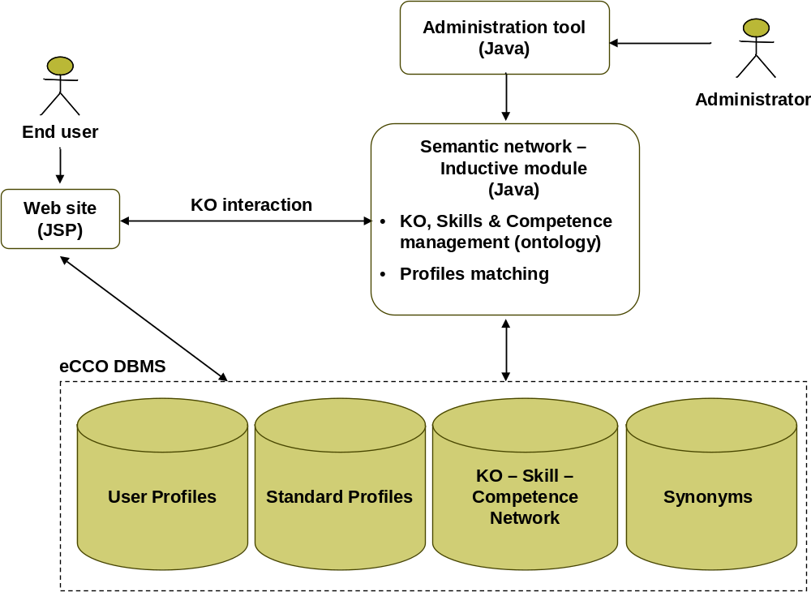
The eCCO system architecture

Slide 7
The eCCO system architecture
The eCCO structure is not hierarchical but based on a semantic network
The nodes are KOs or KOs + AVs (skills); the relationships between them are is-a, requirements linkages
A profile is a subset of the network and it is made of nodes and linkages. It can be formalised as a list of KOs and KOs + AVs
Any institution has an administrator (local administrator) who can insert their own KOs, AVs and profiles
A super administrator manages the whole semantic network
Local administrators can see the whole semantic network but they can only manage the subset referred to their institution
In this way, any institution shares the same grammar and can cooperate to make the semantic network grow

Slide 8
Ongoing activities and next steps
Testing the eCCO tool
Going on populating it
Developing an ontology
Connecting KOs to learning modules
Developing learning paths
Developing a learning model consistent with the cognitive and constructivist approaches and based on non-formal and informal learning principles
Mapping and linking business and work processes

Slide 9
The eCCO management system
Administrators:
  A super administrator (who can see and change the whole semantic network)
  Local administrators (who can see the whole semantic network but who can only change the subset referred to their institution)
Users who assess their ICT competences:
  inside a company / organisation
  as individuals
Local Project managers (from each company / organisation)

Slide 10
The application for End Users: a tool for assessment

Slide 11
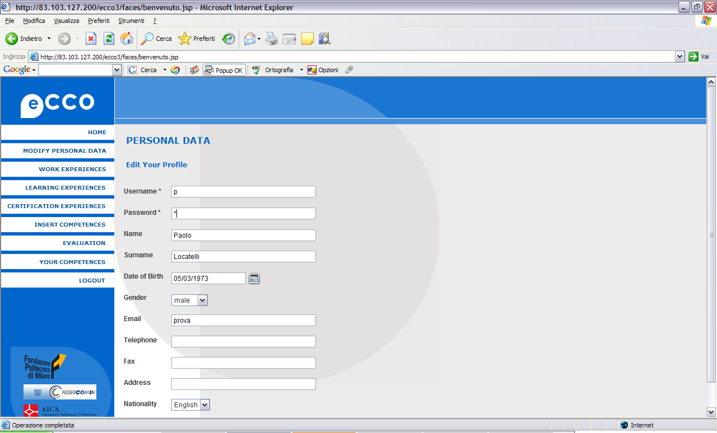
Personal data management

Slide 12
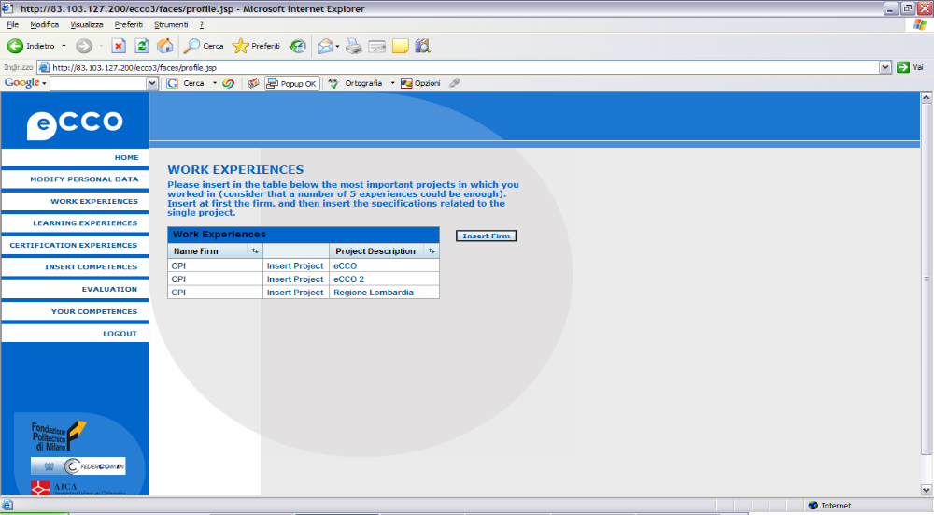
Work experiences

Slide 13
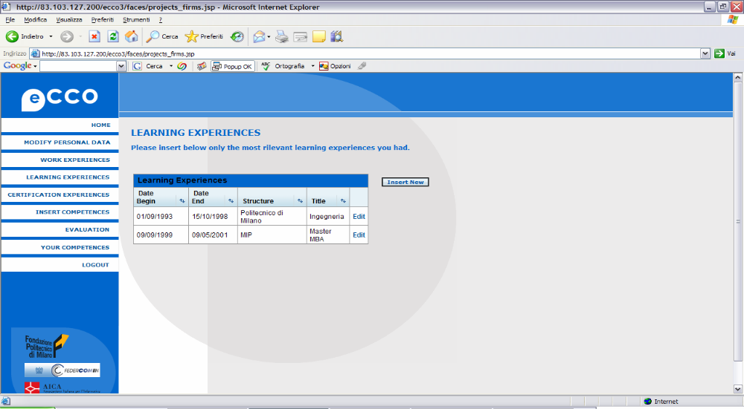
Learning experiences

Slide 14
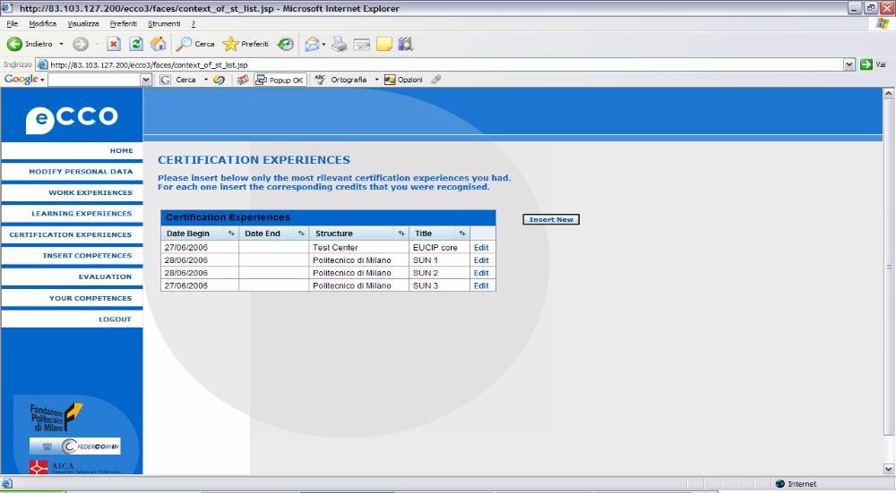
Certifications

Slide 15
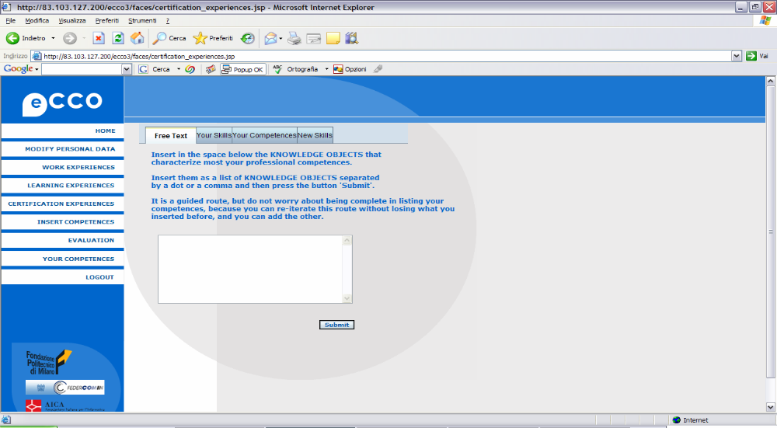
The input of competencies (1/5)

Slide 16
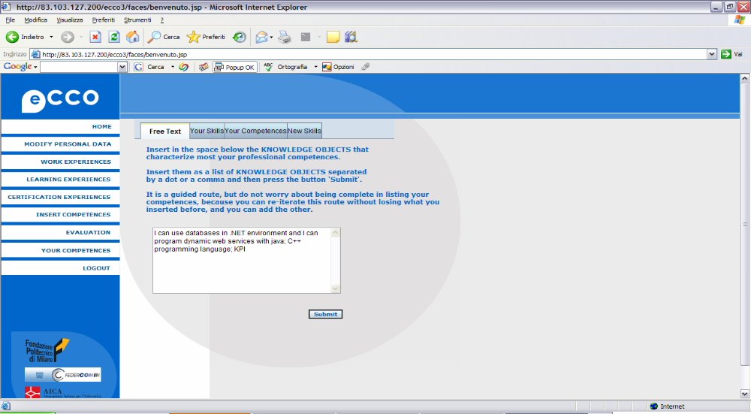
The input of competencies (2/5)

Slide 17
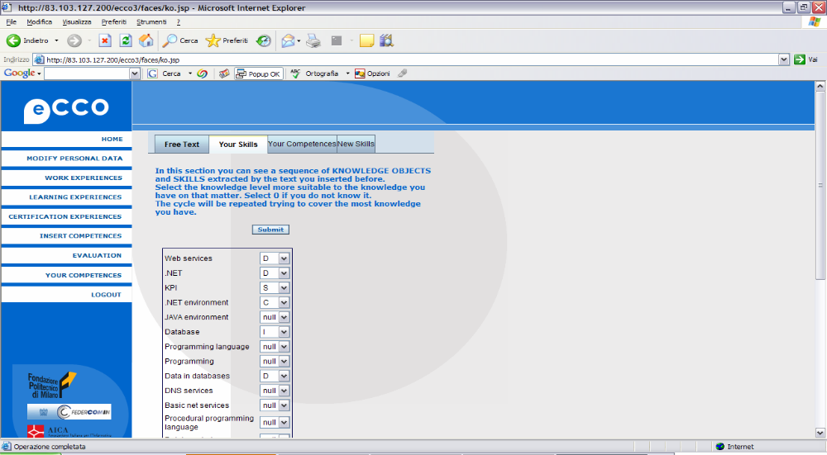
The input of competencies (3/5)

Slide 18
The input of competencies (4/5)

Slide 19
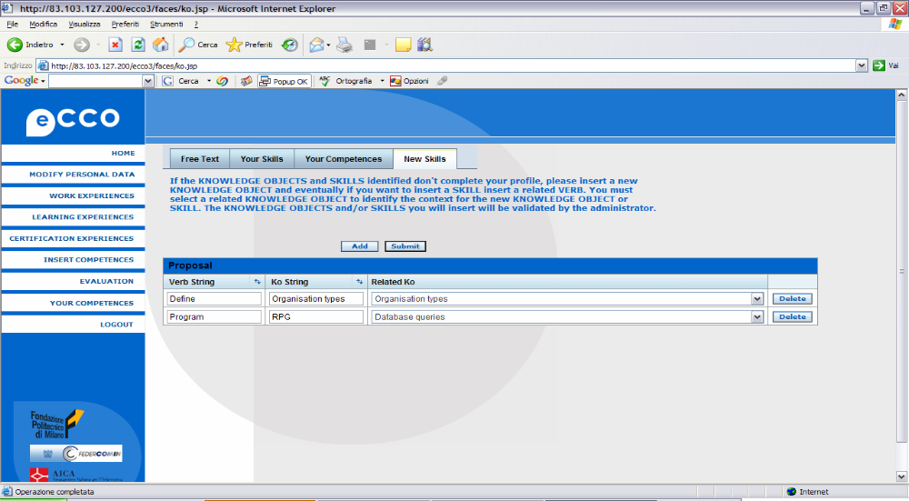
The input of competencies (5/5)

Slide 20
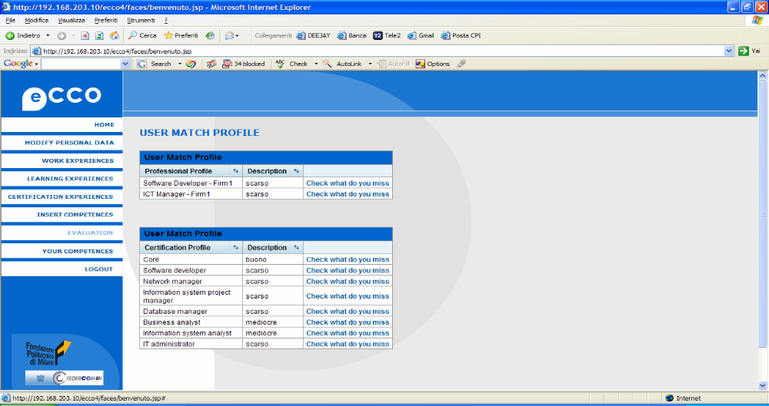
Evaluation

Slide 21
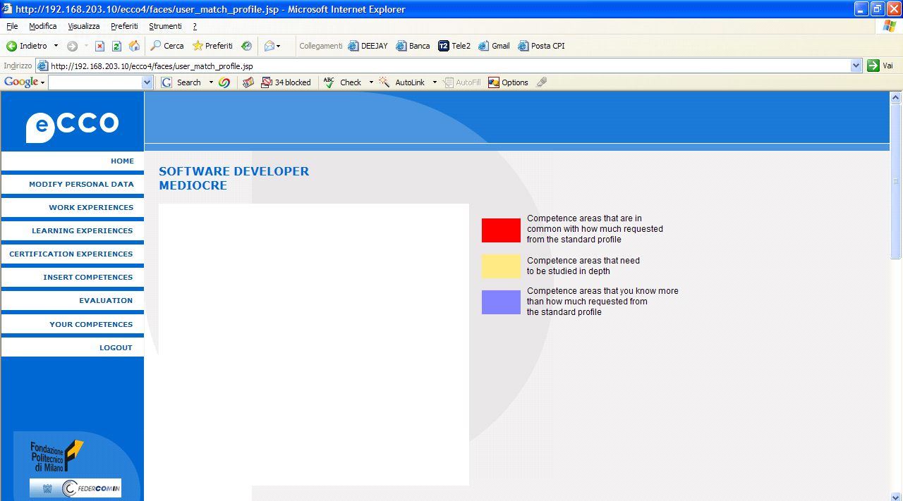
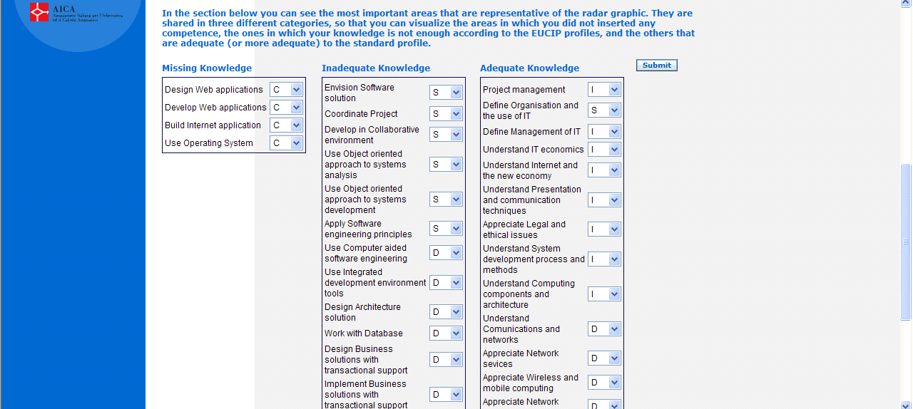
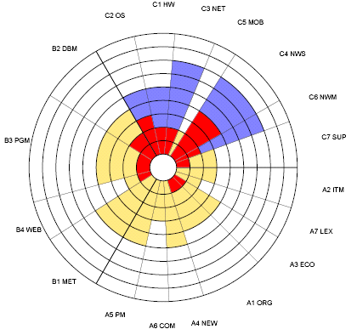

Evaluation: Radar

Slide 22
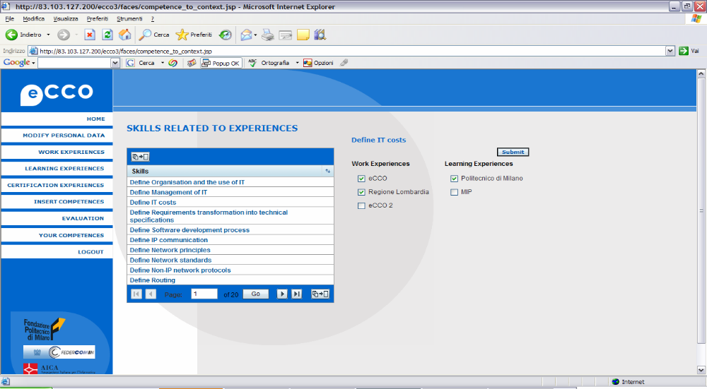
Competencies summary

Slide 23
The application for Administrators: an example from a local administrator (AICA with Eucip profiles)

Slide 24
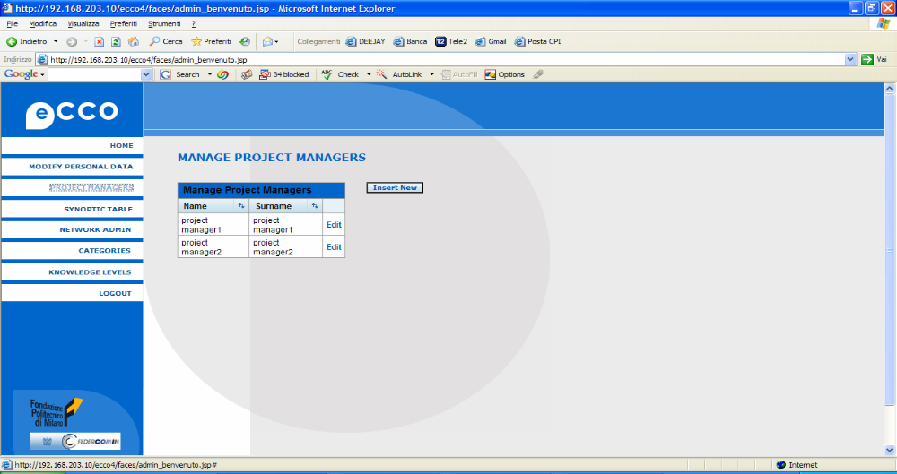
Project manager area

Slide 25
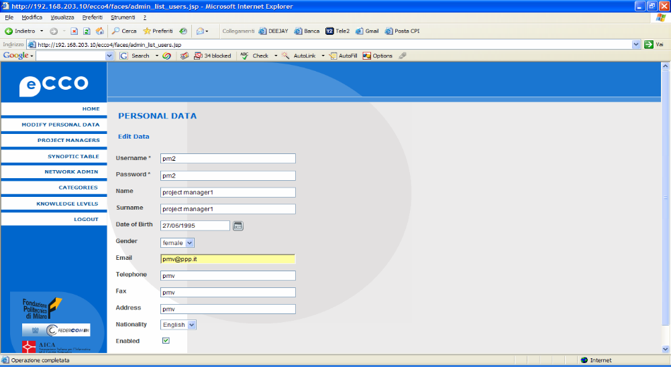
Project manager data change

Slide 26
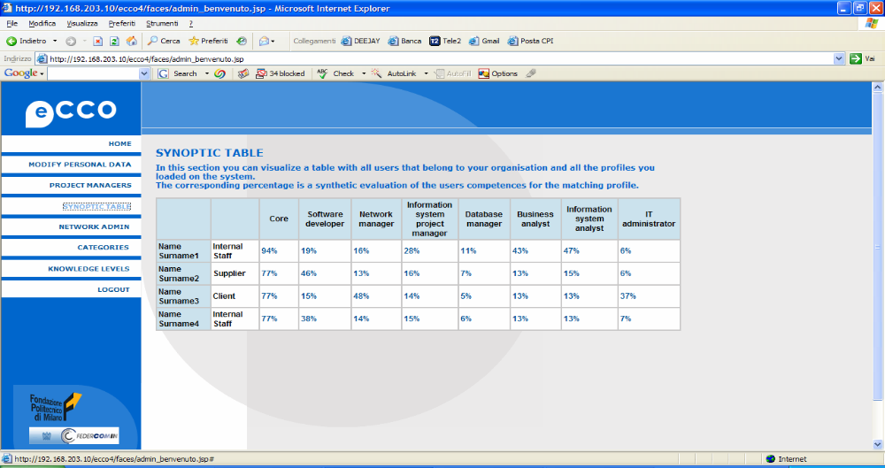
Table of reports

Slide 27
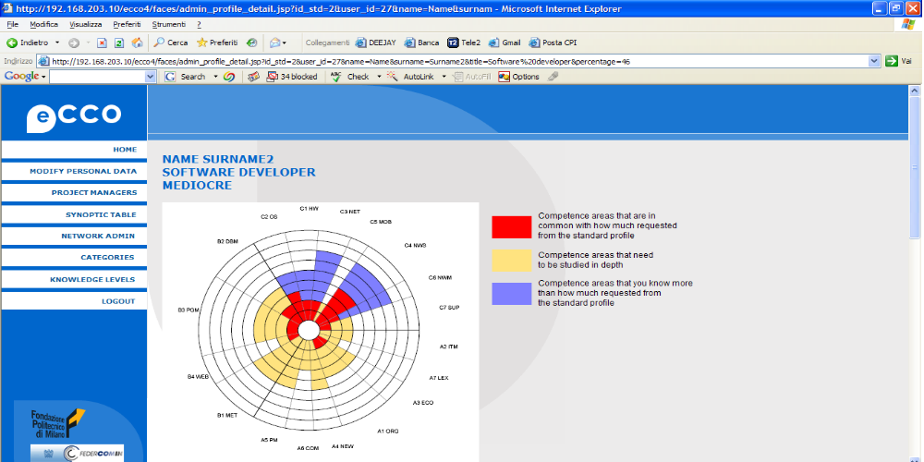
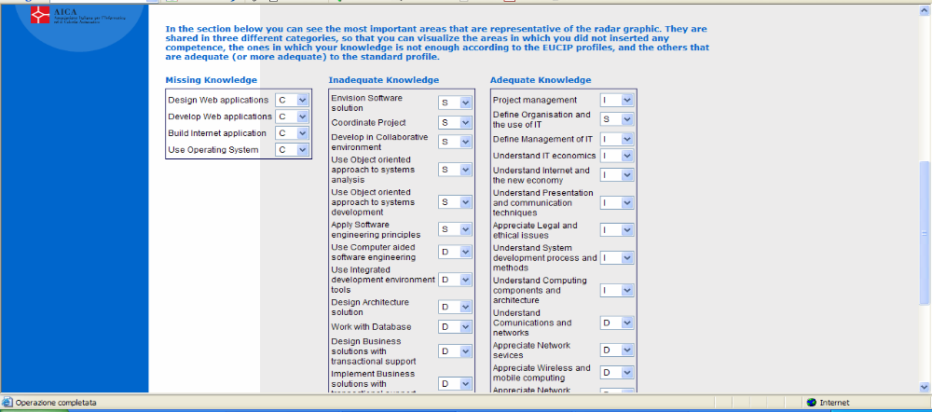
Reports

Slide 28
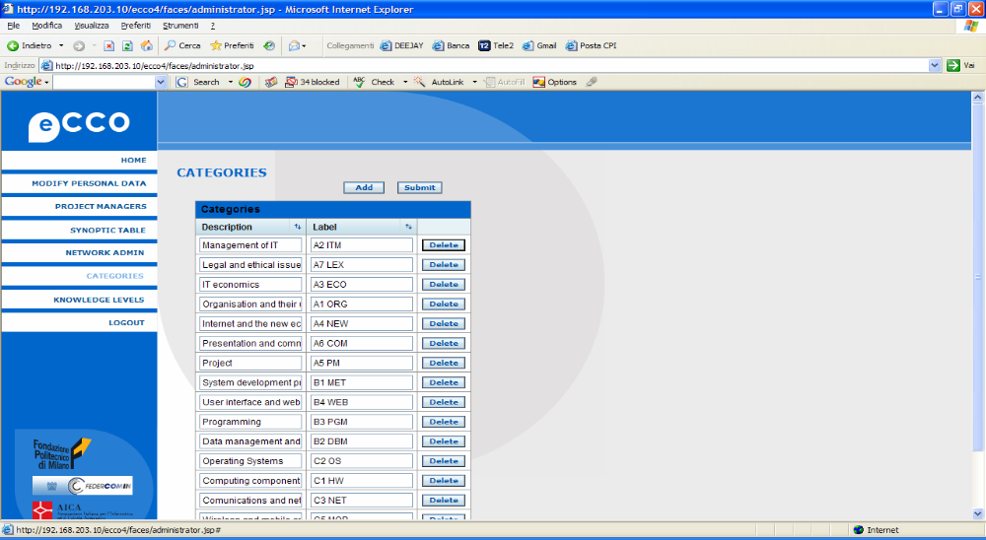
Profiles categories

Slide 29
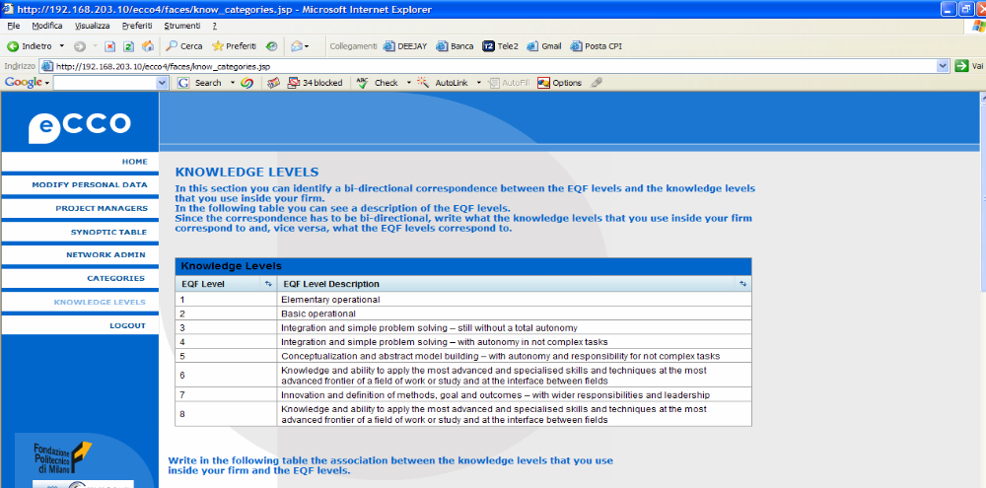
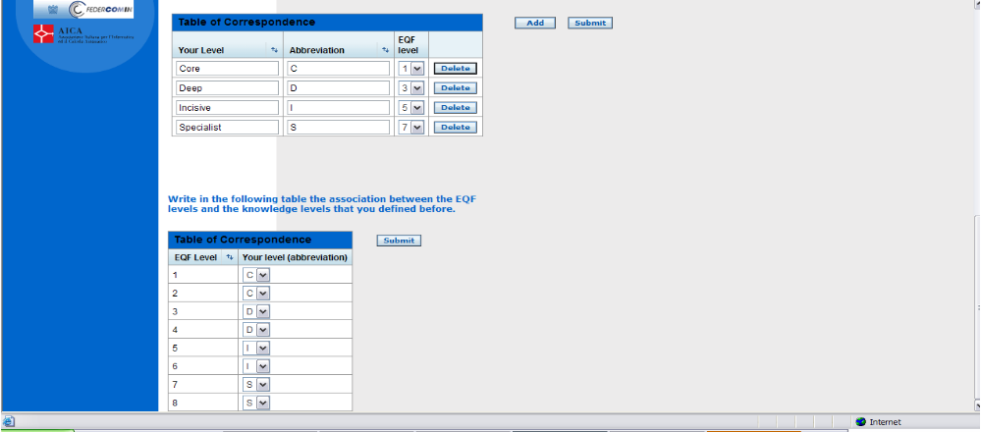
Profiles levels

Slide 30
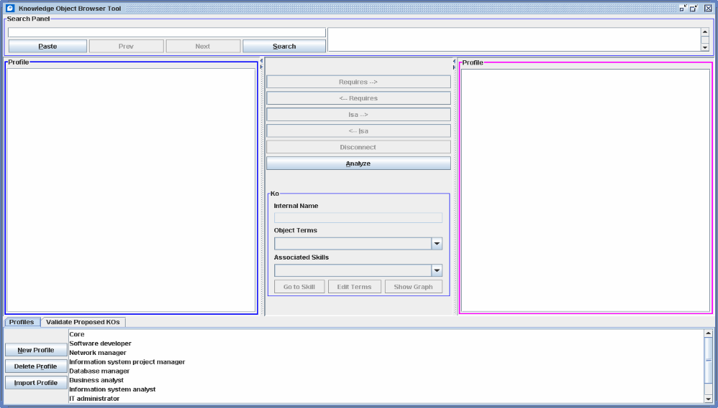
Semantic network administration 1/5

Slide 31
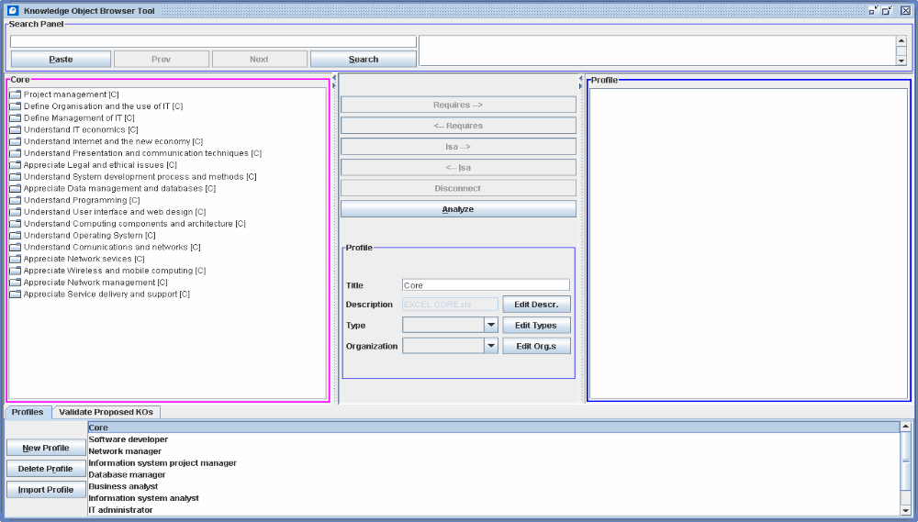
Semantic network administration 2/5

Slide 32
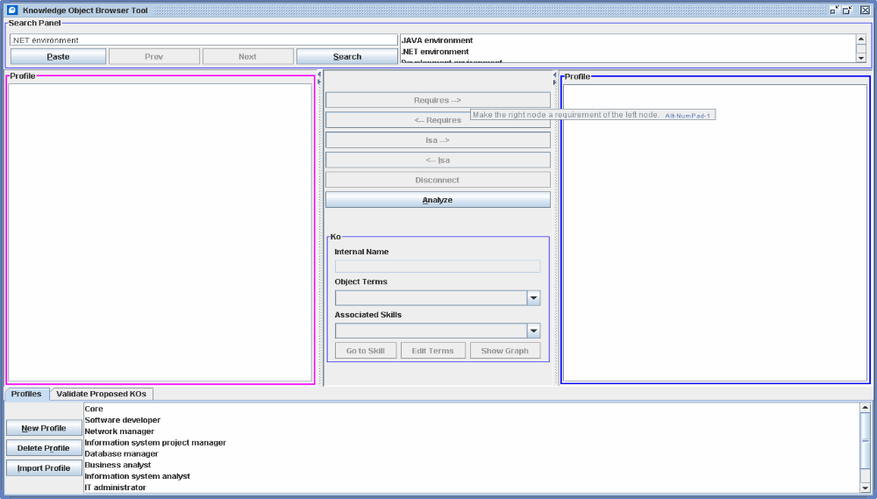

Semantic network administration 3/5

Slide 33
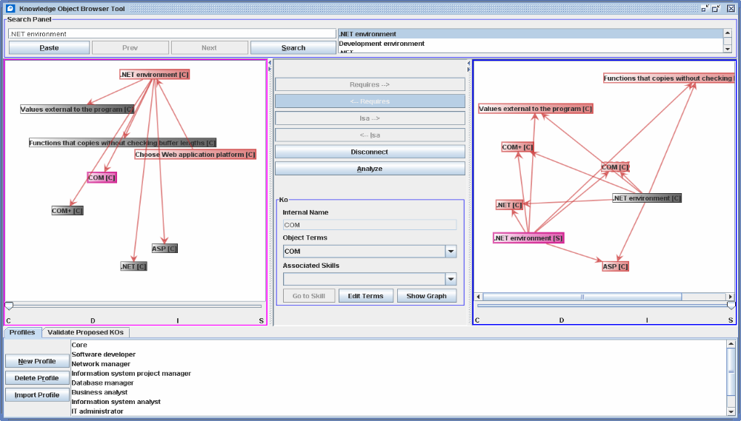
Semantic network administration 4/5

Slide 34
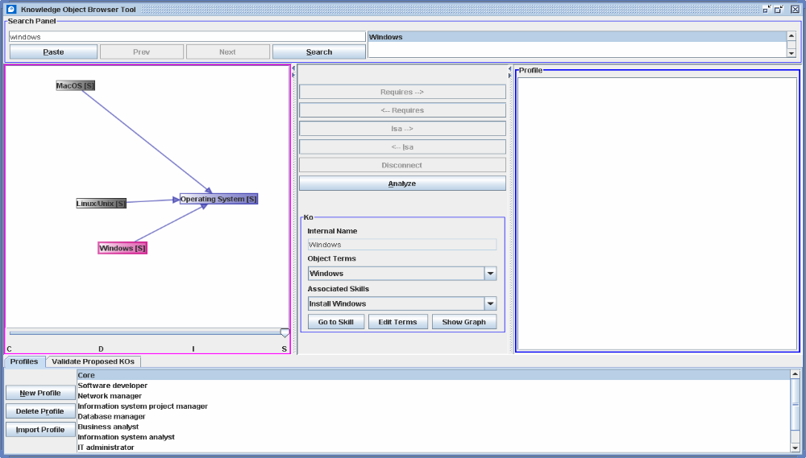
Semantic network administration 5/5

Slide 35
Clementina Marinoni
Fondazione Politecnico di Milano
Via Garofalo, 39 20133 Milano – I
+39 02 2399 9168
marinoni@fondazionepolitecnico.it
www.fondazionepolitecnico.it
I

