Slide 1
An Ontological Approach to Competency Translation
Leonardo TRACE Project
Karsten Lundqvist, Keith Baker, Shirley Williams
University of Reading, UK

Slide 2
Many Problems
Culture
  Countries
  Sectors
  Workplaces
Frameworks
  Diversity in approaches
  Different measures
  Multiple goals
Individuals
  Diversity
  Conform to any model?
ePortfolio
  Allow diversity
  Free text
  Free links
  No conformance
  Evidence
Ontology
  One viewpoint
  Rigid

Slide 3
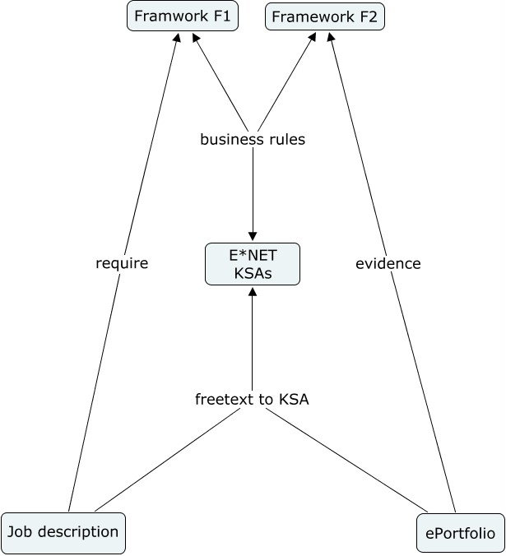
Solution Model
KSA - O*NET
  Knowledge
  Skills
  Ability
Frameworks
  Rule based Referencing
Feasibility From free text to KSA
  Granularity
  Data mining
  Folksonomies
  Tag ontology

Slide 4
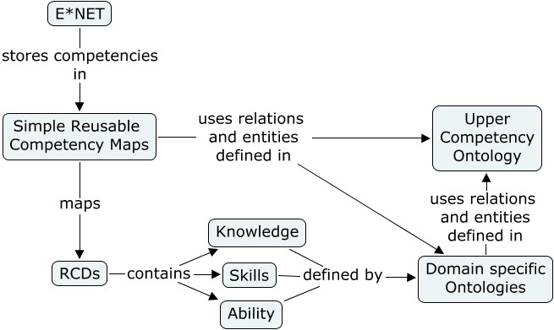
Internal Model
Formally Specified entities and relations enables:
  Referencing
  Aggregation
  Comparison
  Translation

