Slide 1
Semantic Metadata Extraction using GATE
  Diana Maynard
  Natural Language Processing Group
  University of Sheffield, UK

Slide 2
h-TechSight project
Integration of a variety of next generation knowledge management technologies, in the domain of chemical engineering.
Knowledge Management Portal enables support for knowledge intensive industries in monitoring information resources on the Web:
  observe information resources automatically on the internet
  notify users about changes occurring in their domain of interest.
Much effort in terms of knowledge management has been placed in the area of employment because it affects every organisation and business
Monitoring job advertisements over time can alert users to changes such as requirements for skills, general trends in the field, comparison of salaries, etc.

Slide 3
An Architecture for Language Engineering
GATE is used to enable the ontology-based semantic annotation of web-mined documents
Instances in the text are linked with concepts in the ontology
Performs analysis of unrestricted text to extract from the text instances of concepts in the ontologies
Instances linked to the ontology are exported to a database, enabling monitoring of such instances and concepts over time, according to the user’s interests

Slide 4
Gate IE system
Architecture consists of a pipeline of processing resources which run in series
Many of these processing resources are language and domain-independent
Pre-processing stages include:
  word tokenization
  sentence splitting
  part-of-speech tagging
Main processing is carried out:
  by a gazetteer linked to one nor more ontologies
  by a set of grammar rules

Slide 5
Demo Employment ontology
Demo Employment ontology has 9 Concepts: Location, Organisation, Sectors, JobTitle, Salary, Expertise, Person and Skill
Each concept in the ontology has a set of gazetteer lists associated with it, which help identify instances in the text
  default lists - quite large and contain common entities such as first names of persons, locations, abbreviations etc.
  domain-specific lists - need to be created from scratch.
  keyword lists - collected for recognition purposes to assist contextually-based rules, also attached to the ontology, because they clearly show the class to which the identified entity belongs.
Lists can be acquired automatically from the web or from training data

Slide 6
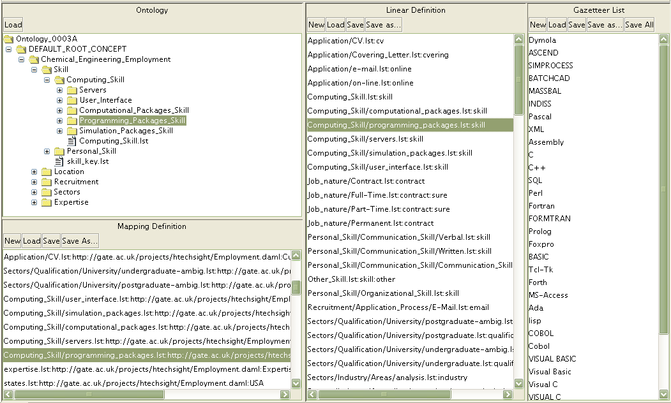
Populated ontology
Lists are linked directly to an ontology, such that instances found in the text can then be related back to the ontology

Slide 7
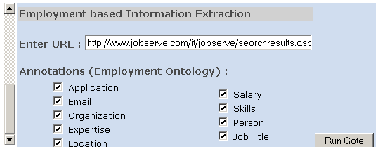
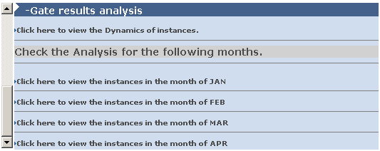
Visualisation of Results
Implemented as a web service.
User selects a URL and the concepts in which he/she is interested
System performs the analysis
User can view analysis in different ways
URL Site Declaration Area
Concept Selection Area

Slide 8
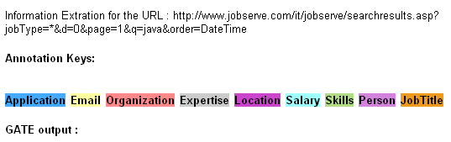
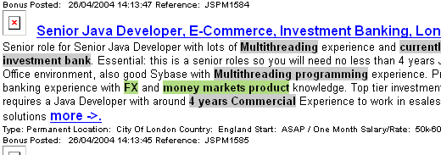
Visualisation of Results
A new web page is created with highlighted annotations

Slide 9
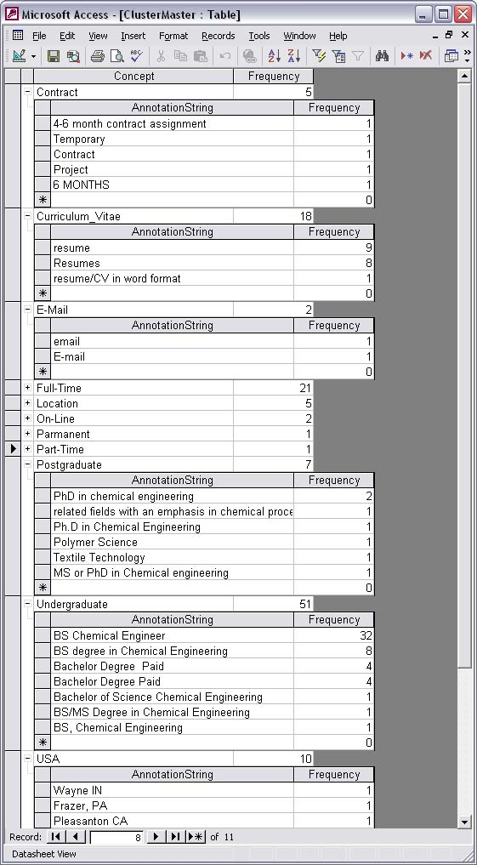
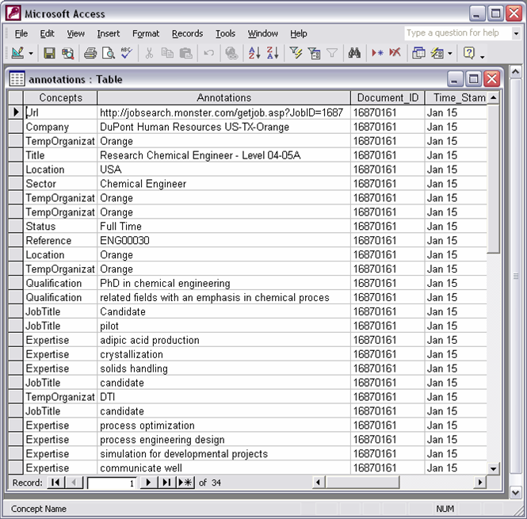
Database Output
The occurrences of the instances over time are stored dynamically in a database

Slide 10
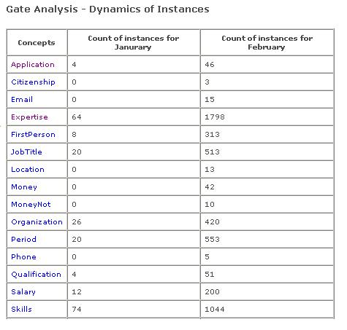
Dynamics of Concepts
Users may see tabular results of statistical data about how many annotations each concept had in the previous months, as well as seeing the progress of each instance in previous time intervals
Click a Concept to see Dynamics of its Instances

Slide 11
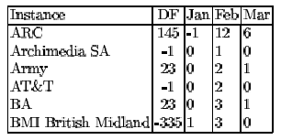
Dynamics of Instances
DF is an elasticity metric that quantifies dynamics of an instance, taking account of volume of data and time period
Instances for the concept "Organisation" can track the recruitment trends for different companies.
Monitoring instances for concepts such as Skills and Expertise can show which kinds of skills are becoming more or less in demand.

Slide 12
Evaluation and User feedback
Overall, the system achieved 97% Precision and 92% Recall
Tested by real users in industry, e.g. Bayer, JetOil, IChemE.
Found to be “helpful in increasing efficiency in acquiring knowledge and supporting project work…helping to scan, filter, structure and store the wealth of information”
Application areas spanned from R&D, engineering and production, to marketing and management
Employment application was a “valuable means of graduates gaining a fresh insight into their jobs and related training which may be narrower than it ideally should due to company constraints (i.e. time and money)

