Slide 1
Stories of
Research and Education under Israeli Occupation
24/4/2024
Mustafa Jarrar
Birzeit University
Palestine
Notes:
Thank you for this introduction
and
Thank you for inviting me to talk about the challenges
facing the Palestinian academia under the Israeli education
Before telling you our sad stories about the occupation and
the challenges we face,
and ((how (YOU) can help us))
I first show some positive stories.
I will show how I established a successful research lab
without money or resources.

Slide 2
Content
The story of my research lab
Challenges facing us
Ways to help usa

Slide 3
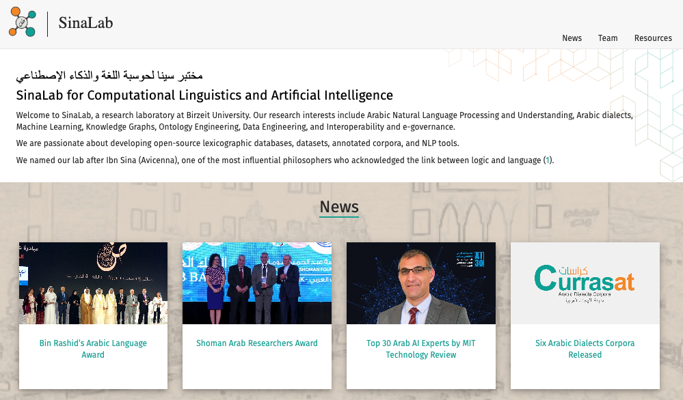
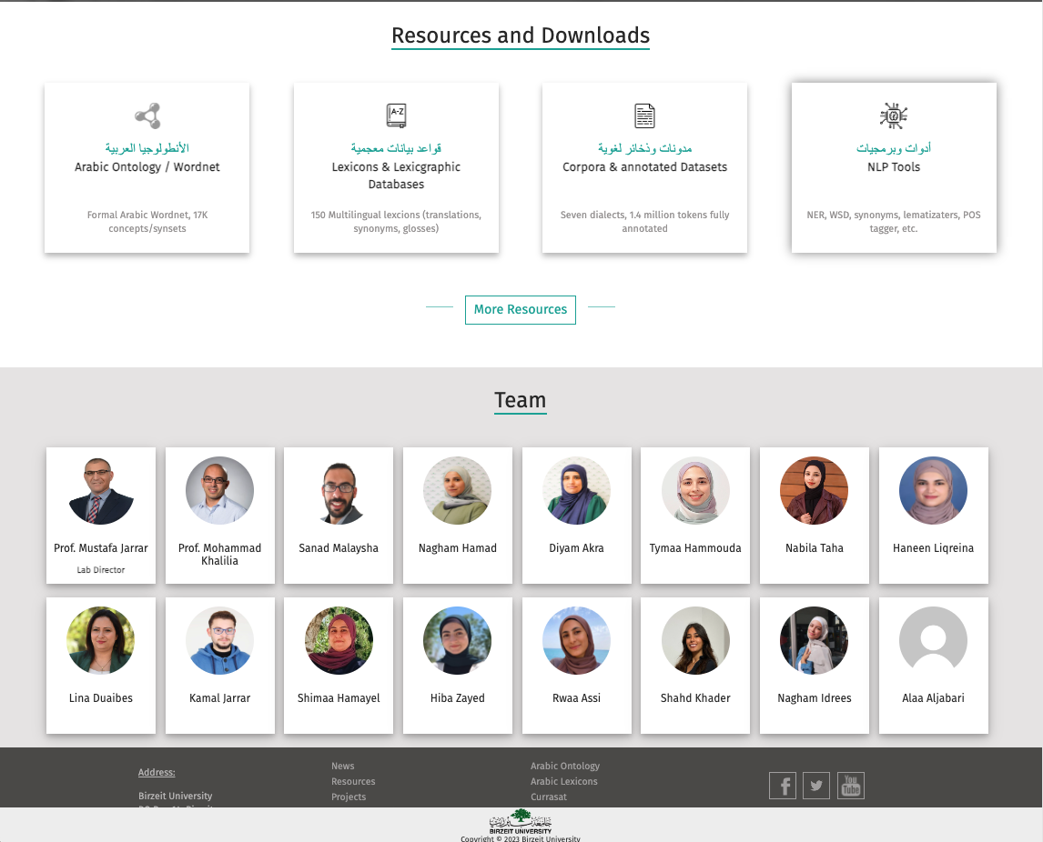
https://sina.birzeit.edu/

Slide 4
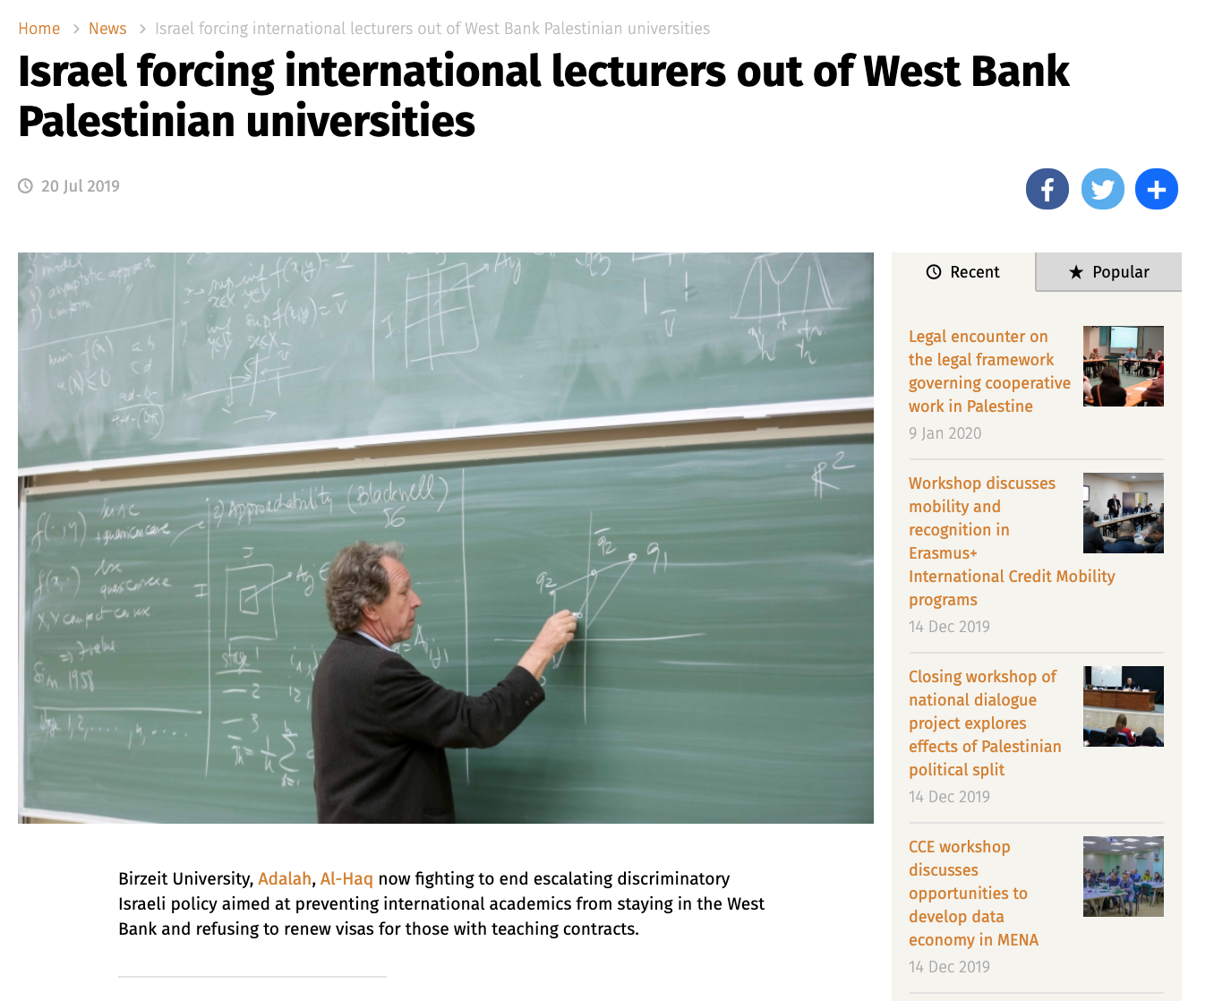
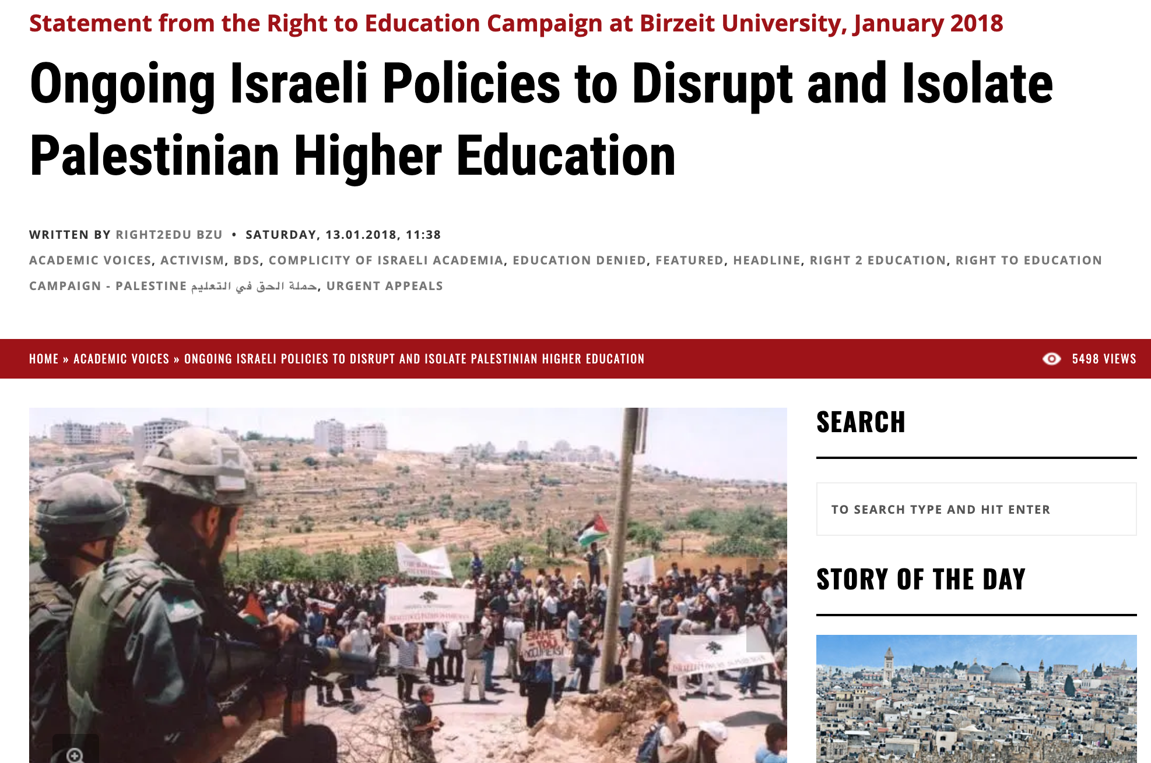
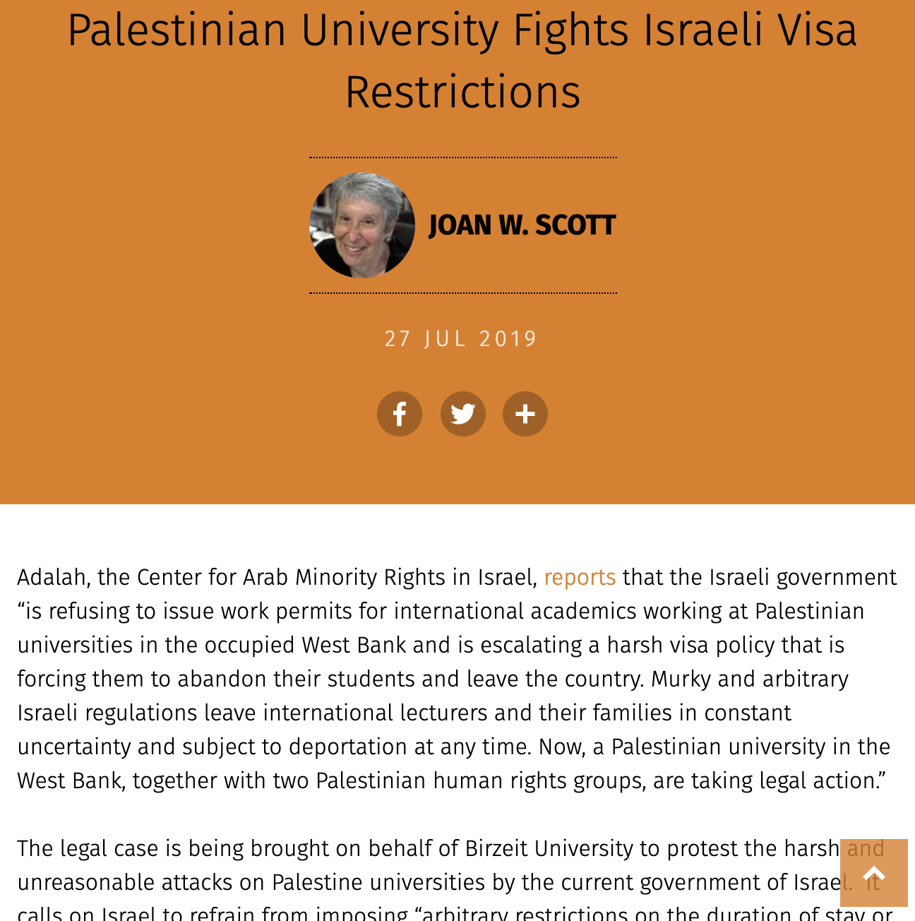
Cannot recruit external professors
Israel does not give permission or long term VISAs
Notes:
One of the major challenges we face (you can imagine its impact) is that
We're unable to hire external professors because Israel doesn't
issue long-term visas, which restricts our ability to bring in
expertise from abroad and collaborate with academics internationally.

Slide 5
Resource Limitations
No Research Funding programs
Palestine is an authority (not a state) and has no financial resources.
Difficult for universities to maintain adequate funding for research.
Very limited access to academic journals, books, and resources, GPUs, data …
No funding to travel conferences …..
Notes:
Another challenge (you can imagine its implication) is that
we have no or limited financial resources or research funding.
And thus
we have no or very limited access to academic journals, books, resources, cloud and GPUs, dataset, …
we have very limited funding to travel conferences …..

Slide 6
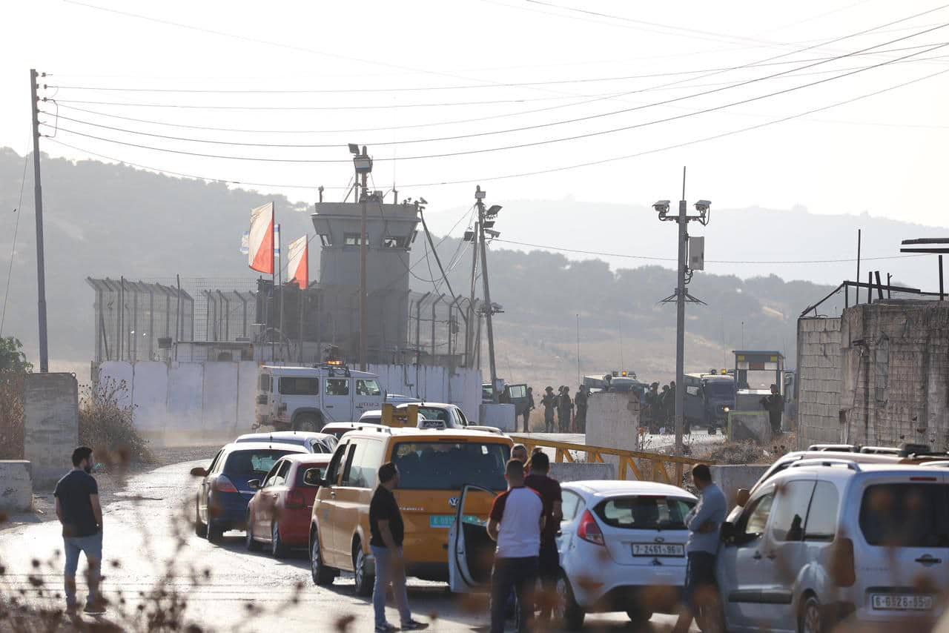
Restrictions on Movement
Students and researchers are often delayed by checkpoints and roadblocks.
Leave home very early, and come back very late (very disturbing)!
Disrupts educational schedules
Notes:
A more visible and more direct challenge for Palestinian
academia is the mobility restrictions
Staff and Students cannot make it on time
often delayed by checkpoints
Imagine you are giving a lecture/exam, and many
students do not come, or come late!
This disrupts our educational schedules

Slide 7
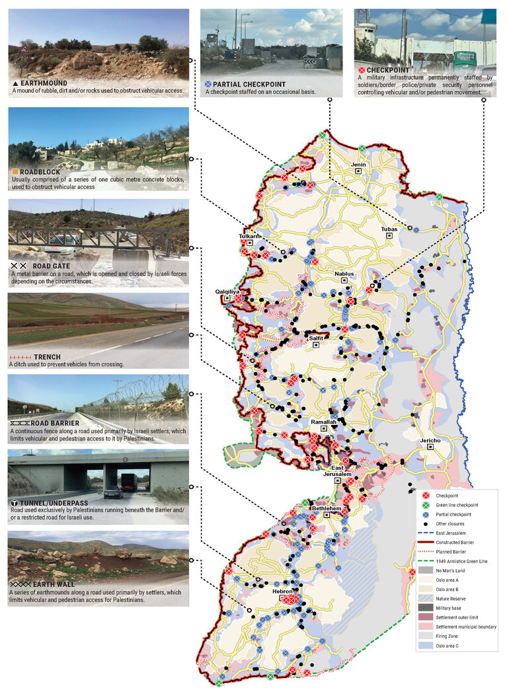
Restrictions on Movement
https://www.ochaopt.org/2023-movement
Notes:
Extremlly diffecuclt to travel between scities – or from town to a city
There are different types of blokades and checkpoits (perminant, temporal, occasional, etc)
The goal of the checkpoits is not security but rather, a humiliation specially for students and young man

Slide 8
When traveling for conferences and meetings
travel to Jordan/Egypt and fly from there (mostly closed,).
Extra time! extra cost! Extra security checks and humiliation!
Impact not only on Palestinian scientists,
but others avoid partnering with us!
Notes:
the complexity is also when we traval confernces and meetings
we have to travel to jordan or egypt to fly from there
(the border are mostly close of very crowded)
and you can imagine the impact (time, cost, security ...)
and makes it diffecult for people to cooperate with us

Slide 9
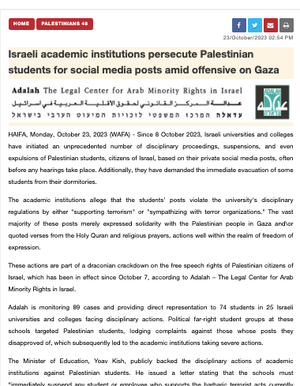
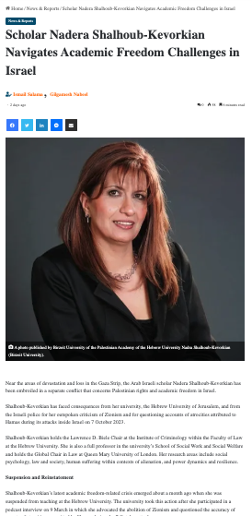
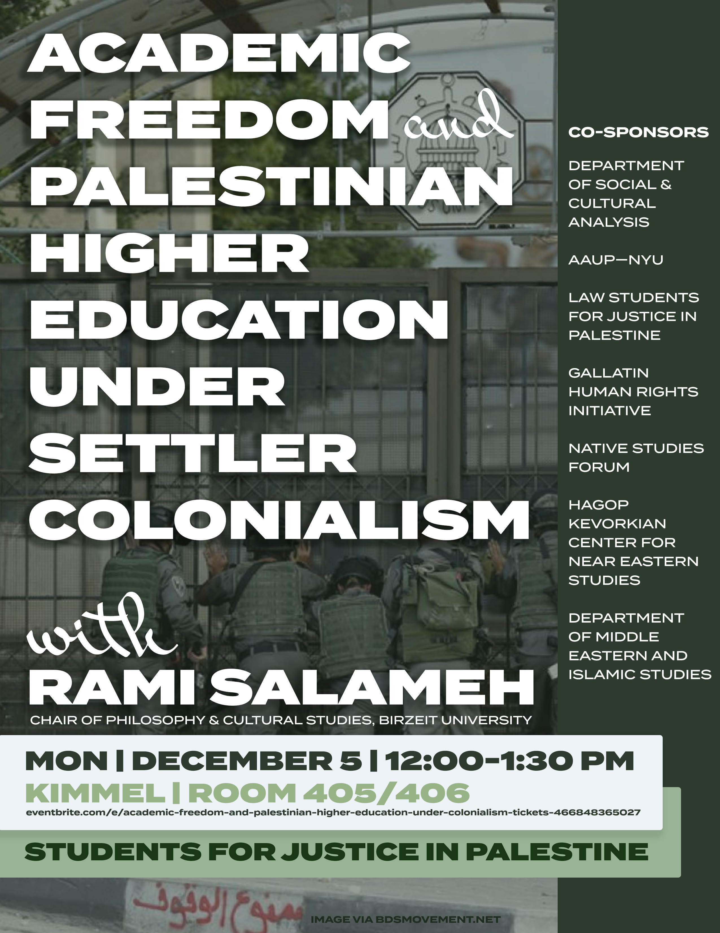
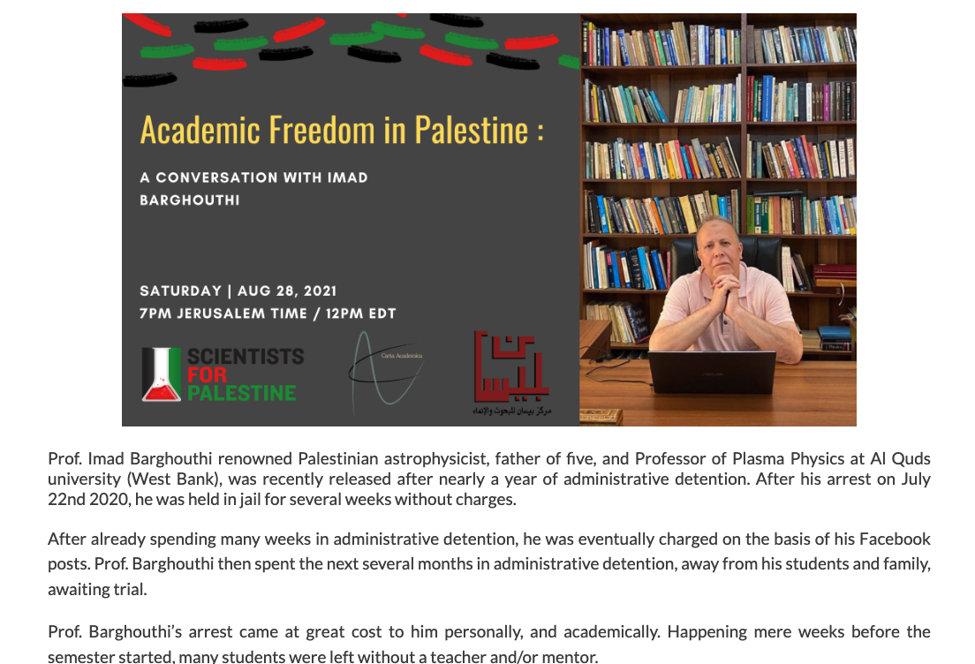
Academic Freedom
الحرية الأكاديمية
limitations by Israel, on research topics, publications, and expressing opinions.
Academic Bias, in some academic journals and communities.
Notes:
Academic freedom for the Palestinian academia, is a big issue because of Israeli restrictions.
Some academics have ended up in jail for speaking out, even on social media.
On top of that, Palestinian scholars face bias in the academic world, with some journals
refusing papers from Palestine.

Slide 10
Academic Brain Drain
هجرة العلماء
Academics are pushed to leave (especially in Gaza)
weakening the local research and
education sector.
Notes:
Brain drain is a serious issue in the Palestinian Academia.
Unfortunately, insecurity and political and social restrictions
drive skilled academics to leave the country
This currently a very serious issue in Gaza,
and you can imagine how the education sector without professors
and established academics.

Slide 11
Educide in Gaza
deliberately targeting universities and academics in Gaza
killed
5,479 students
261 teachers
95 university professors,
3 university presidents
injured
7,819 students
756 teachers
Destroyed:
195 Heritage sites
227 Mosques
3 churches
60% educational facilities (all/17 universities, 80% of schools in Gaza)
625,000 students have no access to education
Source: https://www.ohchr.org/en/press-releases/2024/04/un-experts-deeply-concerned-over-scholasticide-gaza
Notes:
The situation is Gaza is not like the situation in Webst Bank
In West Bank we talk about serious threats and challenges
In Gaza we talk about total Educide:
Intentionally destroying all universities and killing academics and students.

Slide 12
How to help Palestinian Academia
كيف تدعم الأكاديميا في فلسطين
Priority to Gaza and Jerusalem
In many ways, such as:
Advocacy and awareness
Combat discrimination and Bias
Resources and Funding
Open Access Publications
Joint research projects
Cash to students/universities
Joint PhD supervision
Promote Palestinian researchers
Invite us to chair events
Scholarships and Exchanges
Research visits
Teaching visits
Supporting and cooperating with Palestinians is good
they are Passionate, Smart and hardworking ;-)
Notes:
I am sure each of you might be thinking about how
to help the Palestinian Academia
The priority of help should go first to the acadmia Gaza and Jerusalem
these are some suggestions

Slide 13
Thank You

