Slide 1
DevOps Traning
GIT Terminology

Slide 2
GIT: Goals & Objectives
Repository Contains files, history, Config managed by GIT

Slide 3
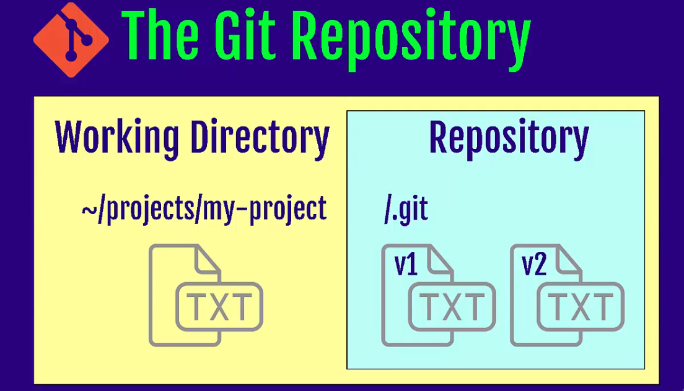
GIT: Goals & Objectives

Slide 4
GIT: Goals & Objectives
Three Stages of GIT
Working Directory
Staging Area – pre Commit Holding Area
Commit – GIT Repository(History)
Remote Repository (GITHUB)
Master Branch

Slide 5
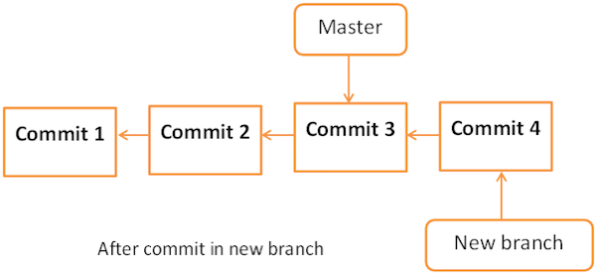
GIT: Goals & Objectives

Slide 6

DevOps Training : Docker

