Slide 1
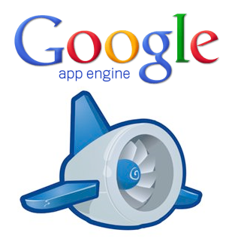
Platform as a Service (PaaS)
Anmar galb

Slide 2
Scope:
Platform as a Service (PaaS)
What is Google App Engine.
  Overview
  Components
  Programming languages support
  Data storage
  App Engine services
  Security
Why to use App Engine.
Lifecycle App Engine.
Architecture App Engine.
When to use Google App Engine.
Developer of App Engine.

Slide 3
1. Platform as a Service (PaaS)
Cloud computing service which provides a computing platform and a solution stack as a service.
Consumer creates the software using tools and/or libraries from the provider.
Provider provides the networks, servers, storage, etc.

Slide 4

2. What is Google App Engine.
Overview
Google App Engine (often referred to as GAE or simply App Engine) is a platform as
a service (PaaS) cloud computing platform for developing and hosting web
applications in Google-managed data centers. Applications are sandboxed and run
across multiple servers. App Engine offers automatic scaling for web applications—
as the number of requests increases for an application, App Engine automatically
allocates more resources for the web application to handle the additional demand.
It was first released as a preview version in April 2008, and came out of
preview in September 2011.

Slide 5

2. What is Google App Engine.
  Overview
Google App Engine lets you run web applications on Google's infrastructure.
Easy to build.
Easy to maintain.
Easy to scale as the traffic and storage needs grow.
Yes, free for upto 1 GB of storage and enough CPU and bandwidth to support 5 million page views a month. 10 Applications per Google account.
Free ???

Slide 6
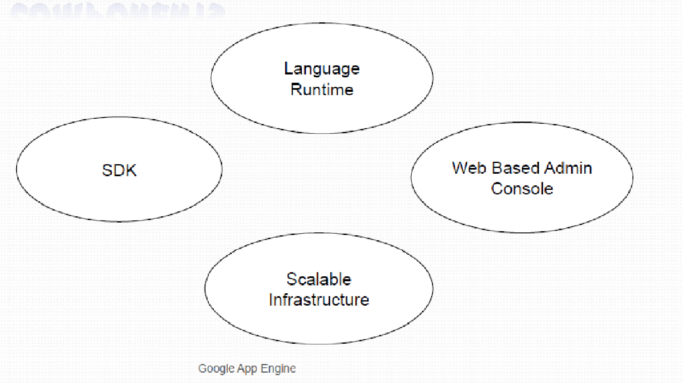
2. Components App Engine.

Slide 7
2. What is Google App Engine.
  Programming languages support
Java:
App Engine runs JAVA apps on a JAVA 7 virtual machine (currently
supports JAVA 6 as well).
Uses JAVA Servlet standard for web applications:
  WAR (Web Applications ARchive) directory structure.
  Servlet classes
  Java Server Pages (JSP)
  Static and data files
  Deployment descriptor (web.xml)
  Other configuration files
Getting started :
  https://developers.google.com/appengine/docs/java/gettingstarted/

Slide 8
2. What is Google App Engine.
  Programming languages support
Python:
Uses WSGI (Web Server Gateway Interface) standard.
Python applications can be written using:
  Webapp2 framework
  Django framework
  Any python code that uses the CGI (Common Gateway Interface) standard.
Getting started :
  https://developers.google.com/appengine/docs/python/gettingstartedpython27/

Slide 9
2. What is Google App Engine.
  Programming languages support
PHP (Experimental support):
Local development servers are available to anyone for developing
and testing local applications.
Only whitelisted applications can be deployed on Google App Engine.
(https://gaeforphp.appspot.com/).
Getting started: https://developers.google.com/appengine/docs/php/
Google’s Go:
Go is an Google’s open source programming environment.
Tightly coupled with Google App Engine.
Applications can be written using App Engine’s Go SDK.
Getting started:
https://developers.google.com/appengine/docs/go/overview

Slide 10
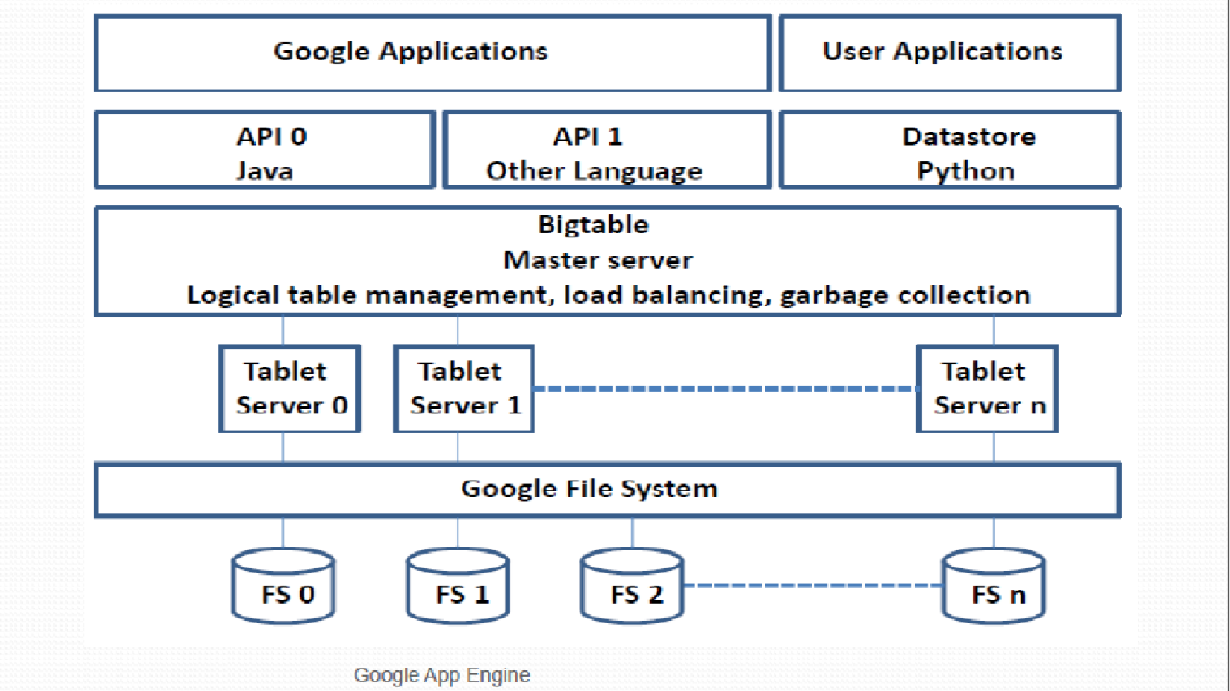
2. What is Google App Engine.
Data storage

Slide 11
2. What is Google App Engine.
  Data storage
App Engine Datastore:
NoSQL schema-less object based data storage, with a query engine and
atomic transactions.
Data object is called a “Entity” that has a kind (~ table name) and a set of
properties (~ column names).
JAVA JDO/ JPA interfaces and Python datastore interfaces.
Google cloud SQL:
Provides a relational SQL database service.
Similar to MySQL RDBMS.

Slide 12
2. What is Google App Engine.
  Data storage
Google cloud store:
RESTful service for storing and querying data.
Fast, scalable and highly available solution.
Provides Multiple layers of redundancy. All data is replicated to multiple
data centers.
Provides different levels of access control.
HTTP based APIs.
Notes:
Difference between Google data store and Google cloud store:
=> Cloud store uses the same Google infrastructure as used by other Google products, like, Google drive, etc. Multiple levels of redundancy and gaurantees high availability.
=> Data store is a schema-less key-value based dedicated solution just for Google App Engine.

Slide 13
2. What is Google App Engine.
  App Engine services
App Engine also provides a variety of services to perform common operations when managing your application.
URL Fetch:
    Facilitates the application’s access to resources on the internet, such as web services or data.
Mail:
  Facilitates the application to send e-mail messages using Google infrastructure.
Memcache:
  High performance in-memory key-value storage.
  Can be used to store temporary data which doesn’t need to be persisted.

Slide 14
2. What is Google App Engine.
  Security
The sandbox:
All hosted applications run in a secure environment that provides limited access to
the underlying operating system.
Sandbox isolates the application in its own secure, reliable environment that is
independent of hardware, operating system and physical location of a web server.
Limitations imposed by sandbox (for security):
  An application can only access other computers over internet using the provided URL fetch and email services. Other computers can only connect to the application through HTTP/ HTTPS requests on the standard ports (80/ 443).
  Applications cannot write to local file system in any of the runtime environments.
  Application code runs only in response to a web request, a queued task or a scheduled task and must return the response data within 60 seconds. A request handler cannot spawn a sub-process or execute code after the response has been sent.

Slide 15
3.Why to use App Engine
•Lower total cost of ownership
•Rich set of APIs
•Fully featured SDK for Local development
•Ease of Deployment

Slide 16
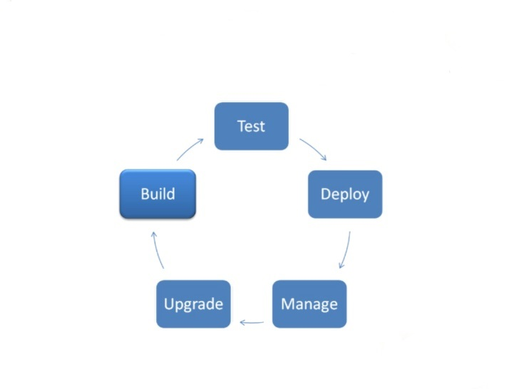
4. Lifecycle App Engine.

Slide 17
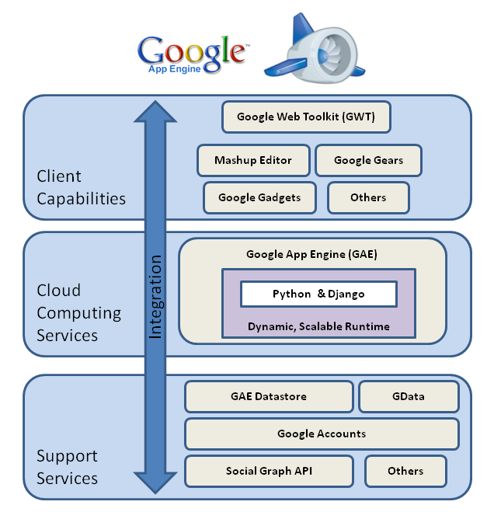
5. Architecture App Engine.

Slide 18
6. When to use Google App Engine.
Use App Engine when:
You don’t want to get troubled for setting up a server.
You want instant for-free nearly infinite scalability support.
Your application’s traffic is spiky and rather unpredictable.
You don't feel like taking care of your own server monitoring tools.
You need pricing that fits your actual usage and isn't time-slot based (App engine provides pay-per-drink cost model).
You are able to chunk long tasks into 60 second pieces.
You are able to work without direct access to local file system.

Slide 19
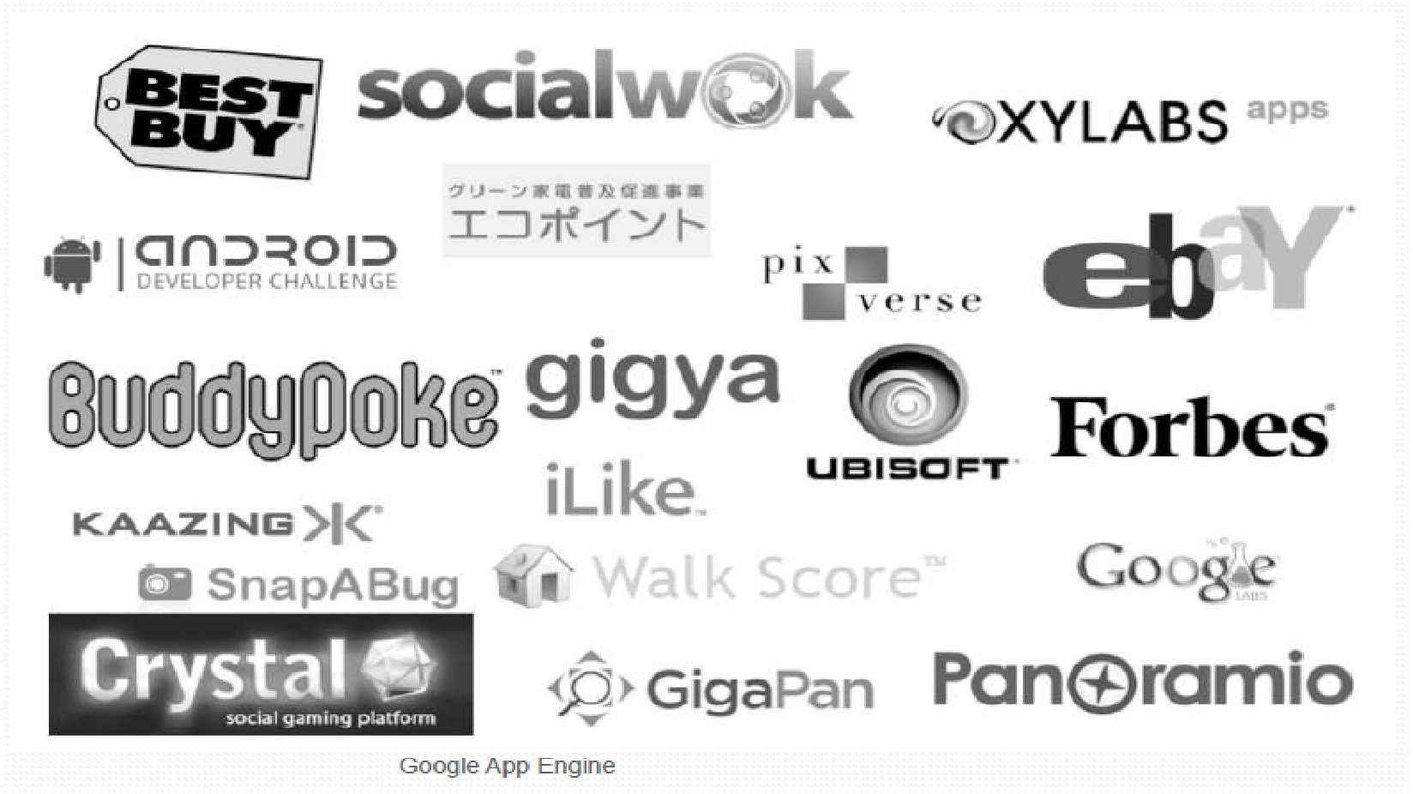
3.Developer of App Engine.

Slide 20
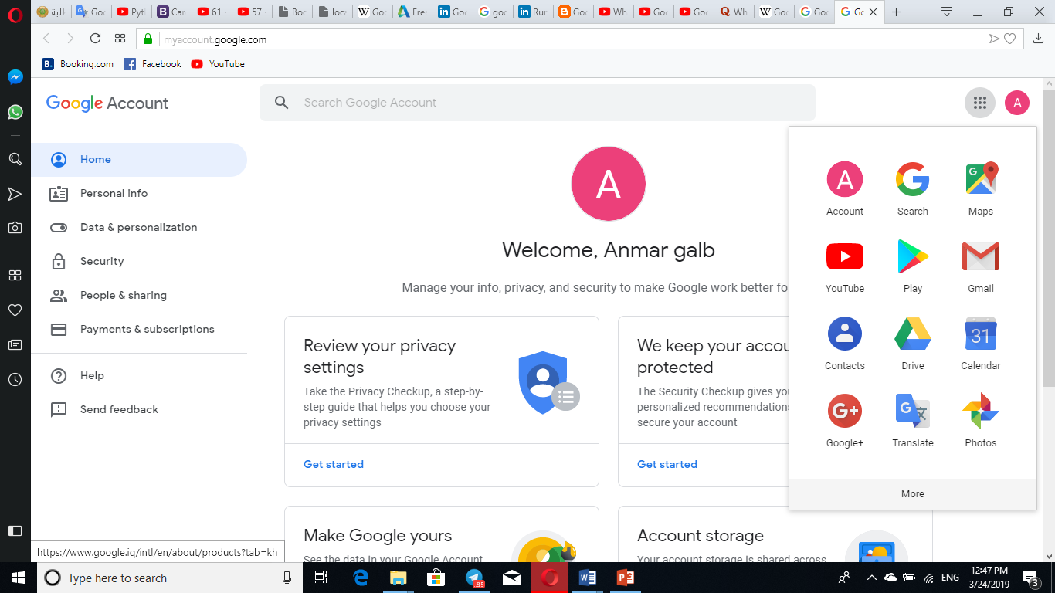

Slide 21
Thank you !

