Slide 1
A WEB MODULE FOR CLEARING SYSTEM TO MANAGE PLEDGE PROCESS
Mentor : VijayPrakash Sodisetti
I Nautix Technologies Pvt Ltd
Chennai
By,
1. Patel Vamshi Krishna - 117003137
2. Mohameed Musthafa - 117003121

Slide 2
GENERAL TERMS:
What are Shares ?
A share or stock or equity is unit of account, of company’s capital. The complete shares constitutes company’s ownership.
Each user can have any number of shares. The user gets profit/loss on shares based on the Market movements.
What is Pledging ?
Pledging is the process by which the user borrows money from the bank by placing their securities under the custody of the bank.
What is Releasing ?
The process by which the user returns money back to the bank and release his/her pledged shares.

Slide 3
What is clearing house system?
A clearing house is an intermediary between buyers and sellers of financial instruments.
Example:
If you agree to sell your 100 shares of Company XYZ to John for $10,000, the clearing house ensures that John is delivered the 100 shares and you are delivered $10,000.
It also records and reports the transaction to everyone involved.
Either way, the clearinghouse is responsible for ensuring that the transaction happens in an accurate and timely manner.
What is Auto Release ?
Auto Release is the feature in which all the securities pledged by the users are released automatically. This occurs everyday at 12 am .

Slide 4
PROBLEM STATEMENT:
In Early, it was very difficult to manage this pledge process for the individual clients.
Many system are need to be referred to check the status of the individual user’s pledge process.
To view, update and delete the user’s pledge records, DB team has to navigate to different modules which are tedious process.
To overcome this, a single page application which integrates all the three screens in one screen is developed.
The bank details, broker details and the stock details can be viewed in the same page and are processed dynamically.
Both pledge and release features are available for the end user.

Slide 5
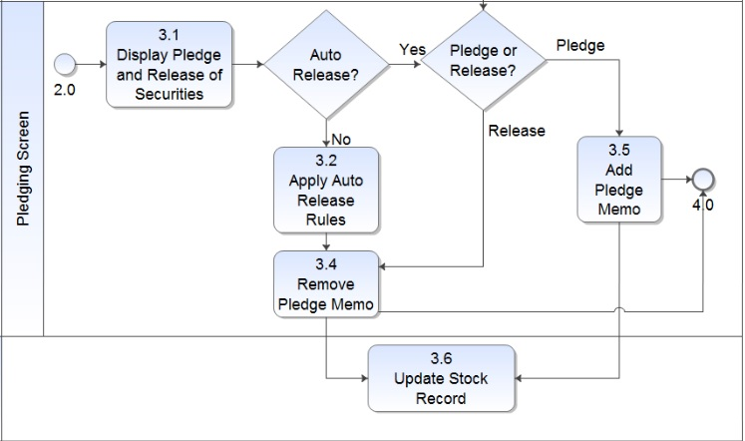
BLOCK DIAGRAM:

Slide 6
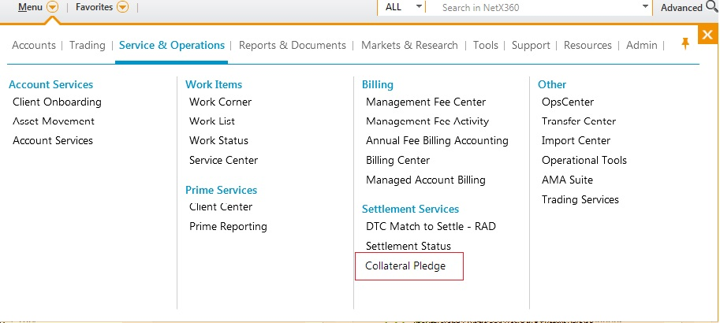
SETTLEMENT SERVICES MENU:

Slide 7
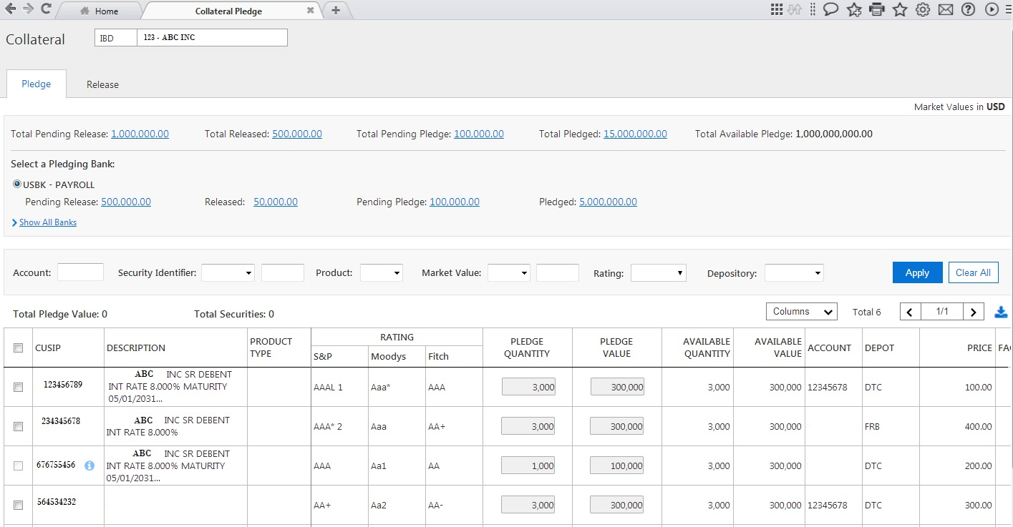
PLEDGE SCREEN:

Slide 8
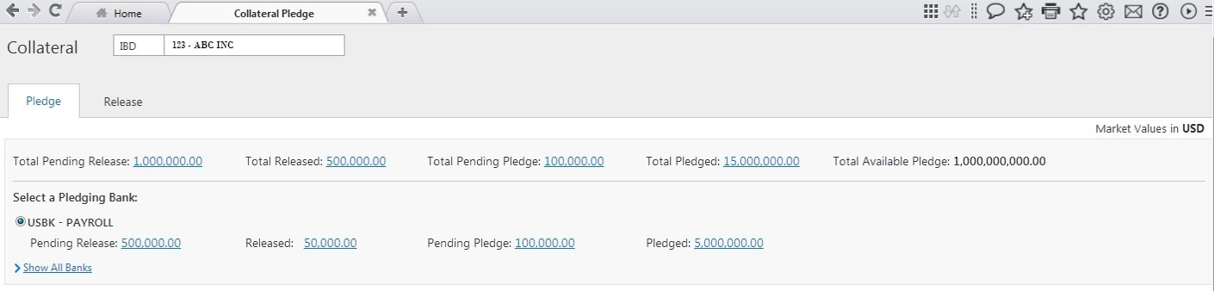
PLEDGE SCREEN- BANK LIST :

Slide 9
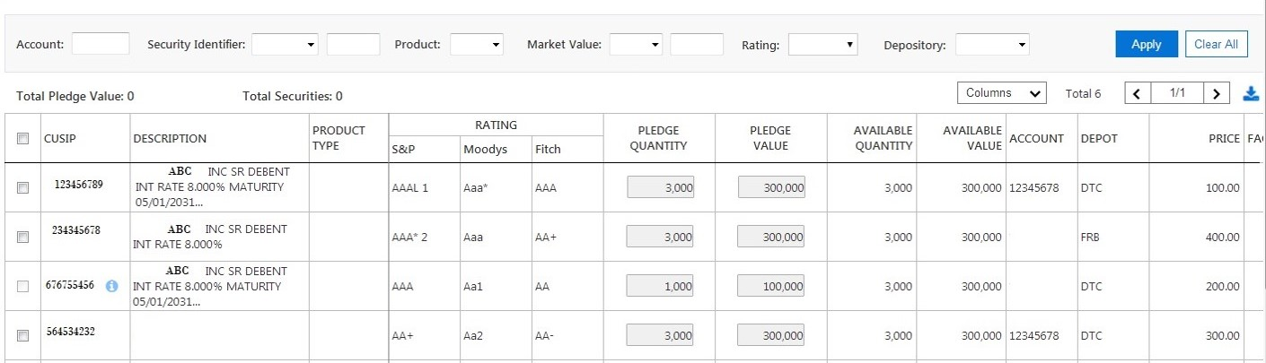
PLEDGE SCREEN-TABLE:

Slide 10
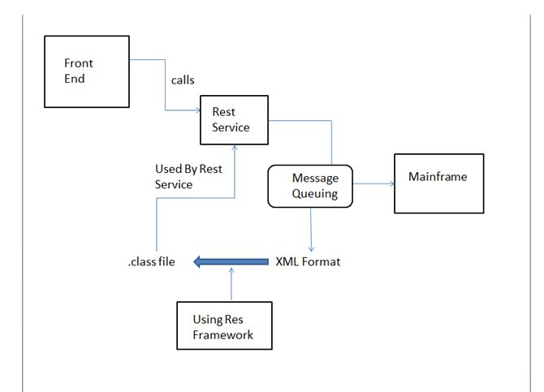
FLOW DIAGRAM:

Slide 11
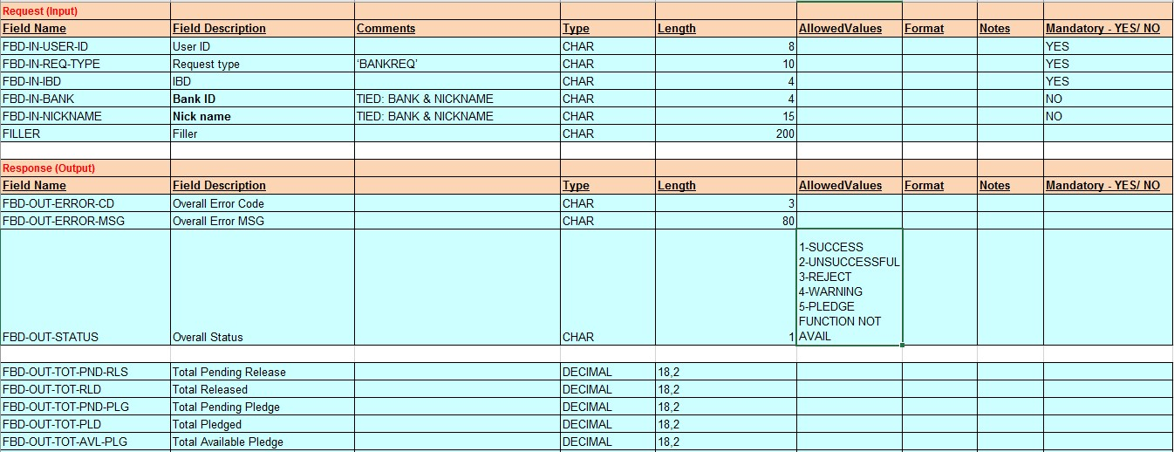
XML FORMAT:

Slide 12
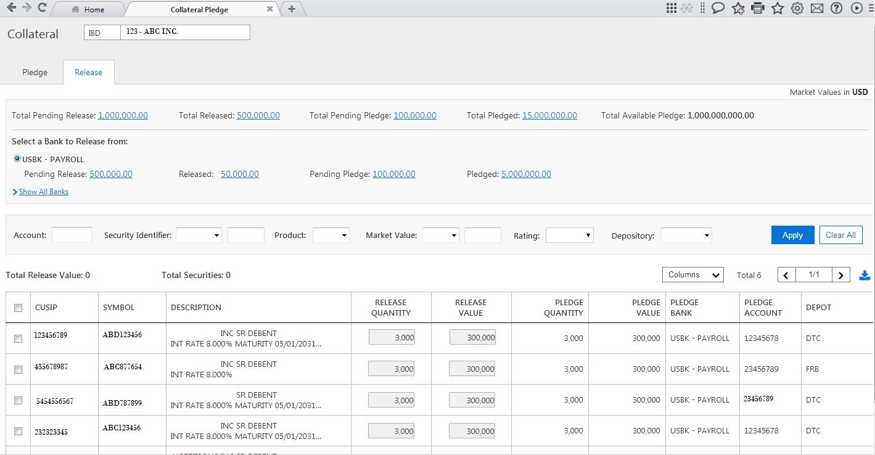
RELEASE SCREEN:

Slide 13
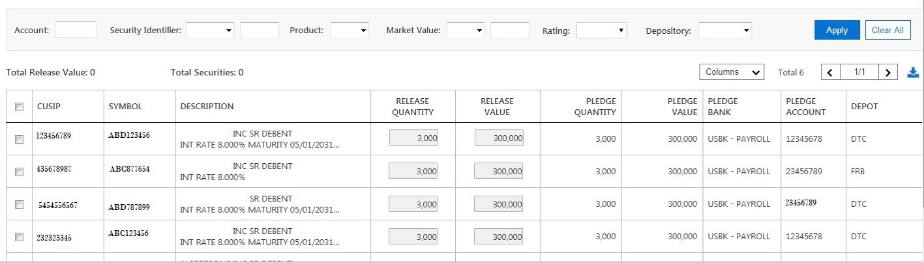
RELEASE SCREEN-TABLE:

Slide 14
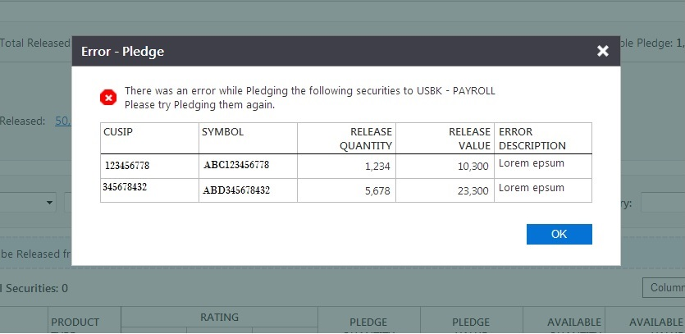
ERROR SCREEN:

Slide 15
Technologies used:
Why Angular JS FrameWork ?
Single Page Application.
Two Way Data Binding.

Slide 16
Softwares used

Slide 17
Thank you!!

