Slide 1
PROJECT-II PACKING GAME
CME1251-PROJECT BASED LEARNING-I
By
Sıla kılınç
Çağatay önal
Alperen efe

Slide 2
OUTLINE
PROGRESS SUMMARY
.Changes in Requirements
.Task Sharing and Scheduling
.Completed Tasks
.Incompleted Tasks : Reasons,Explanations
.Additional Improvements
PROBLEMS ENCOUNTERED
ALGORİTHMS AND SOLUTION STRATEGIES
SCREENSHOTS
CONCLUSION
REFERENCES

Slide 3

1- Introduction
We worked on two-player packing game.Human plays against the computer.The one who has the highest score in 60 seconds wins the game.The aim of the game is to transfer blocks from box 0 to boxes 1,2,3.
Game Elements
2 players(Human,Computer)
Randomly generated 12 blocks(length:4-9 squares) for both players(box 0 :A,B,C,D,E,F,G,H,I,J,K,L blocks for each players)
3 empty boxes (length:20 squares) for each player

Slide 4
2.1 - Changes in Requirements
First of all, when we started to code, we used string for variables but then we learned it does not count.Our teachers said to us ‘’You should use char for variables.’’.Then we change the string to char.
Secondly, when we code the timer, it did not work well.Then we changed this code.
Then, we code the view without set cursor position.
When we code to assign letters to boxes from box0,it is assigning with space and it was problem to assign letters back.Then we code it shiftingly.

Slide 5
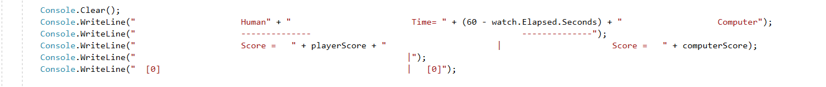
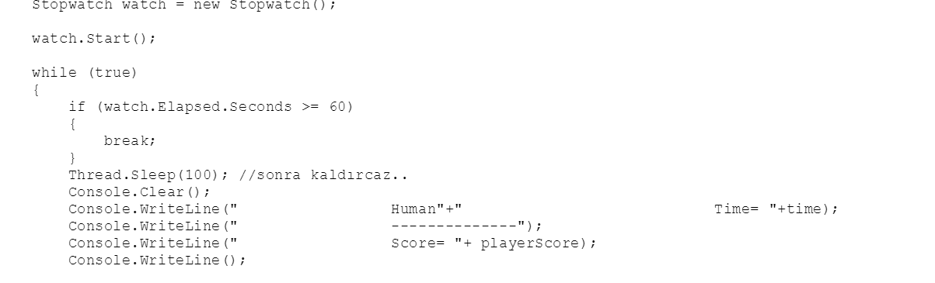

Slide 6
2.2 - Tasks Sharing and Scheduling
First of all,while we were working on plan of the way,each of us thought about new things.(For instance:ReadKey,SetCursorPosition,Timer) because we have not heard these words before.Then we tried to learn them with indivual studying.
Secondly, when we met to code,each of us tell something to develop the code.Each of us worked individually but at the end, we combined our works to find the shorter and efficient way .
Then,while we were working on poster,Çağatay worked on view of poster,Sıla and Alperen worked on content of poster.
Finally, while we were working on presentation,we met to share time of talking about presentation.Çağatay worked on design of slide.Sıla and Alperen worked on content of slide.

Slide 7
2.3-Completed Tasks
We found the letters which in box0 according to ASCII characters and we code to print letters.
We code to delete letters to write letters again.
We code to compare computer’s and user’s scores to find the winner.
While we were coding , we tried to better way for coding so we combined our indivual works.
When we finished to work on each task,we checked our metarials to find a mistake and then make it correct.

Slide 8
2.4 Incomplete Tasks:Reasons,Explanations
We could not save the best score so we could not define best score for computer.
Timer works well if the user text.Otherwise,user can not see the time.
We can not assign to box0 from box1,box2,box3 for computer.

Slide 9
2.5 Additional Improvements
We did not use SetCursorPosition so screen was shifting because of commands or assignments.So we defined ‘’spaceLength=10’’ and we code a loop to spaceLength-letters from 0 for each raw then we write ‘’ ‘’ in this loop.

Slide 10
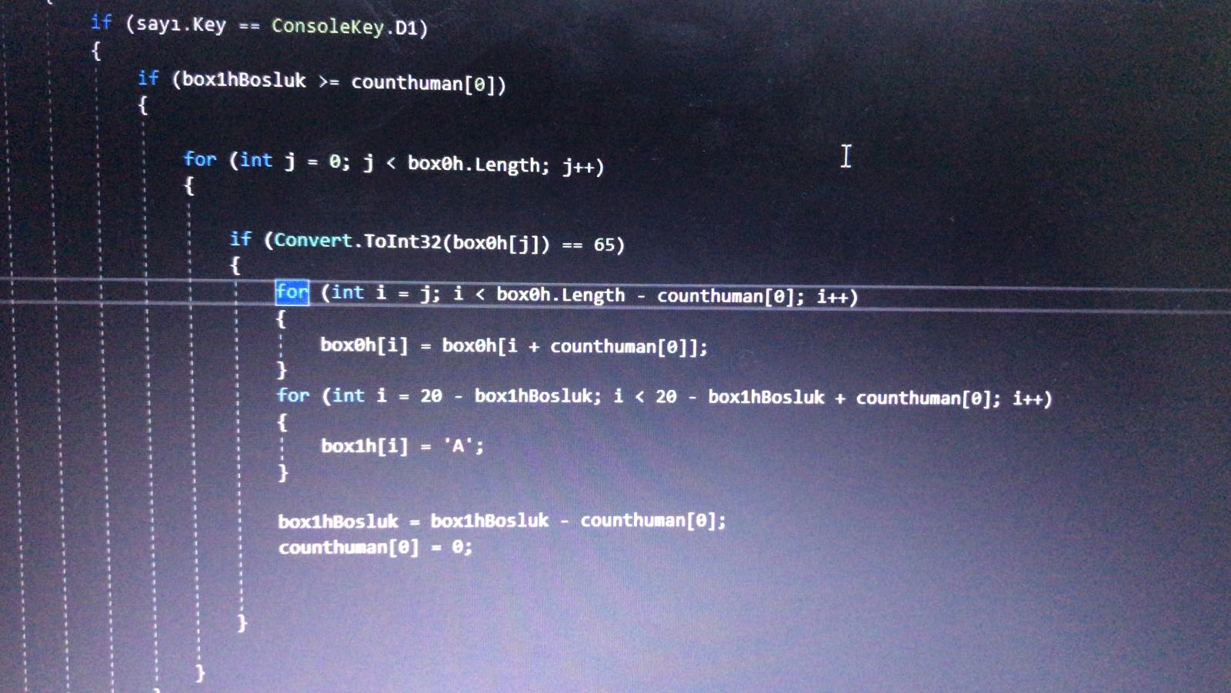

3- Problems Encountered
When we assign the letters from box0, it writed with lots of shift.Then, we developed code to solve it.

Slide 11
4- Algorithms and Solution Strategies
We code timer and interface.
We code to assign computer’s command randomly.
We code to take command from user and read it.
We assign letters different arrays and we printed them display according to their ASCII.
We defined : Box1,box2 and box 3 are arrays.And each of them have 20 chars.
We code to assign to box1,box2 and box3 from box0.
We checked: Box0 has enough letters to move.
We code to delete letters to write letters again.
We code to compare computer’s and user’s scores to find the winner.

Slide 12
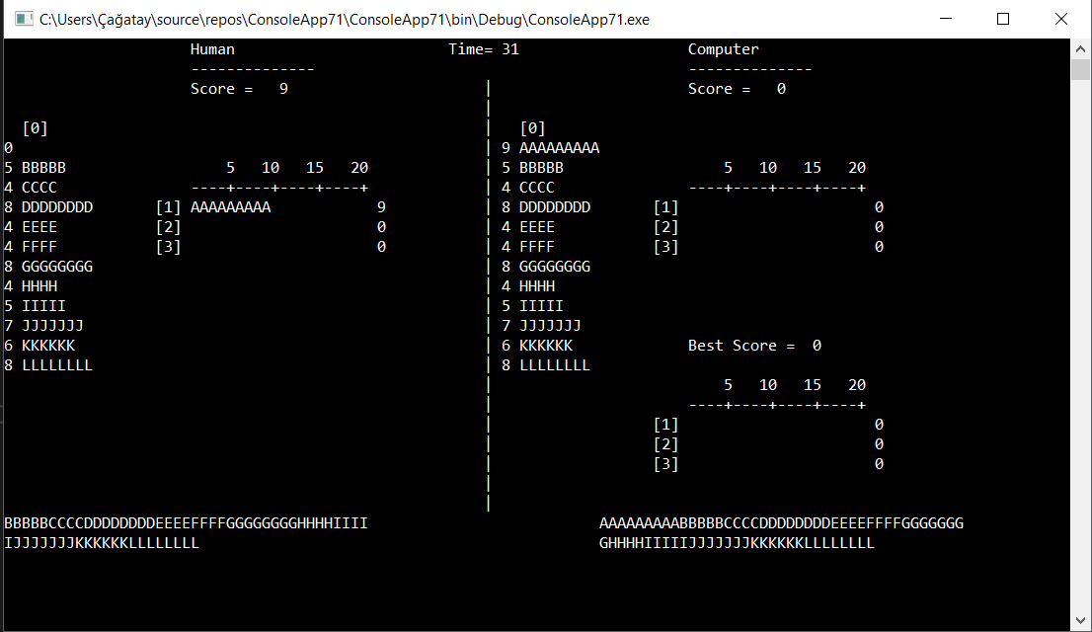
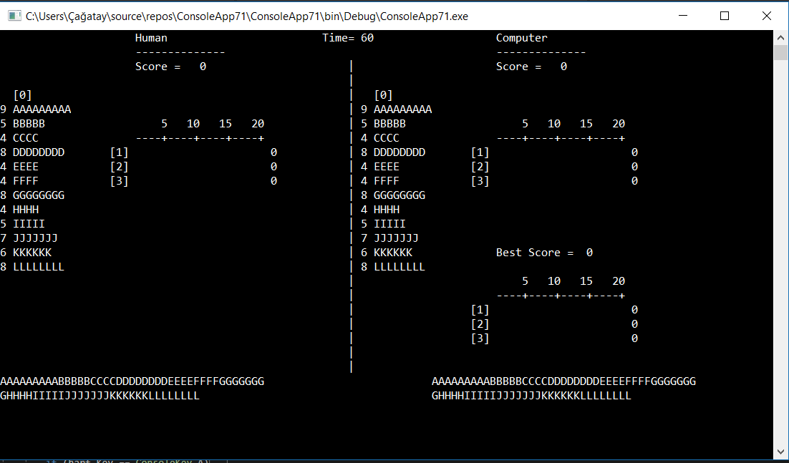
5 - SCREENSHOTS

Slide 13
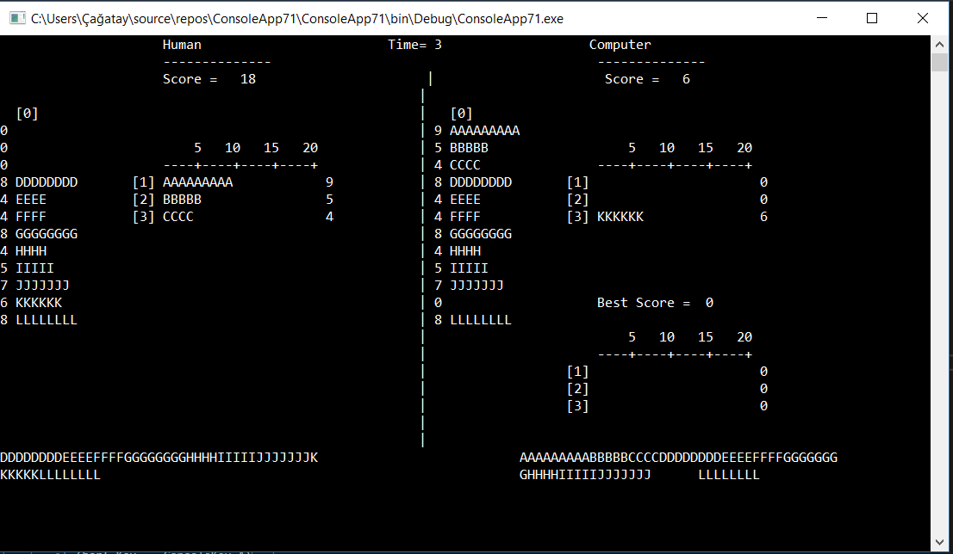
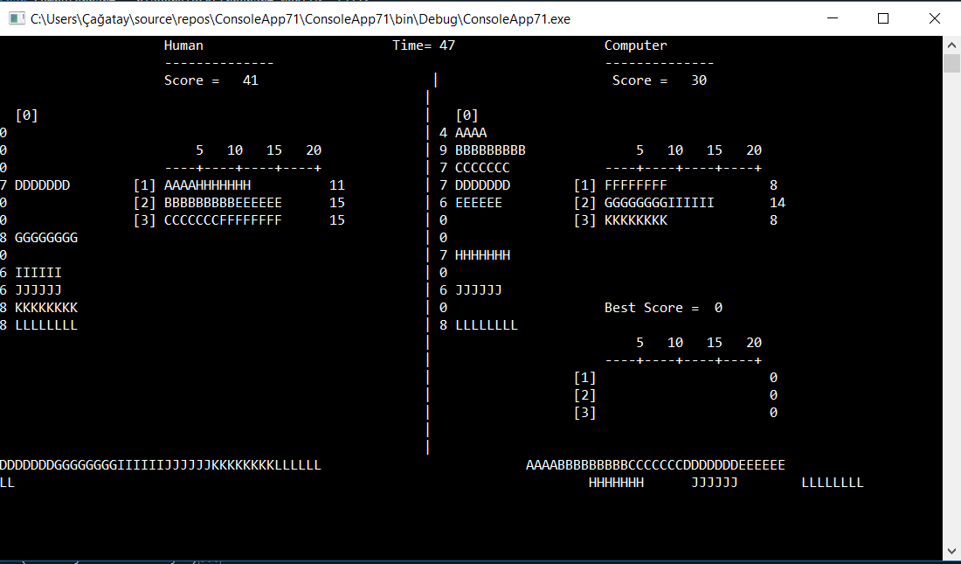

Slide 14
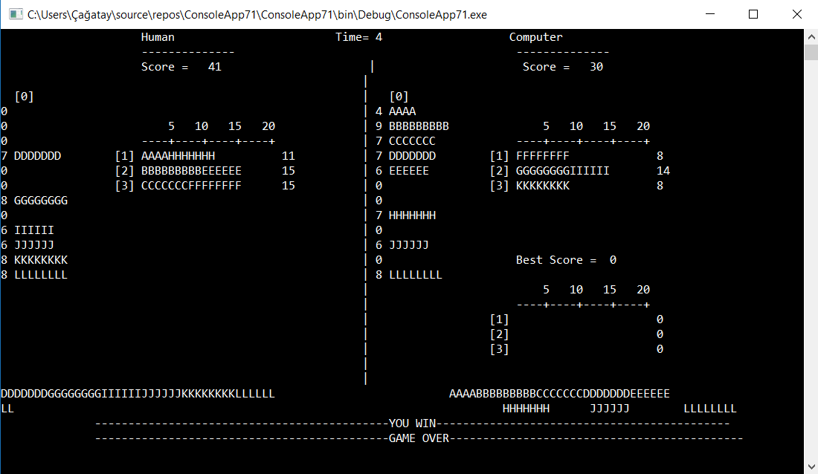

Slide 15
6- Conclusion
In conclusion, it was the important for us.We learned make correct other group friend’s mistakes.We solve problems which was algorithms together.It was special project for us because it has lots of new things –which is we have not heard in class- and it has lots of basis things. We have a chance to do practise to what we learn in theoric lessons.Then,when we tried to do practise ,we faced with problems and we learned to solve them together thanks to our teachers.
We learned how to use SetCursorPosition,Readkey and arrays in C#.

