Slide 1
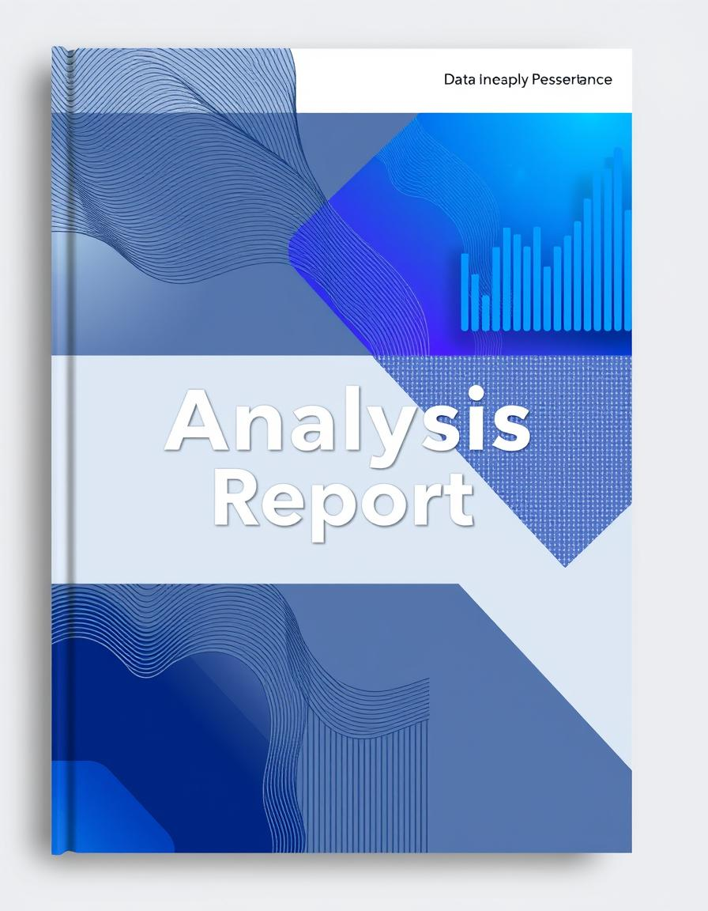
Sales Data Analysis Report
Dataset: Sample – Superstore
Prepared by: Mustafa Oun
Date: June 26, 2025
Tools Used: Python, Power BI

Slide 2

Project Objectives
This project aims to analyze Superstore sales data to uncover actionable insights for marketing and managerial decisions.
We utilized Python for comprehensive exploratory data analysis (EDA) and Power BI for creating interactive, dynamic visualizations.
The goal is to provide a data-driven foundation for strategic business improvements.

Slide 3
Dataset Overview
The Superstore dataset provides a rich source of sales information, enabling a deep dive into various business dimensions.
Key Columns:
Order Date
Sales
Profit
Customer Name
Product Name
Category
Region
Number of Rows | 9,994
Number of Columns | 21
Time Period | 2015–2018

Slide 4
Data Cleaning & Preparation
Date Format Conversion
Converted 'Order Date' and 'Ship Date' to datetime for temporal analysis.
Data Type Adjustments
Changed 'Postal Code' to string format to preserve leading zeros.
Redundancy Removal
Removed 'Row ID' as it was non-informative for our objectives.
Data Integrity Check
Confirmed the absence of null values and duplicate entries across the dataset.
Derived Column Creation
Generated 'Shipping Days', 'Month', 'Year', and 'Month-Year' for enhanced trend analysis.

Slide 5
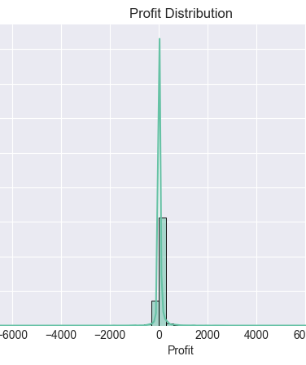
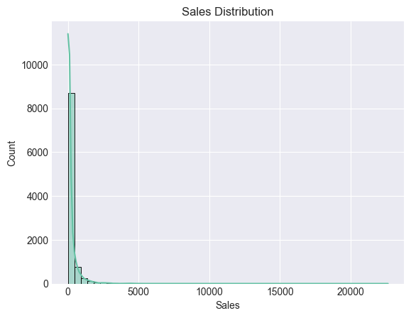
Exploratory Data Analysis: Profit & Sales
Distribution Insights
Sales range from $0.44 to $22,638.48.
Profit ranges from -$6,599.98 to $8,399.98.
The distribution is right-skewed, indicating most transactions are low-value.
Identified 1,881 profit outliers, highlighting transactions with extreme gains or losses.

Slide 6
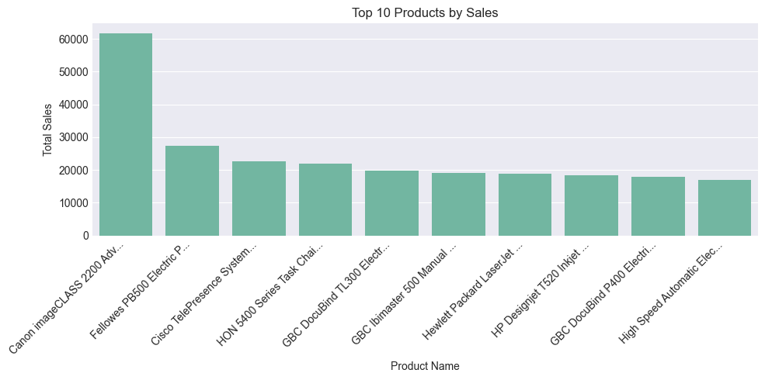
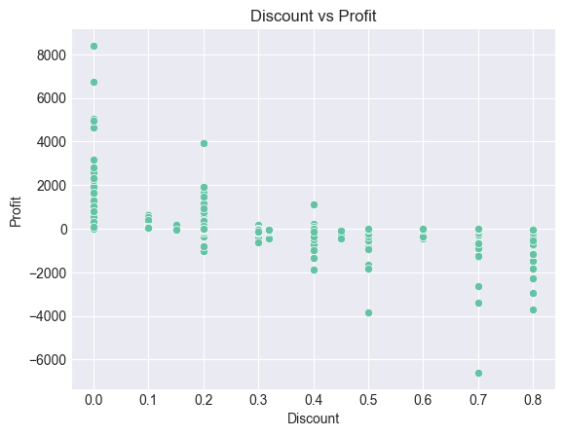
EDA: Discount Impact & Top Products
The scatterplot clearly shows a negative correlation between discounts and profitability, indicating that higher discounts often lead to reduced profits. This suggests a need to re-evaluate discount strategies.
"Canon imageCLASS 2200 Advanced Copier" stands out as the highest-selling product. However, high sales do not always translate to high profits, underscoring the importance of analyzing profitability alongside sales volume for individual products.

Slide 7
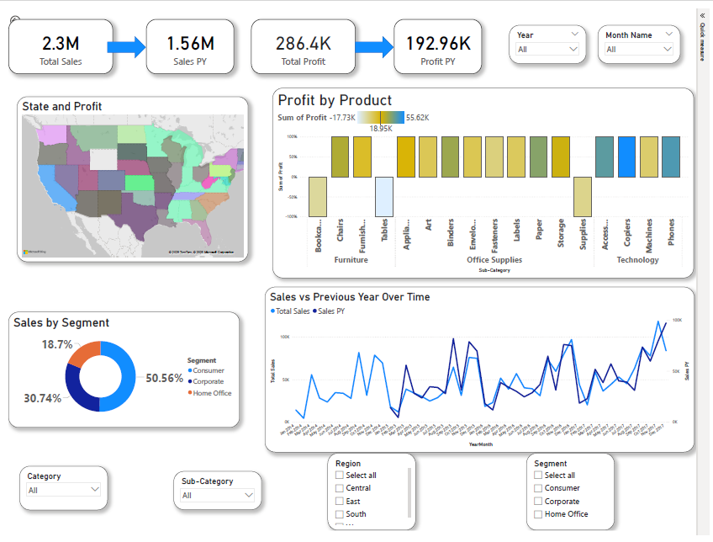
Power BI Dashboard

Slide 8
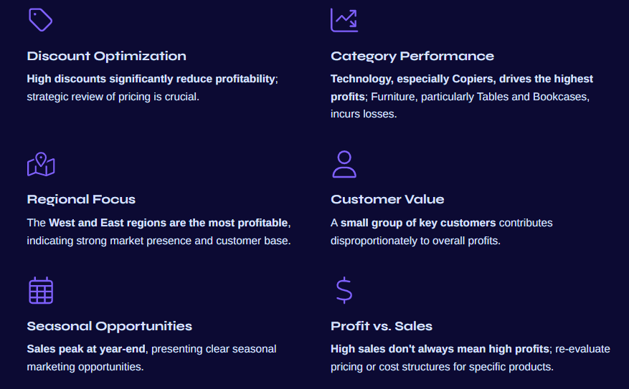
Key Strategic Insights

Slide 9



Thank You
https://www.linkedin.com/in/mustafa-oun/
https://github.com/mustafaoun

