Slide 1


NYC Airbnb Data Analysis and Modeling Project
This project explores the rich 2019 NYC Airbnb dataset consisting of nearly 49,000 listings across all five boroughs. It includes detailed attributes spanning host info, property features, geographic location, pricing, and reviews over an eight-year span. Our goal is to develop predictive models for pricing and classification tasks, uncover factors driving price variability, and deliver actionable insights for hosts and investors in the competitive short-term rental market.
By Rawan

Slide 2

Estimating overall expenditure for a guest’s minimum stay using regression models.
Problem Overview
1
Predict total booking cost
2
Classify listings into high/low price categories
Handled missing values, outliers, and skewed features using robust statistical methods and transformations. Categorical data encoded to capture nuanced distinctions.
Separating properties into price‑tier groups to guide targeted pricing strategies.
3
Segment listings via clustering
Uncovering natural listing segments based on revenue potential, availability, and location.
Business Impact: Help hosts optimize pricing, target promotions, and understand market segments

Slide 3
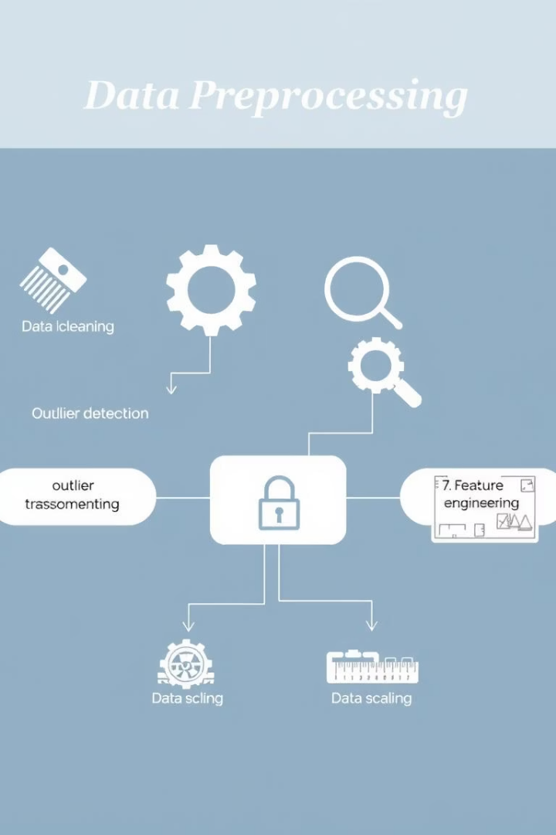
Data Preprocessing and Feature Engineering Pipeline
1
Data Preprocessing Steps
2
Domain-Specific Feature Creation
Handled missing values, outliers, and skewed features using robust statistical methods and transformations. Categorical data encoded to capture nuanced distinctions.
Constructed new variables such as total minimum stay cost, occupancy rates, and annual revenue potential to capture deeper insights tied to pricing and demand dynamics.
3
Scaling and Standardization
Ensured numerical features were normalized to improve model stability and convergence across regression and classification tasks.

Slide 4
Modeling Approaches: Regression , Classification
And Clustering
Regression
Binary Classification &
Multi-class Classification
Clustering
Predict continuous price values based on listing and host characteristics.
Classify listings into high versus low price categories to assist pricing segmentation.
Categorize listings into three price tiers: low, medium, and high for granular price banding.
Segment listings via clustering
Group listings into meaningful segments by applying K‑Means on annual income potential, availability ratio, and geographic coordinates

Slide 5

Regression Model Performance Highlights
Top Accuracy
Speed vs Performance
Insights
RandomForest and XGBoost demonstrated exceptional predictive accuracy with R² scores above 0.95 and low RMSE.
Ridge regression was the fastest with a good accuracy trade-off, while Lasso and ElasticNet showed poor predictive power.
Tree-based ensemble methods excelled in capturing nonlinear relationships and complex feature interactions in pricing data.

Slide 6






Classification Model Performance Summary
Balanced Models
GBM and CatBoost closely matched LightGBM’s performance, demonstrating consistency across boosting algorithms.
Best Performer
Trade-offs
LightGBM led binary classification with accuracy of 82.7% and strong F1 scores, balancing speed and precision.
Naive Bayes was fastest but least accurate; SVM offered decent accuracy but had prohibitive training times.

Slide 7
Clustering Model Performance Summary
Balanced Models
K-Means with different k values (2-3) showed consistent performance, with the elbow method suggesting k=2 and silhouette analysis favoring k=3.
Best Performer
Trade-offs
K-Means with 3 clusters provided the optimal segmentation with a silhouette score of 0.2637, effectively identifying distinct property segments in 625 seconds.
DBSCAN created too many clusters (64) with poor cohesion (silhouette: -0.4351); K-Means offered better interpretability despite longer processing time.

Slide 8
Key Influential Factors on Airbnb Pricing
Geographic Influence
Property Traits
Host & Temporal Patterns
Manhattan and parts of Brooklyn show significantly higher price listings, making location a strong predictor in pricing models.
Entire homes command higher prices than shared or private rooms. Minimum night restrictions shape occupancy and pricing strategies.
Hosts with multiple listings use more consistent pricing. Seasonal availability and listing tenure influence price stability and premiums.

Slide 9

Challenges Encountered in the Project
Data Quality
Model Complexity
Missing values and extreme price outliers complicated data cleaning and analysis, requiring robust imputation and outlier treatment techniques.
Trade-offs between interpretability and accuracy emerged; highly accurate tree ensembles demand more computational resources and tuning.
Feature Engineering
High collinearity among engineered features challenged model stability, necessitating iterative selection and domain-driven feature design.

Slide 10




Lessons Learned and Strategic Recommendations
Methodology
Tree-based gradient boosting algorithms consistently outperformed, with feature engineering crucial for boosting predictive power.
Hosts
Adjust minimum night stays by neighborhood demand
Manage availability strategically to influence pricing
Increase review volume to enhance pricing power
Investors
Focus on properties in high price-to-availability zones
Consider converting units into entire homes/apartments
Target neighborhoods with rising review trends and moderate prices

Slide 11

Future Directions for Enhanced Modeling
Integrate External Data
Time Series Analysis
Add neighborhood amenities, transit accessibility, and demographic layers for richer context and improved model accuracy.
Model seasonal pricing dynamics and trends to capture temporal variability and improve forecasting.
Ensemble Models & Visualizations
Combine strengths of multiple models and build interactive visualization tools to empower stakeholders with real-time insights.

Slide 12

Conclusion and Impact of the NYC Airbnb Project
Business Insights
Model Development
Generated actionable recommendations empowering hosts and investors with data-driven decision support in an evolving rental marketplace.
Data Analysis
Implemented and evaluated regression and classification models, demonstrating strong predictive performance mainly from tree ensemble methods.
Comprehensive exploration of a complex dataset revealed critical pricing drivers and hosted insightful feature engineering.

