Slide 1

Code Refactoring and Bug Fixing on Notebooth Application
Muhammed Mustafa Shaik
IN1240812

Slide 2


About me
I’m holding a Bachelor's degree in Computer Science and Engineering, where I developed a strong foundation in programming, algorithms, and software development, I have an experience of 1.2 years as programmer, I have a very keen interest in software development and always open to learn and explore new technologies.
I've always been fascinated by the power of data to solve complex problems and drive decision-making. This interest has led me to dig deeper into data science, exploring topics such as machine learning and big data analytics. To further my career and align with my interests, I am eager to learn more about data science, particularly in areas like predictive modeling and data visualization. My goal is to leverage my programming background and new data science skills to develop innovative data-driven solutions.

Slide 3
Objective of the Project:
Refactor the existing codebase and ensure the proper functioning of the Note Taking Application. Document all identified bugs during the debugging process. Remember, the task is not about recreating the app from scratch. Your goal is to fix the already existing codebase and make the application work as intended.
Main Agenda
As a backend developer, we need to need to make changes to the existing codebase and make sure its working as intended.
The following changes should be made,
We need to reorganize the code.
We need to find the bugs in the code.

Slide 4
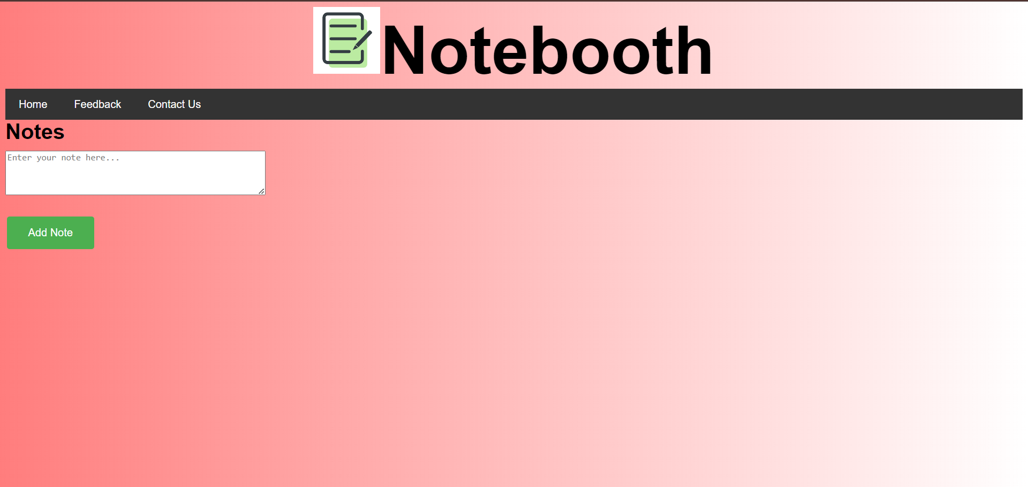
Project Description:
Notebooth is an application which was developed by using a python framework named as Flask and HTML. This application contains a user friendly interface which allows a user to make notes, and give feedback.
Technical Tools Used:
Python
Flask
HTML
CSS
Application Interface:

Slide 5
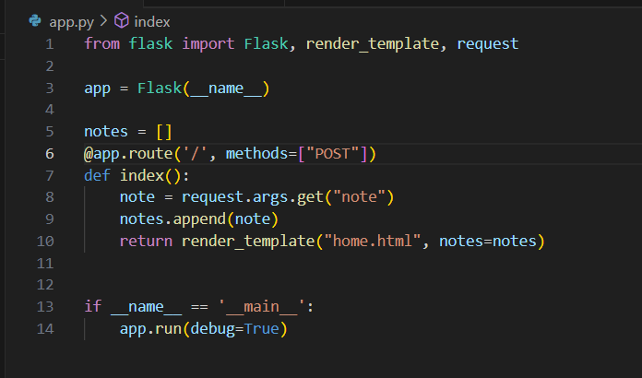
Bug Identification:
Existing Code:
Since the existing flask code snippet has been configured for handling post requests and the user is trying to retrieve note using request.args.get method which is returning note value as None.

Slide 6
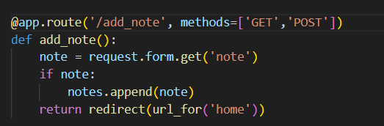
Bug Resolving
For handling the post requests from the user, the existing code has been refactored from request.args.get() to request.form.get() method, by this correction the application can handle both get and post methods arguments

Slide 7
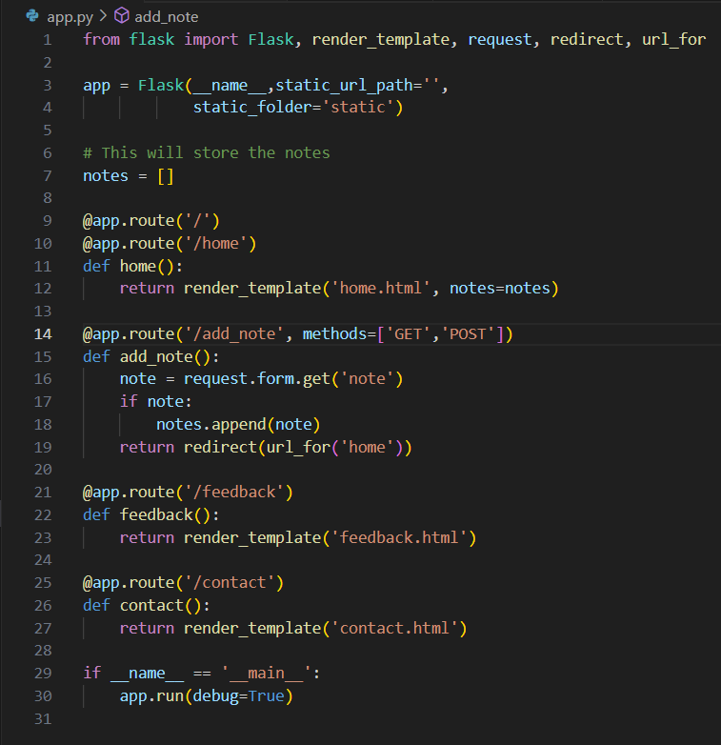
Enhancements:
Notes text field has been moved to homepage section
Added Feedback and contact us section
CSS Styling

Slide 8
Section Layouts:
Homepage Section

Slide 9
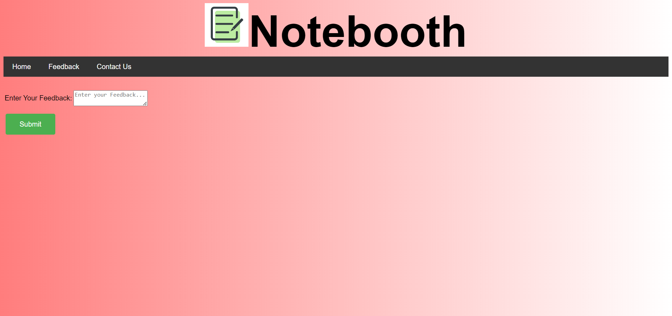
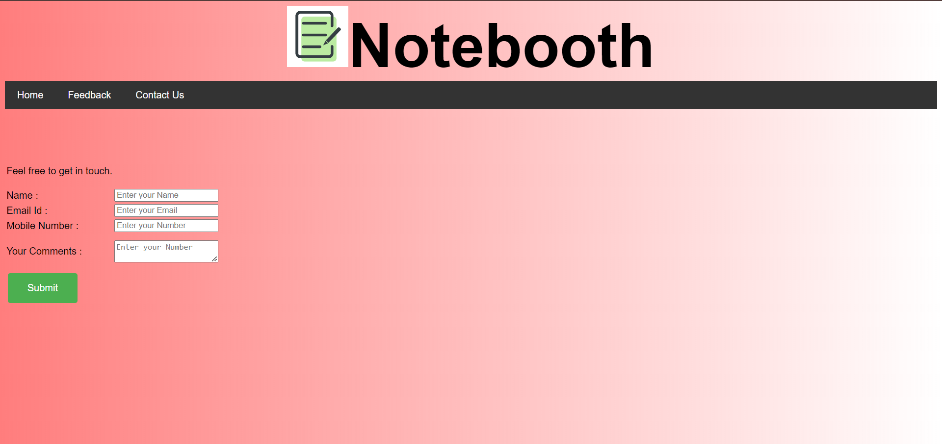
Feedback Section
Contact Us Section

Slide 10
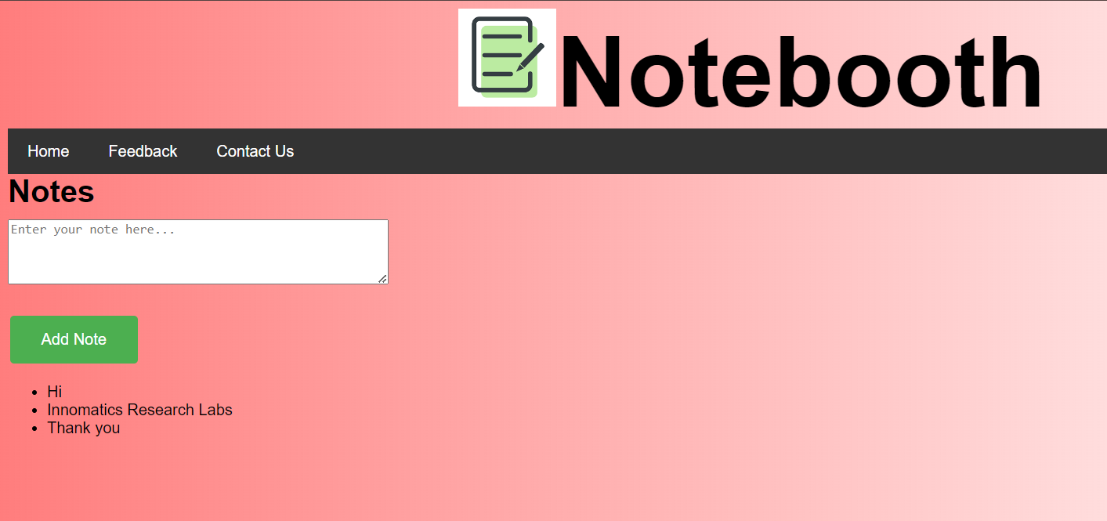
Conclusion:
The existing code base has been refactored, all the bugs has been resolved and enhanced the user interface and made the application work as intended
Result Page:

Slide 11

ANY QUERIES?
THANK YOU

