Slide 1


ConVox
GREAT9 IPL
Next Generation Technology for your Inbound/ Outbound/ Blended Call Center

Slide 2
GREAT9 IPL
Agenda
Great9 Ipl – An Introduction
Predictive vs Manual Dialing
ConVox Features
Next Generation Technology with IP-PBX
ConVox Setup
Adding ConVox in existing Setup
Call Flow for Outbound Call Center
Reports
Call Flow for Inbound Call Center
Going ahead with installation
Great9’s Commitment to Customer Service

Slide 3

GREAT9 IPL
Great9 IPL - Introduction
Great9 IPL is a fast growing software development company in the area of CTI/ IVRS and VoIP.
Great9 IPL is Official Dialogic Technology Partner (Dialogic is No. 1 company in the world for manufacturing of CTI/ IVRS boards )
Our customers include prestigious national and international names like Country Club, Satyam Computers, Prasad I-MAX, Assist America, Cention AB, Stockholm, Russels spoken english etc.
ConVox is result of Our focus on Call Center Solutions and long experience in implementing them for different types of Call Centers.

Slide 4
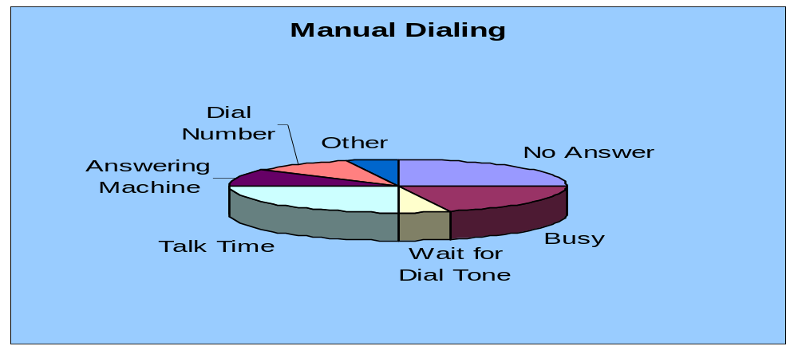
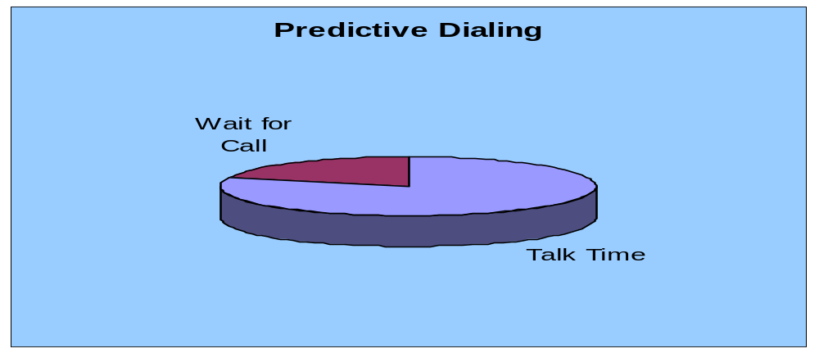
GREAT9 IPL
Manual Dialing vs Predictive Dialing
Talk Time = 25%
Talk Time = 80%

Slide 5
GREAT9 IPL
ConVox Features
General Setup Features
Web-Based Architecture for easy installation and management.
A SIP based Predictive Dialer, to save time and effort in manual dialing. Calls are dialed by a Central Dialer, and live calls are transferred to the agents.
Answering Machine ( 85%+) and Fax detection. A customized message can be played for answering machine calls.
Real time monitoring of agents Login/ Logout/ Timeout, for effective Call Center management.
Comprehensive CRM interface to accommodate all kind of scripts, record customer details and disposition of calls.
Choice of Agent’s communication Device as Softphone, IP Phone or Analog Telephony Adapter.
Choice of CODECs as G.729, G.723 or G.711
Complete and high quality voice recording of conversation between agent and customer.
Multiple Campaigns can be handled from the single server
Linux based Soft IP-PBX
Unlimited Dialing channels (channel capacity depends on processor power)
Comprehensive and customizable reporting to track the agents and calls in your call center.

Slide 6
GREAT9 IPL
ConVox Features
General Setup Features contd…
IP based remote support for installation and configuration.
Agents can log in remotely and calls can be directed to any SIP phone.
Freedom from adding hardware boxes to their communications systems to get advanced interaction management feature.
Active Call Management Features
Call Answering
Call Holding
Call Transfer
Call Conference (External and Internal Parties)
Responding to IVRS
Incoming Call Beep (Configurable)
Call Barge-In (Internal and External)

Slide 7
GREAT9 IPL
ConVox Features
Inbound Calling Features
Call Queuing and Call waiting message
Skill based ACD (Automatic Call Distribution)
IVRS.

Slide 8
GREAT9 IPL
Next –Gen Technology with IP-PBX
Feature | Conventional Way | ConVox Way
Call Switching | Uses CTI Cards, PBX | No Hardware Needed
Call Path | Circuit Switched | VoIP
Telecom Infrastructure within Call Center | Requires Separate Cabling for Telephones | Works on LAN cabling
Agent’s Communication Equipment | Analog Telephone with Dial Pad as Only Option | Three Options Softphone on Computer with Head Phone attached to the sound card. Analog Phone with ATA IP Phone
Remote Extensions for Distributed Call Center Setup | Not Available or Available through Complex and costly infrastructure | Seamless
Maintenance | High | Low because of less components
Cost | Very High | 30-40% of the Conventional Call Center Setup

Slide 9


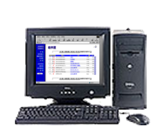



GREAT9 IPL
ConVox Setup
PSTN/Telco
ISDN/ Analog Lines
Internet/WAN
ConVox Server
IP - PBX
Router
Agent PC with Softphone

Slide 10






GREAT9 IPL
Adding ConVox in Existing Setup
USA
India
(Hyderabad)
Servers and Call Switching Equipments
Dedicated VPN Link
PSTN/ VoIP Gateway
Internet
Inbound
Fortigate Firewall
DS3
Outbound
ConVox Server
IP-PBX
Router
Router
Server / Proxy

Slide 11
GREAT9 IPL
Call Flow in Predictive Dialer
Agent Terminal
ConVox Server
IP-PBX
SIP Proxy/ Server
ConVox Server dials numbers from the call list using Dialing Channels. Up to four calls can be initiated for an agent depending on Pacing Ratio.
IP PBX makes a call to the customer through SIP Proxy/ Server
Call Connected
Call Connected
Server performs ACD logic to find best agent to transfer this call.
Customer CRM details are transferred to the agent terminal
Call completes and call Updates are transferred to the ConVox server

Slide 12
GREAT9 IPL
Call Flow for Inbound Calls
Customer Calls in
Queue Message
(Your call is
important to us
please wait for
next available
operator)
Getting More
Information
e.g Customer ID,
Service Selection
Wait for 5 Seconds
Welcome Message
&
Language Selection
ACD Tries to
finds the best
available agent
No Operator Available
Perform database search for given customer ID
Found Suitable Operator
Transfer the call and
pop-up customer Info
on agent terminal
Agent takes the call and disposes for further action.

Slide 13
Existing System Reports
GREAT9 IPL
The next few slides will give a preview of reporting module. Please note that our development team can customize the reports to exactly suit your process.

Slide 14
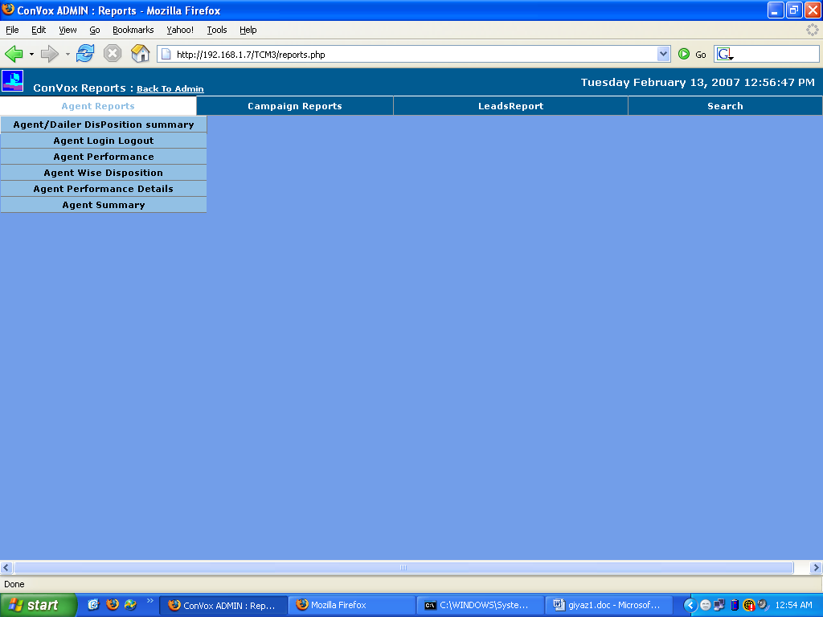

Existing System Reports

Slide 15
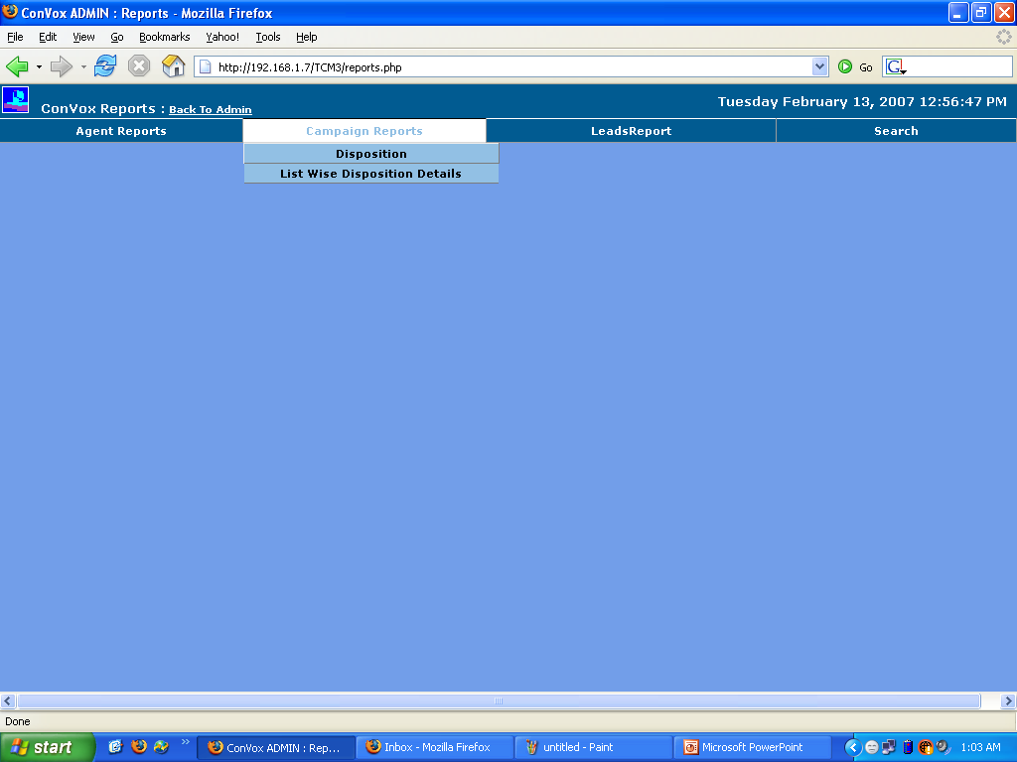
Existing System Reports

Slide 16
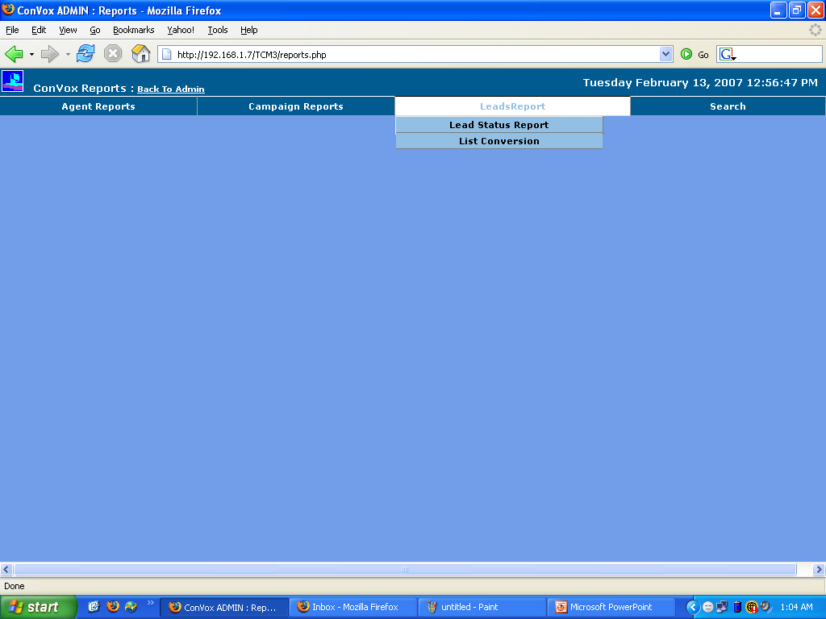
Existing System Reports

Slide 17
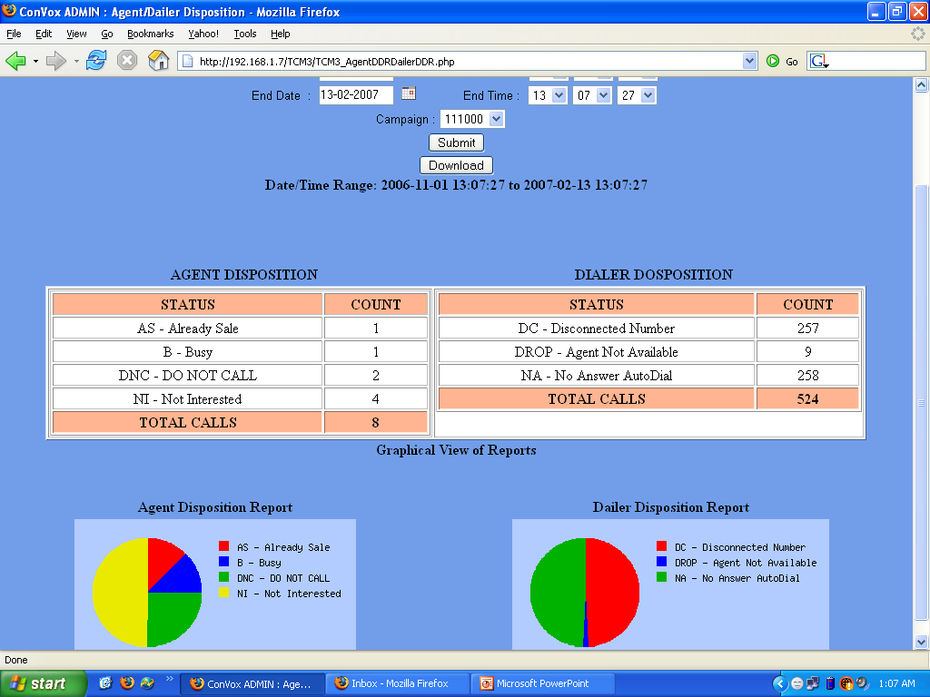
Existing System Reports

Slide 18
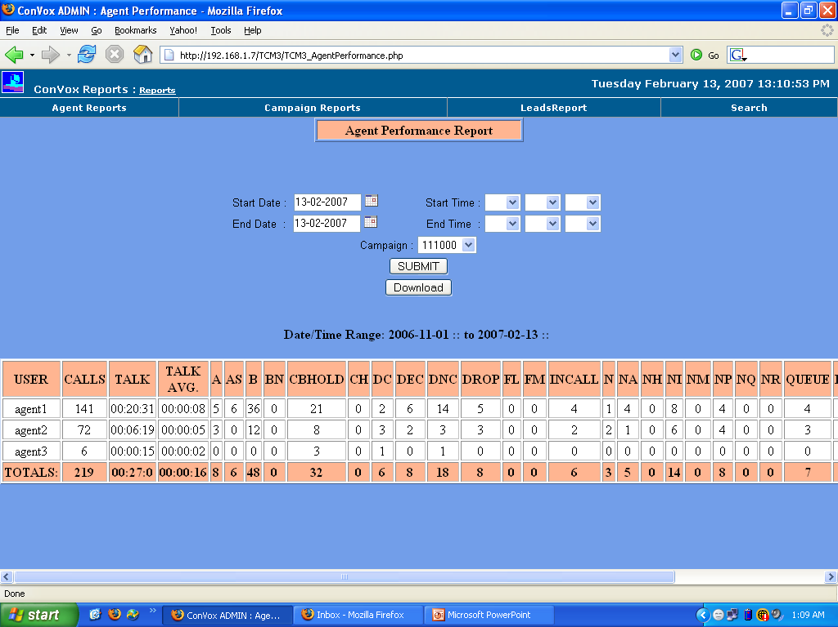
Existing System Reports

Slide 19
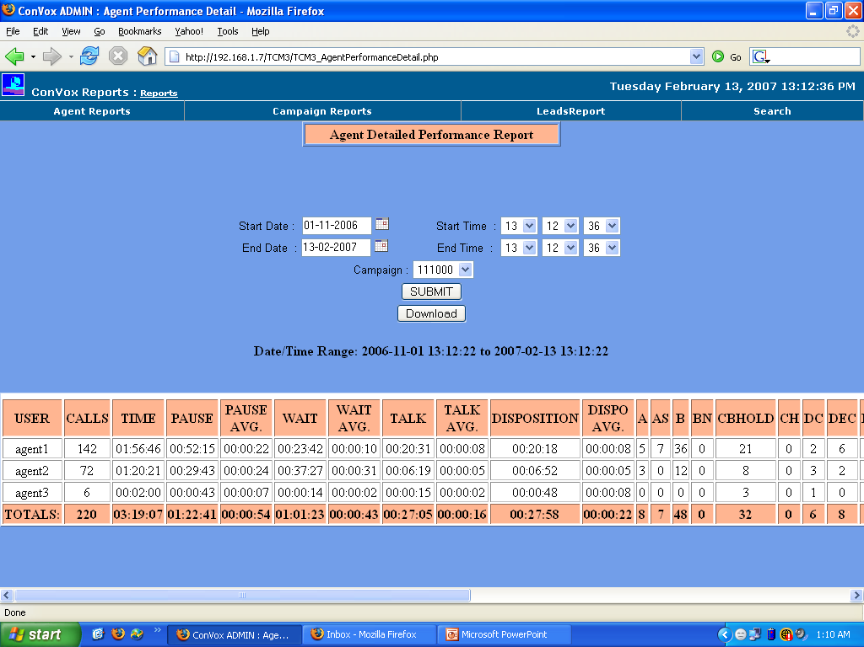
Existing System Reports

Slide 20
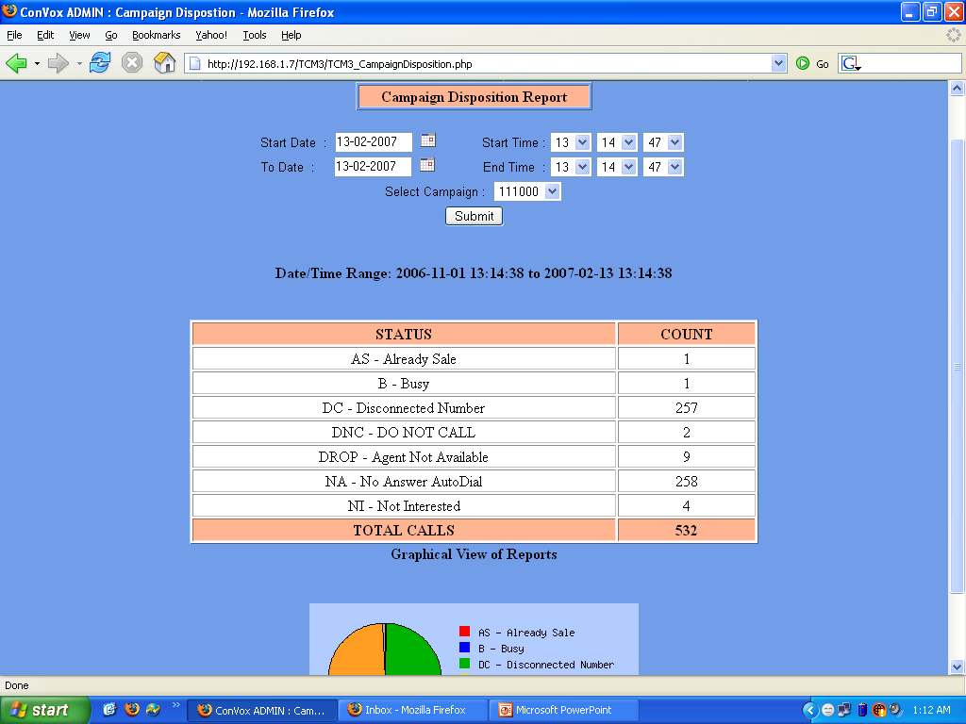
Existing System Reports

Slide 21
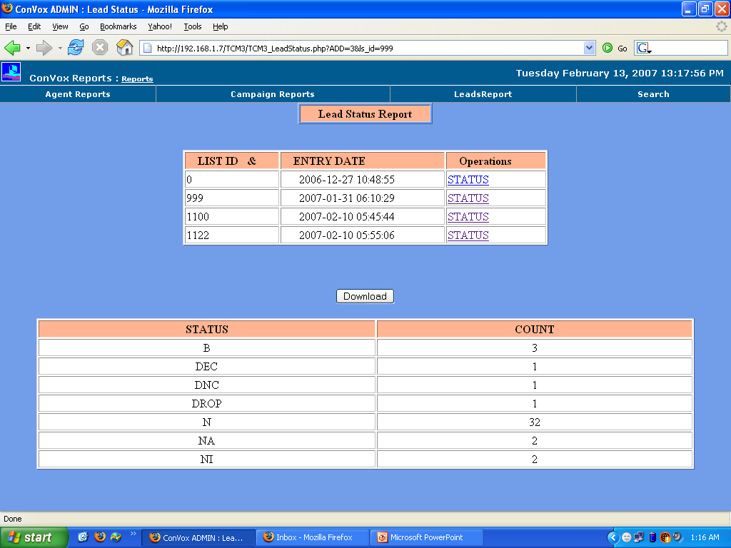
Existing System Reports

Slide 22
GREAT9 IPL
System Hardware Requirement Summery
Agents | PSTN Connectivity (Domestic) | VoIP Connectivity (International) | Server Requirement
1-12 | 24 Analog/ 1 ISDN PRI | 512 KBPS | Call Center Server – Intel Pentium IV PC with 2.8 GHz, 512 MB RAM IP-PBX – No Separate Hardware
13- 24 | Duel ISDN PRI | 1 MB | Call Center Server – Intel Xeon Server with 3.0 GHz, 1 GB RAM IP-PBX – No Separate Hardware
24-48 | Duel ISDN PRI | 2 MB | Call Center Server – Intel Xeon Server with 3.0 GHz, 1 GB RAM IP-PBX – Intel Xeon Server with 3.0 GHz, 1 GB RAM
48 - 72 | Duel ISDN PRI + ISDN PRI | 3 MB | Call Center Server – Intel Xeon Server with 3.0 GHz, 1 GB RAM IP-PBX (2 - Nos) – Intel Xeon Server with 3.0 GHz, 1 GB RAM
72 - 96 | Duel ISDN PRI (2 – Nos) | 4 MB | Call Center Server – Intel Xeon Server with 3.0 GHz, 1 GB RAM IP-PBX (2 - Nos) – Intel Xeon Server with 3.0 GHz, 1 GB RAM
Client PC - Pentium- IV Processor, 40 GB HDD, 128 MB RAM, CD-R/W, 17” Color Monitor, Good Quality Head Phones, Windows 2000 Professional OS.

Slide 23
GREAT9 IPL
Installation and Maintenance of the System
- Normal Installation Time is 1 Week. Depending on the customization requirement it may take more time.
- Our Engineers can install and configure the system initially. A training is given to the administrator and users of the system at customer premises.
- 24X7 Support is available through, Phone Call, Chat, Remote Login and On site visit.
- Highest commitment for Customer Support.

Slide 24
Contact Us at
Great9 Infoservices Pvt. Ltd.
#8-3-214/2, 3rd Floor,Murthy Mansions,
Srinivasa Colony(West),Hyderabad-500038.
Ph: +91-40-23730588, +91-40-23730589.
Mobile: 919849355589,919886868815
Website: www.great9.org
Branches:

