Slide 1
Zero Waste Challenge
VanFutures Hackathon

Slide 2
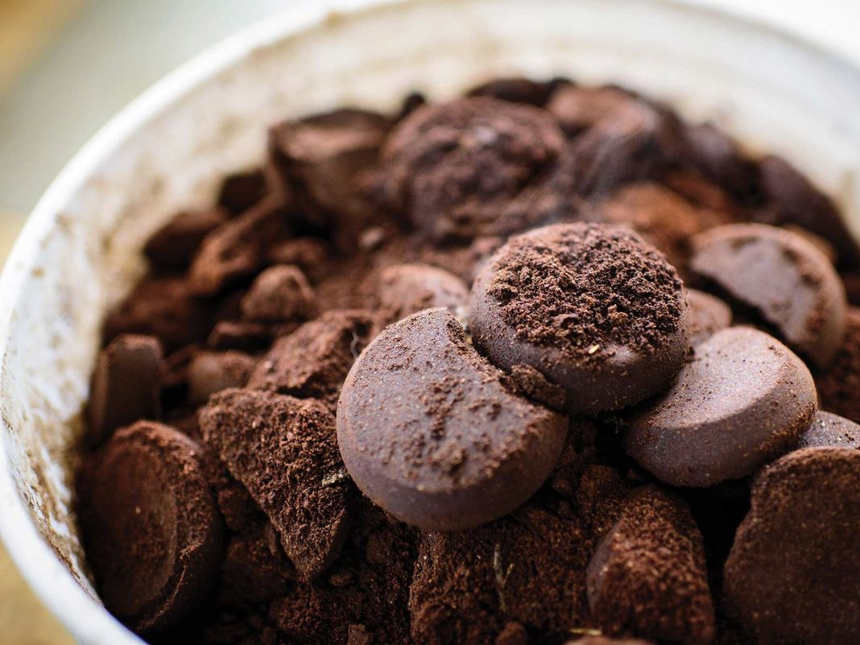
Notes:
http://bloximages.chicago2.vip.townnews.com/taosnews.com/content/tncms/assets/v3/editorial/4/66/4664ca62-badb-11e5-9e15-8b428a8098f6/5697cbd4e2963.image.jpg?resize=1200%2C801

Slide 3
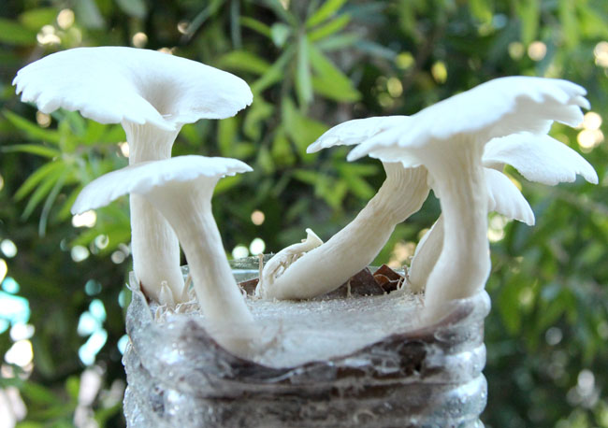
Notes:
http://www.apieceofrainbow.com/wp-content/uploads/2015/10/grow-mushrooms-on-coffee-grounds-apieceofrainbowblog-8.jpg

Slide 4
WASTEMATCH

Slide 5
WasteMatch.com

Slide 6
Impact
370,000
Disposal & Waste to Energy
Potential Addressable Market
*Amounts in Tonnes
Notes:
25 million metric tonnes in Vancouver

Slide 7
New commodity
Repaired/
Refurbished
Unique product
2016
2040

Slide 8
Businesses
Naturally separate waste
Consistently use existing garbage pick-up
Up-cyclers
Need consistent supply of waste product to achieve economies of scale

Slide 9
CONCLUSION

Slide 10
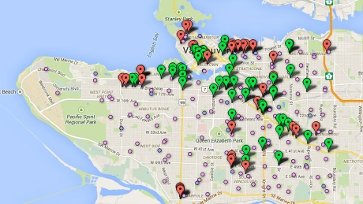
Category | 2015 | 2020 | 2030 | 2040
# of Upcycle businesses | 100* | 200 | 300 | 400
# of kg upcycled | 1000 | 4000 | 8000 | 20000
*Data from upcyclevancouver.com

Slide 11
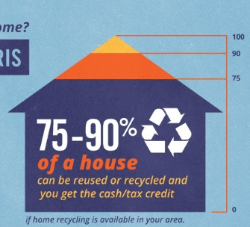
How will this tip the needle?
In 2015, the VEC launched UpcycleVancouver.com to highlight local circular economy businesses and help with “matchmaking” deconstruction
professionals, material recovery and reus outlets, and the upcycle design community. The community already has 100 active members.
- GCAP 2015

Slide 12
Why will this work?
Examples:
Chopstocks
Biofuel

Slide 13
Estimated Impact
Category | 2015 | 2020 | 2030 | 2040
# of Upcycle businesses | 100* | 200 | 300 | 400
# of kg upcycled | 1000 | 4000 | 8000 | 20000

