Slide 1



EE 464 Term Project DC-DC Converter Design
Doge Power Inc.
Onur Öztaş 2330389
Mustafa Yıldız 2233013

Slide 2
Project Specifications
DC/DC
Converter
12V DC output voltage
Isolated signal
100W output power
Less than 4% voltage ripple
Less than 3% line regulation
Less than 3% load regulation
220V-400V DC Voltage

Slide 3
Topology Selection
Flyback
Forward
Half Bridge
Full Bridge
Push – Pull

Slide 4
Topology Selection
Flyback
Advantages:
Less component requirement, no output inductance
Disadvantages:
Big output capacitor requirement
Narrow closed loop bandwidth

Slide 5
Topology Selection
Forward
Advantages:
One switching element
Disadvantages:
Transformer utilization factor is not sufficient

Slide 6
Topology Selection
Half Bridge
Full Bridge

Slide 7
Topology Selection
Push Pull
Advantages:
Better transformer utilization
Core size is small compared to others
Transformer ratings are smaller
Small output filter requirement
Disadvantages:
Transformer utilization factor is not sufficient

Slide 8


Analytical Calculations
Calculation of Turns Ratio
Limit Values of Duty Cycle
$$\frac{0.6}{2}=0.3$$
$$\frac{220+400}{2}=310$$
$$V_{o}=V_{in}∗2∗\frac{N_{2}}{N_{1}}∗D$$
$$12=310∗2∗\frac{N_{2}}{N_{1}}∗0.3$$
$$\frac{N_{2}}{N_{1}}=\frac{1}{16}$$
$$V_{o}=V_{in}∗2∗\frac{N_{2}}{N_{1}}∗D_{min}$$
$$12=400∗2∗\frac{1}{16}∗D_{min}$$
$$D_{min}=0.24$$
$$12=400∗2∗\frac{1}{16}∗D_{max}$$
$$D_{max}=0.4364$$

Slide 9



Analytical Calculations
Calculation of main parameters
f=100kHz
$$\frac{{ΔV}_{o}}{V_{o}}=\frac{(1−2∗D){(\frac{1}{f_{s}})}^{2}}{8∗L∗C}$$
$$D=0.4364 (Worst Case)$$
$$0.04>\frac{(1−2∗0.4364){(\frac{1}{{2∗f}_{s}})}^{2}}{8∗L∗C}$$
$$L∗C∗{f_{s}}^{2}>0.09943$$
$$L∗C>\frac{0.09943}{{(10∗{10}^{3})}^{2}}$$
$$L∗C>9.943∗{10}^{−12}$$
L=160μH
$$C>\frac{9.943∗{10}^{−12}}{160∗{10}^{−6}}$$
$$C>62.15 nF$$

Slide 10
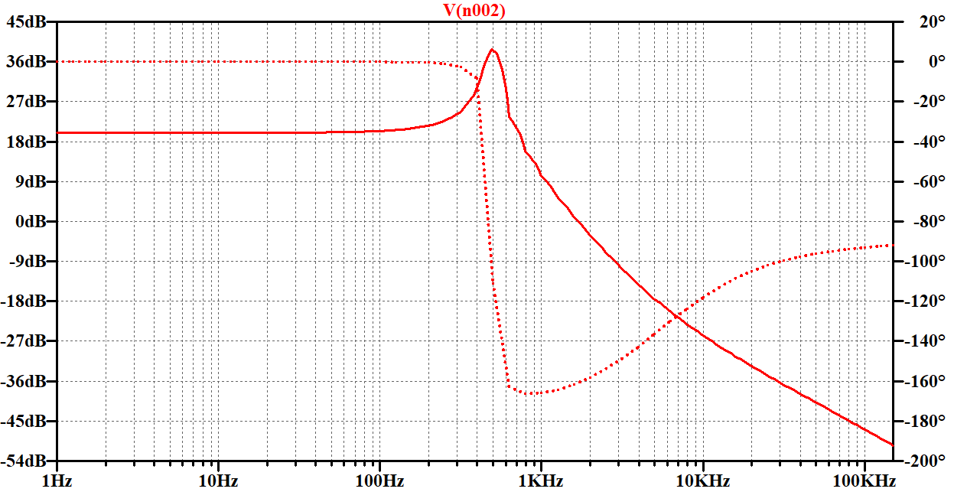
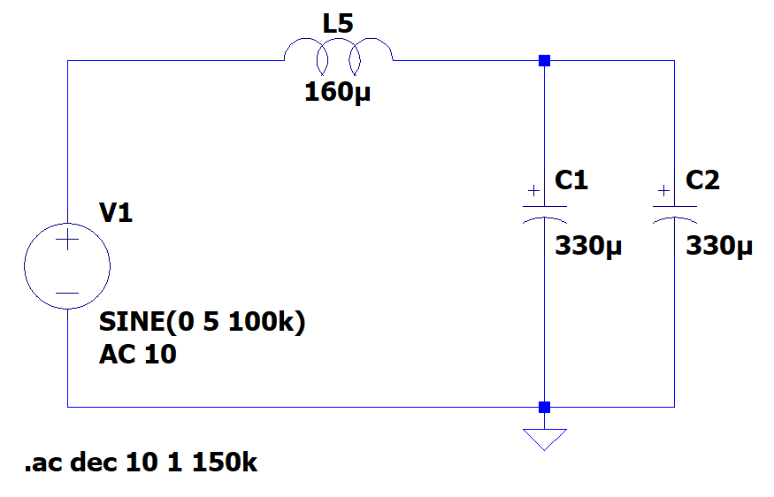
Output Filter Design

Slide 11
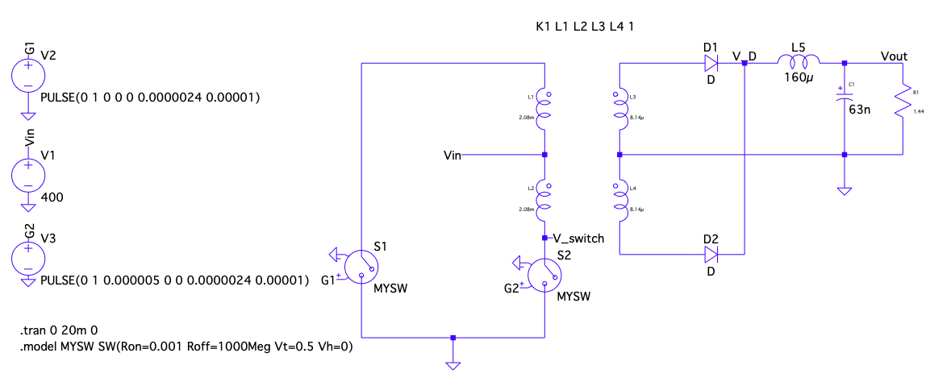
Analytical Calculations

Slide 12
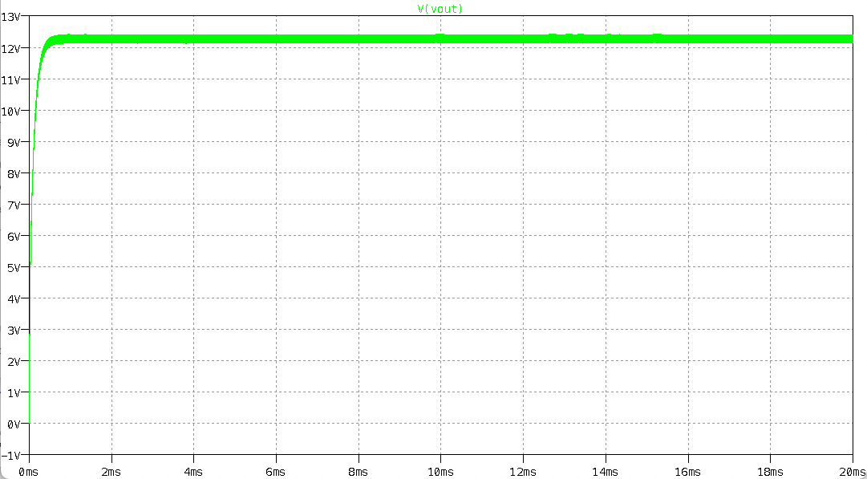
Analytical Calculations

Slide 13
Analytical Calculations
Current Rating of Output Inductor
8.333 A
Voltage Rating of Output Capacitor
12 V
Voltage Rating of Diodes
50 V (blocking)
Current Rating of Diodes
9 A (forward)
Voltage Rating of Switches
800 V (blocking)
Current Rating of Switches
800 mA

Slide 14
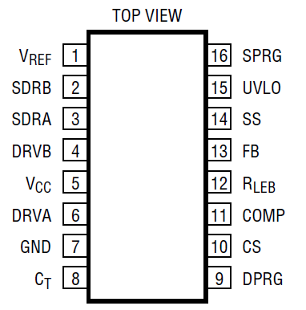
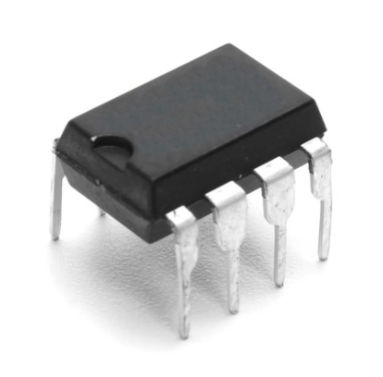
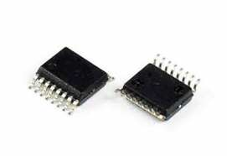
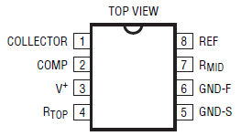
Controller Design
LTC3723 Current Mode Controller
LT1431 Programmable Reference
(Opto – Driver )

Slide 15
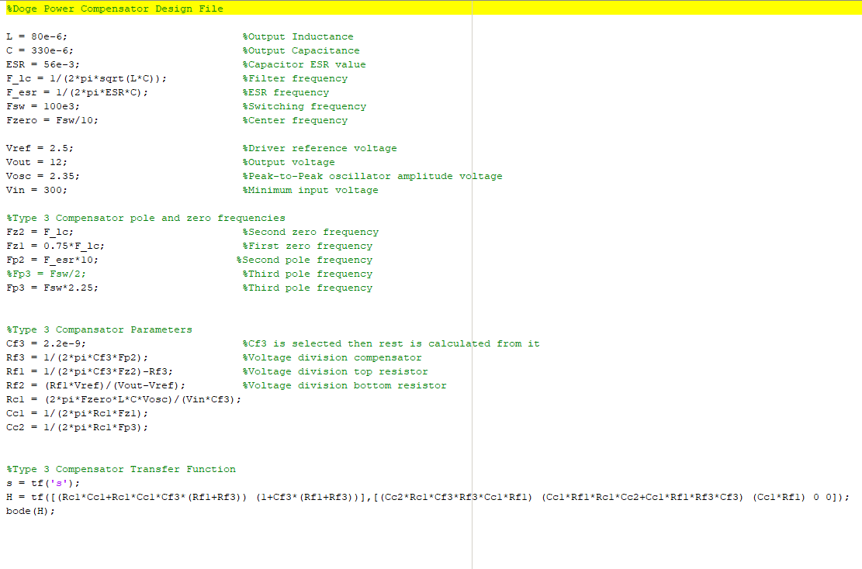
Controller Compensator Design

Slide 16
Controller Compensator Design

Slide 17
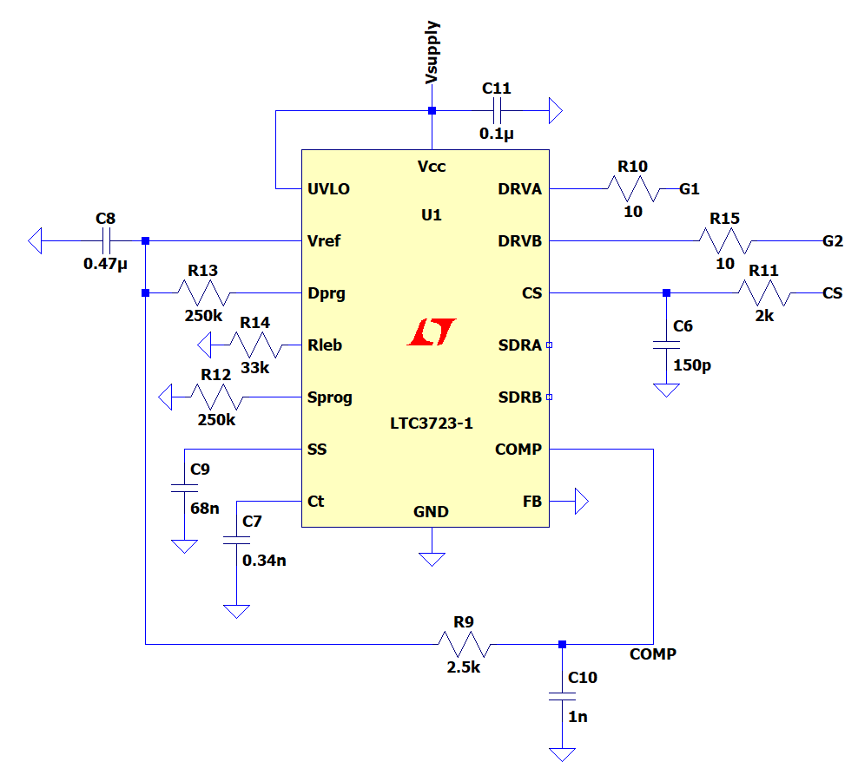
Controller Compensator Design

Slide 18
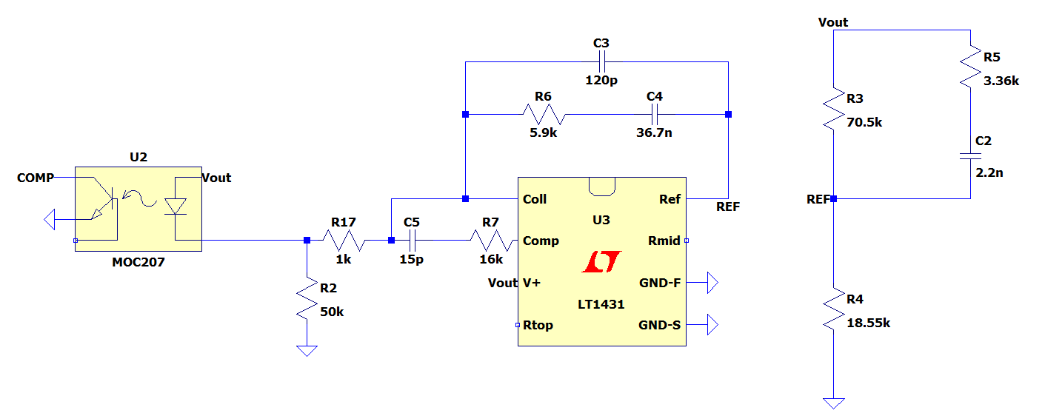
Controller Compensator Design

Slide 19
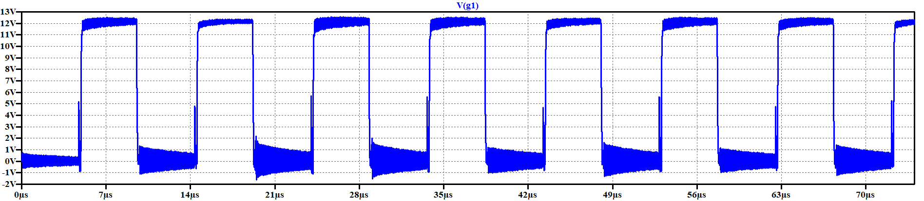
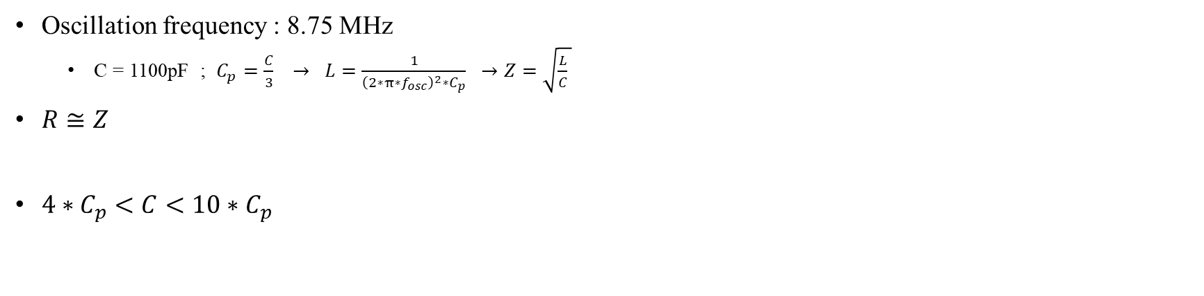
Snubber Design
Oscillation frequency : 8.75 MHz
C = 1100pF ; $C_{p}=\frac{C}{3} → L=\frac{1}{{\left(2∗π∗f_{osc}\right)}^{2}∗C_{p}} →Z=\sqrt{\frac{L}{C} }$
$R≅Z$
$4∗C_{p}<C<10∗C_{p}$

Slide 20
Snubber Design

Slide 21
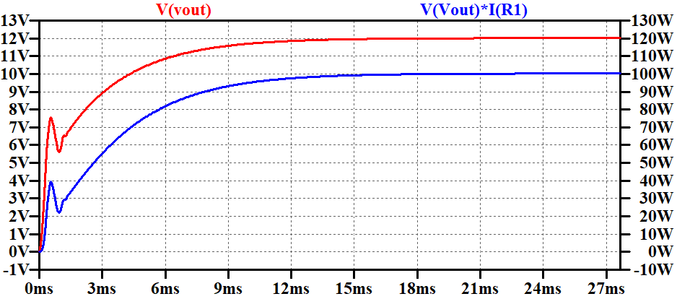
Simulation Results
220V input voltage

Slide 22
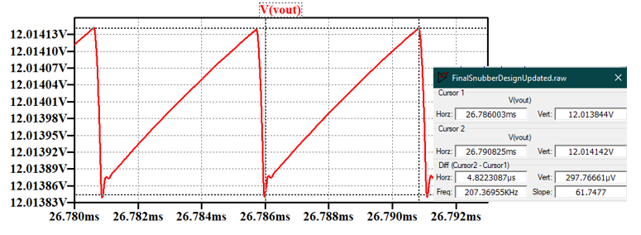
Simulation Results
220V input voltage – output voltage ripple

Slide 23
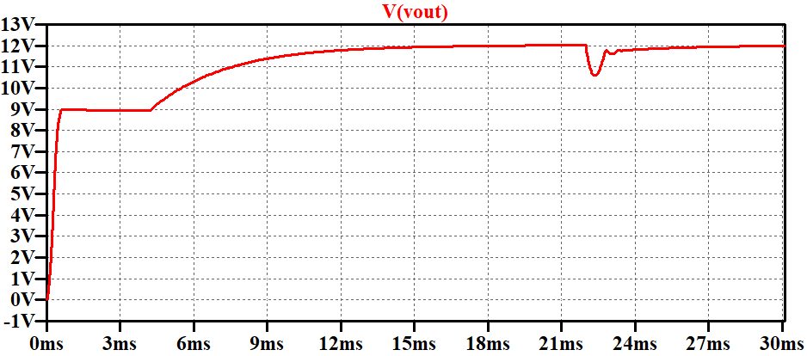
Simulation Results
220V input, No load to Full Load

Slide 24
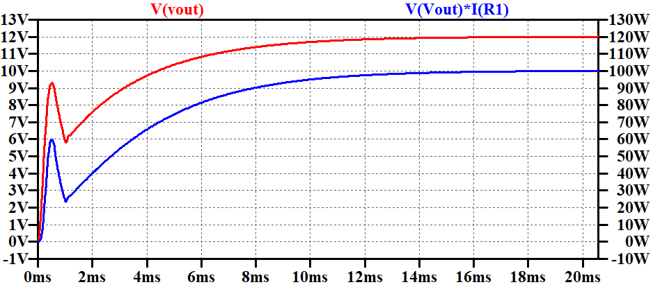
Simulation Results
400V input voltage

Slide 25
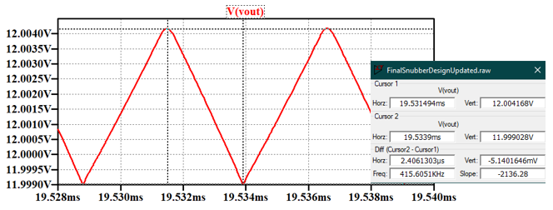
Simulation Results
400V input voltage – output voltage ripple

Slide 26
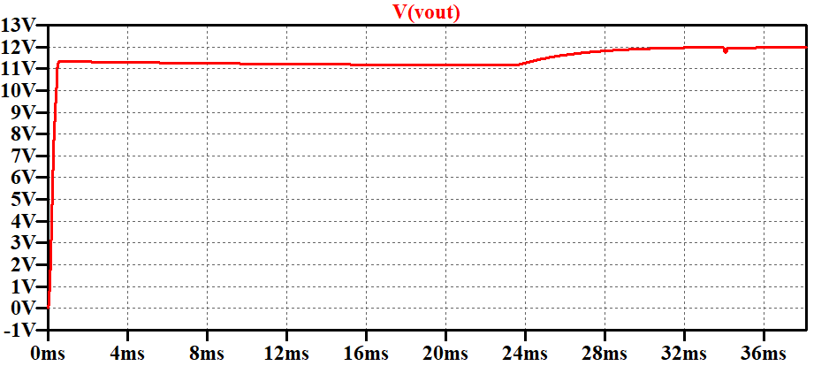
Simulation Results
400V input, No load to Full Load

Slide 27

Magnetic Design of Transformer
Minimum turns for not saturating the core
Other Specifications
$$n_{1}>\frac{V_{i,max}∗D_{max}∗\frac{1}{f_{s}}}{B_{sat}∗A_{e}}$$
$$n_{1}>\frac{400∗0.4364∗\frac{1}{100∗{10}^{−3}}}{0.53∗0.77∗{10}^{−6}}$$
$$n_{i}>42.76$$
$$n_{1}=48 Turns$$
$$n_{2}=\frac{48}{16}$$
$$n_{2}=3 Turns$$
Input Current
0.25A at 100kHz
AWG 25 (due to frequency)
Output Current
9A DC
AWG 12 (due to current)
2 EER cores
PC47EER28-Z

Slide 28

Magnetic Design of Transformer – Magnetising Inductance
$$µ=µ_{0}∗µ_{r}$$
$$µ=2500∗4∗π∗{10}^{−7}$$
$$µ=0.003142$$
$$R=\frac{\frac{14+9.65}{2}∗{10}^{−3}∗2}{µ∗{\left(\frac{9.9}{2}\right)}^{2}∗π}∗\frac{\frac{\frac{21.2+3.4}{2}∗{10}^{−3}∗2}{µ∗4.35∗{10}^{−3}∗11.4∗{10}^{−3}}+\frac{\frac{14+9.65}{2}∗{10}^{−3}∗2}{µ∗3.4∗{10}^{−3}∗11.4∗{10}^{−3}}}{2}$$
$$R=443821$$
$$L_{m}=\frac{N^{2}}{R}$$
$$L_{m}=\frac{{48}^{2}}{443821}$$
$$L_{m}=5.19 mH$$

Slide 29

Magnetic Design of Transformer - Skin Depth
$$Skin Depth\left(δ\right)=\sqrt{\frac{ρ}{π∗f_{o}∗μ_{r}∗μ_{0}}}$$
$$Skin Depth\left(δ\right)=\sqrt{\frac{1.678∗10^{−6}}{π∗100∗10^{3}∗0.999995∗4∗π∗10^{−7}}}$$
$$Skin Depth\left(δ\right)= 206μm$$
AWG12 : 2.05mm diameter
AWG25 : 0.455mm diameter

Slide 30


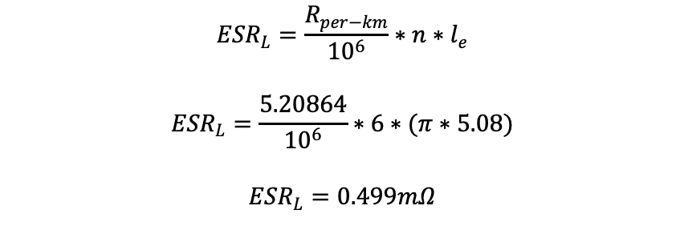
Magnetic Design of Inductor
Selected Core: 0W41305TC
ESR Value
$${ESR}_{L}=\frac{R_{per−km}}{{10}^{6}}∗n∗l_{e}$$
$${ESR}_{L}=\frac{5.20864}{{10}^{6}}∗6∗(π∗5.08)$$
$${ESR}_{L}=0.499mΩ$$
$$L>160 µH$$
$$n>\sqrt{\frac{160∗{10}^{−6}}{4760∗{10}^{−9}}}$$
$$n>5.79$$
$$n=6$$
$$L=4760∗{10}^{−9}∗6^{2}$$
$$L=171.36 µH$$
Filling Ratio = 0.6
$$A_{req}=\frac{6∗3.31}{0.6}$$
$$A_{req}=33.1 {mm}^{2}$$
$$A_{w}=52.04 {mm}^{2}$$

Slide 31
Component Selection
Key parts are:
Controllers
MOSFETs
Diodes
Thermal Analysis and Heatsink

Slide 32

Component Selection
MOSFET
Diodes
Drain-Source Resistance
350m$Ω$
Transient time
Rise time: 16 ns
Fall time: 17 ns
Gate Charge
19 nC
Forward voltage
0.56 V

Slide 33
Component Selection - Controllers
LTC3723-1
LT1431
Controller + Gate Driver
Non-isolated – Required external isolation
Dead-Time control
Frequency control
Soft start property
2 gate synchronous drive capability
Opto-coupler driver
Internal compensator design property

Slide 34

Loss Calculations
MOSFETs (Calculated for One):
$$P_{conduction}=I^{2}∗D∗R_{DS}$$
$$P_{conduction}=7^{2}∗0.12∗0.35$$
$$P_{conduction}=2.058 W$$
$$P_{switching}=\frac{1}{2}∗V_{in}∗I_{in}∗\left(t_{r}+t_{f}\right)∗f$$
$$P_{switching}=\frac{1}{2}∗400∗7∗\left(16+17\right)∗{10}^{−9}∗100∗{10}^{3}$$
$$P_{switching}=4.62 W$$
$$P_{gate}=V_{GS}∗f∗Q_{g}$$
$$P_{gate}={20∗100∗10}^{3}∗19∗{10}^{−9}$$
$$P_{gate}=0.038 W$$

Slide 35

Loss Calculations
Transformer:
$$P_{core}=1.72 W$$
Diodes (Calculated for One):
$$P_{loss}=0.6∗I_{f\left(AV\right)}+0.00367∗I_{f(rms)}^{2}$$
$$P_{loss}=0.6∗4.165 +0.00367∗{5.592}^{2}$$
$$P_{loss}=2.613 W$$
Output Inductor:
$$P_{loss}=I_{o}^{2}∗ESR$$
$$P_{loss}={8.333}^{2}∗0.499∗{10}^{−3}$$
$$P_{loss}=0.035 W$$
Integrated Circuits:
$$P_{total}=0.42 W$$

Slide 36
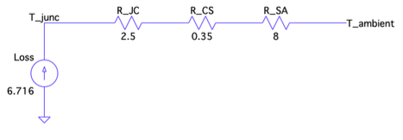


Thermal Analysis - MOSFET
$$P_{loss,MOSFET}=6.716$$
$$T_{junction}=\left(8+0.35+2.5\right)∗6.716+25$$
$$T_{junction}={97.87}^{o}C$$

