Slide 1
EE 464 Term Project DC-DC Converter Design
Team: Doge Power
Onur Öztaş 2330389
Mustafa Yıldız 2233013

Slide 2
INPUT
220V-400V DC Voltage
OUTPUT
12V DC output voltage
100W output power
Less than 4% voltage ripple
Less than 3% line regulation
Less than 3% load regulation

Slide 3
Topology Selection

Slide 4


Analytical Calculations
Calculation of Turns Ratio
Limit Values of Duty Cycle
$$\frac{0.6}{2}=0.3$$
$$\frac{220+400}{2}=310$$
$$V_{o}=V_{in}∗2∗\frac{N_{2}}{N_{1}}∗D$$
$$12=310∗2∗\frac{N_{2}}{N_{1}}∗0.3$$
$$\frac{N_{2}}{N_{1}}=\frac{1}{16}$$
$$V_{o}=V_{in}∗2∗\frac{N_{2}}{N_{1}}∗D_{min}$$
$$12=400∗2∗\frac{1}{16}∗D_{min}$$
$$D_{min}=0.24$$
$$12=400∗2∗\frac{1}{16}∗D_{max}$$
$$D_{max}=0.4364$$

Slide 5


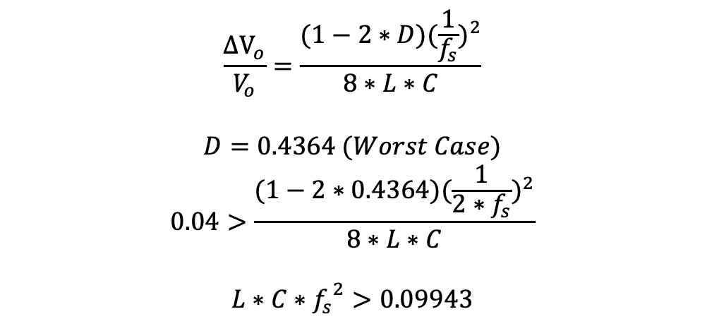
Analytical Calculations
Calculation of main parameters
f=100kHz
$$\frac{{ΔV}_{o}}{V_{o}}=\frac{(1−2∗D){(\frac{1}{f_{s}})}^{2}}{8∗L∗C}$$
$$D=0.4364 (Worst Case)$$
$$0.04>\frac{(1−2∗0.4364){(\frac{1}{{2∗f}_{s}})}^{2}}{8∗L∗C}$$
$$L∗C∗{f_{s}}^{2}>0.09943$$
$$L∗C>\frac{0.09943}{{(10∗{10}^{3})}^{2}}$$
$$L∗C>9.943∗{10}^{−12}$$
L=160μH
$$C>\frac{9.943∗{10}^{−12}}{160∗{10}^{−6}}$$
$$C>62.15 nF$$

Slide 6
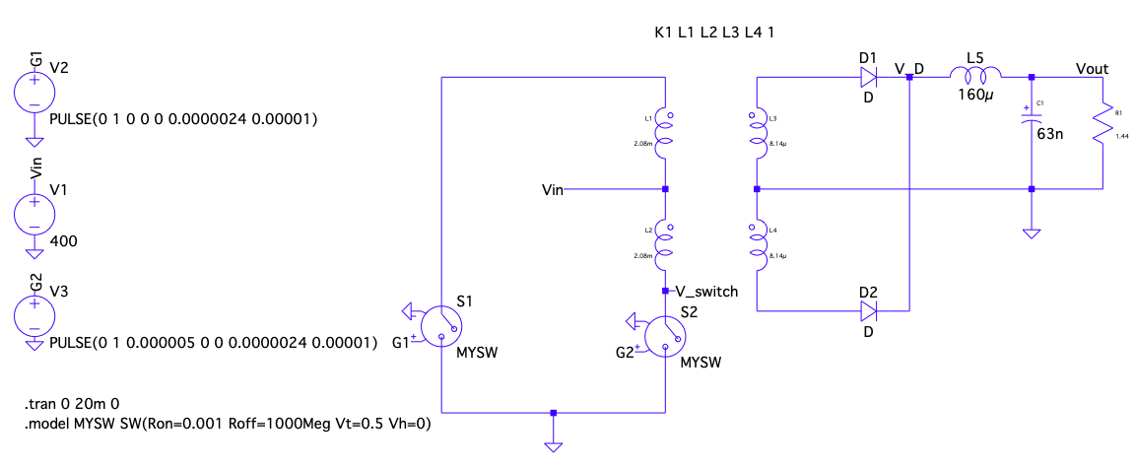
Analytical Calculations

Slide 7
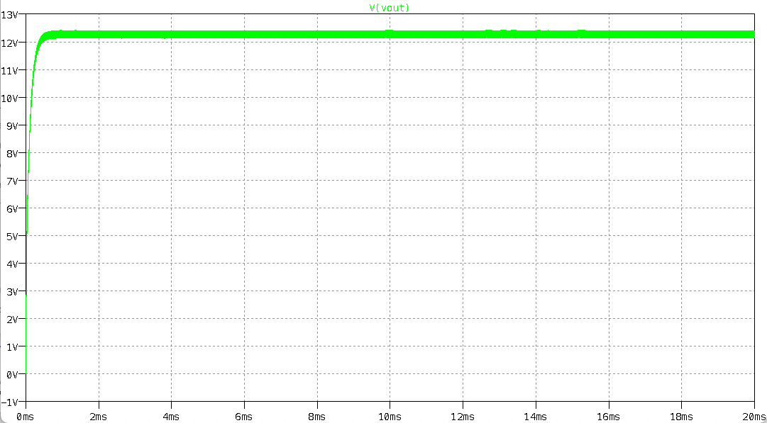
Analytical Calculations

Slide 8
Analytical Calculations
Current Rating of Output Inductor
8.333 A
Voltage Rating of Output Capacitor
12 V
Voltage Rating of Diodes
50 V (blocking)
Current Rating of Diodes
9 A (forward)
Voltage Rating of Switches
800 V (blocking)
Current Rating of Switches
800 mA

Slide 9
Controller Design

Slide 10

Magnetic Design of Transformer
Minimum turns for not saturating the core
Other Specifications
Input Current
0.25A at 100kHz
AWG 25 (due to frequency)
Output Current
9A DC
AWG 12 (due to current)
2 EER cores
PC47EER28-Z
$$n_{1}>\frac{V_{i,max}∗D_{max}∗\frac{1}{f_{s}}}{B_{sat}∗A_{e}}$$
$$n_{1}>\frac{400∗0.4364∗\frac{1}{100∗{10}^{−3}}}{0.53∗0.77∗{10}^{−6}}$$
$$n_{i}>42.76$$
$$n_{1}=48 Turns$$
$$n_{2}=\frac{48}{16}$$
$$n_{2}=3 Turns$$

Slide 11


Magnetic Design of Transformer
Magnetizing Inductance
Skin Depth
$$µ=µ_{0}∗µ_{r}$$
$$µ=2500∗4∗π∗{10}^{−7}$$
$$µ=0.003142$$
$$R=\frac{\frac{14+9.65}{2}∗{10}^{−3}∗2}{µ∗{\left(\frac{9.9}{2}\right)}^{2}∗π}∗\frac{\frac{\frac{21.2+3.4}{2}∗{10}^{−3}∗2}{µ∗4.35∗{10}^{−3}∗11.4∗{10}^{−3}}+\frac{\frac{14+9.65}{2}∗{10}^{−3}∗2}{µ∗3.4∗{10}^{−3}∗11.4∗{10}^{−3}}}{2}$$
$$R=443821$$
$$L_{m}=\frac{N^{2}}{R}$$
$$L_{m}=\frac{{48}^{2}}{443821}$$
$$L_{m}=5.19 mH$$
$$Skin Depth\left(δ\right)=\sqrt{\frac{ρ}{π∗f_{o}∗μ_{r}∗μ_{0}}}$$
$$Skin Depth\left(δ\right)=\sqrt{\frac{1.678∗10^{−6}}{π∗100∗10^{3}∗0.999995∗4∗π∗10^{−7}}}$$
$$Skin Depth\left(δ\right)= 206μm$$

Slide 12


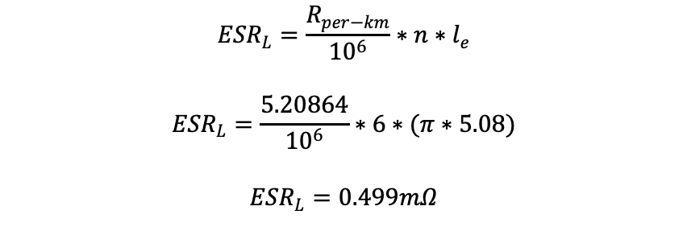
Magnetic Design of Inductor
Selected Core: 0W41305TC
ESR Value
$${ESR}_{L}=\frac{R_{per−km}}{{10}^{6}}∗n∗l_{e}$$
$${ESR}_{L}=\frac{5.20864}{{10}^{6}}∗6∗(π∗5.08)$$
$${ESR}_{L}=0.499mΩ$$
$$L>160 µH$$
$$n>\sqrt{\frac{160∗{10}^{−6}}{4760∗{10}^{−9}}}$$
$$n>5.79$$
$$n=6$$
$$L=4760∗{10}^{−9}∗6^{2}$$
$$L=171.36 µH$$
Filling Ratio = 0.6
$$A_{req}=\frac{6∗3.31}{0.6}$$
$$A_{req}=33.1 {mm}^{2}$$
$$A_{w}=52.04 {mm}^{2}$$

Slide 13
Component Selection
Key parts are:
Controllers
MOSFETs
Diodes
Thermal Analysis and Heatsink

Slide 14
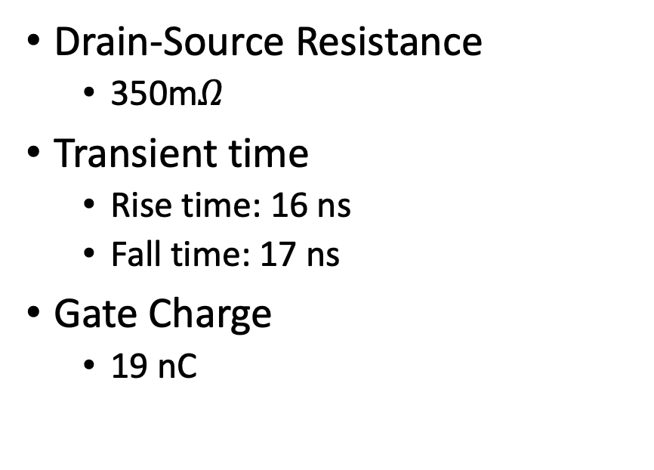
Component Selection
MOSFET
Diodes
Drain-Source Resistance
350m$Ω$
Transient time
Rise time: 16 ns
Fall time: 17 ns
Gate Charge
19 nC
Forward voltage
0.56 V

Slide 15
Component Selection - Controllers

Slide 16

Loss Calculations
Transformer:
$$P_{core}=1.72 W$$
MOSFETs (Calculated for One):
$$P_{conduction}=I^{2}∗D∗R_{DS}$$
$$P_{conduction}=7^{2}∗0.12∗0.35$$
$$P_{conduction}=2.058 W$$
$$P_{switching}=\frac{1}{2}∗V_{in}∗I_{in}∗\left(t_{r}+t_{f}\right)∗f$$
$$P_{switching}=\frac{1}{2}∗400∗7∗\left(16+17\right)∗{10}^{−9}∗100∗{10}^{3}$$
$$P_{switching}=4.62 W$$
$$P_{gate}=V_{GS}∗f∗Q_{g}$$
$$P_{gate}={20∗100∗10}^{3}∗19∗{10}^{−9}$$
$$P_{gate}=0.038 W$$

Slide 17

Loss Calculations
Diodes (Calculated for One):
$$P_{loss}=I∗V_{f}$$
$$P_{loss}=8.333∗0.56$$
$$P_{loss}=4.67 W$$
Output Inductor:
$$P_{loss}=I_{o}^{2}∗ESR$$
$$P_{loss}={8.333}^{2}∗0.499∗{10}^{−3}$$
$$P_{loss}=0.035 W$$
Integrated Circuits:
$$P_{total}=0.42 W$$

Slide 18
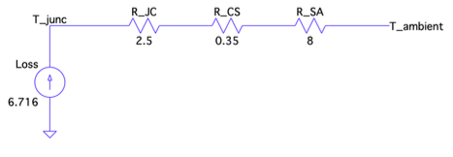


Thermal Analysis
$$P_{loss,MOSFET}=6.716$$
$$T_{junction}=\left(8+0.35+2.5\right)∗6.716+25$$
$$T_{junction}={97.87}^{o}C$$

