Slide 1

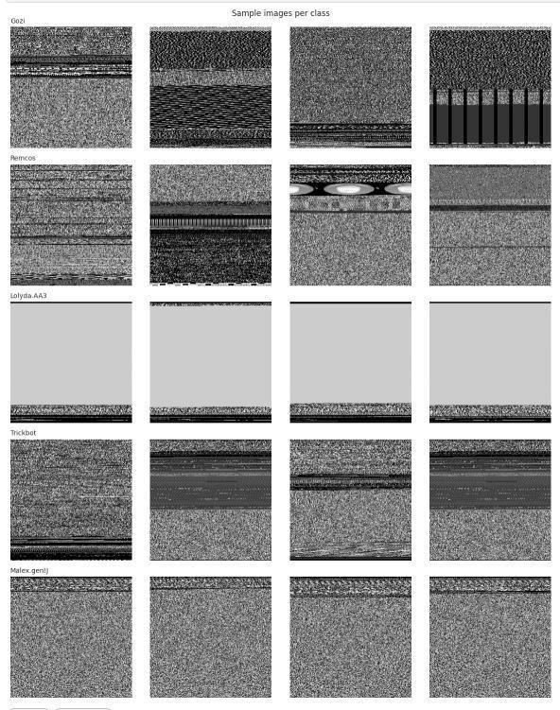

Malware Family Classification
Using an Image-to-Graph GCN on the MaleBin Dataset
Track 2: Image → Graph → GCN
Instructor: Dr. Raihanul Islam, Associate Professor
Department of CSE, East West University
ICE 478 • GROUP-1:
1. Md. Mustafidur Rahman
ID: 2022-3-50-006
2. Amana Akter Arfa
ID: 2022-3-50-006
3. Rakiba Alam
ID: 2022-3-50-025
Byte-derived grayscale malware textures
Notes:
1

Slide 2
Research problem and objectives
We test whether spatial relations between malware-image regions add useful information.
PROBLEM
Binary files can
be represented as
grayscale images
CNNs learn
texture, but do not
explicitly model
patch relationships
GCN can pass
messages between
spatial nodes
Malware evolves
and may evade
signature-based
detection
RESEARCH QUESTION
OBJECTIVES:
Can an image-to-graph representation improve malware family classification by modeling relationships between neighboring byte-image patches?
Establish strong CNN baselines
1
2
Build and evaluate a PatchGCN
3
Improve the GCN, then test ablation, CV, significance and XAI
02
Notes:
2

Slide 3
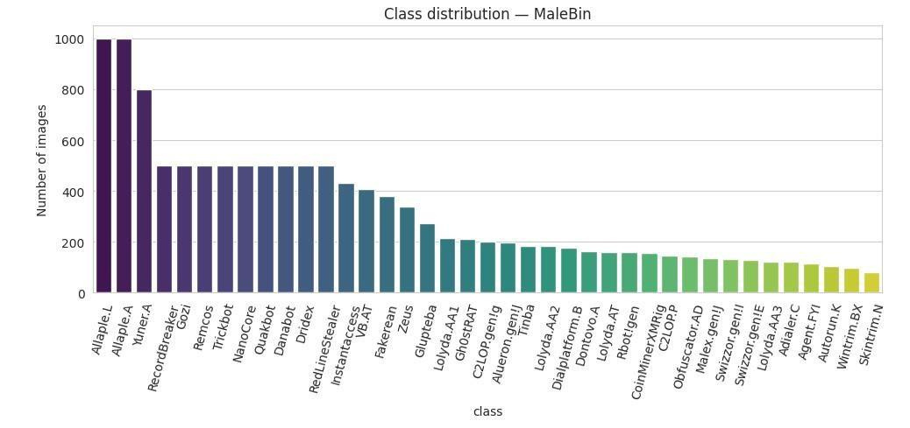
Dataset, cleaning and EDA
Original MaleBin images were cleaned before modeling to reduce leakage risk.
12,464
39
9,230
35
70/15/15
Original images
Original families
Final images
Retained classes
Split
EDA takeaway: families show distinctive texture patterns, but class imbalance makes macro-F1 more informative than accuracy alone.
Sample byte images
03
Notes:
3

Slide 4
Related work and research gap
We use the related work as design guidance, not as directly comparable MaleBin benchmarks.
2022
2022
2023
2023
2025
CNN features + GCN
ViG
IMGCN-LPE
WaveMesh
ShapeGNN
Patch nodes
nearest-neighbor graph
SLIC superpixels
+ positional GCN
Multiscale superpixels
+ SplineCNN
Superpixel geometry
+ GNN
Learned region features
+ graph classifier
RESEARCH GAP
Most image-GCN studies use natural-image regions or superpixels. MaleBin byte-images are texture-like, so there is no reliable semantic region to segment.
Natural images
→ semantic regions
MaleBin
→ fixed patch graph
Our focus: test whether a simple, leakage-free patch graph still adds useful relational information.
04
Notes:
4

Slide 5
Complete project methodology
The work moves from data understanding to an honest final evaluation.
MaleBin
dataset
EDA
Duplicate
control
70/15/15
split
CNN baselines
(SimpleCNN, ResNet18, MobileNetV3)
First PatchGCN
(6 statistical features/node)
Improved CNN-feature GCN
(128 learned features/node)
Ablation + CV
+ significance
XAI + final
interpretation
Principle: compare models on the same leakage-controlled split and report what actually happened, even when the GCN does not beat the strongest CNN.
05
Notes:
5

Slide 6
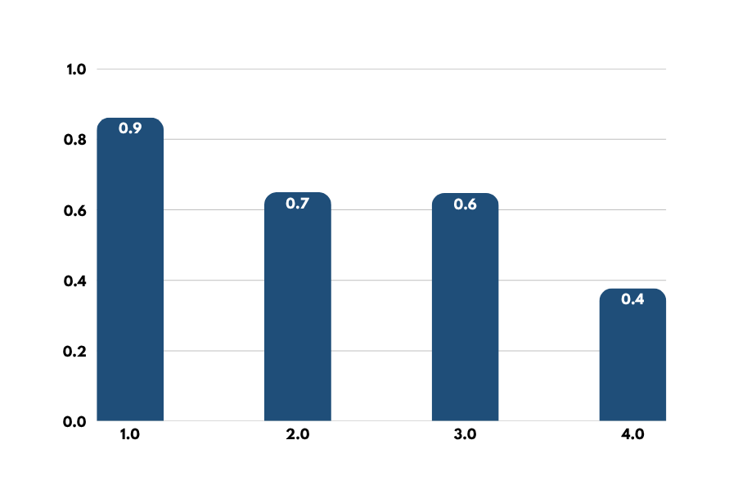
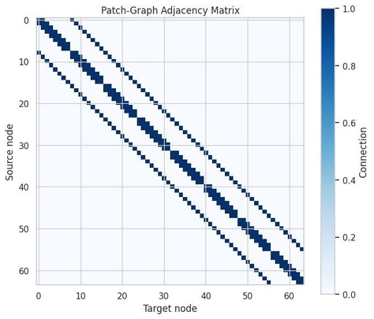
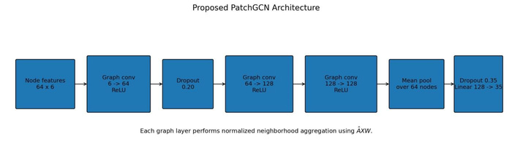
Task 2: CNN baselines and first PatchGCN
The first graph model used simple patch statistics and became the baseline to improve.
FIRST PATCHGCN CONSTRUCTION
128×128
image
8×8 grid
64 nodes
6 features
per node
4-neighbor
edges
Main Task 2 finding: ResNet18 was the strongest baseline. The first PatchGCN was compact, but six statistics per patch lost too much discriminative texture.
06
Notes:
6

Slide 7
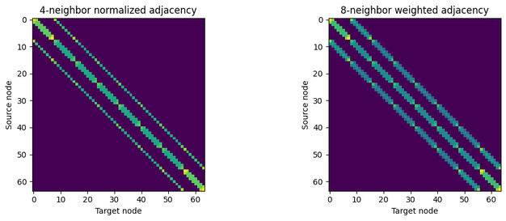
Task 3: Improved CNN-feature GCN
The main upgrade was changing node features from handcrafted statistics to learned CNN vectors.
128×128
grayscale
CNN backbone
32→64→128
8×8 feature map
64 nodes × 128-D
4-neighbor graph
+ self-loops
3 GCN layers
+ residual
Mean + max pool
35 classes
WHAT CHANGED FROM TASK 2?
Task 2
6 handcrafted statistics / node
Task 3
128 learned CNN features / node
Ablation tested 4-neighbor vs weighted 8-neighbor graphs
Why this matters: learned patch features keep richer local texture information before message passing combines nearby node representations.
07
Notes:
7

Slide 8
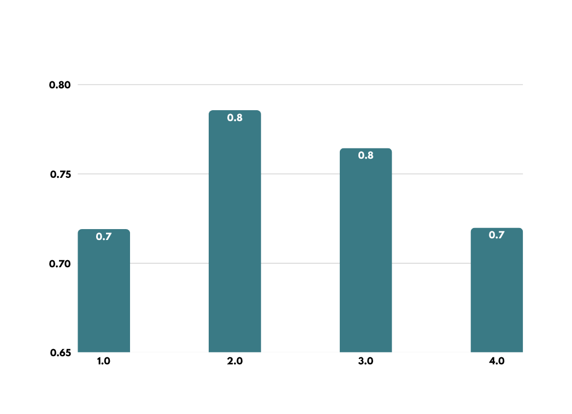
Ablation study: what actually helped?
Every variant was tested on the same held-out split.
FINDINGS
Graph message passing helped
0.7191 → 0.7857 (+0.0666)
More edges were not automatically better
4-neighbor > weighted 8-neighbor
Batch normalization stabilized the graph network
0.7645 → 0.7199 when removed
Selected final model: CNN_GCN_4N
08
Notes:
8

Slide 9
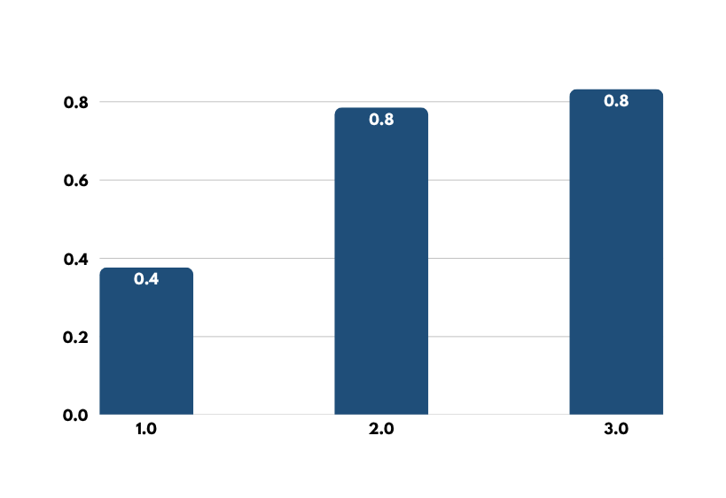
Final performance, CV and significance
The improved GCN became competitive, but ResNet18 remained the stronger classifier.
FIVE-FOLD CV
Metric
ResNet18 / Final GCN
Macro-F1
0.7309 ± 0.0501 / 0.6829 ± 0.0543
Accuracy
0.7278 ± 0.0735 / 0.7304 ± 0.0295
SIGNIFICANCE TESTS
Test
Result
McNemar fixed test
p = 0.000004, significant
EFFICIENCY
Wilcoxon 5-fold Macro-F1
p = 0.3125, not significant
Model
Checkpoint
Model
Inference
Final GCN
0.61 MB
Final GCN
1.20 ms/img
42.76 MB
1.39 ms/img
Honest interpretation: the final GCN improved a lot over the first GCN, but the fixed-test and CV evidence do not show that it beats ResNet18.
ResNet18
ResNet18
09
Notes:
9

Slide 10
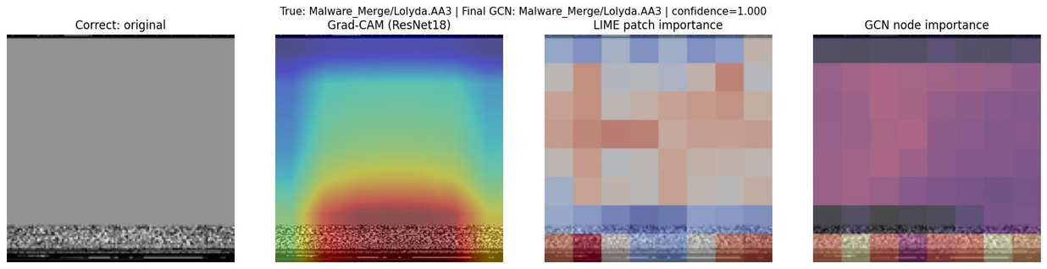
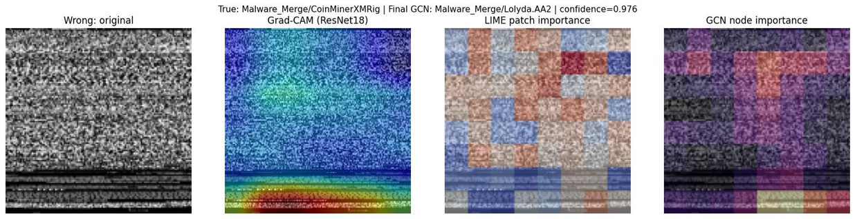
Explainability: correct vs wrong prediction
Correct: Lolyda.AA3 → Lolyda.AA3 | confidence 0.9998
WHAT THE VIEWS SHOW
Correct example: lower structured regions are consistently important across Grad-CAM, patch importance and node occlusion.
Wrong example: importance is more distributed, and the model is highly confident despite focusing on texture that is not specific enough.
Wrong: CoinMinerXMRig → Lolyda.AA2 | confidence 0.9759
Limitation: a highlighted patch is evidence of model sensitivity in the image representation, not a specific malware function, code block or causal program behavior.
10
Notes:
10

Slide 11
Pillar A and Pillar B
Pillar A: No same-dataset published result was available among the five Track-2 related works, so a fair Beat / Match / Below category against published work cannot be established.
Pillar B: The model works by turning CNN feature positions into graph nodes, passing messages between 4-neighbor patches, then pooling node features for classification.
Internal comparison
Macro-F1
What actually happened: graph message passing improved the graph-off model, but did not outperform ResNet18.
First PatchGCN
0.3771
CNN-only ablation
0.7191
Final GCN
0.7857
Why this matters: the project explains both success and limitation instead of forcing an unsupported win.
ResNet18
0.8323
Evidence-based final story: improved GCN helped, but ResNet18 stayed strongest.
11
Notes:
11

Slide 12
Conclusion
Main result progression
First PatchGCN
Macro-F1 0.3771
Final CNN-GCN
Macro-F1 0.7857
ResNet18
Macro-F1 0.8323
1. Learned CNN node features were the main reason the GCN improved over the first patch-statistics graph.
3. ResNet18 remained strongest on the fixed test comparison, so we do not claim the GCN is best overall.
2. The 4-neighbor graph added useful message passing over the graph-off CNN backbone.
4. XAI helps understand model sensitivity, but byte-image regions are not semantic malware-code regions.
Final conclusion: the improved GCN is compact and competitive, but the safest evidence-based choice for highest accuracy on MaleBin is still ResNet18.
12
Notes:
12

