Slide 1

Ahsanullah University of Science and Technology
Department of Computer Science and Engineering
CSE 3104 Project Proposal
Topic: LifeLink
Hospital Management System
By,
NAME : Shadman Muhtasim - 20230104110
NAME : Ahbab Hasan -20210204119
NAME : Mustakim Musa - 20210204122

Slide 2
OVERVIEW
Introduction
Motivation
Requirements
Goals
Objectives
Functionalities
Features
Entity Relationship Diagram
Development Tools and Platforms

Slide 3
INTRODUCTION
LifeLink is a practical hospital management web application built to handle real hospital workflows through one connected platform.
The system now supports:
role-based login and dashboard routing
patient, donor, and applicant registration
applicant approval into Doctor, Nurse, and IT staff roles
department-based staff workflows
patient appointments and medical records
admissions, bed allocation, and discharge support
blood request, donor screening, donor matching, and blood bank operations
public department directory and department detail pages
Instead of only proposing a database model, the project has now been developed into a working Laravel + MSSQL + Docker-based application with real UI and API integration.

Slide 4
MOTIVATION
To reduce manual hospital workflow fragmentation by combining multiple operations into one platform
To provide role-specific workspaces for Admin, IT Worker, Doctor, Nurse, Patient, Donor, and Applicant
To improve coordination between departments, especially for admissions, appointments, and blood bank operations
To digitize staff approval and department assignment workflows
To support safer and faster hospital decision-making using structured, real-time data
To create a practical full-stack hospital system instead of only a theoretical ERD/database design

Slide 5
REQUIREMENTS
Goals:
Build a working hospital management system with connected frontend, backend, and database
Maintain secure authentication and role-based access control
Support department-aware workflows for hospital staff
Track patient, staff, applicant, donor, and blood-bank related data reliably
Provide admin-side control for staff onboarding and approval
Create a modular system that can grow into a larger hospital platform later

Slide 6
OBJECTIVES
To manage role-based user access using JWT authentication and RBAC
To support patient appointments, records, and blood requests
To support nurse monitoring and Blood Bank nurse screening workflows
To support doctor appointments, patient lists, and bed/admission-related actions
To support IT workflows for admissions, bed allocation, and operational coordination
To support donor availability, eligibility, notification, and donation workflows
To support applicant approval and department assignment before staff activation
To provide public department pages with doctor listings, reviews, and availability information

Slide 7
FUNCTIONALITIES
1. Core Hospital Resource & Care Module
Patient registration and portal access
Doctor and nurse department-based profile workflows
Appointment management
Medical record access
Admissions and bed allocation support
Discharge support and status tracking
Department-scoped clinical monitoring and operational lookup

Slide 8
FUNCTIONALITIES
2. Blood Bank & Operational Coordination Module
Blood request submission and request tracking
Donor registration and donor self-enrollment
Donor availability tracking
Blood Bank nurse donor screening and eligibility logging
Blood matching and donor suggestion support
Donation logging and inventory-linked blood bank operations
Interconnected Blood Bank IT/admin approval and fulfillment-side actions

Slide 9
FUNCTIONALITIES
3. Administrative & Access Control Module
Admin review of job applications
Approval/rejection of Doctor, Nurse, and IT worker applicants
Department assignment during staff onboarding
User account control (including freeze/unfreeze support)
Role-based access control using users, roles, permissions, and middleware
Public department directory and department-detail management support

Slide 10
FEATURES
Role-Based Access Control with JWT authentication
Role-specific dashboards for Admin, IT Worker, Doctor, Nurse, Patient, Donor, and Applicant
Applicant-to-staff approval workflow
Department-aware staff experiences
Appointment and patient workflow support
Blood request and donor management support
Public department directory with doctor reviews and availability
Docker-based local deployment with MSSQL backend
Shared dashboard UI shell and modernized Blade-based web interface

Slide 11
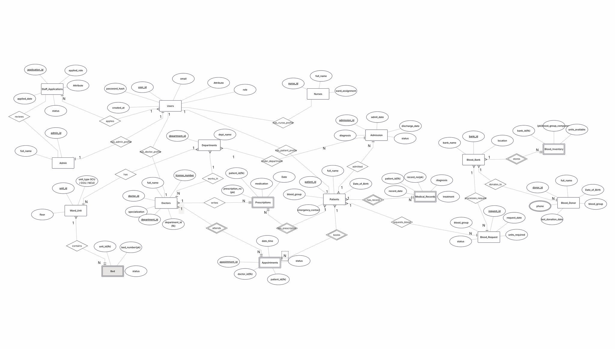
Entity Relationship Diagram

Slide 12
DEVELOPMENT TOOL AND PLATFORM
Frontend / UI:
Laravel Blade
Shared CSS design system
JavaScript for dashboard interaction and panel switching
Backend:
Laravel (PHP)
REST-style API controllers
Middleware-based role access control
Database:
Microsoft SQL Server

Slide 13
DEVELOPMENT TOOL AND PLATFORM
Authentication / Security:
JWT authentication
Role-based access control
Middleware protection
DevOps / Local Deployment:
Docker
Docker Compose
Version Control:
Git and GitHub
UI Prototyping / Design Direction:
Figma / Figma Make (used as design inspiration)

Slide 14
CONCLUSION
LifeLink has moved beyond the proposal stage into a practical full-stack hospital management system.
The project now demonstrates:
real user authentication and routing
real admin approval and department assignment flow
real staff, patient, donor, and applicant workflows
admissions, appointments, and blood-bank related operations
public department pages and connected database-backed hospital information
This project gave us hands-on experience in:
backend API design
relational database integration
role-based system design
Docker-based local deployment
practical hospital workflow modeling through software

Slide 15
Thank you

