Slide 1

Ahsanullah University of Science and Technology
Department of Computer Science and Engineering
CSE 3104 Project Proposal
Topic: Hospital Resource Management System
By,
Student ID: 20230104110
Student ID: 20210204119
Student ID: 20210204122

Slide 2
Overview
Introduction
Motivation
Requirements
Goals
Objectives
Functionalities
Features
Entity Relationship Diagram
Development Tools and Platforms

Slide 3
Introduction
LifeLink is a real-time, database-driven application designed to manage critical hospital resources efficiently. The system centralizes data on beds, blood banks, medical equipment, staff, and emergency supplies into a single structured database. It focuses on real-time tracking, automation, and intelligent allocation to improve emergency response and operational efficiency in crowded hospitals. Implemented using MySQL and modern web technologies, it ensures data integrity, scalability, and real-world applicability in medical environments.

Slide 4
Motivation
To eliminate delays in locating ICU beds and emergency resources during critical situations.
To provide real-time visibility into blood bank inventory and prevent shortages during emergencies.
To reduce manual errors and time wastage in tracking medical equipment and staff availability.
To improve coordination between hospital departments during mass casualty events.
To enable predictive resource management and data-driven decision-making for hospital administrators.

Slide 5
REQUIREMENTS
Goals:
To design a reliable, real-time relational database for hospital resource management.
To ensure data integrity through proper normalization, constraints, and validation.
To support complete resource lifecycle tracking—from availability to allocation and replenishment.
To provide an intuitive dashboard for doctors, staff, and administrators for seamless resource management

Slide 6
Objectives
To maintain real-time status of beds (occupied/vacant/cleaning) across all wards.
To track blood inventory by type, quantity, expiry, and transfusion logs.
To monitor medical equipment usage, maintenance schedules, and availability.
To manage staff schedules, specialties, and real-time location within the hospital.
To enable emergency resource tracking and automated alerting for low stock.
To provide role-based access for doctors, nurses, administrators, and lab staff.

Slide 7
REQUIREMENTS
Functionalities: 1. Resource Management Module:
Real-time bed allocation and status updates.
Blood inventory management with expiry tracking.
Equipment maintenance and availability logs.
Staff duty scheduling and availability tracking.

Slide 8
REQUIREMENTS
Functionalities:
2. Emergency & Operational Module:
Instant resource lookup during emergencies.
Automated alerts for low stock or expired items.
Inter-department resource request and approval system.
Disaster mode for mass casualty resource mapping.

Slide 9
REQUIREMENTS
Functionalities:
3. Administrative Module:
Dashboard with analytics and predictive insights.
User and role management for hospital staff.
Audit logs for resource changes and transactions.
Reporting module for compliance and planning.

Slide 10
REQUIREMENTS
Features:
Real-Time Tracking: Live updates for beds, blood, equipment, and staff.
Predictive Alerts: Automated notifications for shortages and maintenance.
Role-Based Access Control: Secure access for doctors, nurses, admins, and lab staff.
Offline Capability: Syncs data once the internet is restored.
Scalable Design: Modular structure allowing future integration with IoT and AI.
HIPAA-Compliant Security: Encrypted data and secure authentication

Slide 11
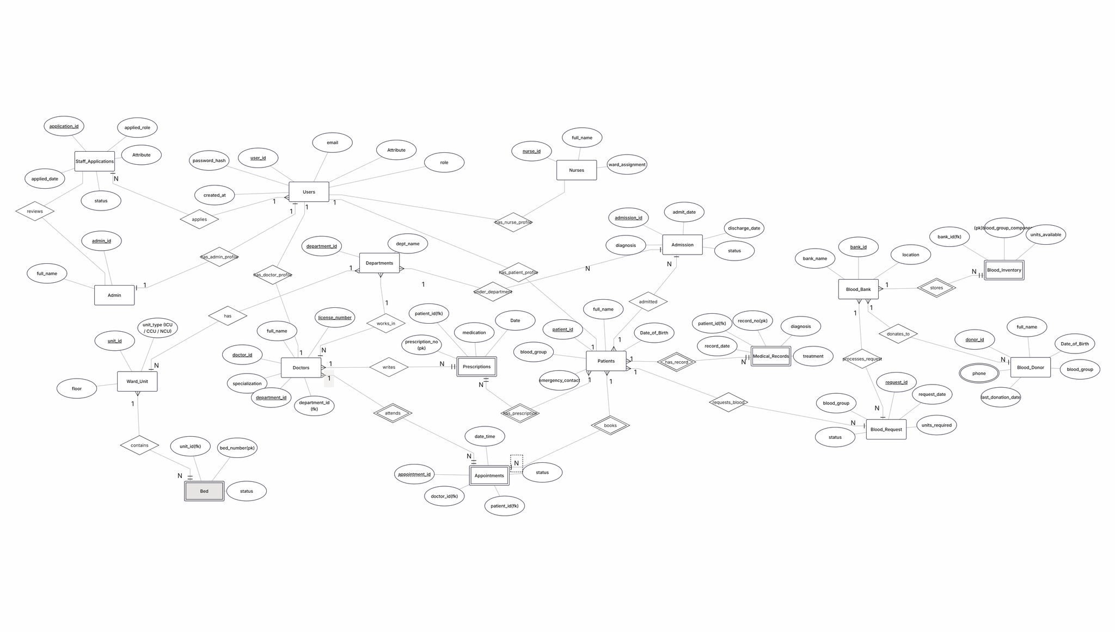
Entity Relationship Diagram

Slide 12
DEVELOPMENT TOOL AND PLATFORM
Frontend: React.js Backend: Node.js, Express.js Database: MySQL, Redis (caching) Real-Time Communication: Socket Version Control: Git, GitHub Deployment: Docker, AWS/Azure (optional) Security: JWT, encryption, HIPAA-compliant practices

Slide 13
CONCLUSION
Successfully models real-world hospital resource management challenges.
Organizes critical data efficiently to ensure consistency and real-time usability.
Designed to support scalable, life-saving operational processes.
Demonstrates the power of a well-structured database for complex, critical applications.
Provides hands-on experience in practical, impact-driven system design

Slide 14
Thank you

