Slide 1
Logic Expressions: Part 3
Make sure to read book material!

Slide 2
Motivation for Predicates
If the patient is an infant, then the patient has no children.
assume “the patient” = “Alex”
AlexIsInfant → ¬AlexHasChild
This expression is only about Alex!
What if we want to make this assertion about all patients?
If any patient is an infant, then that patient has no children.

Slide 3
Motivation for Predicates
If any patient is an infant, then that patient has no children.
Propositional logic expressions cannot express such statements
We need to make a statement about “arbitrary” patients
A predicate is a “propositional function” with one or more arguments
Example Predicates:
Infant(x) : is true if and only if x is an infant
HasChild(x) : is true if and only if x has a child

Slide 4
Motivation for Predicates
If Alex is an infant, then Alex has no children.
Infant(Alex) → ¬HasChild(Alex)
proposition based on predicate Infant(x)
proposition based on predicate HasChild(x)
But again, this statement is only about Alex!

Slide 5
Universal Quantifier
If any patient is an infant, then the patient has no children.
∀x Infant(x) → ¬HasChild(x)
Universal quantifier (∀) :
read as “for all x”
x is restricted to a domain of discourse (here patients)
For all x, where x is a patient, if x is an infant, then x does not have a child.

Slide 6
Existential Quantifier
There exists a patient that is an infant and has the flu.
∃x Infant(x) ∧ HasFlu(x)
Existential quantifier (∃) :
read as “there exists an x”
x is restricted to a domain (here patients)
There exists an x, where x is a patient, such that x is an infant and x has the flu.

Slide 7
Negating Quantifiers
Not all patients are infants.
¬ (∀ x Infant(x))
(recall the “domain” of x here is over all patients)
There exists a patient that is not an infant.
∃x ¬Infant(x)
Are these statements equivalent?
Yes.

Slide 8
Negating Quantifiers
There does not exist a patient that is an infant.
¬ (∃ x Infant(x))
(recall the “domain” of x here is over all patients)
For all patients, none of them are infants.
∀x ¬Infant(x)
Are these statements equivalent?
Yes.

Slide 9
Negating Quantifiers
In general we have:
¬∀x P(x) ≡ ∃x ¬P(x)
¬∃x P(x) ≡ ∀x ¬P(x)
Similar to De Morgan’s Laws.

Slide 10
Learning Objectives
Understand what a predicate is and why it is useful
Understand universal and existential quantifiers
Understand why specifying domain is important
Translate English sentences to expressions involving quantifiers
Translate quantified expressions to english

Slide 11
Applications of Logic in Computer Science
We have focused on how to represent statements via logic
These statements are used in various ways throughout computer science. Two examples include,
Automated Program Verification
Automated Theorem Proving

Slide 12
Automated Program Verification
Desired Properties of Program, e.g.
The variable x should always be positive
No item will go unprocessed
Computer Program
Verification
Algorithm
Output:
“Yes” if program satisfies properties
“No” otherwise
Different types of logics used to specify properties!

Slide 13
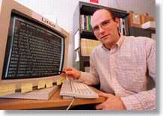
Automated Theorem Proving (or automated mathematics)
Description of mathematical system (expressed in logic)
Theorem Proving Algorithm
Proof or
Disproof
Conjectured Theorem (expressed in logic)
A mathematical conjecture (Robbins conjecture) unsolved for decades.
First non-trivial mathematical theorem proved automatically.
[An Argonne lab program] has come up with a major mathematical
proof that would have been called creative if a human had thought of it.
New York Times, December, 1996

Slide 14
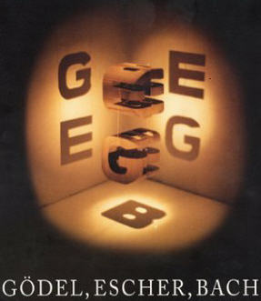
Good Book
Gödel, Escher, Bach: An Eternal Golden Braid (1979) Douglas Hofstadter

