Slide 1
Sets: Notation and Definitions
Make sure to read book material!

Slide 2
What is a set?
{1, 2, 3} is a set with elements 1, 2, and 3
A set is an unordered collection of objects/elements
Sets are widely used throughout mathematics
Sets are a basic data structure of computer science
Databases are sets of records
A folder/directory is a set of files
etc.

Slide 3
Basic Notation
The empty set is denoted by ∅ or sometimes by { }
e ∈ S denotes that e is an element of set S
Example: 2 ∈ {1, 2, 3}
The cardinality of set S is the # of elements in it
Denoted by |S|
Example: | {1, 2, 3} | = 3

Slide 4
Ways to Describe Sets
Simply list all of the elements of the set:
{1, 2, 3}
{Sophie, Alex, John}
{red, blue, green}

Slide 5
Ways to Describe Sets
Set Builder Notation:
{n | n > 2, n ∈ R}, where R is the set of real numbers
Read as: “all n such that n > 2 and n is a real number”
{x | x is an OSU student and x studies computer science}
Z⁺ = {n | n > 0, n ∈ Z }, where Z is the set of integers
E⁺ = {x | x = 2n, n ∈ Z⁺}

Slide 6
Set Equality
Two sets are equal if and only if they have the same elements
A = B denotes that A and B are equal sets.
{1,2,3} = {2,1,3}
{1,2,2,3,3,3} = {1,2,3}

Slide 7
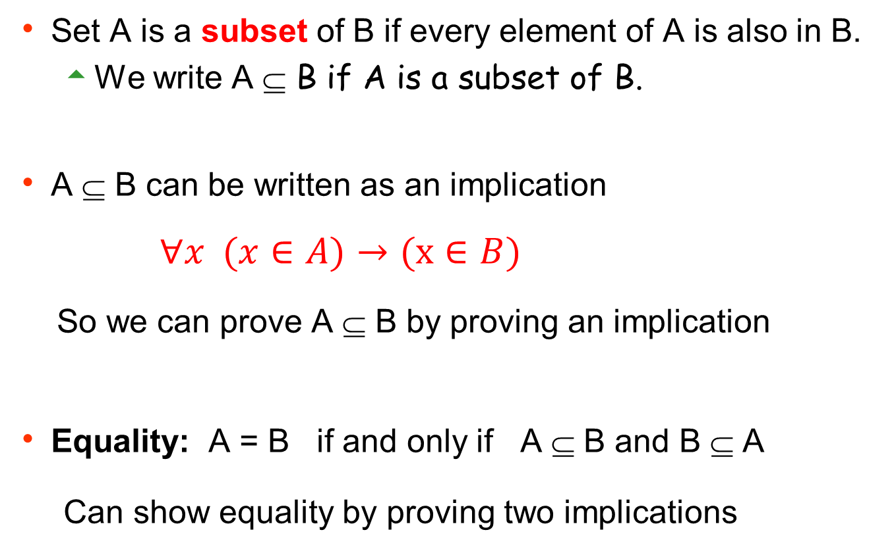
Subset
Set A is a subset of B if every element of A is also in B.
We write A ⊆ B if A is a subset of B.
A ⊆ B can be written as an implication
$∀x (x∈A)→(x∈B)$
So we can prove A ⊆ B by proving an implication
Equality: A = B if and only if A ⊆ B and B ⊆ A
Can show equality by proving two implications

Slide 8
Sets of Sets
The elements of a set can be sets.
Example 1: A = { {a,b}, {1,2}, {4}, 4 }
Set A has elements {a,b}, {1,2}, {4}, 4 |A| = 4
Example 2: B = {A} = {{ {a,b}, {1,2}, {4}, 4 }}
Set B has element { {a,b}, {1,2}, {4}, 4 } |B| = 1

Slide 9

Russell’s Paradox
Consider a set S that contains all sets that do not contain themselves.
S = { x | x is a set and x $∉$x }
not an element of
Does S contain itself ?
Suppose that it does. Then by definition of S it does not.
Suppose that it does not. Then by definition of S it does.
Various approaches were used to resolve paradox.

Slide 10
Power set
The power set of set A is the set of all subsets of A.
We denote it by P(A).
Examples:
P({1,2,3}) = {∅, {1}, {2}, {3}, {1,2}, {1,3}, {2,3}, {1,2,3}}
P(∅) = {∅}
P({1})={∅, {1}}

Slide 11
Ordered Tuples
Sets do not consider the order of elements
We often do care about the order of elements
Example: longitude-latitude coordinates (long,lat)
An ordered n-tuple (a₁, a₂, …, a_{n}) has a₁ as its first element, a₂ as its second element, …, a_{n} as its nth element.
The order of elements is important in such a tuple.
Note that (a₁, a₂ ) ≠(a₂, a₁) but {a₁, a₂ }={a₂, a₁ }.

Slide 12
Cartesian product
To “construct” sets of n-tuples we use the Cartesian product.
The Cartesian product of the sets A₁, A₂, …, A_{n}, denoted by A₁ x A₂ x …x A_{n}, is defined as the set of ordered tuple (a₁,a₂,…,a_{n}) where a₁ ∈ A₁ , a₂ ∈ A₂, …, a_{n} ∈ A_{n .}
Example:
{1,2} x {3,4,5} = {(1,3), (1,4), (1,5), (2,3), (2,4), (2,5)}

Slide 13
Learning Objectives
Understand and use the basic set definitions and notation.
Understand the subset and equality relations on sets
Understand the distinction between sets and tuples.

