Slide 1
Set Operations
Make sure to read book material!

Slide 2
Set operations
We are familiar with operations on numbers
+, -, x, /, …
We are familiar with operations on propositions
∧, ∨, ¬, →, …
What about sets?
union, intersection, difference, complement

Slide 3
Set intersection
The intersection of sets A and B (denoted A ∩ B) is the set that contains the elements that are in both A and B.
More Formally: A ∩ B = {x | x ∈A ∧ x ∈B}.
Examples: {a, b, c} ∩ {b, c, d} = {b, c} {x | x>0} ∩ {x | x>100} = {x | x>100}

Slide 4
Set union
The union of two sets A and B (denoted A ∪ B) is the set that contains the elements that are in either A or B (or both).
More formally: A ∪ B = {x | x ∈A ∨ x ∈B}.
Examples: {a, b, c} ∪ {b, c, d} = {a, b, c, d} {x | x>0} ∪ {x | x>100} = {x | x>0}

Slide 5
Cardinalities of Union
A
What is |A ∪ B| ?
B
General Expression: |A ∪ B| = |A| + |B| - |A ∩ B|
adjust for double counting
Above Example: |A ∪ B| = 5 + 4 – 2 = 7

Slide 6
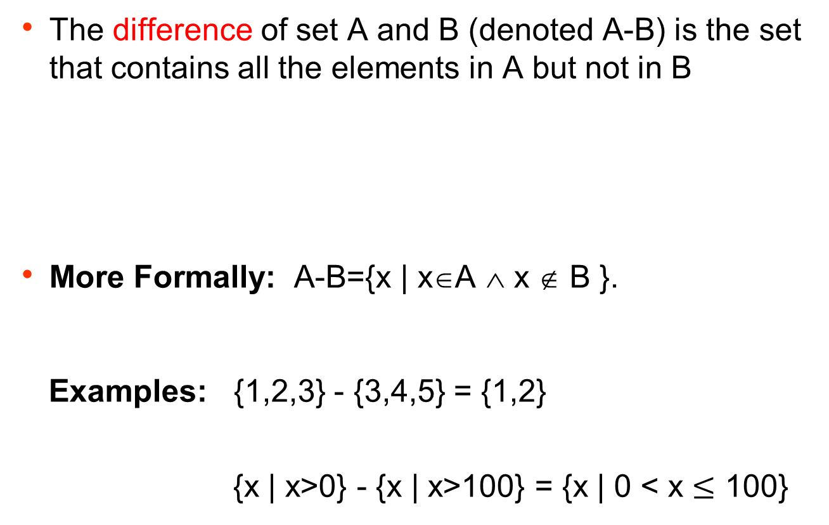
Set difference
The difference of set A and B (denoted A-B) is the set that contains all the elements in A but not in B
More Formally: A-B={x | x∈A ∧ x ∉ B }.
Examples: {1,2,3} - {3,4,5} = {1,2}
{x | x>0} - {x | x>100} = {x | 0 < x $≤$ 100}

Slide 7
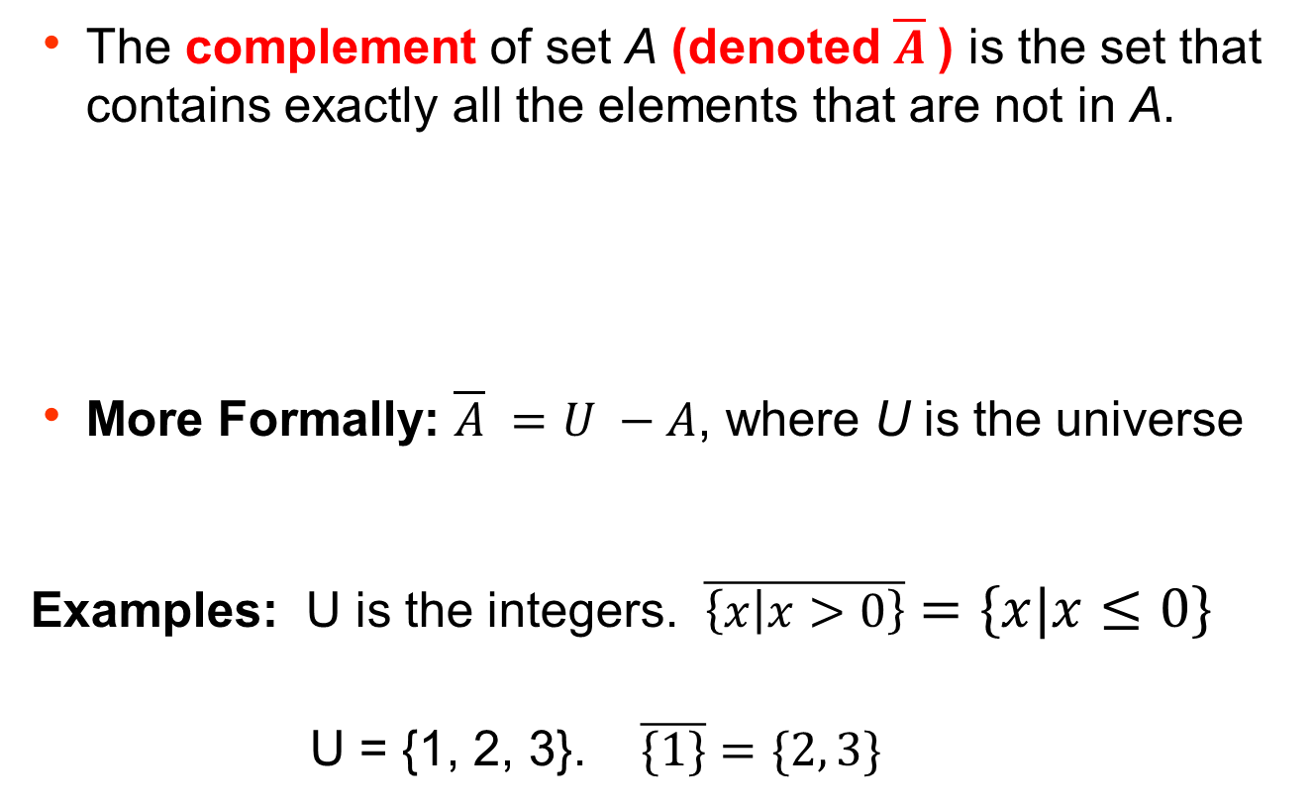
Set complement
The complement of set A (denoted $\overline{A}$) is the set that contains exactly all the elements that are not in A.
More Formally: $\overline{A} =U −A$, where U is the universe
Examples: U is the integers. $\overline{\left\{x | x>0\right\}}=\left\{x | x≤0\right\}$ U = {1, 2, 3}. $\overline{\{1\}}=\{2, 3\}$

Slide 8
Translating to English
Consider:
A = {x | x is a responsible student} B = {x | x is a smart student}
A ∩ B : the set of responsible and smart students
A ∪ B: the set of responsible or smart students
A – B : the set of students that are responsible but not smart
B – A: the set of students that are smart but not responsible

Slide 9
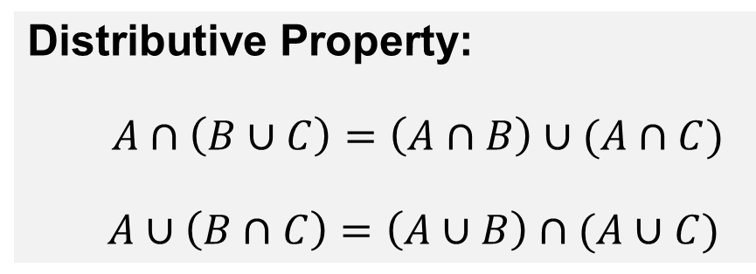
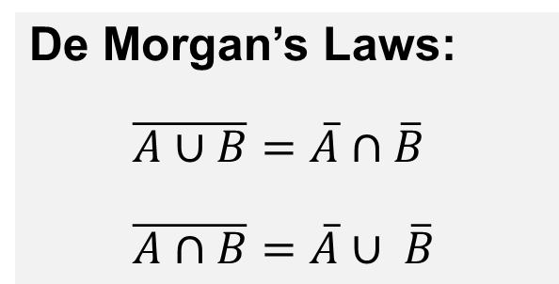
Basic Set Identities
There are many set identities that are analogous to the ones we saw in logic
Distributive Property:
$A∩\left(B∪C\right)=\left(A∩B\right)∪(A∩C)$
$$A∪\left(B∩C\right)=\left(A∪B\right)∩(A∪C)$$
De Morgan’s Laws:
$\overline{A∪B}=\overline{A}∩\overline{B}$
$\overline{A∩B}=\overline{A}∪ \overline{B}$
Your book give a number
of other identities.

Slide 10
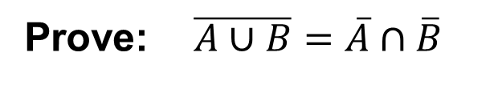
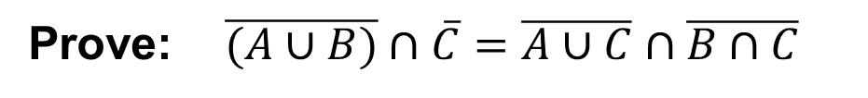
Proving Identities
Prove: $\overline{A∪B}=\overline{A}∩\overline{B}$
Prove: $\overline{(A∪B)}∩\overline{C}=\overline{A∪C}∩\overline{B∩C}$

Slide 11
Learning Objectives
Understand and use the basic set operations.
Know and recognize basic set identities.
Prove both basic and more complex set identities.

Slide 12
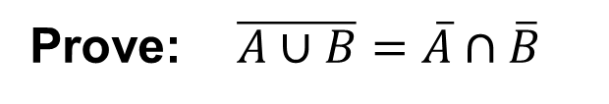
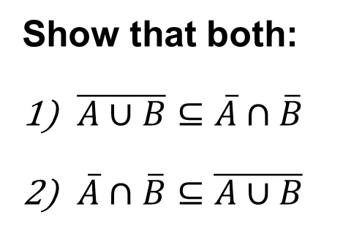
Proving Identities
Prove: $\overline{A∪B}=\overline{A}∩\overline{B}$
Show that both:
$\overline{A∪B}⊆\overline{A}∩\overline{B}$
$\overline{A}∩\overline{B}⊆$ $\overline{A∪B}$

Slide 13
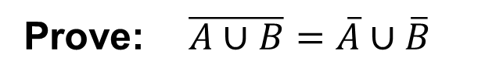
Proving Identities
Prove: $\overline{A∪B}=\overline{A}∪\overline{B}$
Proof by sequence of equivalences (“iff proof”).

Slide 14
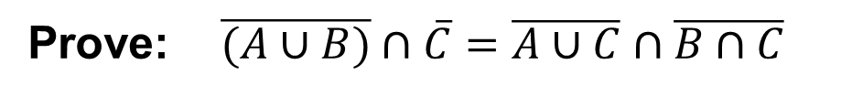
Proving Identities via Rewriting
Prove: $\overline{(A∪B)}∩\overline{C}=\overline{A∪C}∩\overline{B∩C}$
Proof by sequence of known identities.

