Slide 1
Sequences and Sums
Make sure to read book material!

Slide 2
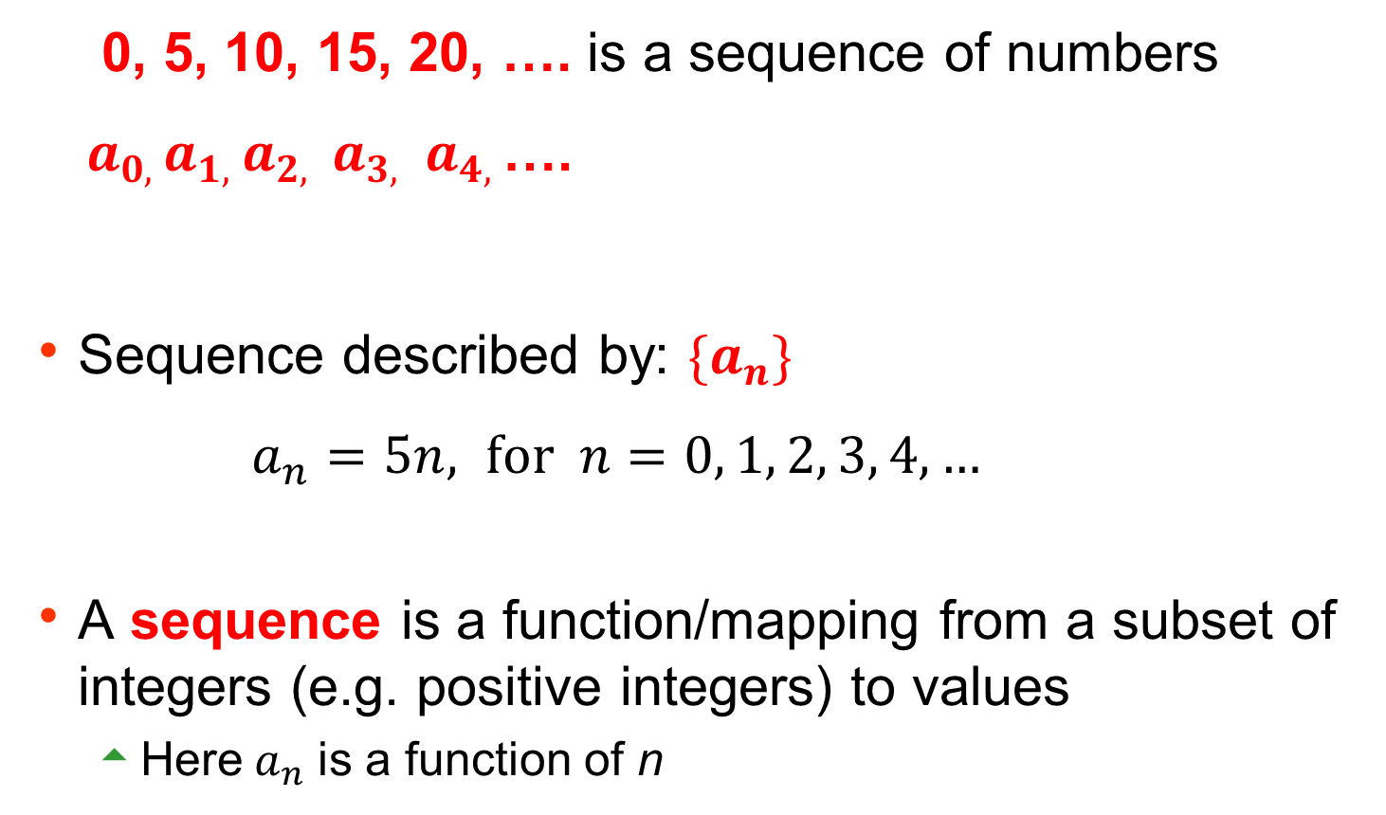
What is a sequence?
0, 5, 10, 15, 20, …. is a sequence of numbers
${ a}_{0, }a_{1, }a_{2, } a_{3, }$ $a_{4, }$….
Sequence described by: ${\{a}_{n}\}$
$a_{n}=5n, \text{for} n=0, 1, 2, 3, 4,…$
A sequence is a function/mapping from a subset of integers (e.g. positive integers) to values
Here$a_{n}$ is a function of n

Slide 3
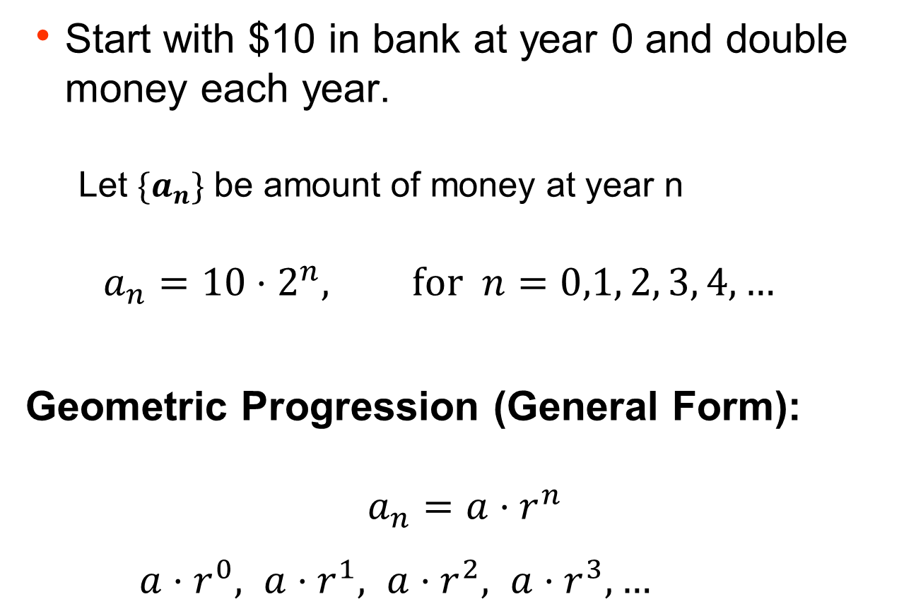
Geometric Progressions
Start with $10 in bank at year 0 and double money each year.
Let ${\{a}_{n}\}$ be amount of money at year n
$$a_{n}={10⋅2}^{n}, \text{for} n=0,1, 2, 3, 4,…$$
Geometric Progression (General Form): $$a_{n}={a⋅r}^{n}$$
${a⋅r_{}^{0}, a⋅r_{}^{1}, a⋅r_{}^{2}, a⋅r_{}^{3},…}_{}$

Slide 4
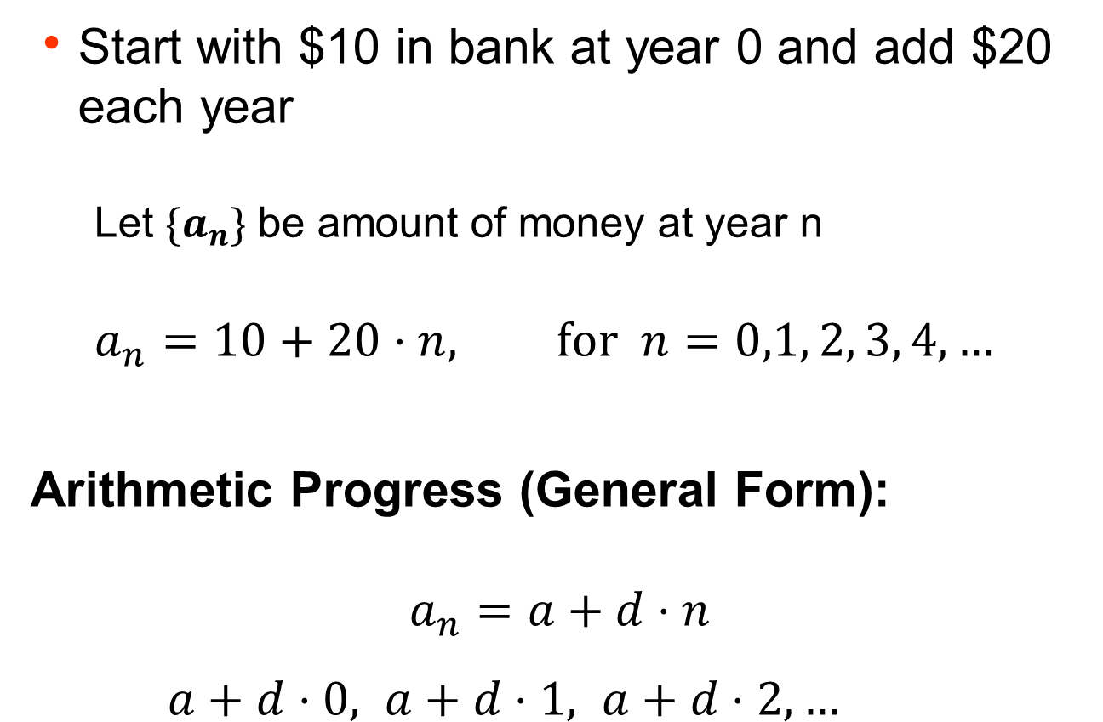
Arithmetic Progressions
Start with $10 in bank at year 0 and add $20 each year
Let ${\{a}_{n}\}$ be amount of money at year n
$$a_{n}=10+20⋅n, \text{for} n=0,1, 2, 3, 4,…$$
Arithmetic Progress (General Form): $$a_{n}=a+d⋅n$$
${a+d⋅0, a+d⋅1, a+d⋅2, …}_{}$

Slide 5
Summations
depth d = 3
How many nodes in a tree of depth d ?

Slide 6

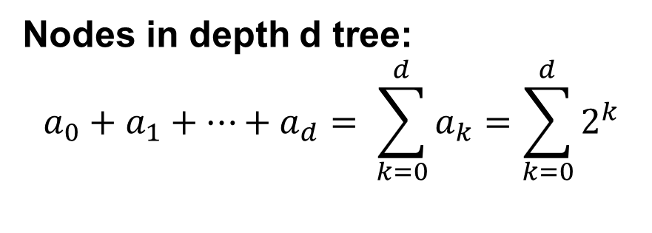

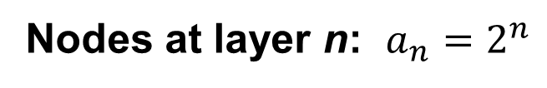


Summations: Geometric Progressions
$$a_{0}=1$$
$$a_{1}=2$$
$$a_{2}=4$$
$$a_{3}=8$$
Nodes at layer n: $a_{n}=2^{n}$
Nodes in depth d tree: $$a_{0}+a_{1}+⋯+a_{d}= \sum_{k=0}^{d}{a_{k}}=\sum_{k=0}^{d}{2^{k}}$$

Slide 7
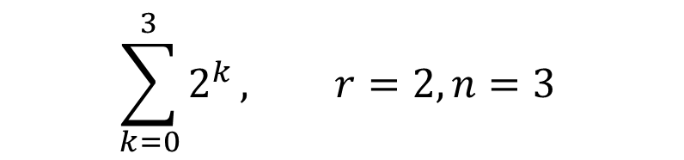
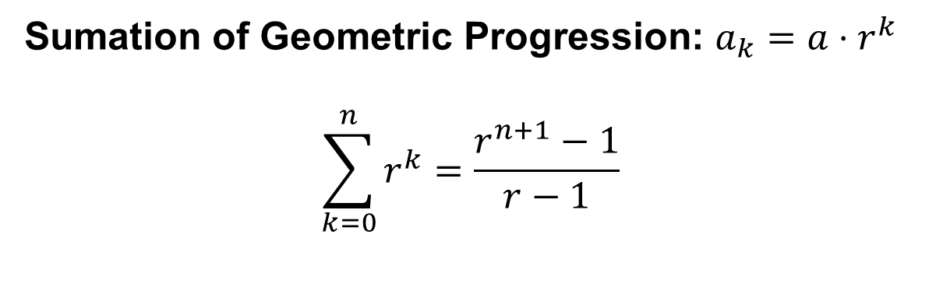
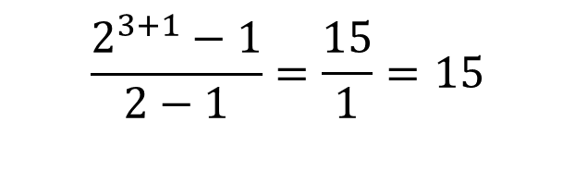
Summations: Geometric Progressions
Sumation of Geometric Progression: $a_{k}=a⋅r^{k}$
$$\sum_{k=0}^{n}{r^{k}}=\frac{r^{n+1}−1}{r−1}$$
$$\sum_{k=0}^{3}{2^{k}}, r=2, n=3$$
$$\frac{2^{3+1}−1}{2−1}=\frac{15}{1}=15$$

Slide 8
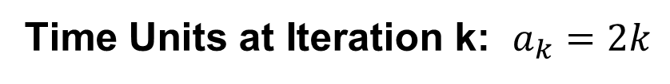
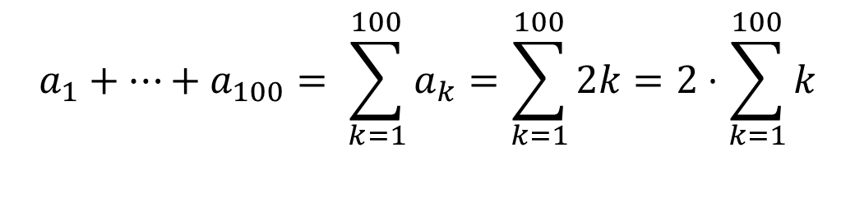
Summations
For k = 1 to 100 do
computation requiring 2k units of time
How many total time units with the loop consume?
Time Units at Iteration k: $a_{k}=2k$
$$a_{1}+⋯+a_{100}= \sum_{k=1}^{100}{a_{k}}=\sum_{k=1}^{100}{2k}=2⋅\sum_{k=1}^{100}{k}$$

Slide 9
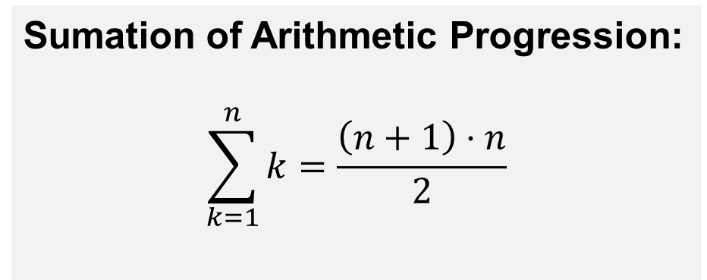
Summations: Arithmetic Progression
1, 2, 3, 4, ……….., n-4, n-3, n-2, n-1, n
Sumation of Arithmetic Progression:
$$\sum_{k=1}^{n}{k}=\frac{\left(n+1\right)⋅n}{2}$$

Slide 10
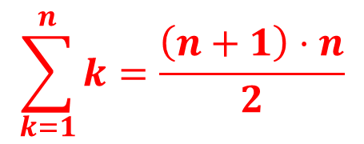
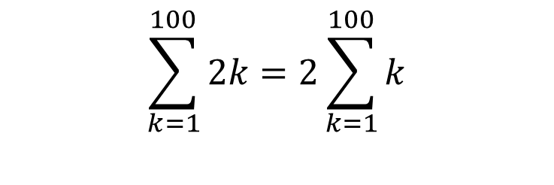
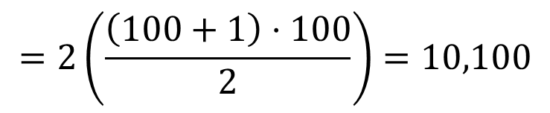
Summations: Arithmetic Progression
For k = 1 to 100 do
computation requiring 2k units of time
$$\sum_{k=1}^{100}{2k}=2\sum_{k=1}^{100}{k}$$
$$=2\left(\frac{\left(100+1\right)⋅100}{2}\right)=10,100$$
$$\sum_{k=1}^{n}{k}=\frac{\left(n+1\right)⋅n}{2}$$

Slide 11
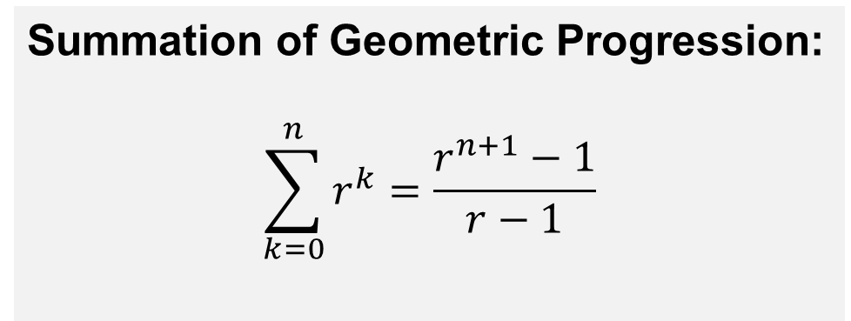
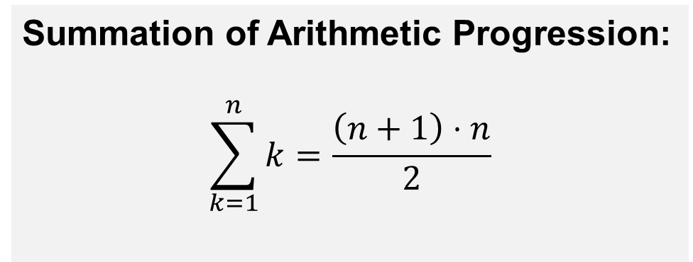
Things to Remember
Summation of Geometric Progression:
$$\sum_{k=0}^{n}{r^{k}}=\frac{r^{n+1}−1}{r−1}$$
Summation of Arithmetic Progression:
$$\sum_{k=1}^{n}{k}=\frac{\left(n+1\right)⋅n}{2}$$

Slide 12
Learning Objectives
Recognize and produce geometric and arithmetic progressions
Know the closed-form expressions for geometric and arithmetic summations
Solve for the value of expressions involving summations
Next lecture

Slide 13
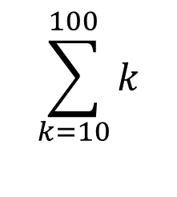
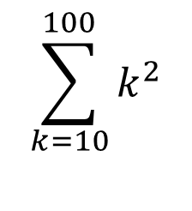
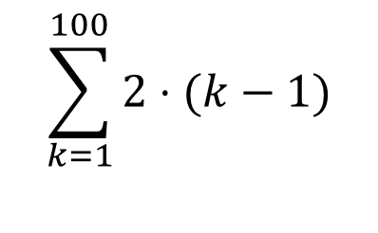
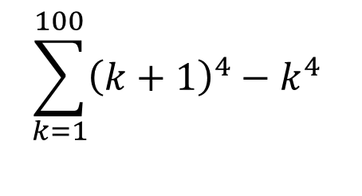
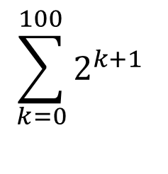
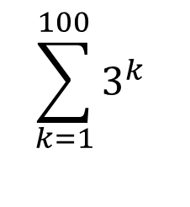
Examples
$$\sum_{k=1}^{100}{2⋅(k−1)}$$
$$\sum_{k=10}^{100}{k}$$
$$\sum_{k=0}^{100}{2^{k+1}}$$
$$\sum_{k=10}^{100}{k^{2}}$$
$$\sum_{k=1}^{100}{3^{k}}$$
$$\sum_{k=1}^{100}{{\left(k+1\right)}^{4}−k^{4}}$$

