Slide 1
Strong Induction
Make sure to read book material!

Slide 2
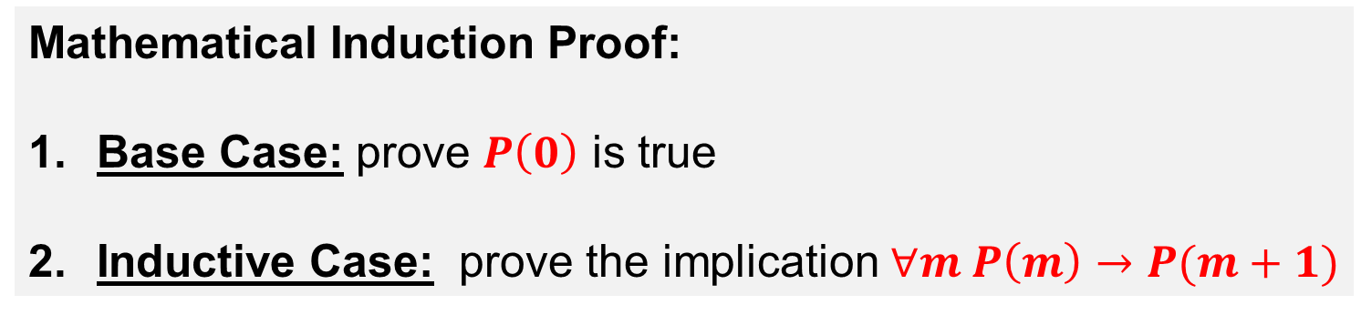
Proving ∀𝒏 𝑷(𝒏)
P(0) P(1) P(2) P(3) P(4) … P(1000) ….
True
True
True
True
True
True
Mathematical Induction Proof:
Base Case: prove $P\left(0\right)$ is true
Inductive Case: prove the implication $∀m P\left(m\right)→P(m+1)$
Sometimes it is hard to prove P(m+1) assuming only P(m).

Slide 3
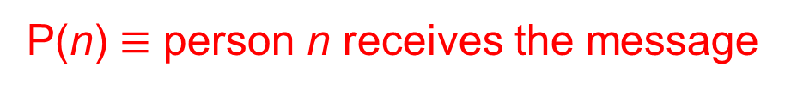
Example
P(1) P(2) P(3) P(4) P(5) P(6) P(7) …
Consider an infinite list of people.
The first three people are given a message.
When the j’th person in the list gets a message they give the message to person j+3
Prove that for any n, the n’th person will get the message.
P(n) $≡$ person n receives the message
Base Case: (n=1 through 3) Trivial.

Slide 4
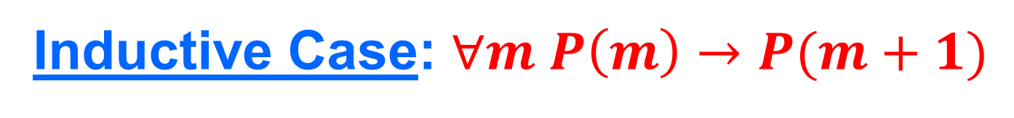
Inductive Case: $∀m P\left(m\right)→P(m+1)$
P(1) P(2) P(3) …. P(m) P(m+1)
Assume P(m): person m receives message
Show P(m+1)?
We need to know that person m-2 received message.
But assumption is about person m.

Slide 5
Problem w/ Mathematical Induction
P(0) P(1) P(2) P(3) … P(m) P(m+1) ….
True
Mathematical Induction Proof:
Base Case: prove $P\left(0\right)$ is true
Inductive Case: prove the implication $∀m P\left(m\right)→P(m+1)$

Slide 6
Strong Induction
P(0) P(1) P(2) P(3) … P(m) P(m+1) ….
True
True
True
True
True

Slide 7
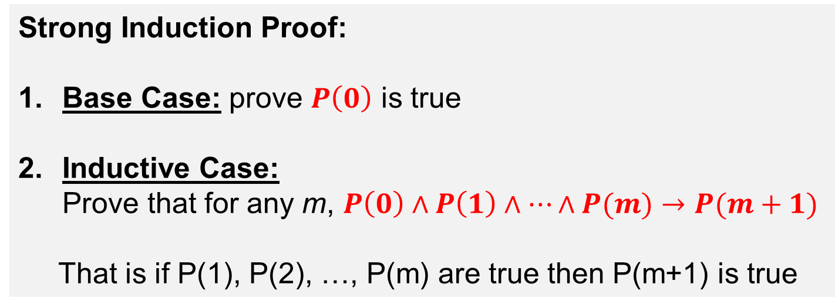
Strong Induction
P(0) P(1) P(2) P(3) … P(m) P(m+1) ….
True
True
True
True
True
Strong Induction Proof:
Base Case: prove $P\left(0\right)$ is true
Inductive Case: Prove that for any m, $P\left(0\right)∧P\left(1\right)∧⋯∧P(m)→P(m+1)$
That is if P(1), P(2), …, P(m) are true then P(m+1) is true

Slide 8
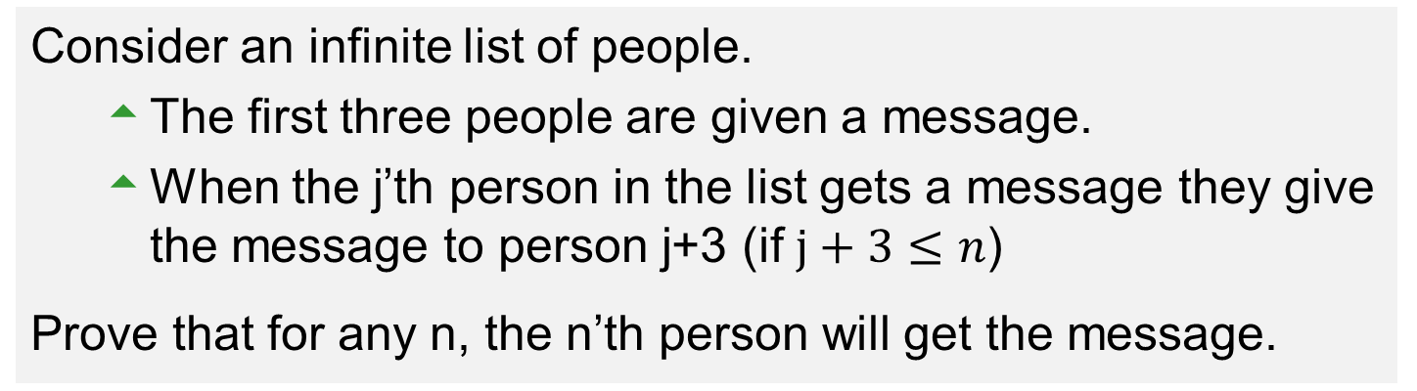
Example
P(1) P(2) P(3) P(4) P(5) P(6) P(7) …
Consider an infinite list of people.
The first three people are given a message.
When the j’th person in the list gets a message they give the message to person j+3 (if $j+3≤n$)
Prove that for any n, the n’th person will get the message.
P(n) $≡$ person n receives the message
Base Case: (n=1 through 3) Trivial.

Slide 9
Inductive Case: Strong Induction
P(1) P(2) P(3) …. P(m) P(m+1)
Prove: $P\left(1\right)∧⋯∧P(m)→P(m+1)$
Assume P(1), … , P(m): first m people receive message
This implies person m-2 received message.
Thus, person m+1 receives the message from person m-2.
So P(m+1) is true.

Slide 10
Learning Objective
Understand and create proofs via strong induction.

