Slide 1
Recursive Definitions
Make sure to read book material!

Slide 2
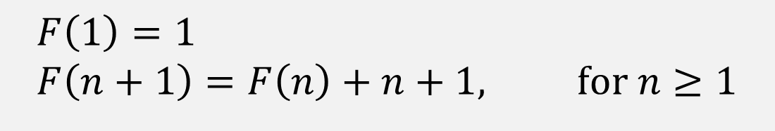
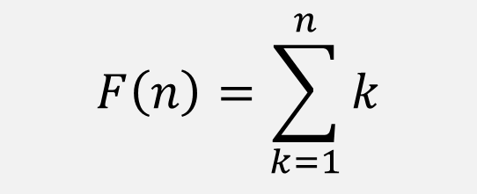
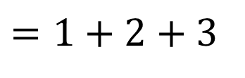
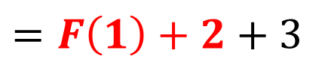
Example
$$F\left(n\right)=\sum_{k=1}^{n}{k}$$
$$F\left(1\right)=1 \\ F\left(n+1\right)=F\left(n\right)+n+1, \text{for} n≥1$$
$$=1+2+3$$
$$F\left(3\right)=F\left(2\right)+3$$
$$=F\left(1\right)+2+3$$

Slide 3
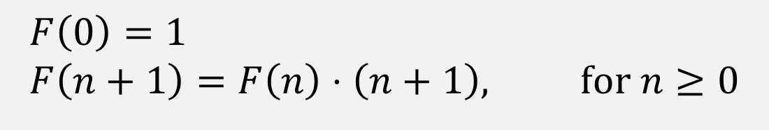
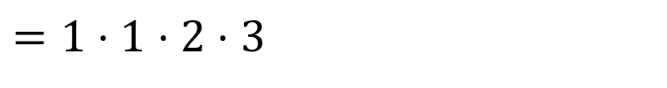

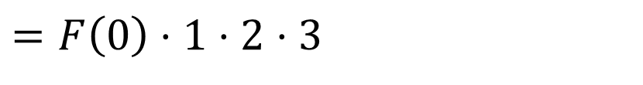
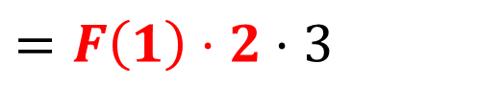
Example
$$F\left(n\right)=n!$$
$$F\left(0\right)=1 \\ F\left(n+1\right)=F\left(n\right)⋅\left(n+1\right), \text{for} n≥0$$
$$=F\left(0\right)⋅1⋅2⋅3$$
$$F\left(3\right)=F\left(2\right)⋅3$$
$$=F\left(1\right)⋅2⋅3$$
$$=1⋅1⋅2⋅3$$

Slide 4
Recursively Defined Functions
Many functions can be defined in terms of themselves.
We call them recursive.
Recursive definition of F(n) of nonnegative integers:
Base Case: specify a value for F(0)
Recursive Case: give a rule for finding F(n+1) in terms of values of F(k) for 0<k<n+1.

Slide 5
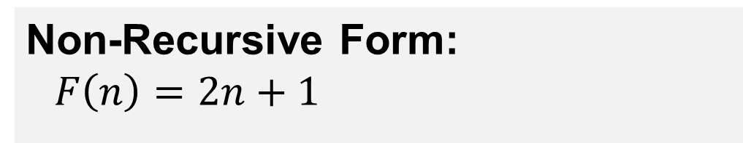
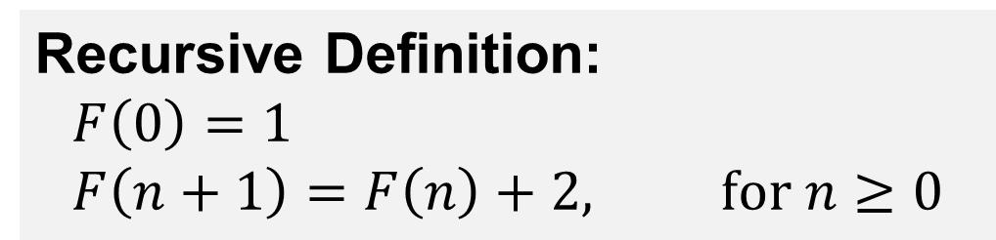
Example
Recursive Definition:
$$F\left(0\right)=1 \\ F\left(n+1\right)=F\left(n\right)+2, \text{for} n≥0$$
n 0 1 2 3 4 5 ….
F(n) 1 3 5 7 9 11 ….
Non-Recursive Form:
$$F\left(n\right)=2n+1$$

Slide 6

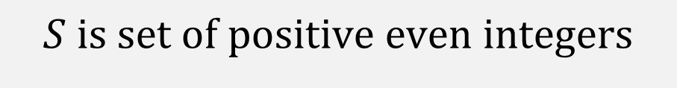
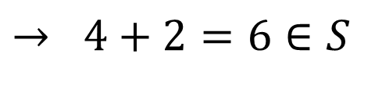
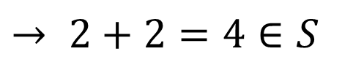
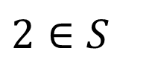
Example: Recursively Defined Set
$$S \text{is} \text{set} \text{of} \text{positive} \text{even} \text{integers}$$
$$2∈S$$
$$\text{If} n∈S \text{then} n+2∈S$$
$$2∈S$$
$$→ 2+2=4∈S$$
$$→ 4+2=6∈S$$

Slide 7
Recursively Defined Sets
Many sets can be defined recursively.
Recursive definition of a set S:
Base Case(s): specify one or more “base elements” of S
Recursive Case: give a rule for adding other elements to S in terms of elements already in S

Slide 8
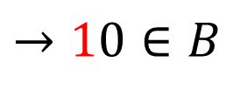
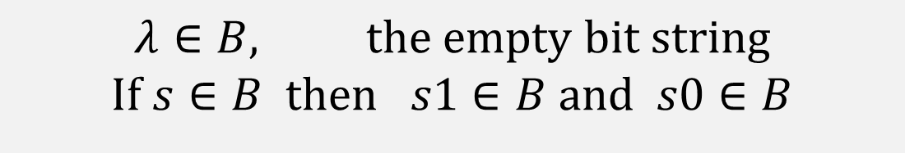
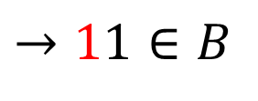
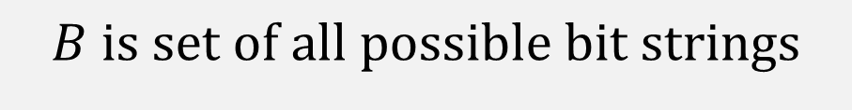

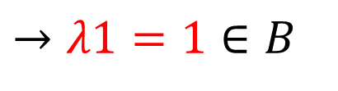
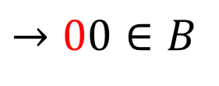
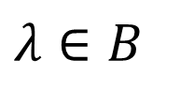

Example: Recursively Defined Set
$$B \text{is} \text{set} \text{of} \text{all} \text{possible} \text{bit} \text{strings}$$
$$λ∈B, \text{the} \text{empty} \text{bit} \text{string}$$
$$\text{If} s∈B \text{then} s1∈B \text{and} s0∈B$$
$$→11∈B$$
$$→λ1=1∈B$$
$$→10∈B$$
$$λ∈B$$
$$→λ0=0∈B$$
$$→01∈B$$
$$→00∈B$$

Slide 9
Example: Set of all Trinary Trees

Slide 10
Example: Set of all Trinary Trees
Recursive definition of set of trinary trees T:
Base Case(s): a single leaf node is in T
Recursive Case:
If r, s, and t are trees in T, then add new tree with a root node connected to roots of r, s, and t.

Slide 11
Learning Objective
Understand and create recursive definitions of functions.
Understand and create recursive definitions of sets, e.g.
Sets of numbers.
Strings.
Trees.

