Slide 1
Basic Counting Rules
Make sure to read book material!

Slide 2
Examples
A product ID is either three letters followed by three numbers
or three numbers followed by three letters.
How many product IDs are there?
How many distinct bit strings of length n either start with a 0
or end with 11?

Slide 3
Counting Problems
A counting problem specifies a set of objects with certain properties and asks how many such objects there are.
Many counting problems are not obvious
Solution: Break problem down into simpler problems via counting rules
Product Rule
Sum Rule

Slide 4
Product Rule: Example
Suppose that an interior room designer can choose from:
5 different styles
6 different color schemes
3 different luxury levels
Count the number of possible designs.
6 color schemes each of 5 styles = 5x6 color-style combinations
3 luxury levels for each color-style combination = 3x5x6 designs

Slide 5
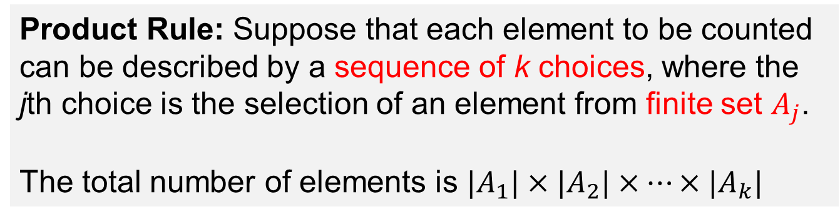
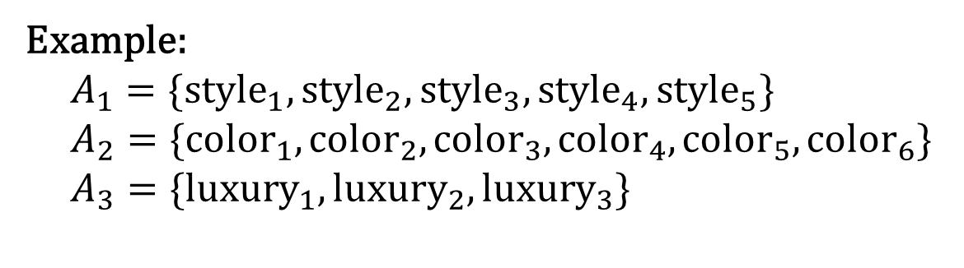
Product Rule: General Form
Product Rule: Suppose that each element to be counted
can be described by a sequence of k choices, where the
jth choice is the selection of an element from finite set $A_{j}$.
The total number of elements is $|A_{1}|×|A_{2}|×⋯×{|A}_{k}|$
Example:
$$A_{1}=\{{\text{style}}_{1},{\text{style}}_{2},{\text{style}}_{3},{\text{style}}_{4},{\text{style}}_{5}\}$$
$A_{2}=\{{\text{color}}_{1},{\text{color}}_{2},{\text{color}}_{3},{\text{color}}_{4},{\text{color}}_{5},{\text{color}}_{6}\}$
$$A_{3}=\{{\text{luxury}}_{1},{\text{luxury}}_{2},{\text{luxury}}_{3}\}$$

Slide 6
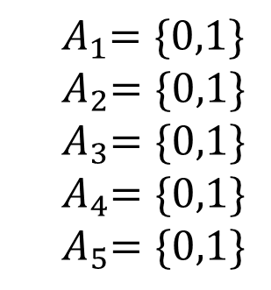

Product Rule: Example
Count the number of bit strings of length 5.
00000, 10000, …. 01011, …, 11111
$${ A}_{1}=\{0,1\}$$
$${ A}_{2}=\{0,1\}$$
$${ A}_{3}=\{0,1\}$$
$${ A}_{4}=\{0,1\}$$
$${ A}_{5}=\{0,1\}$$
$$2×2×2×2×2=2^{5}$$

Slide 7
Sum Rule: Example
You need to travel between Portland and Houston.
You can either take a plane, bus, or train.
There are 12 plane options, 5 bus options, and 3 train options.
How many possible trip options are there?
12 + 5 + 3 = 20

Slide 8
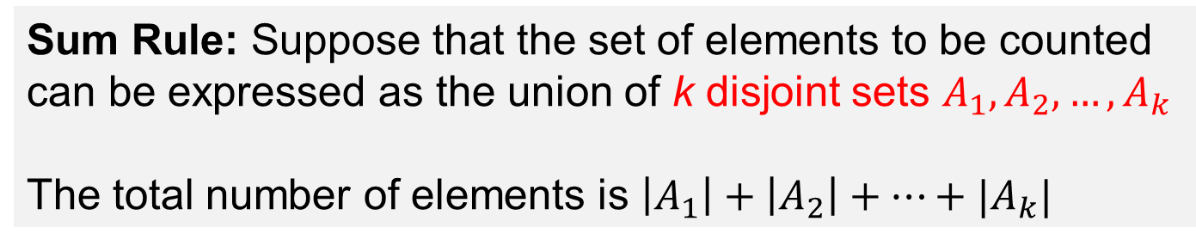
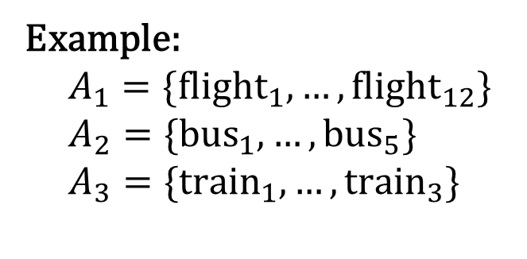
Sum Rule: General Form
Sum Rule: Suppose that the set of elements to be counted can be expressed as the union of k disjoint sets $A_{1},A_{2},…, A_{k}$
The total number of elements is $\left|A_{1}\right|+\left|A_{2}\right|+⋯+|A_{k}|$
Example:
$$A_{1}=\{{\text{flight}}_{1},…, {\text{flight}}_{12}\}$$
$$A_{2}=\{{\text{bus}}_{1},…, {\text{bus}}_{5}\}$$
$$A_{3}=\{{\text{train}}_{1},…, {\text{train}}_{3}\}$$

Slide 9
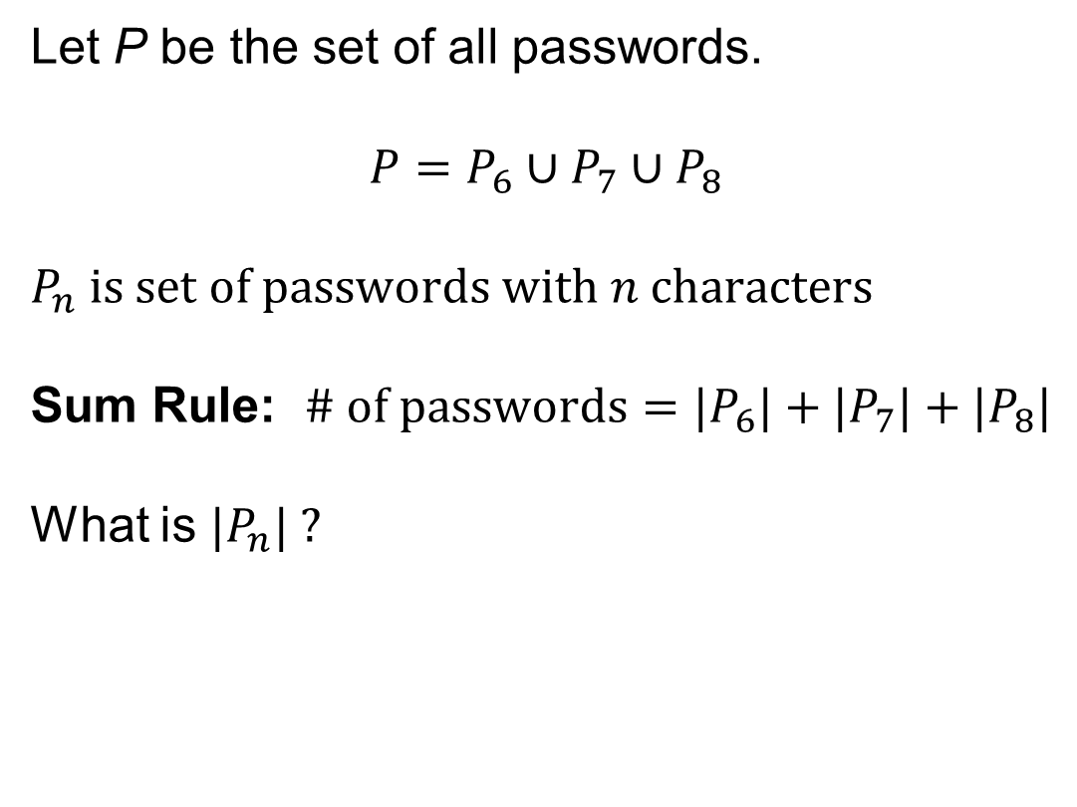
Combining Sum & Product Rules
A password must contain from 6 to 8 case-sensitive alpha-numeric characters.
How many possible passwords are there?
Let P be the set of all passwords.
$$P=P_{6}∪P_{7}∪P_{8}$$
Sum Rule: $\# of passwords={|P}_{6}|+{|P}_{7}|+{|P}_{8}|$
What is ${|P}_{n}| ?$

Slide 10
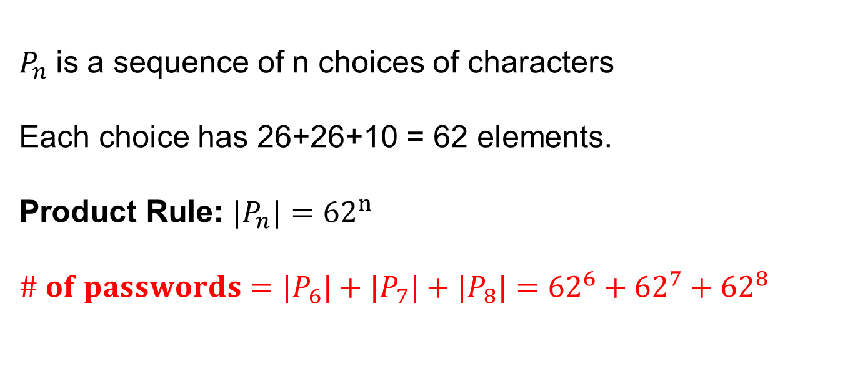
Combining Sum & Product Rules
A password must contain from 6 to 8 case-sensitive alpha-numeric characters.
How many possible passwords are there?
$P_{n}$is a sequence of n choices of characters
Each choice has 26+26+10 = 62 elements.
Product Rule: ${|P}_{n}|={62}^{n}$
$$\# of passwords={|P}_{6}|+{|P}_{7}|+{|P}_{8}|={{62}^{6}+{62}^{7}+{62}^{8}}_{ }$$

Slide 11
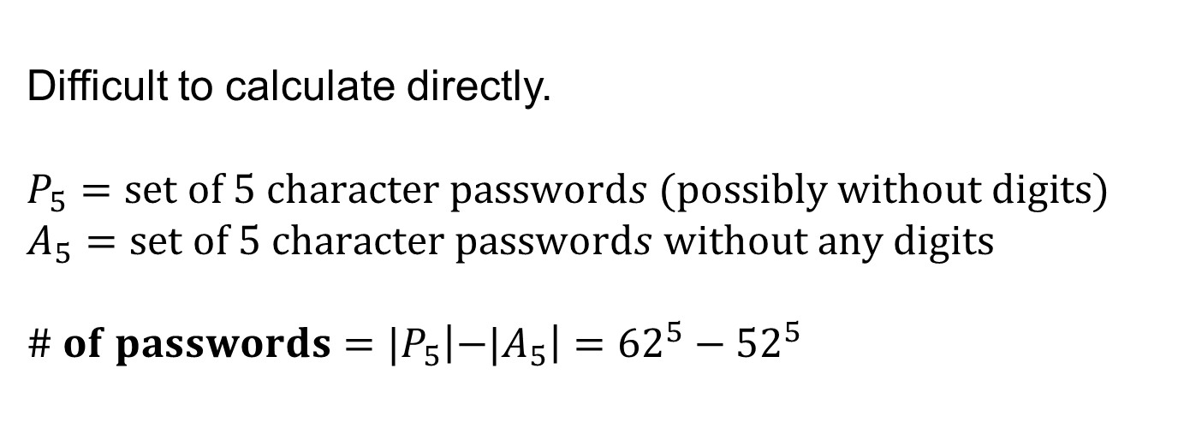
Useful Counting Technique
Passwords must contain exactly 5 case-sensitive
alpha-numeric characters and must have at least one digit.
How many possible passwords are there?
Difficult to calculate directly.
$$P_{5}=\text{set} \text{of}\text{ 5 }\text{character} \text{password}s (\text{possibly} \text{without} \text{digits}\text{)}$$
$$A_{5}=\text{set} \text{of}\text{ 5 }\text{character} \text{password}s \text{without} \text{any} \text{digits}$$
$$\# of passwords={|P}_{5}\left|−{|A}_{5}\right|={62}^{5}−{52}^{5}$$

Slide 12
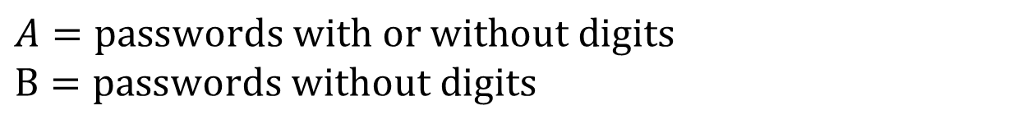
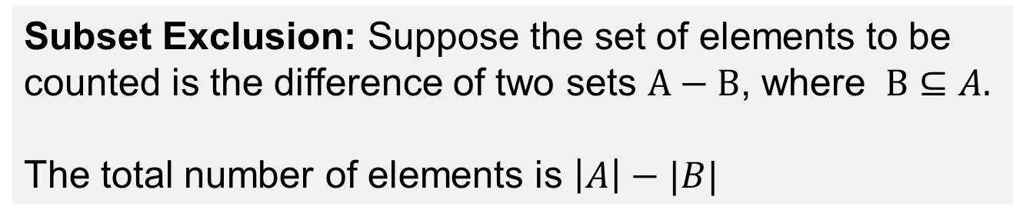
Subset Exclusion
Subset Exclusion: Suppose the set of elements to be
counted is the difference of two sets $A−B$, where $B⊆A.$
The total number of elements is $\left|A\right|−|B|$
A
B
$$A=\text{passwords} \text{with} \text{or} \text{without} \text{digits}$$
$$B=\text{passwords} \text{without} \text{digits}$$

Slide 13

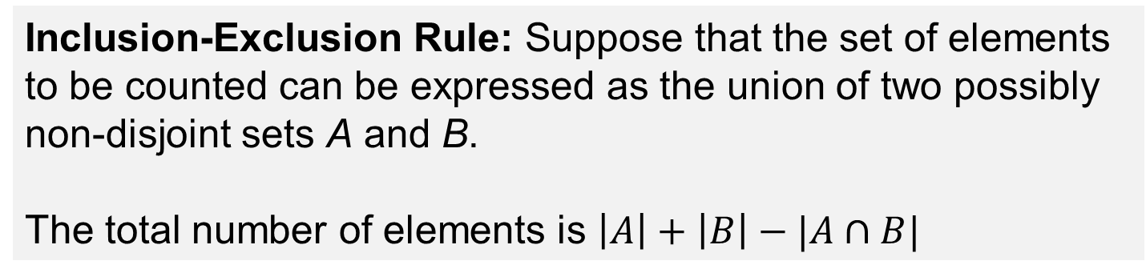
Inclusion Exclusion Principle
Inclusion-Exclusion Rule: Suppose that the set of elements
to be counted can be expressed as the union of two possibly
non-disjoint sets A and B.
The total number of elements is $\left|A\right|+\left|B\right|−|A∩B|$
B
$$A∩B$$
A

Slide 14
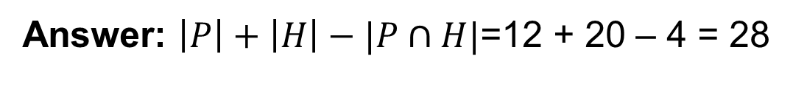
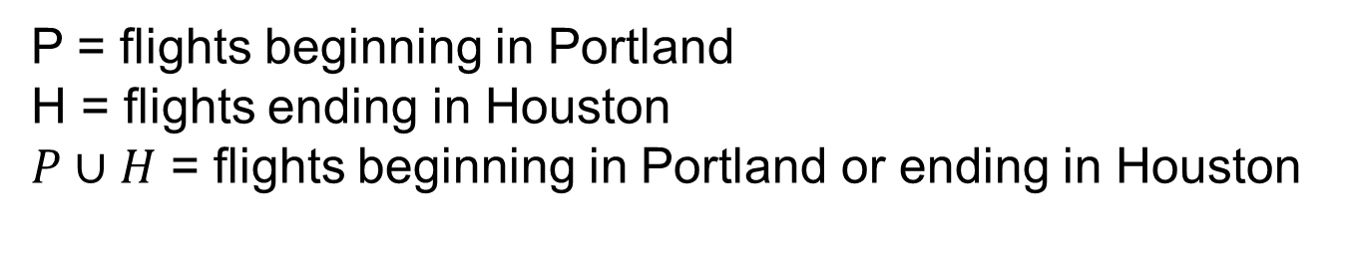
Inclusion Exclusion: Example
There are 12 flights that begin in Portland.
There are 20 flights that end in Houston.
There are 4 flights that begin in Portland and end in Houston.
How many flights are there that either begin in Portland
or end in Houston?
P = flights beginning in Portland
H = flights ending in Houston
$P∪H$ = flights beginning in Portland or ending in Houston
Answer: $\left|P\right|+\left|H\right|−|P∩H|$=12 + 20 – 4 = 28

Slide 15
Learning Objective
Use the individual product and sum rules to count elements
Use combinations of product and sum rules to count elements
Use the inclusion-exclusion principle to count elements

