Slide 1
Permutations and Combinations
Make sure to read book material!

Slide 2
Example
How many ways are their to line up 10 people from a group of 80 people?
Order matters.
How many ways are their to form a 10 person committee from a group of 80 potential committee members?
Order does not matters.

Slide 3
Permutations
A permutation of a set of distinct elements is an ordered arrangement/list of the elements. Each element appears in the arrangement exactly once.
Example: {a, b, c}
a b c
a c b
b a c
b c a
c a b
c b a

Slide 4

Counting Permutations
How many permutations are there of a set with n elements?
$$\{e_{1}, e_{2}, e_{3}, …, e_{n}\}$$
n
. . .
n slots
How many choices?

Slide 5


Counting Permutations
How many permutations are there of a set with n elements?
$$\{e_{1}, e_{2}, e_{3}, …e_{n−1}, e_{n}\}$$
n
n-1
$$e_{3}$$
. . .
n slots
How many choices?

Slide 6


Counting Permutations
How many permutations are there of a set with n elements?
$$\{e_{1}, e_{2}, e_{3}, …e_{n−1}, e_{n}\}$$
n
n-1
n-2
$$e_{3}$$
$$e_{n−1}$$
. . .
n slots
How many choices?

Slide 7







Counting Permutations
How many permutations are there of a set with n elements?
$$\{e_{1}, e_{2}, e_{3}, …e_{n−1}, e_{n}\}$$
n
n-1
n-2
n-3
4 3 2 1
$$e_{3}$$
$$e_{n−1}$$
$$e_{10}$$
$$e_{25}$$
. . .
$$e_{n}$$
$$e_{15}$$
$$e_{6}$$
$$e_{8}$$
n slots
# of permutations $=n⋅\left(n−1\right)⋅\left(n−2\right)⋯2⋅1=n!$

Slide 8
Counting Permutations
Example: {a, b, c}
a b c
a c b
b a c
b c a
c a b
c b a
3! = 6

Slide 9
Permutations: Example
How many ways are there to line up a wedding party of 6 people assume that the groom must always be lined up directly after the bride?
S = {bride, groom, p1, p2, p3, p4}
Lines are permutations of S with subsequence bride, groom.
Treat pair (bride, groom) as a distinct element bride-groom.
S’ = {bride-groom, p1, p2, p3, p4}
Answer: # permutations of S’ = 5! = 120

Slide 10
r-Permutations
An r-permutation of a set is an ordered arrangement/list of r distinct elements of the set.
Example: 2-permutations of {a, b, c}
a b
a c
b a
b c
c a
c b

Slide 11

Counting r-Permutations
How many r-permutations are there of a set with n elements?
Denoted by P(n,r).
$$\{e_{1}, e_{2}, e_{3}, …, e_{n}\}$$
n
. . .
r slots
How many choices?

Slide 12
Counting r-Permutations
How many r-permutations are there of a set with n elements?
$$\{e_{1}, e_{2}, e_{3}, …e_{n−1}, e_{n}\}$$
n
n-1
$$e_{3}$$
. . .
r slots
How many choices?

Slide 13
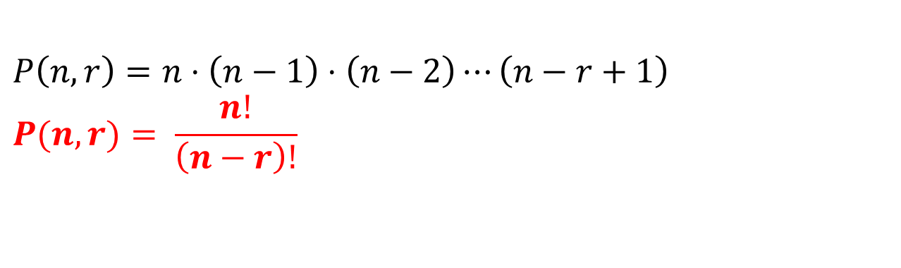


Counting r-Permutations
How many r-permutations are there of a set with n elements?
$$\{e_{1}, e_{2}, e_{3}, …e_{n−1}, e_{n}\}$$
n
n-1
n-r+2
n-r+1
$$e_{3}$$
$$e_{n−1}$$
. . .
$$e_{n}$$
$$e_{15}$$
r slots
$$P\left(n,r\right)=n⋅\left(n−1\right)⋅\left(n−2\right)⋯\left(n−r+1\right)$$
$$P(n,r)= \frac{n!}{\left(n−r\right)!}$$

Slide 14
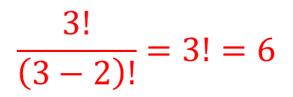
Counting r-Permutations
Example: 2-permutations of {a, b, c}
a b
a c
b a
b c
c a
c b
$$\frac{3!}{\left(3−2\right)!}=3!=6$$

Slide 15

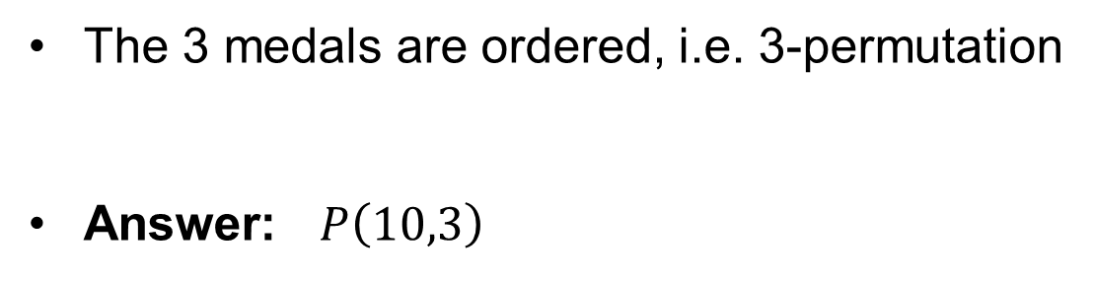


r-Permutations: Example
How many ways are there to award 1st, 2nd, and 3rd place medals in a contesting involving 10 participants?
The 3 medals are ordered, i.e. 3-permutation
Answer: $P\left(10,3\right)$
$$=\frac{10!}{\left(10−3\right)!}$$
$$=\frac{10!}{7!}$$
$$=10⋅9⋅8=720$$

Slide 16
r-Combination
An r-combination of a set is an unordered selection of r distinct elements of the set.
(It is simply a subset of size r.)
Example: 2-combinations of {a, b, c}
{a, b} {a, c} {b, c}
Since order doesn’t matter {a,b} is the same as {b,a}.

Slide 17

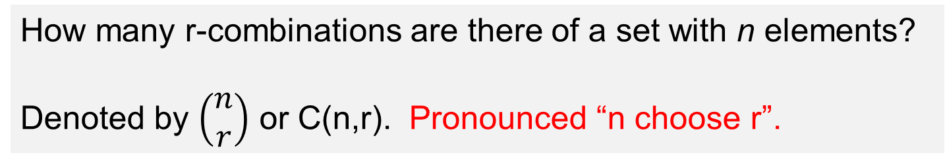


Counting r-Combinations
How many r-combinations are there of a set with n elements?
Denoted by $\left(\begin{matrix}n \\ r\end{matrix}\right)$ or C(n,r). Pronounced “n choose r”.
Consider Generating r-permutations:
$$\{e_{1}, e_{2}, e_{3}, …, e_{n}\}$$
C(n,r) choices
r-combination
$$\{e_{3}, e_{10},e_{20}\}$$
r! choices
permutation
P(n,r) = C(n,r) x r!
$$e_{20} { e}_{3} e_{10}$$
r-permutation

Slide 18

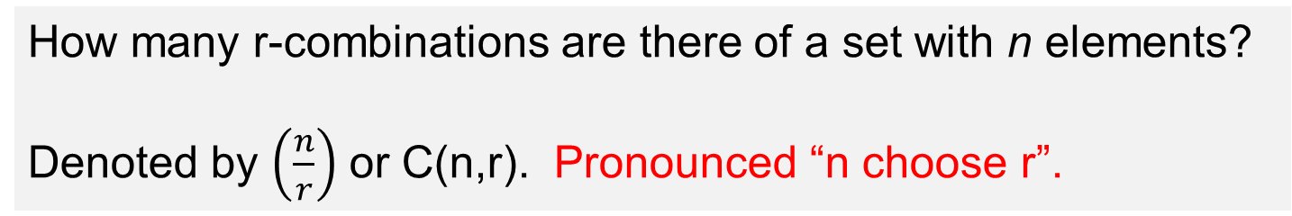
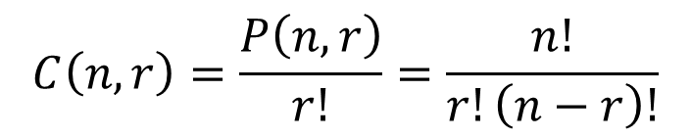
Counting r-Combinations
How many r-combinations are there of a set with n elements?
Denoted by $\left(\frac{n}{r}\right)$ or C(n,r). Pronounced “n choose r”.
$$P\left(n,r\right)=C\left(n,r\right)⋅r!$$
$$C\left(n,r\right)=\frac{P\left(n,r\right)}{r!}=\frac{n!}{r!\left(n−r\right)!}$$

Slide 19
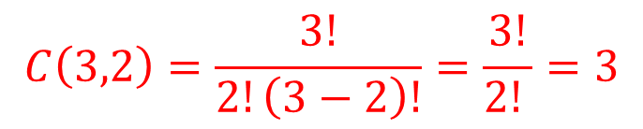
r-Combination
Example: 2-combinations of {a, b, c}
{a, b} {a, c} {b, c}
$$C\left(3,2\right)=\frac{3!}{2!\left(3−2\right)!}=\frac{3!}{2! }=3$$

Slide 20
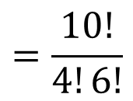
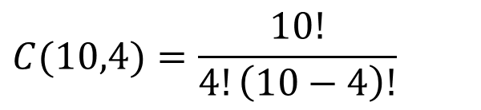
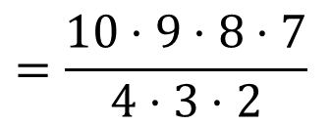

r-Permutations: Example
A coach needs to select a team of 4 players out of at total of 10 players who tried out for the tennis team.
How many possible teams could be selected?
$$C(10,4)=\frac{10!}{4!\left(10−4\right)!}$$
$$=\frac{10!}{4!6!}$$
$$=\frac{10⋅9⋅8⋅7}{4⋅3⋅2}$$
$$=210$$

Slide 21
Learning Objective
Understand the differences between permutations and combinations.
Use permutations, r-permutations, and r-combinations to solve basic counting problems.
Be able to explain how the counting expressions are derived.

