Slide 1
Permutations and Combinations with Repetition
Make sure to read book material!

Slide 2
Example
Suppose we have a bag with a large number of red, green,
and blue marbles (at least 10 of each color) and that we
draw a random sequence of 10 marbles.
How many color sequences can result from the 10 draws?
. . .

Slide 3
Example
Suppose we have a bag with a red, green, and blue marble
and that we draw a random marble from the bag 10 times,
each time replacing the drawn marble back into the bag.
How many color sequences can result from the 10 draws?
An element can be repeatedly drawn.

Slide 4
r-Permutations with Repetition
An r-permutation w/ repetition of a set of distinct elements is an r-permutation where elements are allowed to be included more than once.
Example: 2-permutations w/ repetition of {a, b, c}
a a
a b
a c
b a
b b
b c
c a
c b
c c

Slide 5

Counting r-Permutations w/ Repetition
How many r-permutations with repetition are there of a set with n elements?
$$\{e_{1}, e_{2}, e_{3}, …, e_{n}\}$$
n
. . .
r slots
How many choices?

Slide 6

Counting r-Permutations w/ Repetition
How many r-permutations with repetition are there of a set with n elements?
$$\{e_{1}, e_{2}, e_{3}, …, e_{n}\}$$
n
n
$$e_{3}$$
. . .
r slots
How many choices?

Slide 7



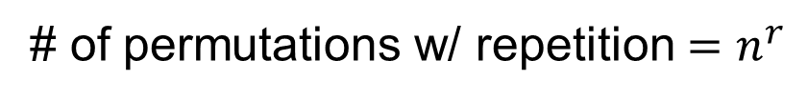




Counting r-Permutations w/ Repetition
How many r-permutations with repetition are there of a set with n elements?
$$\{e_{1}, e_{2}, e_{3}, …, e_{n}\}$$
n
n
n
n
n n n n
$$e_{3}$$
$$e_{n−1}$$
$$e_{10}$$
$$e_{25}$$
. . .
$$e_{3}$$
$$e_{15}$$
$$e_{3}$$
$$e_{8}$$
r slots
# of permutations w/ repetition $=n^{r}$

Slide 8

Counting Permutations
Example: 2-permutations w/ repetition of {a, b, c}
a a
a b
a c
b a
b b
b c
c a
c b
c c
$$3^{2}=9$$

Slide 9
Permutations: Example
Consider creating a police lineup of 3 individuals selected from a group of 10 people including 3 age groups with at least 3 people per age group.
How many possible age group orderings are there for the lineup?
S = {group1, group2, group3}, n=3, r=3
Answer: # permutations w/ repetition = $3^{3}=27$

Slide 10
r-Combinations with Repetition
An r-combination w/ repetition of a set is an unordered selection of r elements of the set allowing for repetition.
Example: 2-combinations with repetition of {a, b, c}
(a, a) (a, b) (a, c) (b, b) (b, c) (c, c)
Since order doesn’t matter (a,b) is the same as (b,a).

Slide 11

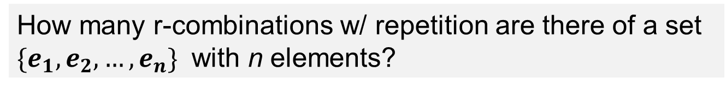
Counting r-Combinations w/ repetition
How many r-combinations w/ repetition are there of a set $\{e_{1}, e_{2}, …, e_{n}\}$ with n elements?
$e_{1} { e}_{2} e_{n}$
. . .
. . .
n bins

Slide 12


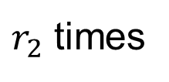

Counting r-Combinations w/ repetition
How many r-combinations w/ repetition are there of a set $\{e_{1}, e_{2}, …, e_{n}\}$ with n elements?
$e_{1} { e}_{2} e_{n}$
. . .
r draws with replacement
. .
. .
. . .
. .
n bins
$r_{1}$ times
$r_{2}$ times
$r_{n}$ times
$$r_{1}+r_{2}+⋯+r_{n}=r$$

Slide 13
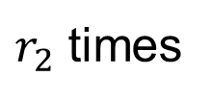
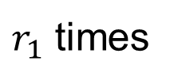
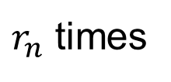
Counting r-Combinations w/ repetition
. .
. .
. . .
. .
n bins
$r_{1}$ times
$r_{2}$ times
$r_{n}$ times
equivalent view
. .
. .
. . .
. .
r elements/items
n-1 dividers

Slide 14
Counting r-Combinations w/ repetition
. .
. .
. . .
. .
n bins
$r_{1}$ times
$r_{2}$ times
$r_{n}$ times
equivalent view
. .
. . .
r elements/items
n-1 dividers

Slide 15
Counting r-Combinations w/ repetition
. .
. .
. . .
. .
r elements/items
n-1 dividers
r+n-1 possible positions
1 2 3 4 5 …….. r+n-1
How many ways to select r positions to be the elements?
C(r+n-1, r)

Slide 16
Counting r-Combinations w/ repetition
. .
. .
. . .
. .
r elements/items
n-1 dividers
r+n-1 possible positions
1 2 3 4 5 …….. r+n-1
How many ways to select n-1 positions to be the dividers?
C(r+n-1, n-1)

Slide 17
Counting r-Combinations w/ repetition
How many r-combinations w/ repetition are there of a set $\{e_{1}, e_{2}, …, e_{n}\}$ with n elements?
C(r+n-1, r) = C(r+n-1,n-1)

Slide 18
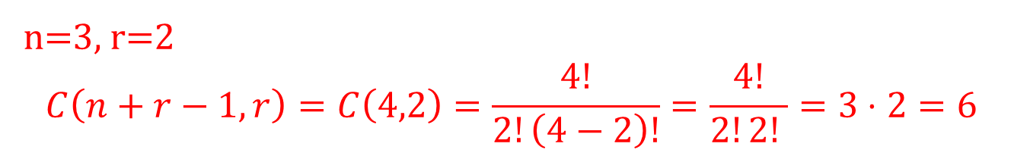
r-Combinations with Repetition
Example: 2-combinations with repetition of {a, b, c}
(a, a) (a, b) (a, c) (b, b) (b, c) (c, c)
n=3, r=2
$$C\left(n+r−1,r\right)=C\left(4,2\right)=\frac{4!}{2!\left(4−2\right)!}=\frac{4!}{2!2! }=3⋅2=6$$

Slide 19
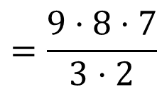
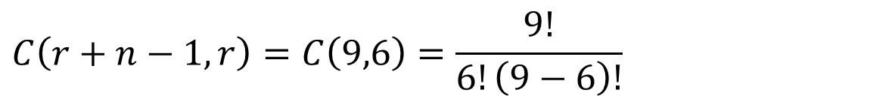

r-Combinations w/ Repetition
Suppose a opinion poll group randomly selects a group of 6 people from a group of 100 people that are uniformly distributed among 4 age groups (25 in each group).
How many possible age group combinations could possible be selected?
n = 4, r = 6
$$C\left(r+n−1,r\right)=C\left(9,6\right)=\frac{9!}{6!\left(9−6\right)!}$$
$$=\frac{9⋅8⋅7}{3⋅2}$$
$$=84$$

Slide 20
Learning Objective
Understand the differences between r-permutations and r-combinations with and without repetition
Use r-permutations and r-combinations with repetition to solve basic counting problems.
Be able to explain how the counting expressions are derived.

